Slide 1









ENVIRONMENT
Twenty-fifth session
Geneva, 13-15 November 2019
Palais des Nations
Meeting room XI
Committee on Environmental Policy
Agenda Item 5: Environmental monitoring, assessment and reporting.
Joint Task Force
on Environmental Statistics and Indicators

Slide 2

Joint Task Force on Environmental Statistics and Indicators
ENVIRONMENT
16th session
28-29 October 2019
16 member States represented
Session report being drafted (Information paper no. 24)
Ongoing developments with relevance for work of Joint Task Force – Shared Environmental Information System and other matters
Review of guidelines for application of UNECE environmental indicators
Ongoing and planned capacity-development activities

Slide 3
Joint Task Force on Environmental Statistics and Indicators
ENVIRONMENT
Shared Environmental Information System
Briefly picked up on matters discussed by the Working Group
Secretariat presented assessment framework and draft outline of final review of progress
Online reporting tool was still being developed. Request that an offline (Excel-based) reporting format also provided and that online reporting tool thoroughly tested by end of 2019
Agreement to provide comments on draft outline of a progress report, by 17 November 2019
Pan-European environmental assessment
Agreement to provide comments on a concept note
  1st round by 12 November 2019, before this session of the Committee
  2nd round until end of 2019

Slide 4
Joint Task Force on Environmental Statistics and Indicators
ENVIRONMENT
Other ongoing developments relevant for work of Joint Task Force
Welcoming of information provided by secretariat on international work related to implementation of System of Environmental-Economic Accounting.
Welcoming of information provided by secretariat and United Nations University on waste statistics framework and e-waste statistics
Noting that countries faced many challenges in gathering official statistics on electronic waste and integrating e-waste estimates into national statistical frameworks
Waste statistics …

Slide 5


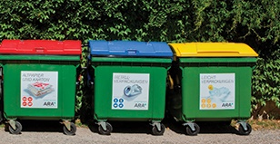
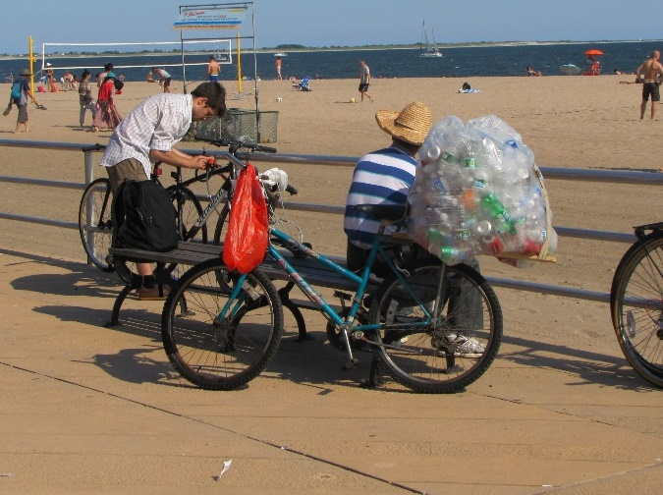
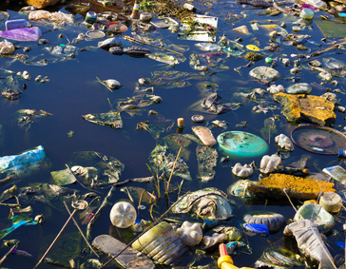
Updates on the UNECE/CES Task Force on Waste Statistics
Developing a framework on waste statistics
STATISTICS
25th session of the Committee on Environmental Policy, Geneva, 13-15 November 2019
Notes:
In 2014 an in-depth review was carried out on measuring extreme events and disasters and what the role of NSOs could be.
The task became topical with SDGs, the Sendai Framework for Disaster-Risk Reduction and the Paris Agreement. All of them adopted in 2015

Slide 6


CES Task Force on Waste Statistics
Developing a waste statistics framework
STATISTICS
  Established in February 2017 based on an issue paper drafted by Netherlands and UNECE in cooperation with Armenia, Kazakhstan, Mexico and Ukraine, as well as with Eurostat, OECD and UNSD
  Members:
  Bosnia and Herzegovina (Chair), Canada (Vice-Chair), Armenia, Austria, Azerbaijan, Israel, Kazakhstan, Mexico, Moldova, Russian Federation
  Basel Convention Secretariat, Eurostat, OECD, UN-Habitat, UNSD
  UNU (Vice-Chair), ISWA, EAWAG, GIZ, University of Leeds
  UNECE provides the Secretariat of the Task Force
  Main objective: To develop a framework on waste statistics and draft a glossary of the most important terms and definitions in waste statistics.
  Status of work: Draft report was presented to CES Bureau in February 2019, extended to work for one more year
Notes:
As we are at the UN Statistical Commission, I wanted to introduce briefly our region and countries participating in the work of the Conference of European Statisticians (CES).
We have over 65 member countries, represented by the Heads of national statistical offices:
- All UNECE Members , including Canada, Russian Federation and United States
- OECD Members and
- Some other countries
And the Chief Statisticians of international organizations, such as Eurostat, OECD, IMF, WB
There are a number of partner organizations involved, now increasingly those interested in statistics for SDGs.
The Conference is one of the oldest bodies in statistics internationally, and has its roots in the League of Nations with the first Conference held in 1928. Traditionally participation of countries has been wide and the Conference is open to any country in principle.

Slide 7
Why is there the need for a framework?
Growing information demand and weaknesses of data collections
STATISTICS
  Growing information demand, e.g.
  SDGs
  Basel Convention
  UNEP 10-year framework programme on Sustainable Consumption and Production
  Circular economy initiatives
  Existing weaknesses, e.g.
  Important waste flows not measured or conceptually not considered (e.g. informal activities)
  Key terms and definitions are not fully harmonized (e.g. “municipal waste”)
  Boundary between waste, products and secondary raw materials is not clearly defined;
  Several waste flows are difficult to measure (e.g. imports and exports of waste)
  Different ways to measure the amounts of waste
  No standard international waste classification
  Often more details needed (e.g. e-waste, textiles waste, food waste,…)
Notes:
As we are at the UN Statistical Commission, I wanted to introduce briefly our region and countries participating in the work of the Conference of European Statisticians (CES).
We have over 65 member countries, represented by the Heads of national statistical offices:
- All UNECE Members , including Canada, Russian Federation and United States
- OECD Members and
- Some other countries
And the Chief Statisticians of international organizations, such as Eurostat, OECD, IMF, WB
There are a number of partner organizations involved, now increasingly those interested in statistics for SDGs.
The Conference is one of the oldest bodies in statistics internationally, and has its roots in the League of Nations with the first Conference held in 1928. Traditionally participation of countries has been wide and the Conference is open to any country in principle.

Slide 8
Key messages of the report
Clarifies important terms and brings them into a semantic relationship
STATISTICS
  Conceptual definitions and relationship of term such as
  Waste
  Waste management
  Informal waste-related activities
  Illegal waste-related activities
  Controlled versus uncontrolled waste
Notes:
As we are at the UN Statistical Commission, I wanted to introduce briefly our region and countries participating in the work of the Conference of European Statisticians (CES).
We have over 65 member countries, represented by the Heads of national statistical offices:
- All UNECE Members , including Canada, Russian Federation and United States
- OECD Members and
- Some other countries
And the Chief Statisticians of international organizations, such as Eurostat, OECD, IMF, WB
There are a number of partner organizations involved, now increasingly those interested in statistics for SDGs.
The Conference is one of the oldest bodies in statistics internationally, and has its roots in the League of Nations with the first Conference held in 1928. Traditionally participation of countries has been wide and the Conference is open to any country in principle.

Slide 9
Key messages of the report
A conceptual framework
STATISTICS
  Text and figures to understand:
    Conceptual links of flows of resources, products, wastes, waste products and releases to the environment
    Key terms and definitions and their relation with each other
Notes:
As we are at the UN Statistical Commission, I wanted to introduce briefly our region and countries participating in the work of the Conference of European Statisticians (CES).
We have over 65 member countries, represented by the Heads of national statistical offices:
- All UNECE Members , including Canada, Russian Federation and United States
- OECD Members and
- Some other countries
And the Chief Statisticians of international organizations, such as Eurostat, OECD, IMF, WB
There are a number of partner organizations involved, now increasingly those interested in statistics for SDGs.
The Conference is one of the oldest bodies in statistics internationally, and has its roots in the League of Nations with the first Conference held in 1928. Traditionally participation of countries has been wide and the Conference is open to any country in principle.

Slide 10
Scope of waste statistics
We need to expand the current scope to address policy needs
STATISTICS
Expanded scope of waste statistics
Secondary raw materials
Re-usable products
Other waste-related activities (c)
Uncontrolled waste picking, recovery, disposal, exports/imports
Traditional scope of waste statistics
Re-usable products (d)
Waste management
Waste exports
Waste imports
Releases
to the environment
Final consumption
In-situ recovery,Re-use,
Repair,
Sharing
Waste generated
(b)
(e)
Waste collection
Waste treatment
Waste disposal
Material
inputs
Pre-treatment and preparatory activities
Recovery operations (recycling; composting; energy recovery; other)
Incineration
Landfilling
Permanent storage
Other
Waste prevention
Production
(b)
In-situ recycling,
Re-use,
Remanu-
facturing
Re-usable
products (d)
Secondary raw materials / recovered energy (f)
International trade flows of importance to the circular economy and the 3Rs
Legend:
Controlled flows and activities: Waste management
Uncontrolled flows and activities: Other waste-related activities

Slide 11
Feedback received from CES Bureau
Meeting in February 2019 in Washington D.C.
STATISTICS
  Welcomed the coverage of illegal and unmanaged waste in the framework
  Suggested for the finalization of work
    Review the definition of waste which is a very important part of the conceptual framework.
    Clarify the differences between the scope and definitions used in the draft framework and in the international questionnaires of Eurostat/OECD and UNSD/UNEP.
    Make recommendations more precise
  →Task Force has agreed on a work plan for finalization of the work
Notes:
As we are at the UN Statistical Commission, I wanted to introduce briefly our region and countries participating in the work of the Conference of European Statisticians (CES).
We have over 65 member countries, represented by the Heads of national statistical offices:
- All UNECE Members , including Canada, Russian Federation and United States
- OECD Members and
- Some other countries
And the Chief Statisticians of international organizations, such as Eurostat, OECD, IMF, WB
There are a number of partner organizations involved, now increasingly those interested in statistics for SDGs.
The Conference is one of the oldest bodies in statistics internationally, and has its roots in the League of Nations with the first Conference held in 1928. Traditionally participation of countries has been wide and the Conference is open to any country in principle.

Slide 12
Joint Task Force on Environmental Statistics and Indicators
ENVIRONMENT
Other ongoing developments relevant for work of Joint Task Force
Welcoming of information provided by secretariat, United Nations Statistics Division, EEA and OECD on matters including:
  Green growth indicators
  Relevant work of Expert Group on Environment Statistics
  Outcomes from Expert Forum for Producers & Users of Climate Change-related Statistics
  Other relevant work of these organizations.
Noting of importance of a coordination mechanism between a national statistical office and environmental authorities when defining environmental statistics
Encouragement to align climate change indicators within the set of UNECE environmental indicators with other climate change-related indicators developed for major policy processes.

Slide 13
Joint Task Force on Environmental Statistics and Indicators
ENVIRONMENT
Review of Guidelines for Application of UNECE Environmental Indicators
Welcoming of a note by secretariat on amendment of the Guidelines
Welcoming of information provided by Armenia, Azerbaijan, Bosnia and Herzegovina, Kazakhstan and Ukraine, as presenters, alongside secretariat, United Nations University, United Nations Statistics Division and OECD, addressing:
  Indicator metadata
  Air pollution and ozone depletion
  Water
  Waste
  Environmental financing.
(cont’d)

Slide 14
Joint Task Force on Environmental Statistics and Indicators
ENVIRONMENT
Review of Guidelines for Application of UNECE Environmental Indicators
Welcoming of work undertaken by secretariat, partner organizations and small technical groups including member State experts to review the Guidelines
Noting that further work on the Guidelines would be carried out by secretariat and small groups. Request that comments made during the session be addressed in that work.
Agreement that, once cleared by the small groups, revised indicator guidelines would be shared with the members of the Joint Task Force for approval
Request to secretariat to present completed parts of revised guidelines as an official document at its next session

Slide 15
Joint Task Force on Environmental Statistics and Indicators
ENVIRONMENT
Ongoing and planned capacity-development activities
Welcoming of information provided by Belarus and Uzbekistan, as presenters, alongside secretariat and UNEP on:
  A training event on energy statistics for use in policy tracking, organized jointly by IEA/UNECE/UNESCAP (21–22 May 2019, Dushanbe)
  A national workshop on environmental and livelihood Sustainable Development Goal indicators (12–14 June 2019, Tashkent)
  Recent and upcoming capacity-development activities by UNECE and UNEP

Slide 16
Joint Task Force on Environmental Statistics and Indicators
ENVIRONMENT
Thanks to Austria, Norway, the Russian Federation, Switzerland and the European Union through the European Environment Agency for their financial support
Next meeting: 26-27 October 2020

Slide 17
Joint Task Force on Environmental Statistics and Indicators
ENVIRONMENT
The Committee on Environmental Policy is invited to consider
Taking note of the work to revise the UNECE Guidelines for the Application of Environmental Indicators
Taking note of the capacity-building activities related to environmental statistics and indicators
Inviting member States and organizations to provide in-kind and financial support to the environmental monitoring and assessment programme

