Slide 1
Twenty-fifth session of the Committee on Environmental Policy
14 November 2019
Sustainable development in the region
Where we stand.
Monika Linn
Principal Adviser and Chief
Sustainable Development and Gender Unit

Slide 2
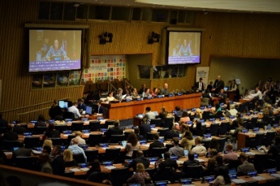
Regional Forum 2020
“Transformative pathways to realize the decade of action and delivery
for sustainable development”
19-20 March 2020 International Conference Center Geneva (CICG)
Multi-stakeholder conference for practical peer-learning on SDGs
Region’s official input to High-level Political Forum
2019: More than 800 participants, more than 50 countries represented
Working with partners
across the UN-system and beyond
Exchange of concrete solutions on SDG implementation
SDG progress report, peer-learning, side events,
pre-meetings

Slide 3
Next steps
December 2019
January 2020
April 2020
Invitations to member States
Call for SDG challenges and side events
Launch of
SDG progress report
Report of the meeting
19-20 March
Informal consultations
Finalization of SDG progress report
Finalization of programme
Pre-meetings (civil society, youth)
High-level Political Forum
November 2019
December 2019
January
2020
July 2020

Slide 4
Regional UNDS review:
Overall status and way forward
UN regional assets essential to 2030 Agenda, but not optimally deployed
Two phases of revamping regional UNDS architecture:
Phase I (2018): Optimized regional mechanisms and processes Phase II (ongoing): Longer-term reprofiling and restructuring
Secretary-General: five key areas of regional transformation
Intergovernmental consultations to finalize and implement regional review
Five proposals:
Regional UN Development System
Creating Regional Collaborative Platforms
Establishing regional knowledge management hubs
Implementing regional results-based reporting
Consolidating data and statistical capacities
Working towards common back offices

Slide 5
Thank you!

