Slide 1
Update on WHO and TFH activities
Hanna Yang,
Technical Officer, Air Quality
WHO European Centre for Environment and Health
Geneva, Switzerland
September, 2017
Notes:
Good afternoon, I am Hanna Yang from WHO ECEH. I would like to update current WHO TFH progresses and activities.

Slide 2
Presentation outline
TFH meeting May 2017
Reporting on activities for 2016-2017
Update relevant regional activities
Workplan 2018 - 2019
Notes:
This is the outline what I will present today. I will briefly introduce previous TFH meeting and activities in this biennium. I will also update relevant regional activities. And lastly I will introduce next biennium workplan.

Slide 3
20th TFH Meeting (16-17 May 2017) :
52 participants from 32 Member States to the Convention
National and international policies and processes on air quality and health
Review of the progress in research on health impacts of air pollution
Communication and public health messages for air pollution
Experiences in using WHO AirQ+ software to quantify the health impacts of air pollution
Discussion of current activities, mandate and work plan of TFH for 2018-2019
*Funding from Switzerland and Germany acknowledged
Notes:
In this May, we had 20th TFH meeting. 52 participants from 32 Member States were attend in the meeting.
This was a historical 20th meeting. So we had short time to reflect and overview the past of Task Force on Health and its main achievement.
In this meeting, national and international policies and processes on air quality and health were updated.
- Especially UNECE introduced the messages of the Towards Cleaner Air : Scientific Assessment Report 2016. Batumi Action for Cleaner Air was brought to the attention and Parties were encouraged to submit more voluntary actions under this initiative.
- A representative of EC introduced that they will launch the European Clean Air Forum. The first Clean Air Forum is planned for November 2017 in Paris
- WHO HQ briefed on the last meeting of the Global Platform on Air Quality and Health which was held in March. This platform aims to strengthen capacity for air quality monitoring worldwide and assessment and reporting of related health impacts and also to stimulate to reduce air pollution exposures and related death and disease. The on going activities of this platform are to further enhancement of methods to assess population exposure, the creation of a Task Force on the exposure-response functions to assess health impacts from air pollution, response to acute air pollution episode and other communication issues. WHO HQ also announced the upcoming WHO Conference on Air Quality and Health to be held in Geneva in 2018.
WHO also explained the overall procedure and expected outcomes of the Ministerial Conference. I will introduce the details outcome of this 6th Ministerial conference later on.
Review of the progress in research on health impacts of air pollution
During TFH meeting, USEPA introduced their studies on health effects due to PM sources and components. VITO and KCL presented the current development of the NO2 exposure assessment in Europe. During TFH meeting, the recent research on associations between NO2 and health effects, exposure and emission of polycyclic aromatic hydrocarbons (PAHs) in Europe also presented by COMEAP and by IDEA-CSIC respectively.
Communication and public health messages for air pollution
- EC briefed on the development of a harmonized EU-wide ambient air quality index. Overview on communication with patients with cardio-respiratory diseases by Lazio Region Health Service. The French surveillance system on air and health was presented. The ELF introduced their experience to communicate the health risks and effects of air pollution to patients and the public.
Experiences of using WHO AirQ+ software to quantify the health impacts of air pollution in Serbia and Hungary were presented during TFH meeting. And the future plan of capacity building on health risk assessment of air pollution using AirQ+ was also presented.
Current activities, mandate and work plan of TFH for 2018-2019 also actively discussed during the meeting. I will present more details about the work plan for 2018-2019 later on.

Slide 4
Workplan/Activities for 2016-2017
Develop further the methodologies for assessment and quantification of direct and indirect effects of long-range transboundary air pollution on human health
Launched of WHO AirQ tool(2016)
Training workshop, including interactive presentation of case studies : 20 May 2016
Example of ongoing work for Serbia presented
Potential for use at global level highlighted
Interest raised by several TFH participants for use of AirQ+ for national health risk assessment
Enhanced capacity-building planned by WHO
Experts meeting : 13-14 Feb 2017
Discussion on further development of AirQ+
Supporting capacity building (Serbia, Hungary)
Notes:
Next is the current biennium work plan and activies. In this biennium, we planned three major activities. First, we planned to develop further the methodologies for assessment and quantification of the effects of air pollution on human health. Based on this plan, we launched WHO AirQ tool in 2016. And we had a training workshop for AirQ+. During this workshop, an example of ongoing work for Serbia was presented and potential use of AirQ+ at global level was highlighted. Several participant showed high interest for use this tool to assess national health risk. Participant asked to have enhanced capacity-building programme by WHO. So we are now developing module of this programme. We also had experts meeting in 13-14 February in this year and discussed on further development of AirQ+. We are also supporting a few countries to quantify health impacts of air pollution by using this AirQ+ tool.

Slide 5
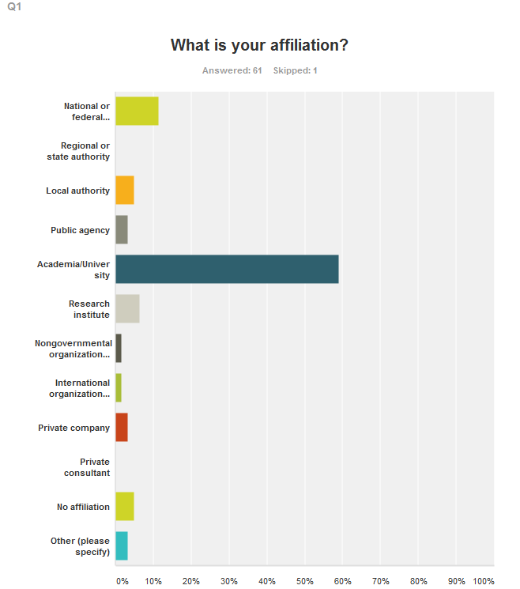
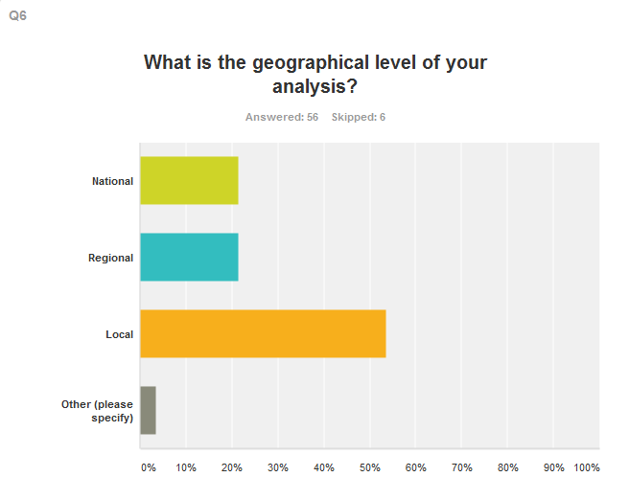
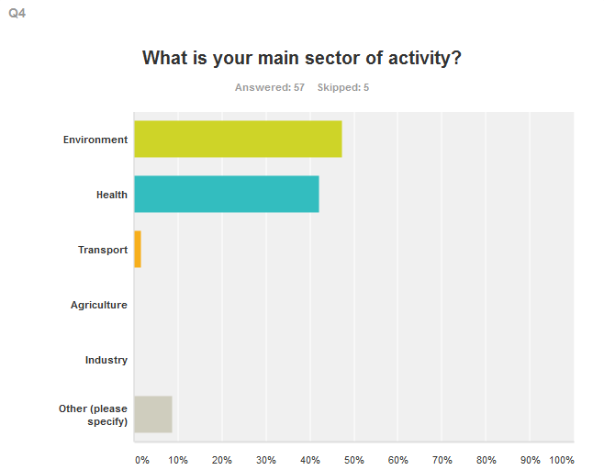
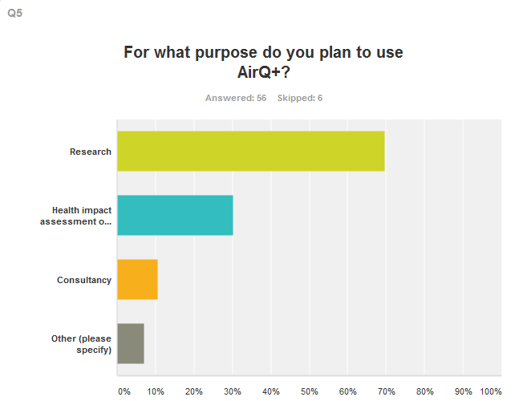
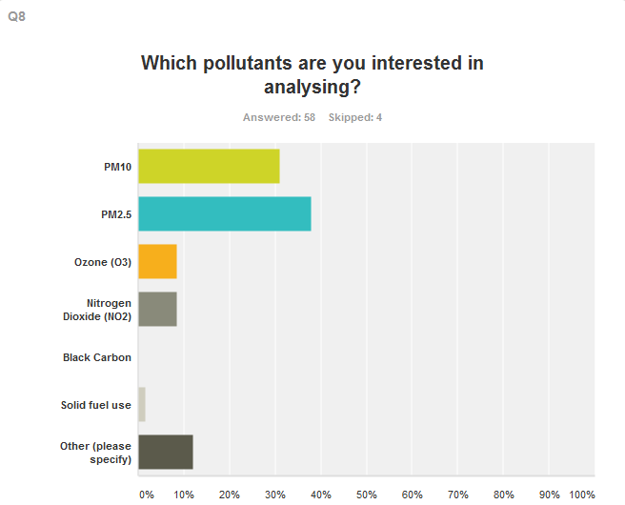
Survey results of the AirQ+ users
Notes:
According to the responses to an on line survey on AirQ+,
More than half of the users from academia;
Over 90% are from the fields of environment or health;
Almost 70% plan to use AirQ+ for research;
Over 50% intends to analyse local level and
Over 60% are interested in analysing particulate matter.

Slide 6
2. Collect and analyse the evidence on health impacts of ozone and particulate matter (including black carbon)
Update of WHO Global Air Quality Guidelines (ongoing)
1st Guideline development group meeting : Sep 2016
Guideline proposal approved by Guideline Review Committee: Jan 2017
Systematic reviews on long-term exposure to (PM, NO2 and O3) and short-term exposure to PM, NO2, O3, SO2, CO : May 2017 ~
2nd guideline development group meeting : 14∼16 March 2018
* Funding/in-kind support received from the European Commission (DG-Env), Switzeland, USA, Germany and Republic of Korea
Notes:
Secondly, we had a plan to collect and analyse the evidence on health impacts of air pollutions specifically ozone and particulate matter(including black carbon).
This plan is performed under the activities of updating WHO Global Air Quality Guidelines. As we explained many times, this project was started from last year 2016. As a one of procedure of this activities, long-term exposure to PM, NO2, O3 and short-term exposure to PM, NO2, O3, SO2 and CO will be systematically reviewed. This systematic review will collect, summarize and analyse all the available evidences of health out come by these air pollution. Some systematic reviews have started from this summer and some reviews will start soon in this year and expected to continue next year.

Slide 7
3. Assess the practices for communication of health risks associated with air pollution exposure
⇒ Overview on communication strategies/systems in different parties to the Convention – results of WHO survey
Survey : 2014 ~2015
Final draft report presented in 19 TFH meeting(May 2016)
Notes:
We are also assessing practise for communication of health risks associated with air pollution exposure. This is currently gaining more and more attention and interest from Member states. We have done survey on communication strategies/systems in different parties in 2014 and 2015. The final draft report of overview of this survey was presented in 19th TFH meeting.

Slide 8
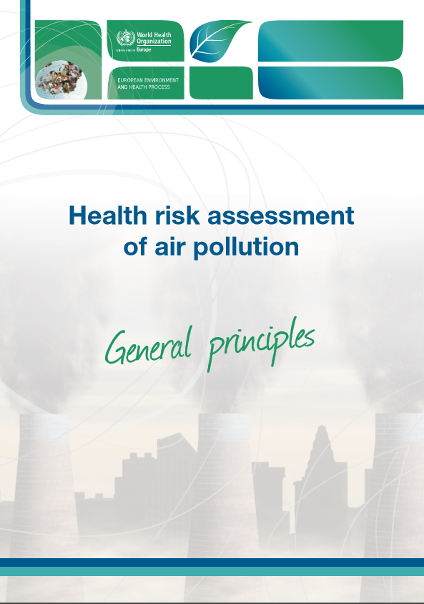
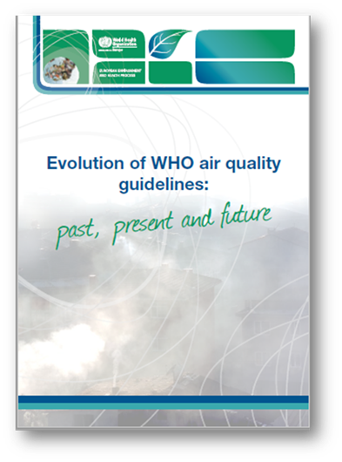
Publications
Publication now available on the web at://www.euro.who.int/en/health-topics/environment-and-health/air-quality/publications
(2016)
(2017)
Notes:
During 2016-2017, we produced two publications. One is Health risk assessment of air pollution: General principles. Another is Evolution of WHO air quality guidelines. These are available on the web.

Slide 9
Update on Relevant Regional Activites

Slide 10
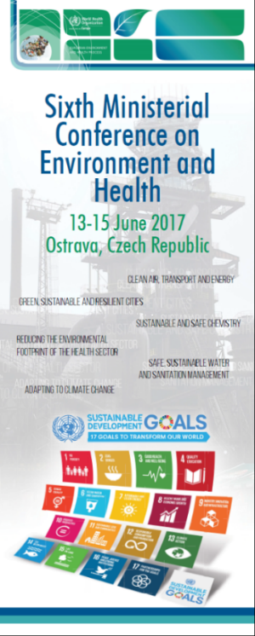
The Ostrava outcome documents
Improving indoor and outdoor air quality for all
Ensuring universal, equitable and sustainable access to safe drinking-water, sanitation and hygiene for all and in all settings
Minimizing the adverse effects of chemicals on human health and the environment
Preventing the adverse environmental and health effects, costs and inequalities related to waste management and contaminated sites
Strengthening adaptive capacity and resilience to climate change-related health risks and supporting mitigation measures
Supporting the efforts of European cities and regions to become healthier, more inclusive, safer, resilient, and sustainable
Building the environmental sustainability of health systems
Enhancing action at the national level – developing national portfolios for action
http://www.euro.who.int/en/media-centre/events/events/2017/06/sixth-ministerial-conference-on-environment-and-health/read-more
Notes:
We had a 6th Ministerial Conference on Environment and Health in 13-15 June in Ostrava.
Air quality and health continues to be high on the agenda of the European Environment and Health Process, as reflected in the outcome documents of the Ministerial Conferences on Environment and Health, including at the recent Sixth Ministerial Conference,
In the Ostrava declaration, 53 Member States of the WHO European region recognize air quality as one of the most important environmental risk factors and as an important element in attainment of human rights.
10

Slide 11
Compendium of possible actions to improve AQ
Develop comprehensive national and local strategies and actions that reduce air pollution, peoples’ exposure to it and its health impacts;
Encourage the implementation of the UNECE Convention on Long-range Transboundary Air Pollution and promote ratification and implementation of its relevant protocols;
Develop and strengthen cross-sectoral and multistakeholder cooperation on air quality improvement at national and regional levels, including on sharing of monitoring data.
Ensure that public health and environment authorities take a leading role in raising public awareness of issues related to air quality and health (Box 3);
Improve air quality monitoring using harmonized data collection for health impact assessment at national and local levels’;
Develop and/or strengthen a national emission inventory and monitoring system to collect data on air pollutants emitted by various sources;
Provide training opportunities and facilitate research on air quality and health, and develop tools to encourage actions to address air pollution through evidence-based policy-making;
Reduce indoor air pollution caused by, inter alia, cooking, heating, tobacco smoke, inadequate ventilation, mould and chemicals in indoor air;
When taking national and local actions on improving indoor and ambient air quality, pay special attention to vulnerable populations including children, youth, women and the chronically ill;.
Take into account the WHO air quality guidelines and indoor air quality guidelines in the policymaking process
Notes:
The annex I to the Ostrava declaration offers a compendium of actions for Member States for the improvement of ambient and indoor air quality, towards meeting the WHO air quality guidelines..
This compendium also emphasized to Encourage the implementation of the UNECE Convention on Long-range Transboundary Air Pollution and promote ratification and implementation of its relevant protocols

Slide 12
WorkPlan 2018 - 2019

Slide 13
Proposed updated mandate for TFH
General/
Long term
Recommendation from policy review group
Specific/
Short term
Proposed Workplan 2018-2019
<Specific recommendation to TFH>
to further review and harmonize methodologies for health impact assessments (short term);
to further assess the health effects of particulate matter(short term and long term);
to further work on dose/concentration response functions (short term);
Airborne effects of HM and POPs be more thoroughly prioritized wrt policy needs (long term)
Discussion of TFH
Notes:
In the TFH meeting the recommendation from policy review group was introduced and WHO proposed draft mandate and workplan which reflect this recommendation.
The next biennium workplan was developed based on the intense discussion during TFH meeting and following up discussion.

Slide 14
WorkPlan 2018-2019
Consolidate existing evidence on health outcomes of exposure to air pollution
Update of the evidence on the health impact of O3, PM, NO2, SO2 and CO (Achieved in the update of the global WHO Air Quality Guidelines)
⇒ A (scoping) emerging issues and methods for health risk/impact assessment of air pollution and cost benefit analysis(pending availability of resources)
Further develop methodologies for assessment and quantification of direct and indirect effects of long-range transboundary air pollution on human health
⇒ Update AirQ+ tool for quantification of the health effects of air pollution
Notes:
We will continue to consolidate existing evidence on health outcomes of exposure to air pollution
Under this plan we will continue to update the evidence on the health impact of O3, PM, NO2, SO2 and CO.
In addition, TFH members expect to review a emerging issues and methods for health risk/impact assessment of air pollution and cost benefit analysis. The availability of this activities depends on the resource.
We will also further develop methodologies for assessment and quantification of direct and indirect effects of long-range transboundary air pollution on human health.
Under this plan we will update AirQ+ further.

Slide 15
WorkPlan 2018-2019
Capacity building for health impacts assessment at regional and sub-regional levels
Development and implementation of the capacity building curriculum, by using AirQ+ tool
Review the methods used for estimating burden of disease attributable to air pollution
Regional input to the global project coordinated by WHO HQ
Review communication strategies for health messages related to air pollution, including on short term episodes and for susceptible groups
⇒ Regional input to the global project coordinated by WHO HQ
Next TFH meeting will be held on 16 - 17 May 2018
Notes:
We will also develop the capacity building programme for capacity building for health impacts assessment at regional and sub-regional level.
Some workplan, which were suggested by TFH members, are closely related with WHO HQ’s project. So in next biennium we will collaborate with WHO on some activities.
Especially with regard to the review the methods used for estimating burden of disease and communication strategies, TFH will provide the regional input the global project coordinated by WHO HQ.
Lastly I would like to inform you we will have 21 TFH meeting on 16-17 May 2018.

Slide 16
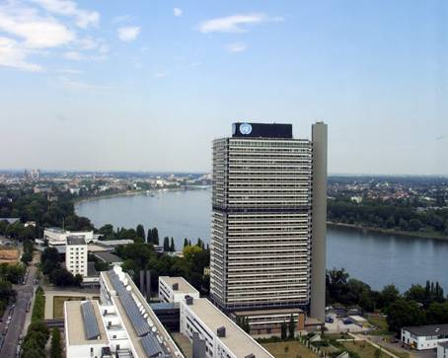
Thank you for your attention
http://www.euro.who.int/en/health-topics/environment-and-health
Notes:
16

