Slide 1

Joint thematic session on B(a)P pollution: main activities and results
Alexey Gusev, MSC-E
3rd Joint session WGE/SB EMEP, 2017
Notes:
1
During the previous thematic session we talked about spatial and temporal trends and stabilization of BaP pollution levels in the EMEP countries. Now we can provide more insights into this.

Slide 2
PAH pollution in the EMEP countries (2005-2015)
Emissions from Residential Combustion
PAH emissions by sectors (EMEP)
Largest contribution is from Residential combustion (~70%)
Emissions of Residential combustion are almost stable
3rd Joint session WGE/SB EMEP, 2017
Notes:
According to recently reported national emission inventories for PAHs, largest contribution is made by Residential Combustion sources. In the majority of countries its contribution is around 70%.
As we can see, during the recent decade the level of these emissions is almost stable.

Slide 3
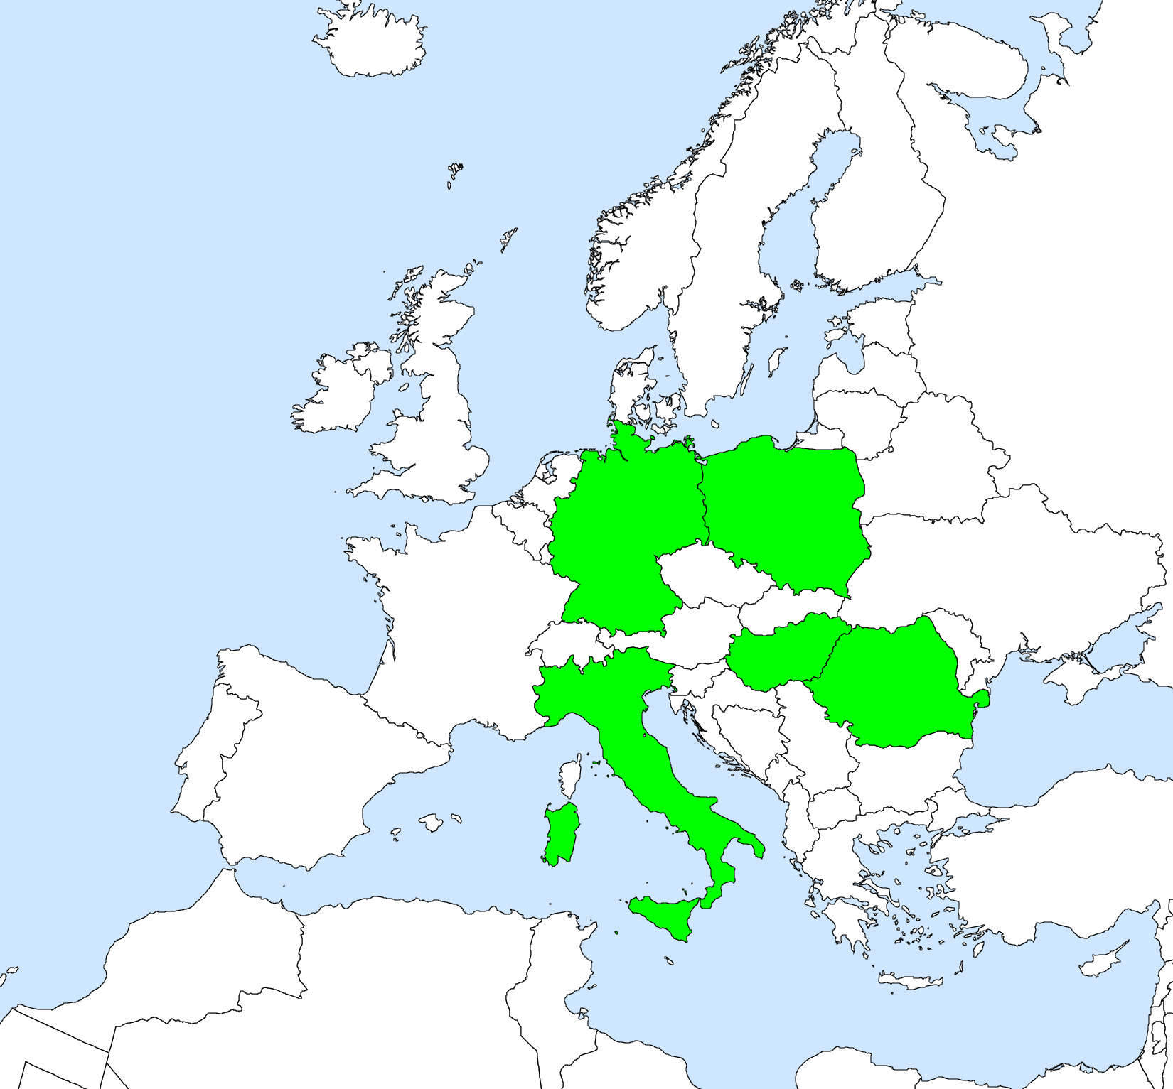
PAH pollution in the EMEP countries (2005-2015)
Emissions from Residential Combustion
PAH emissions by sectors (EMEP)
Largest contribution is from Residential combustion (~70%)
Emissions of Residential combustion are almost stable
Countries with largest emissions reported increase
DE, PL, IT, RO, HU
Five countries with largest emissions from Residential combustion sector (65-70%)
3rd Joint session WGE/SB EMEP, 2017
Notes:
Furthermore, five countries, namely, DE, PL, IT, RO, and HU, provide in total about 65-70% of these emissions.
And in 4 of them level of emissions in 2015 is higher than in the beginning of this period 2005-2015.

Slide 4
PAH pollution in the EMEP countries (2005-2015)
Emissions from Residential Combustion
PAH emissions by sectors (EMEP)
Largest contribution is from Residential combustion (~70%)
Emissions of Residential combustion are almost stable
Countries with largest emissions reported increase
Monitoring sites indicate stable or increasing B(a)P
Increase of B(a)P
Five countries with largest emissions of Res comb
Measured B(a)P air concentrations, 2005-2015 (AirBase)
Notes:
Available national monitoring data on B(a)P in the AirBase as well as some EMEP measurements also indicate stable or increasing levels of concentrations in the highlighted area.

Slide 5
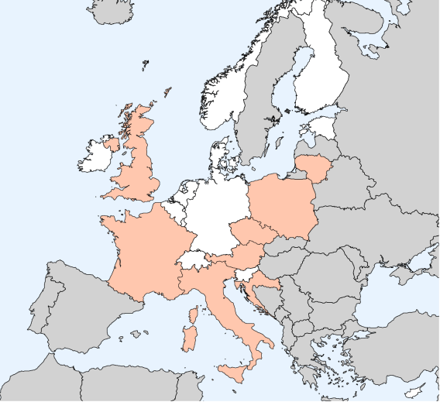
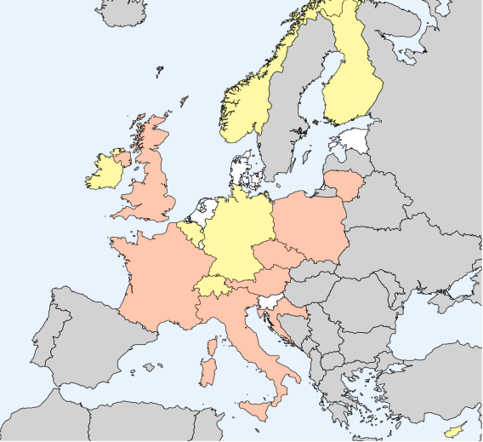
Analysis of exceedancies of B(a)P air quality standards
Exceedance of EU target level 1 ng m⁻³ (AirBase, 2015)
Exceedance of WHO reference level 0.12 ng m⁻³ (AirBase, 2015)
Exceedancies of EU target value for B(a)P 1 ng m⁻³ in 2015 were indicated in 9 countries
Exceedancies of WHO reference level for B(a)P 0.12 ng m⁻³ were indicated in 16 countries
Conclusion from previous session: “…particulate matter from biomass combustion could be considered as harmful as particles from other sources.”
Further co-operation with activities of WGE and Task Force on Health regarding evaluation of exposure is appreciated
3rd Joint session WGE/SB EMEP, 2017
Notes:
If we compare these levels of concentrations in 2015 with air quality standards, we can see that in case of EU target level exceedancies can be seen in 9 countries at about 80 monitoring sites.
In case of WHO reference level, which is much lower, exceedancies are seen in 16 countries at about 300 monitoring sites.
Along with that significant levels of BaP and exceedancies can also take place in other countries that are not covered by measurements, for example, in eastern and southern Europe.
In this context, the conclusion made by the previous session about exposure of population might hide the extent of the problem. Important issue here is chemical composition of PM emitted from biomass burning. As we have seen from the results of AirUse for Life project, emitted particulate matter contains not only B(a)P, but also many other toxic substances like other carcinogenic PAHs, dioxins and furans, and HMs that just increase adverse effects.
So this needs more significant attention and further work on evaluation of exposure to toxic compounds in co-operation with WGE and TF on Health.

Slide 6
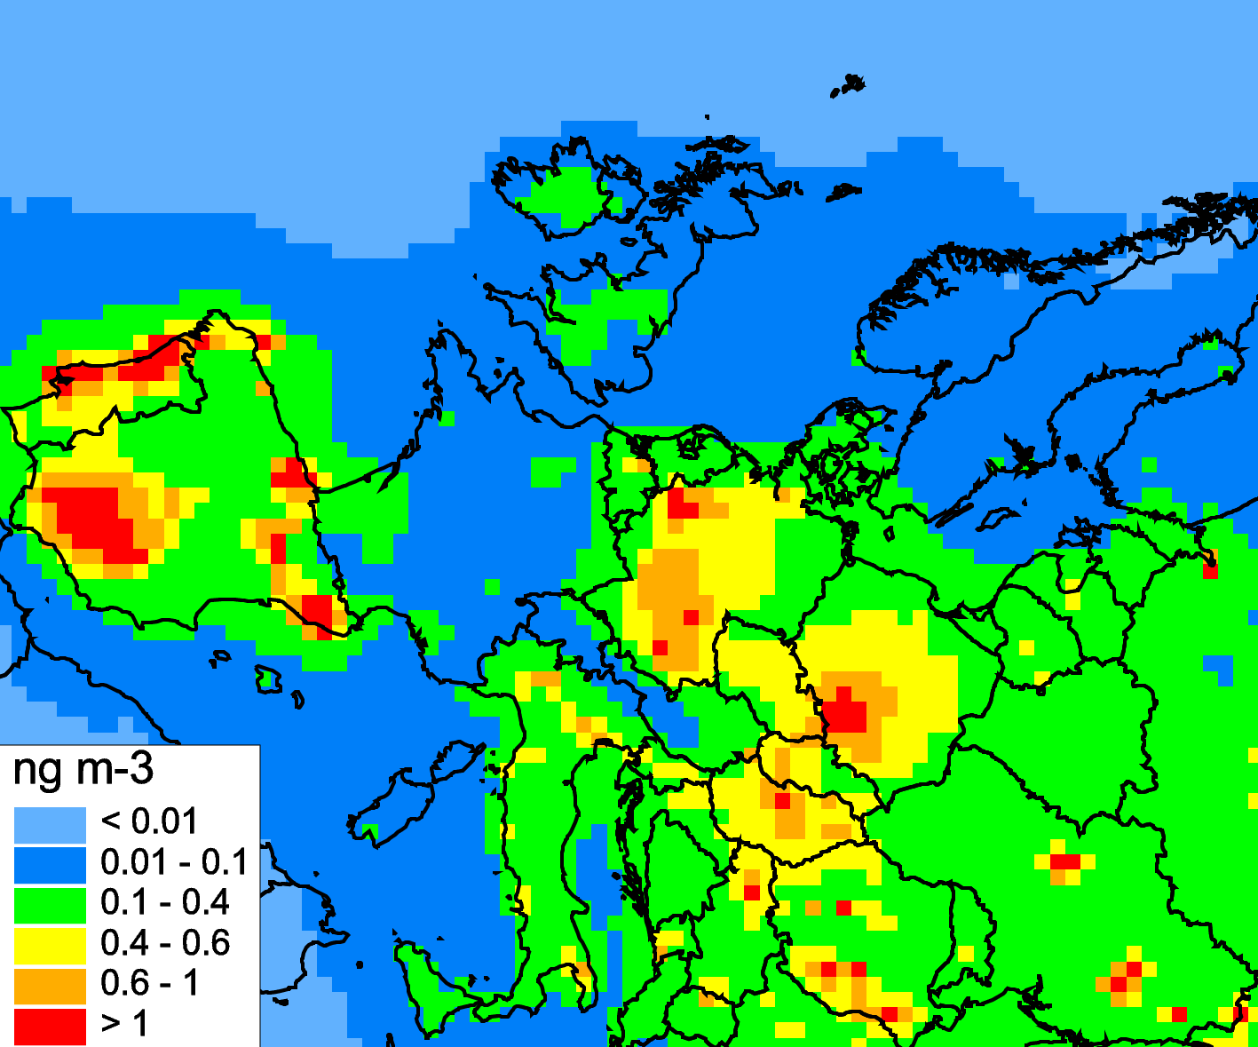
Evaluation of B(a)P pollution in the EMEP countries: problems
Overprediction of observed concentrations (Spain, Germany):
Modelling results for 2015
Modelled vs observed B(a)P (AirBase, 2015)
Unique sector distribution of PAH emissions, high emissions from agriculture (Spain)
Speciation of PAH emission and emission factors (Germany)
DE IIR, 2017: “the PAHs emissions in the inventory are likely to be overestimated”
Notes:
Speaking about model assessment of pollution by BaP, and its accuracy, in general, there is satisfactory agreement with measurements. At the same time there are several problems and we would like to bring your attention to this. We have significant differences between model estimates and measurements in case of 4 countries. Namely, overprediction of observed concentrations for Spain and Germany.
The most likely reasons of this is uncertainty of reported emissions.
In case of Spain, there is non-typical pattern of sector distribution. High emissions are reported for agricultural sources, and relatively low for Residential combustion. At the same time, in the majority of countries there is opposite situation. Thus there is a question concerning importance of this particular sector and emissions assigned to it.
In case of Germany, there are problems with estimation of speciated emissions of PAHs. Total emission of 4 pahs is higher than speciated. Experts involved in preparation of this inventory noted significant uncertainties in the emission factors and concluded that PAH emissions are overpredicted.

Slide 7
Evaluation of B(a)P pollution in the EMEP countries: problems
Underprediction of observed concentrations (France, Poland):
Modelling results for 2015
Modelled vs observed B(a)P (AirBase, 2015)
Underestimation of emissions
“Underestimation of B(a)P emission of France” CHIMERE modelling study (Florian Couvidat, TFMM meeting, 2017)
Refinement of emissions for these 4 countries needs specific attention and co-operation with CEIP, TFEIP, and national experts
PL, ES, and DE reported highest emissions of PAHs
They can be candidates for the case studies on B(a)P
3rd Joint session WGE/SB EMEP, 2017

Slide 8
Country-scale POP pollution assessment for Spain
Objective of case study:
Assessment of B(a)P pollution levels in Spain with fine spatial resolution
Country-specific study activities:
Analysis of available national emissions and measurements
Fine resolution modelling using national emissions and experimental scenarios
Verification of modelling results using national measurements
Comparison of EMEP GLEMOS and CHIMERE (CIEMAT, Spain) model results
B(a)P emission fluxes (0.1°x0.1°), g/km²/y
Observed B(a)P in air (2014), ng/m³
PAH emissions by sectors (2014)
3rd Joint session WGE/SB EMEP, 2017

Slide 9
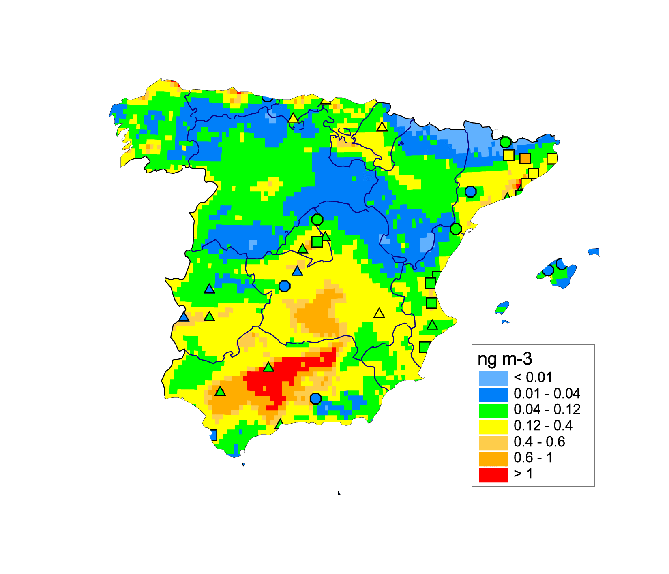
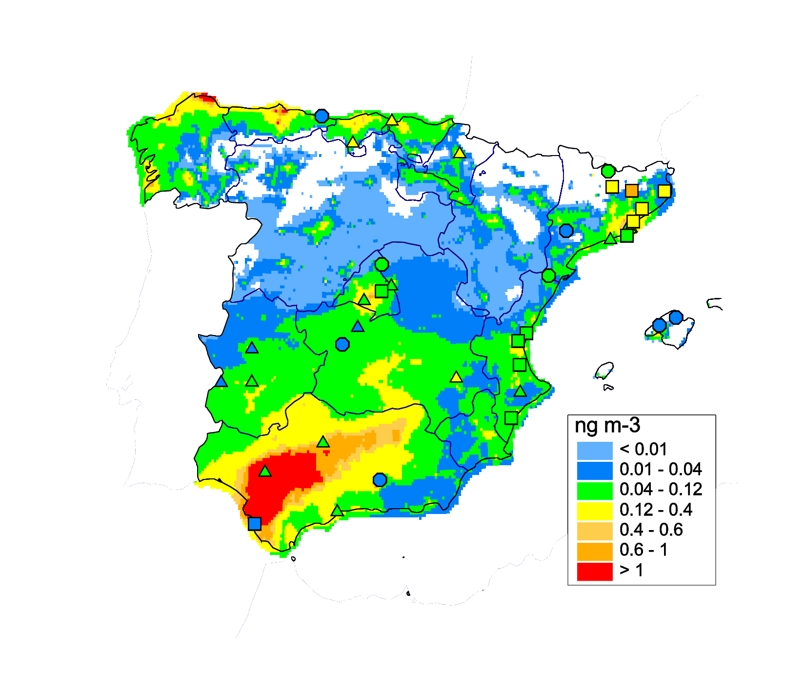
Case study of B(a)P pollution in Spain
Preliminary results:
Comparison of GLEMOS (EMEP) and CHIMERE (CIEMAT, Spain) modelling results
GLEMOS, 2014
CHIMERE*, 2015
Modelled and observed B(a)P air concentrations
Both models tend to overpredict observed annual mean B(a)P concentrations
* - Marta G. Vivanco, Juan L. Garrido, Atmospheric Pollution Division – CIEMAT
3rd Joint session WGE/SB EMEP, 2017

Slide 10
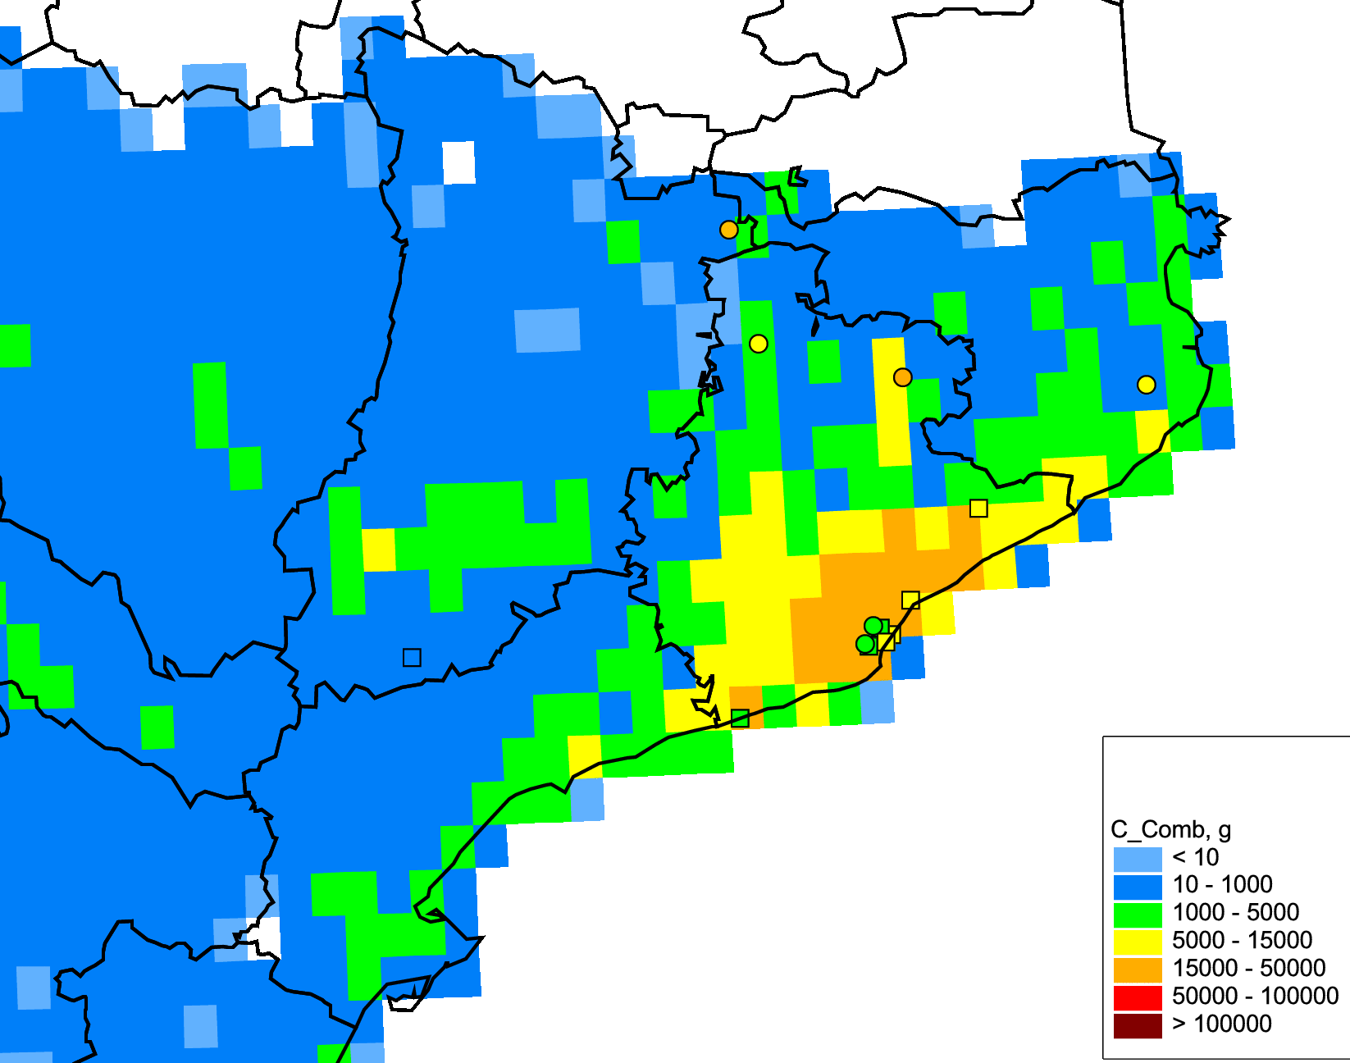
Case study of B(a)P pollution in Spain
Preliminary results:
Possible uncertainties in spatial allocation of emissions in the area of Barcelona
GLEMOS, 2014
Emission from Residential Combustion
Modelled and observed B(a)P air concentrations
Negative correlation between measurements and emissions
Larger emissions in rural areas rather than in Barcelona urban area (Viana et al., 2016; EEA Report)
3rd Joint session WGE/SB EMEP, 2017

Slide 11
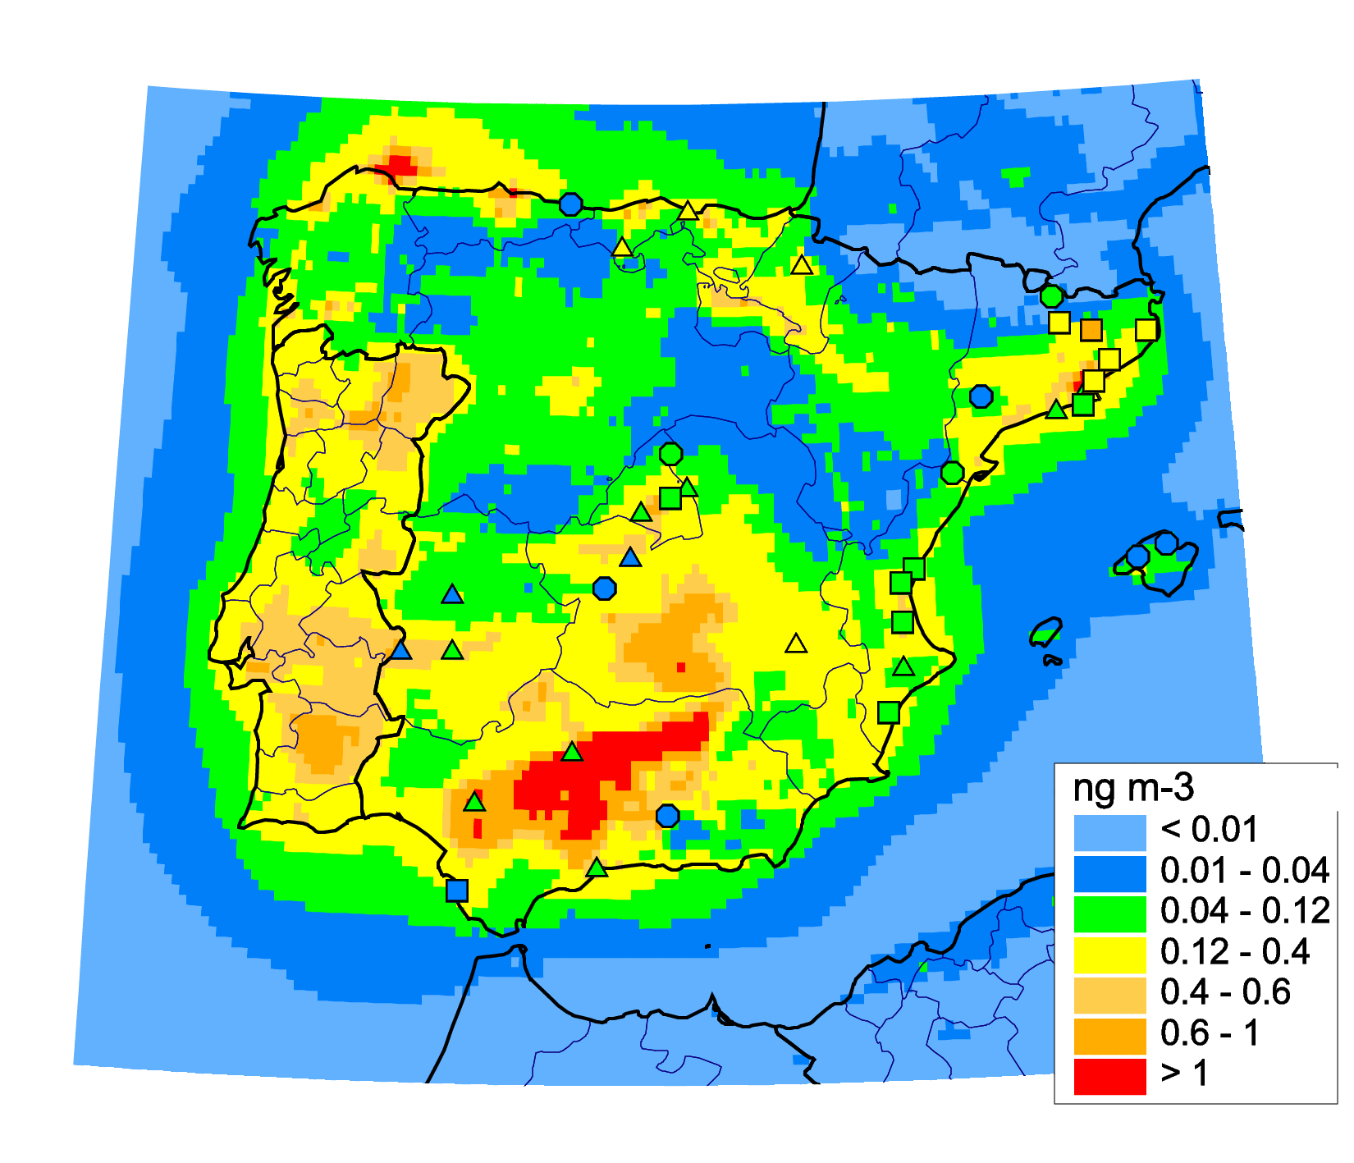
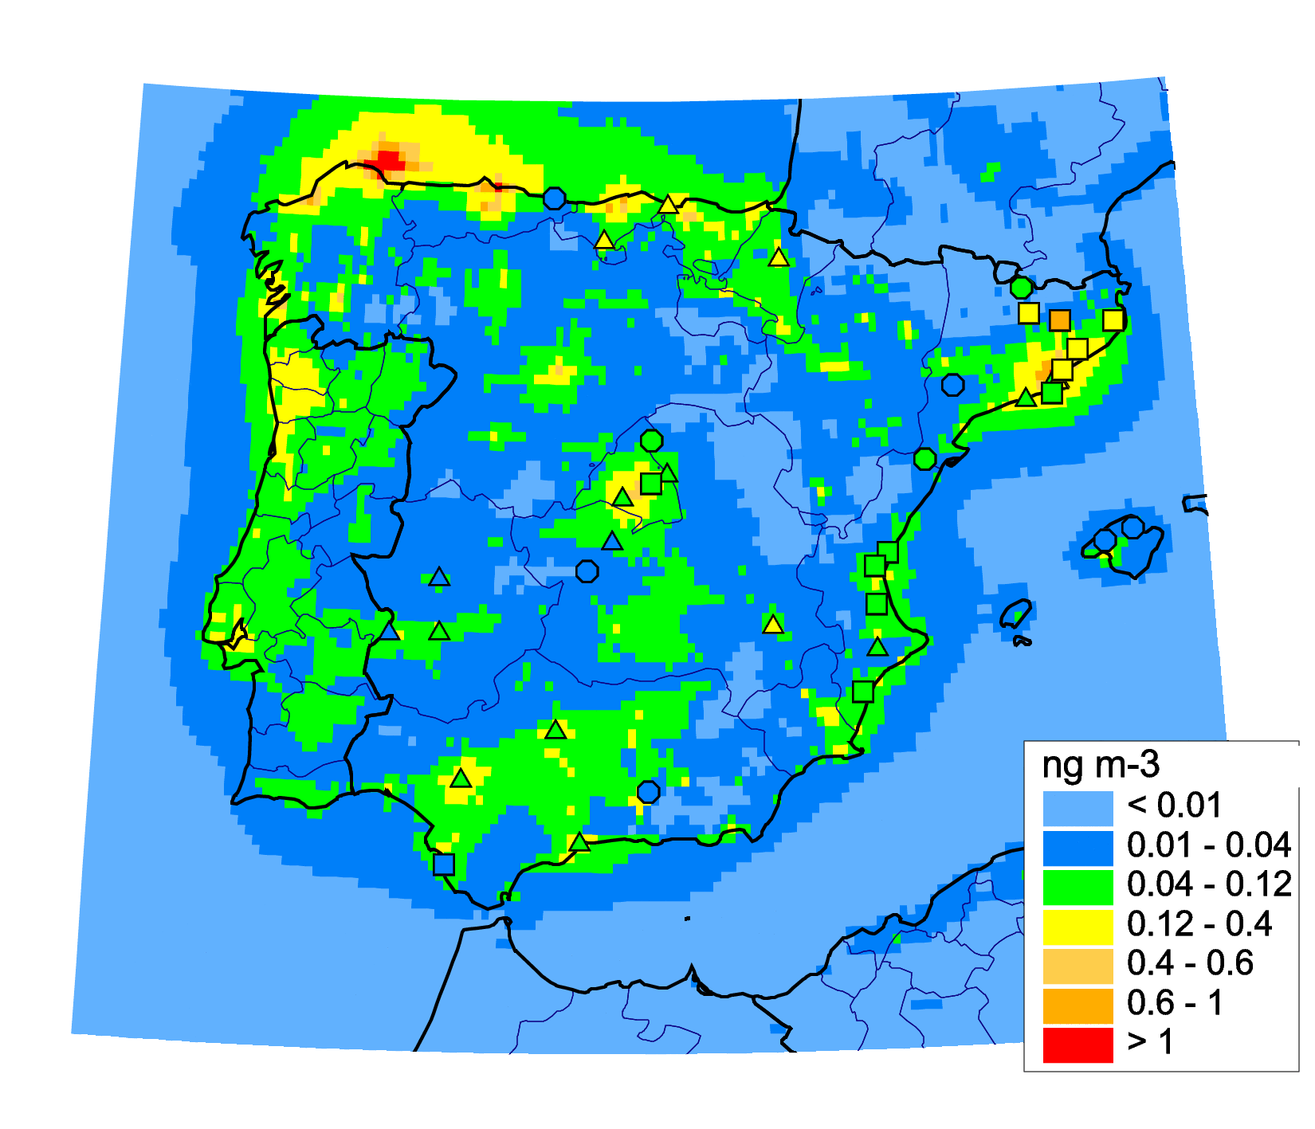
Case study of B(a)P pollution in Spain
Preliminary results:
Model simulations based on national PAH emissions and experimental scenario
National PAH emissions
Experimental scenario with low agricult. emissions
Bias 80%
Corr 0.44
Bias 10%
Corr 0.60
Modelled vs measured annual mean B(a)P air concentrations (2014)
Assumption of lower emissions from agriculture leads to lower bias and higher correlation of model results and measurements
3rd Joint session WGE/SB EMEP, 2017

Slide 12
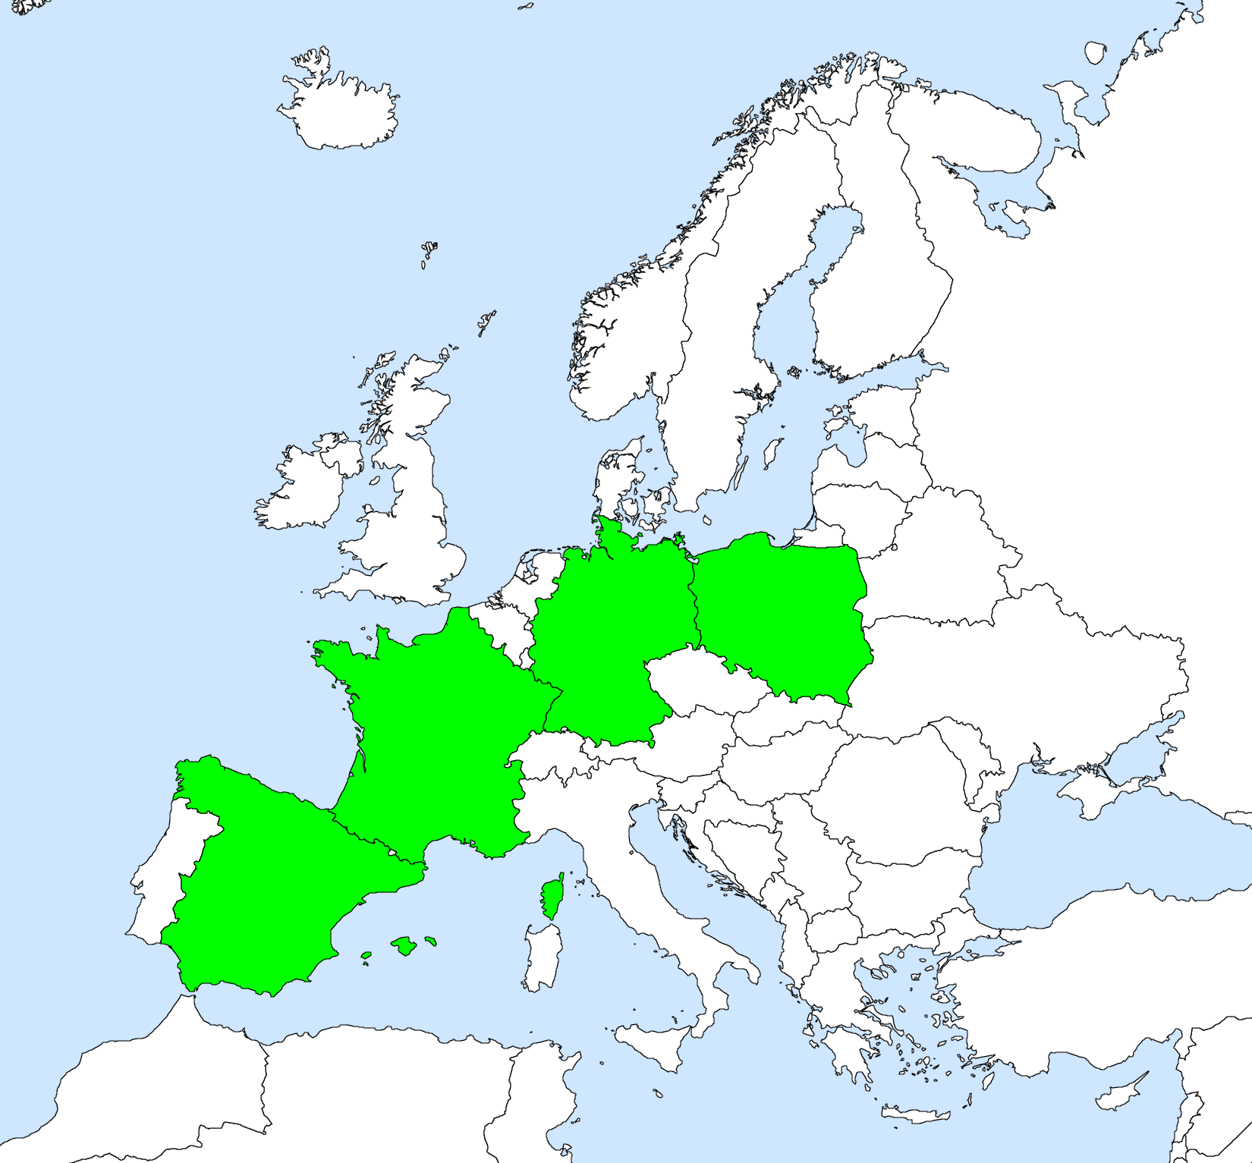
Country-scale POP pollution assessment
Case study on B(a)P for Spain (continuation):
Refinement of modelling results
Analysis of factors affecting B(a)P transport: interaction with aerosols, reactants
Case study on B(a)P for France:
Modelling for Spain and France using GLEMOS, CHIMERE (Spain), CHIMERE (France) models
Draft work plan has been elaborated
Refinement of parameterizations for gas-particle partitioning, degradation, and deposition
Case study on B(a)P for Poland and Germany:
Proposal to perform country-specific assessment to refine estimates of B(a)P pollution
3rd Joint session WGE/SB EMEP, 2017

