Slide 1
EMEP monitoring – quality issues

Slide 2
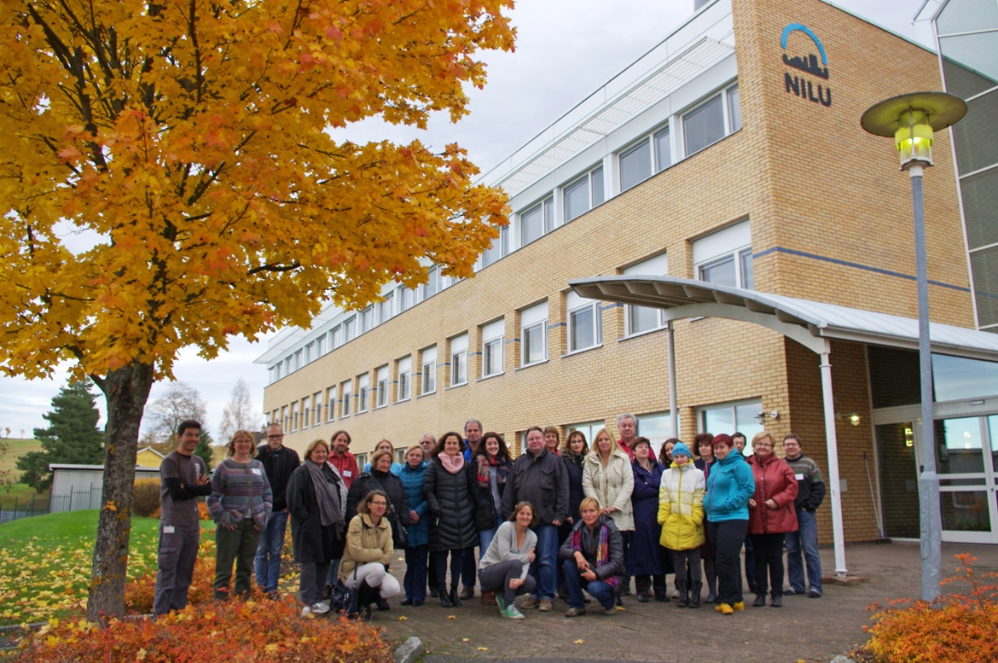
Technical workshop on data quality and data reporting
Agenda
Hands on training: Formatting data for submission to EBAS
Discussion on data quality for most EMEP components
Common challenges
Recommendations for DQO, methods
Documentation of the data quality: new metadata items in the templates for data submission
Kjeller, Norway, 26-28 October 2016
http://www.nilu.no/projects/ccc/tfmm/kjeller_2016/index.html

Slide 3
Recommendations and follow ups
DQO for SO₄ and NO₃ are reduced to 5%, and 7% for NH₄ (before 10 and 15%). In accordance to WMO/GAW
There is a need to focus more on data quality and discuss common problems in lab and field
A wish for dedicated workshops on a technical lab level and/or discussion groups on facebook or other platforms
Suggestion to initiate a field intercomparison on mercury
New metadata item on QA measures is implemented: Results from intercalibrations should now be reported together with the data
Reporting measurements uncertainty in a harmonized way. CCC will make a questionary and report/discuss this at the TFMM meeting in May.

Slide 4
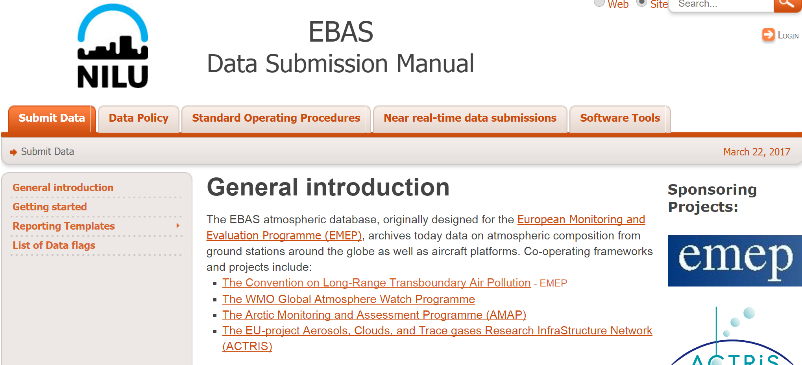

Slide 6
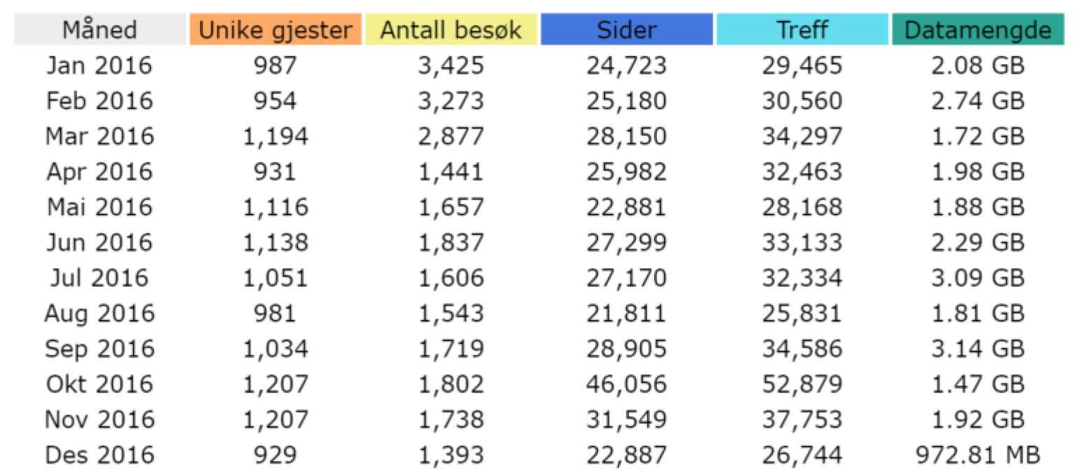
Access to data through web interphase (ebas total)

Slide 7
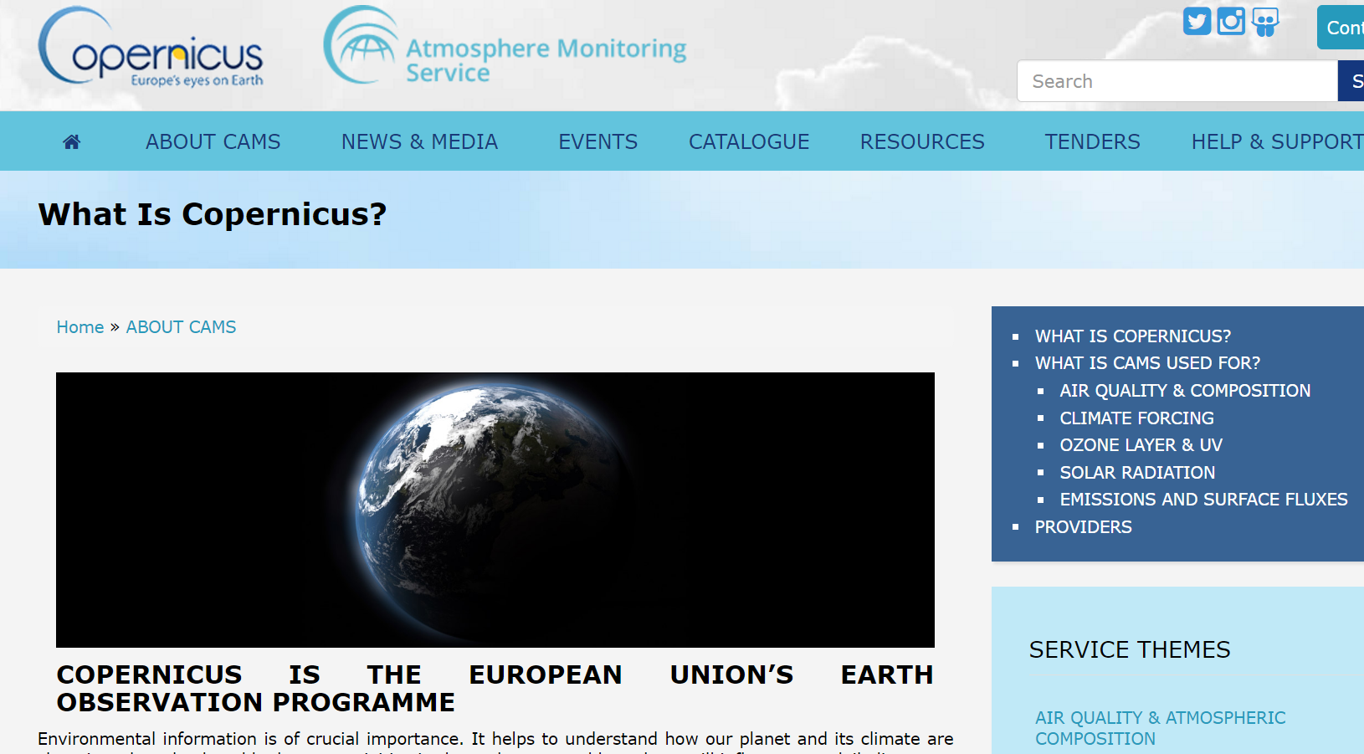

Slide 8
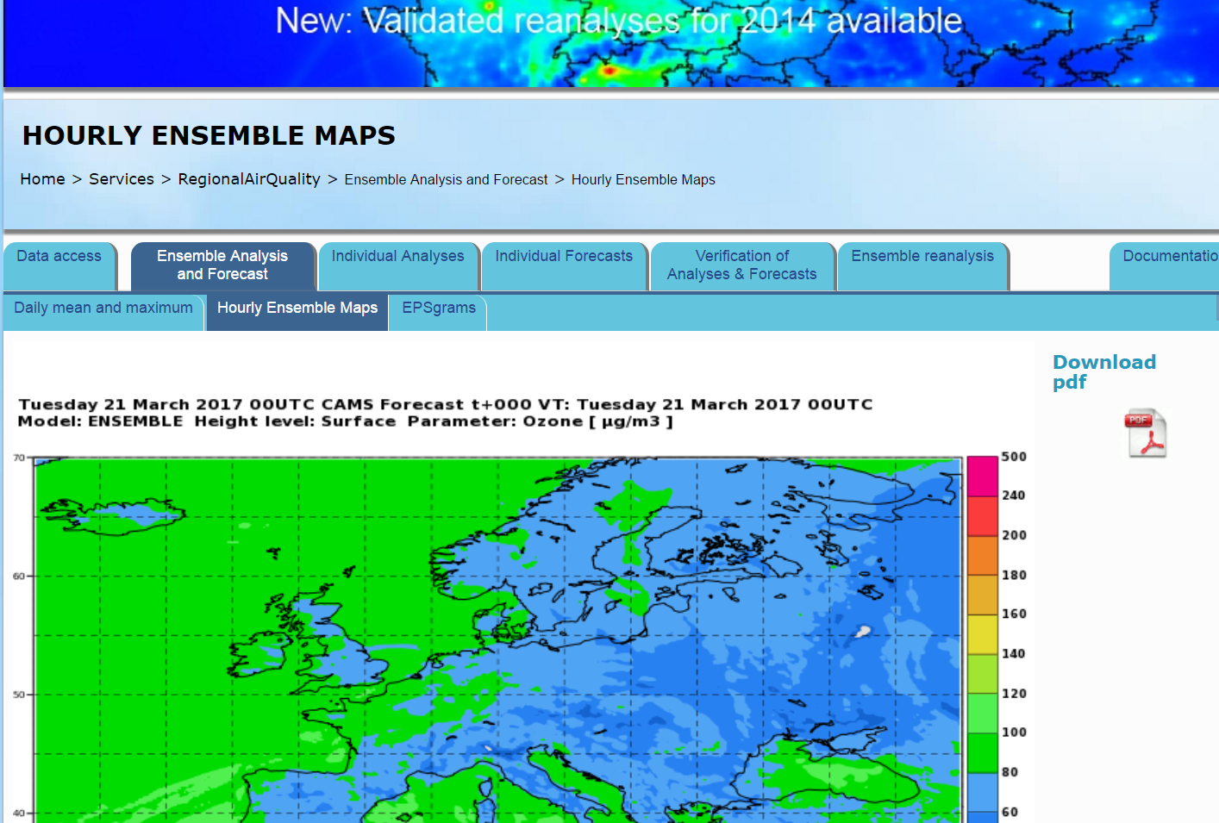

Slide 9
Copernicus utlize EMEP observations, and wish to have operational access to data in near real time
3 (4) contracts will be issued:
EMEP (contract with NILU)
WMO-GAW (contract with MeteoSwiss)
ACTRIS (contract with CNRS-LGGE and CNR)
NILU is data sentre for all three programs, and wish to have approval on the approach for use of available resources

Slide 10
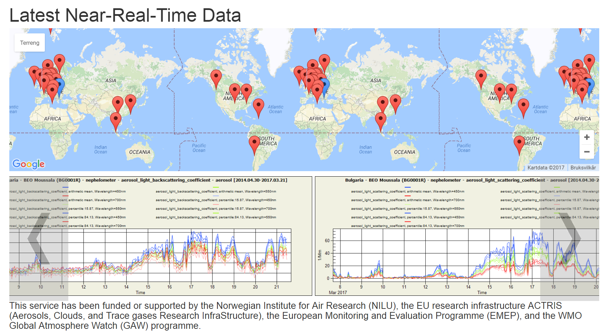
http://ebas-nrt-showcase.nilu.no/

Slide 13
Budget: 400k€ during 2017-2021
Voluntary participation
Basic data sharing already established (ECMWF + EMEP + WMO)
Development needed for some variables
Implementation at site level
Workshop/traning
Follow-up
If ~400 instrument/variable combinations: 250€ per year budget limit. Impossible to foresee sub-contracting or provider support
Specific needs can be covered as required

Slide 14
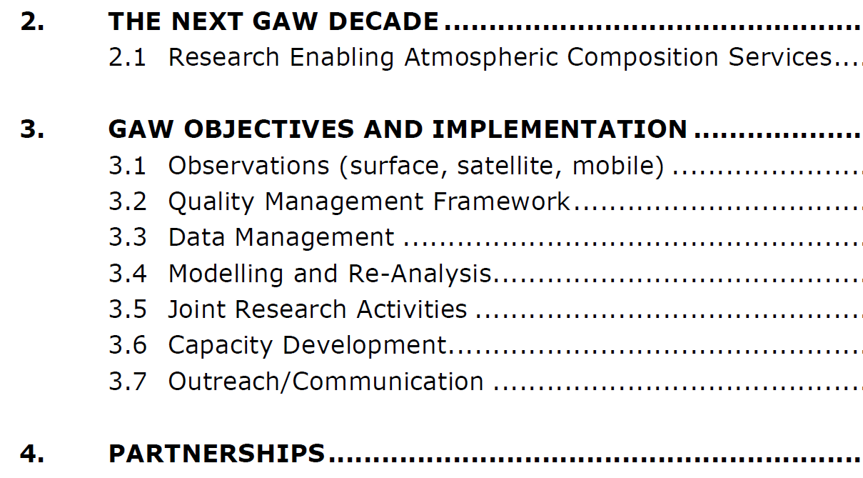
http://library.wmo.int/opac/doc_num.php?explnum_id=3395

Slide 15
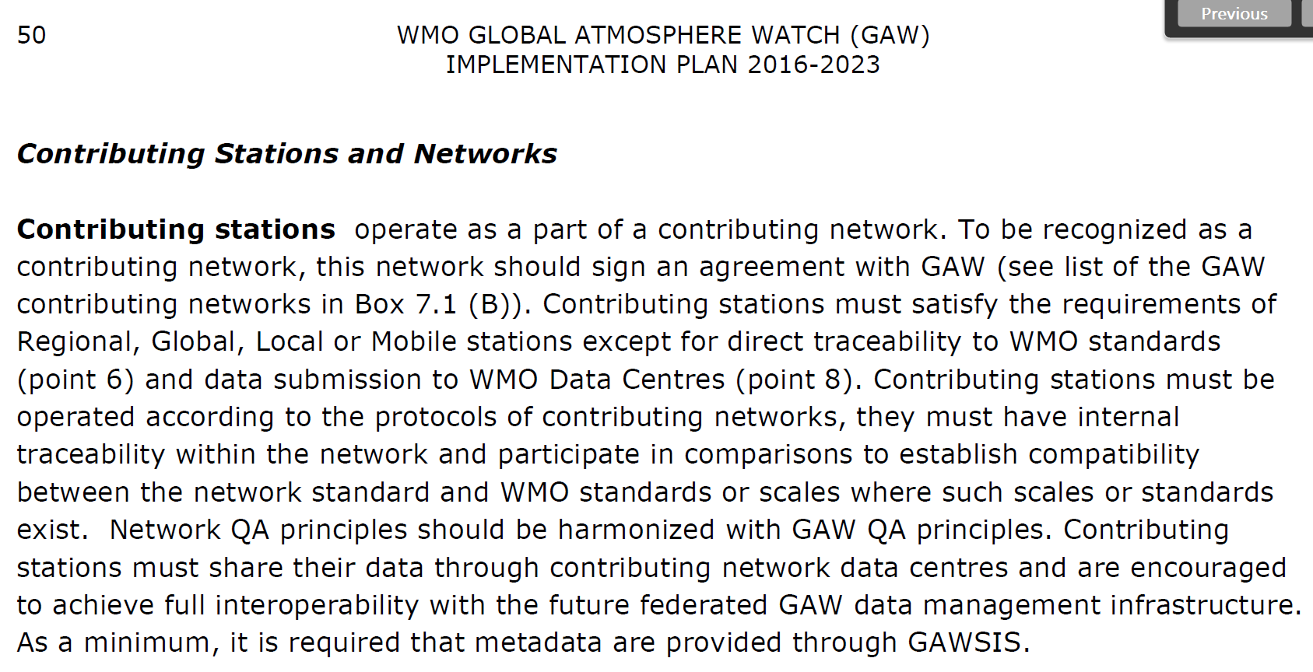

Slide 16
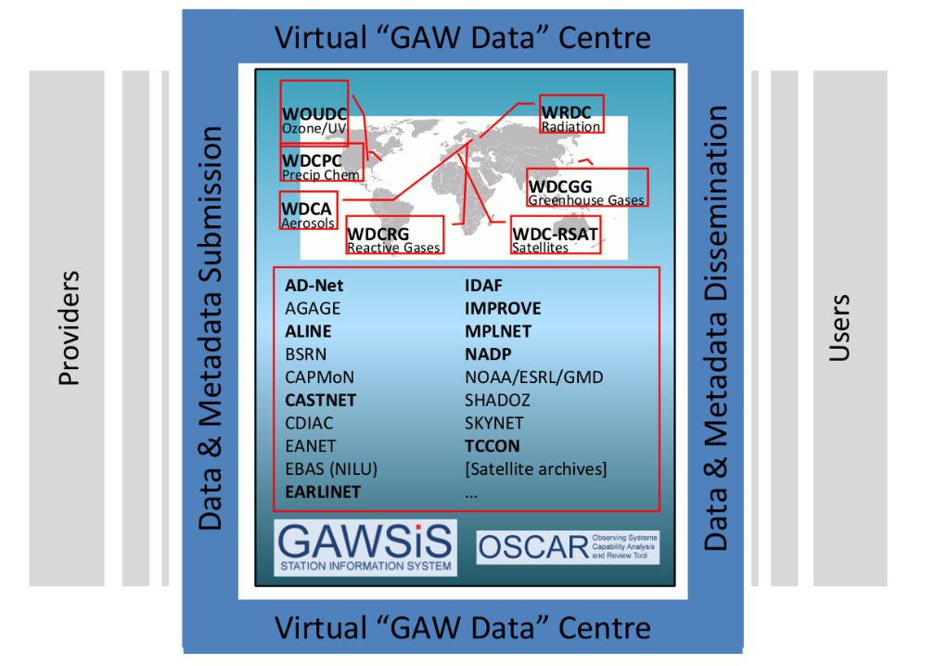

Slide 18
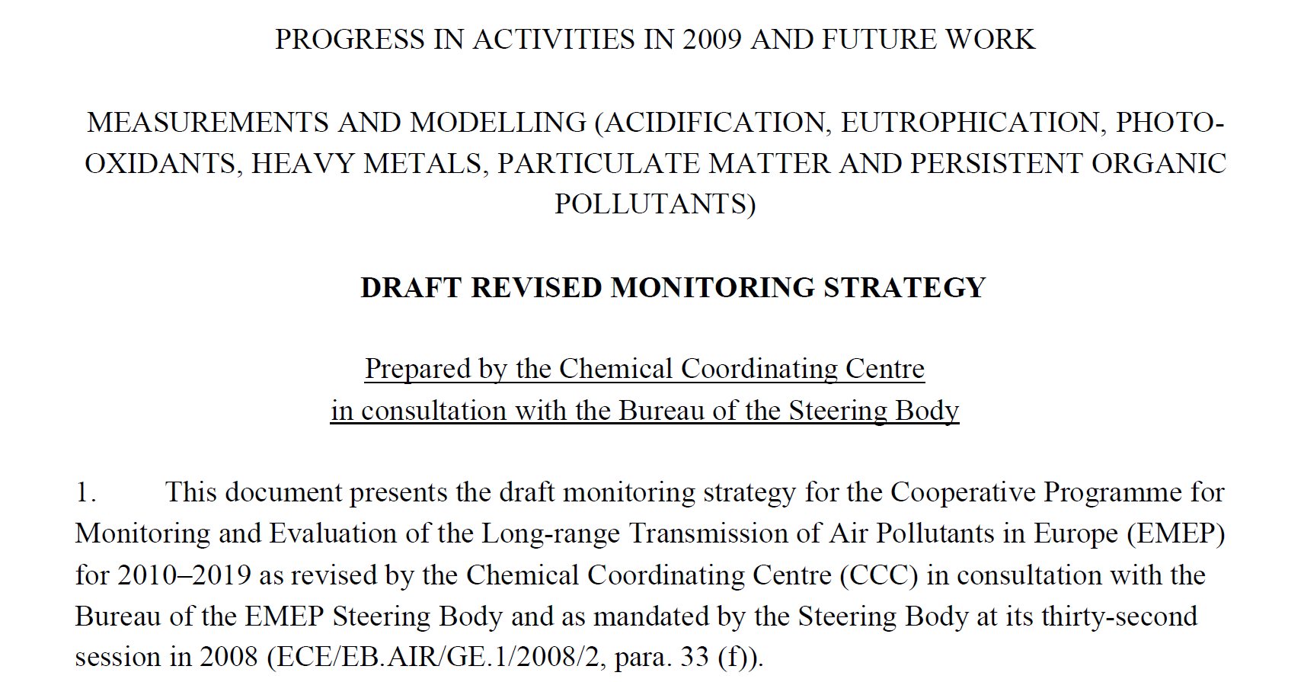

Slide 20
Some aspects related to the revision:
it is not a «static version» we are about to revise..
Major revisions foreseen?
Engagement of TFMM and other national experts, stakeholders and users of data
New methods/capabilities
New data needs?
Linking scales: local, regional, global
Geograhical extent and data beyond EMEP domain, partnership
Atmospheric composition/deposition approach, multi component approach, climate, effects community
Preserve long-term time series
Automated methods/NRT data use
Relation to other UN, EU… programs and regulations
ACTRIS

