Slide 1
WGE annual meeting
ICP M&M - CCE
progress in activities
and results of call for data
Anne Christine Le Gall
Chairwoman ICP Modelling & Mapping
Jean Paul Hettelingh
Head of CCE
Geneva, 11th -15th September 2017

Slide 2
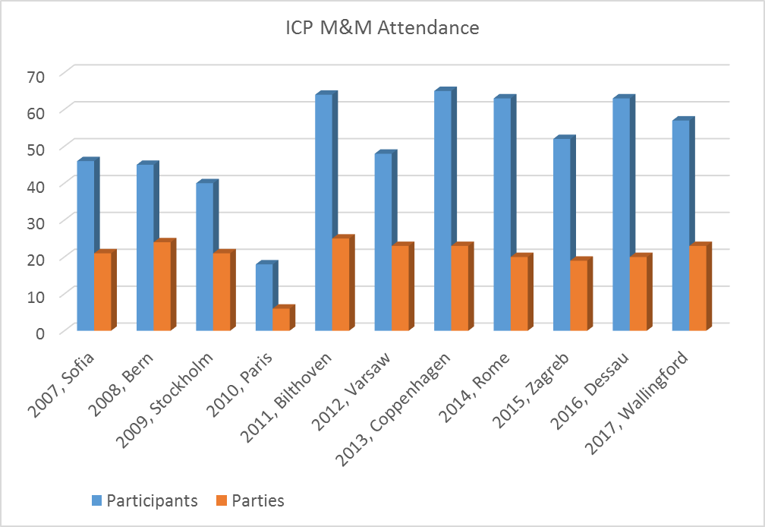
ICP M&M and CCE Workshop Meetings
Objectives of the ICP M&M
Develop modelling methodologies and databases on critical loads and risks of ecosystem effects, in collaboration with « monitoring » ICPs.
Inform the Convention and EU on the impact of air pollution on ecosystems in Europe.
Results: models and maps of critical loads and their exceedances by pollutant deposition, in collaboration with TFIAM and EMEP.

Slide 3
Main achievement of ICP M&M / CCE in 2017
Call for data 2016-2017:
Update of N and S critical loads
Critical load on biodiversity
Data is now available:
For integrated assessment modelling
For research and further development :
Ensure the consolidation, in collaboration with Alterra as appropriate, of national data by NFCs until a successor to the CCE becomes operational…
…and then continue the compilation of the European biodiversity critical load database in collaboration with the new Centre.
Develop links and coordination with the biodiversity community.

Slide 4
Distribution of areas where one, two or three critical loads of nitrogen, i.e. nitrogen acidification, eutrophication and biodiversity for nitrogen are exceeded
Useful for
Robustness analysis
Climate change analysis
Source:
CCE Final Report 2017

Slide 5
Next steps…
Short of an operational successor of the CCE during 2018, the TF-M&M recommends that the WGE calls representatives to continue the 2015-2017 call for data:
For NFCs to submit biodiversity CL at the 2018 ICP M&M meeting and at the 2018 WGE-EMEP meeting, following the instructions of the 2015-2017 call for data.
That they withhold their data until the set up of a new ICP M&M Programme Centre to succeed on the CCE.
The aim of the call will be:
Ensure the consolidation, in collaboration with Alterra as appropriate, of national data by NFCs until a successor to the CCE becomes operational…
…and then continue the compilation of the European biodiversity critical load database in collaboration with the new Centre.
Develop links and coordination with the biodiversity community.

Slide 6
Cross cutting issue: Current update of the Mapping Manual
The Mapping Manual update was started in 2014.
In 2016, one discussion on long term nitrogen immobilisation had not been concluded.
In 2017, the discussion was concluded:
23-24 February: workshop in Olten (CH), 19 participants, lit terature data + observations from France, Switzerland and Germany were assessed, a first draft is written and proposed to the ICP M&M TF meeting.
Main points:
Long term net immobilisation should at most be set equal to the average accumulation rates.
For soil in dynamic equilibrium, long term N immobilisation = 0.
Current observed N immobilisation are influenced by anthropogenic processes and do not reflect critical loads steady state conditions.
Notes:
Workshop on immobilisation: prepared by Germany and Switzerland

Slide 7
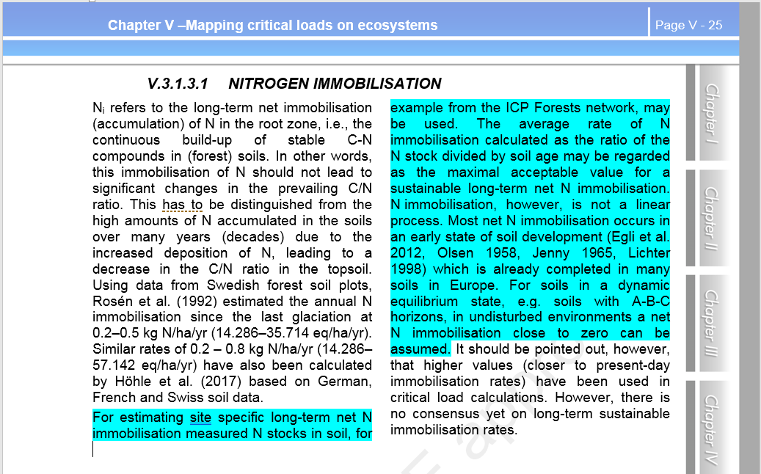
Approval by WGE?

Slide 8
Current update of the Mapping Manual
Meanwhile, discussions within ICP Vegetation have led to minor modifications of chapter 3.
Translation into Russian is in progress at the Institute of Global Climate and Ecology (Moscow).
All Mapping Manual chapters are available at http://icpmapping.org/Mapping_Manual
Notes:
Workshop on immobilisation: prepared by Germany and Switzerland

Slide 9
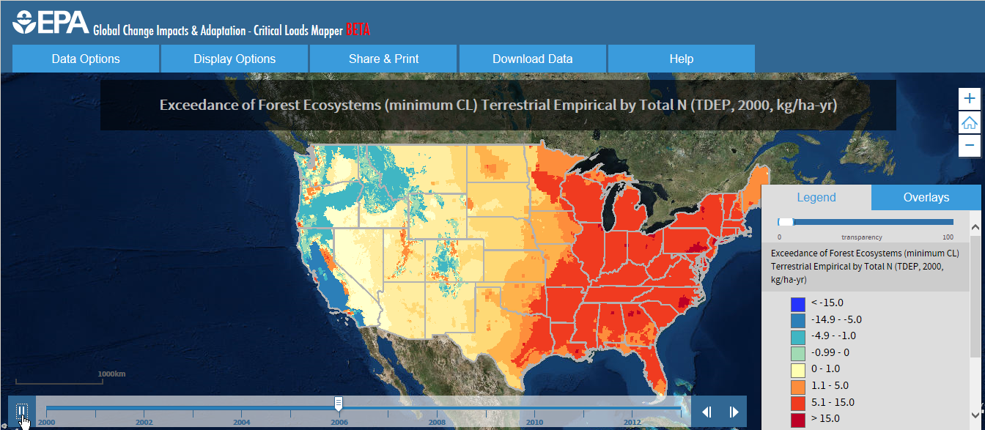
Improving the functionning of the scientific bodies
Data of the ICP M&M is used by the TFIAM and EMEP: update of the CLd database to be used in integrated assessment modelling
Common portal for effect oriented activities: the ICP M&M TF recommended that the functionalities of the US critical load mapper (https://clmapper.epa.gov/) are investigated, and if feasible implemented in the WGE portal.

Slide 10
Other activities
Training of the Czech NFC in modelling and mapping methodologies to prepare response to a follow up to the 2017 call for critical loads, RIVM-CCE, July 2017.
EMEP-MSCE (Oleg Kravnikov) led collaboration with CCE and Alterra to compute and map depositions and exceedances of mercury on an hemispheric scale (ongoing).

Slide 11
Further information at
http://icpmapping.org/
http://wge-cce.org/
http://www.greattravels.co.uk
Next Task Force meeting, Bern, Switzerland, 18th - 20th April 2018

Slide 12
Publications and reports
De Vries W, Posch M, Simpson D, Reinds GJ, 2017. Modelling long-term impacts of changes in climate, nitrogen deposition and ozone exposure on carbon sequestration of European forest ecosystems. Science of the Total Environment 605-606: 1097-1116; DOI: 10.1016/j.scitotenv.2017.06.132
Kopáček J, Hejzlar J, Porcal P, Posch M, 2017. Trends in riverine element fluxes: A chronicle of regional socio-economic changes. Water Research 125: 374-383; DOI: 10.1016/j.watres.2017.08.067
Dirnböck T, Djukic I, Kitzler B, Kobler J, Mol-Dijkstra JP, Posch M, Reinds GJ, Schlutow A, Starlinger F, Wamelink GWW, 2017. Climate and air pollution impacts on habitat suitability of Austrian forest ecosystems. PLoS ONE, accepted
Jonson JE, Borken-Kleefeld J, Simpson D, Nyiri A, Posch M, Heyes C, 2017. Impact of excess NOx emissions from diesel cars on air quality, public health and eutrophication in Europe. Environmental Research Letters, accepted
Hettelingh J-P, Posch M, Slootweg J (eds.), 2017. European critical loads: database, biodiversity and ecosystems at risk, CCE Final Report 2017 (in prep.)
Hettelingh J-P, Posch M, Slootweg J (eds.), 2017. Ko-Finanzierung der Aktivitäten des Coordination Centres for Effects (CCE), Projectnr. 78394, final report to UBA, May 2017.
Moldan F and Hettelingh J-P, 2017. Critical loads for biodiversity – establishing a first European map based on new concepts for the CLRTAP, Interim report to the Nordic Council of Ministers, July-August 2017.
Posch M, 2017. Contribution to EMEP Status Report 2017, Transboundary particulate matter, photo-oxidants, acidifying and eutrophyin pollutants, Status Report 1/2017

Slide 13
ICP M&M future work
- Set up a new Programme Centre for ICP M&M
- Transfer of the Critical load European database to CIAM
- Translation of the mapping manual into russian
- Consolidate the [biodiversity] critical load databases
At parties level
At UNECE level

Slide 14
Final questions
Recommendation for the use of classical critical load to be used for integrated assessment modelling and policy purpose ?
Recommendation for the use of biodiversity critical loads for further development and research?
Request for continuing the call for data on biodiversity?

Slide 15
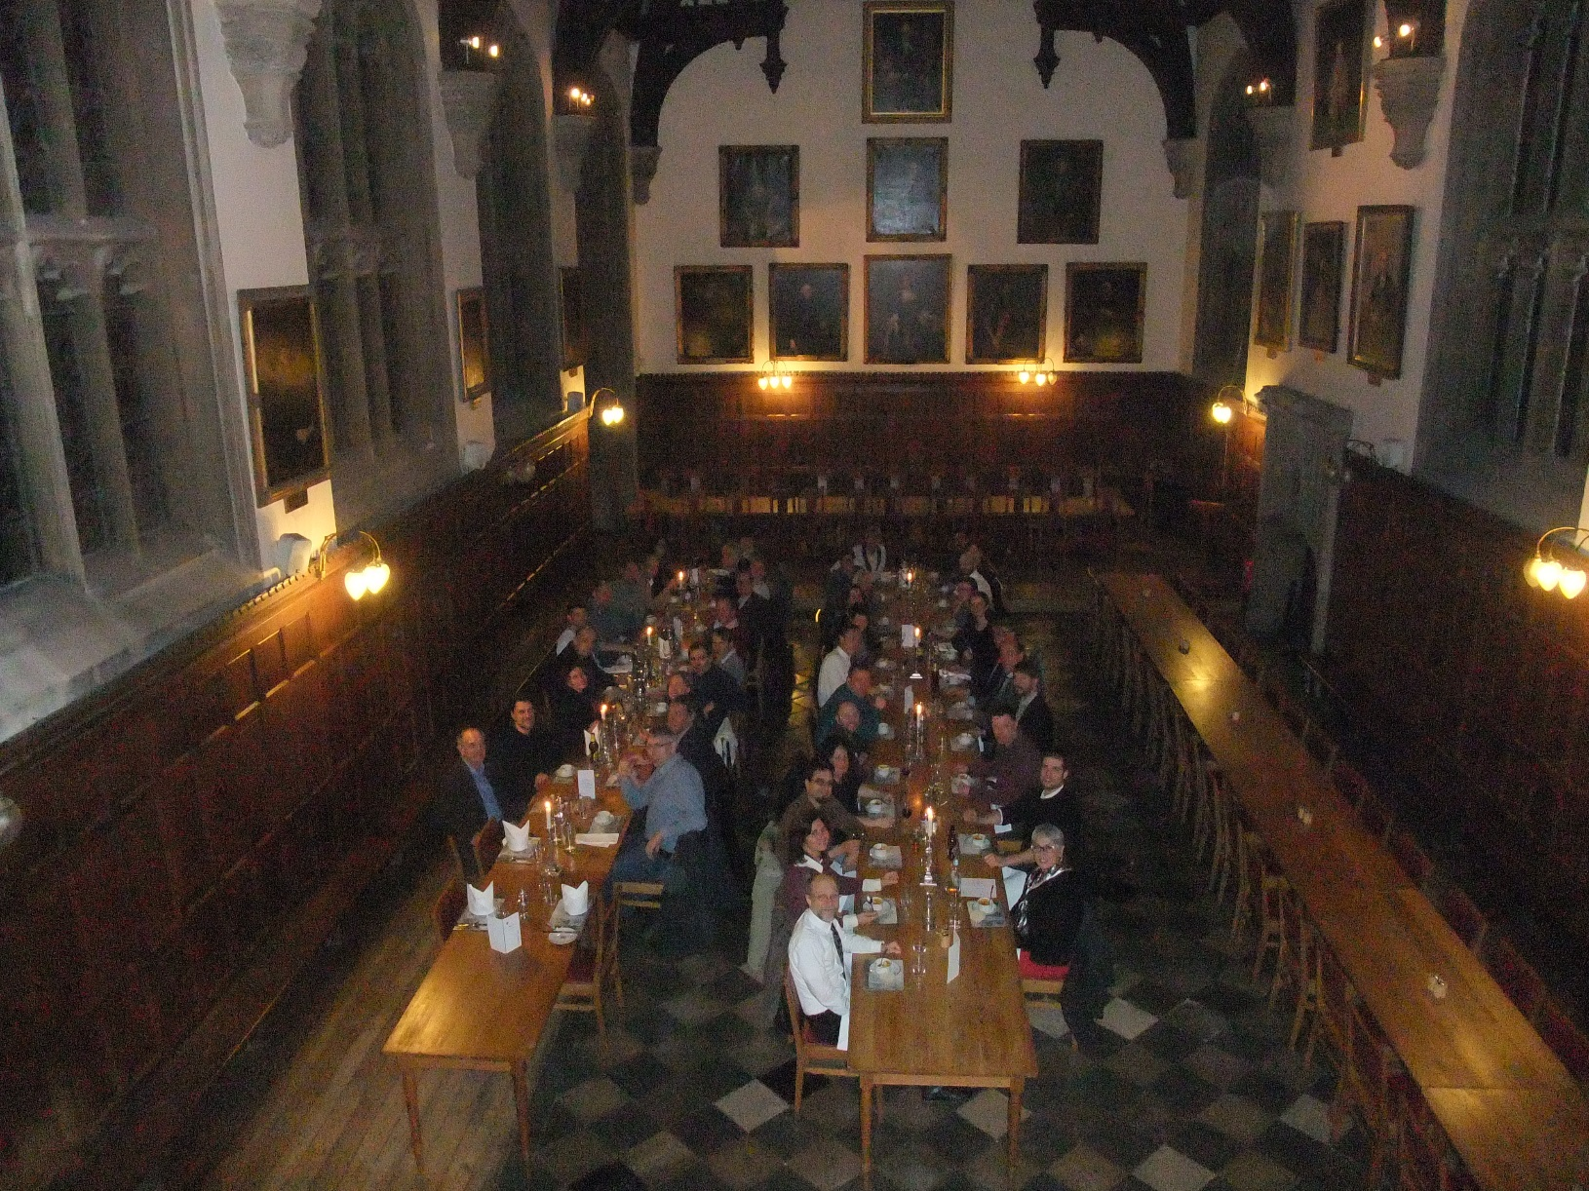
Thank you for your attention

