Slide 1

Follow Up on Second Joint Session:
Impacts of Climate Change on Air Quality
Co-Chairs
Frank Dentener, PhD Terry Keating, PhD
EC JRC U.S. EPA
13 September 2017
Notes:
1

Slide 2
Air Quality in a Changing World
3-6 April 2017 @ USEPA in North Carolina
Part 1: HTAP2/AQMEII3/MICS3 Activities
Part 2: Climate Change Impacts on Air Quality
  Arlene Fiore: A Review Focused on O3 and US
  Augustin Colette: European Impacts
  Bill Collins: HTAP Impacts on Radiative Forcing
  Ruth Doherty: ACCMIP CO Tracer Analysis
  Loretta Mickley: Perspectives from Statistical Models
Part 3: Kickoff of EPA-Funded Projects on
“Particulate Matter and Related Pollutants in a Changing World”
Presentations are available at http://www.htap.org

Slide 3
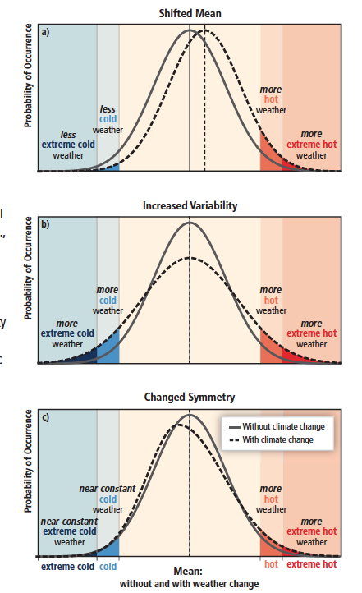


How and why might extreme air pollution events change?
TEMPERATURE (AIR POLLUTION)
Meteorology (e.g., stagnation vs. ventilation)
Mean
shifts
Degree of mixing
pollutant sources
Variability
increases
Feedbacks (Emis, Chem, Dep)
T
Fires
OH
NO_{x}
VOCs
Deposition
H₂O
PAN
Symmetry
changes
Changing global emissions (baseline)
Changing regional emissions (episodes)
→ Shift in mean?
→ Change in symmetry?
Need to understand how different
processes influence the distribution
Figure SPM.3, IPCC SREX 2012
http://ipcc-wg2.gov/SREX/
From Arlene Fiore

Slide 4
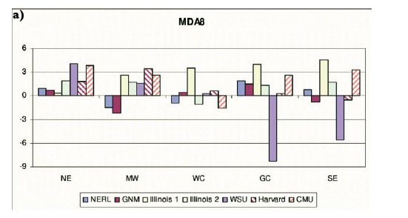
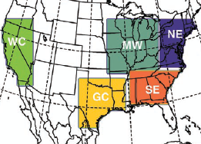
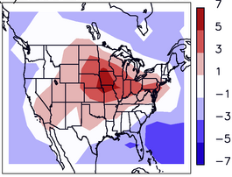
Models estimate a ‘climate change penalty’ (+2 to 8 ppb) on surface O₃ over U.S. but often disagree in sign regionally
Modeled changes in summer mean of daily max 8-hour O₃ (ppb; future – present)
NE MW WC GC SE
Weaver et al., BAMS, 2009
Uncertain regional climate responses
Model estimates typically based on a few years of present and future (often 2050s) meteorology from 1 realization (ensemble member) of 1 GCM
Wu et al., JGR, 2008:
“Climate Penalty”
From Arlene Fiore
ppbv

Slide 5
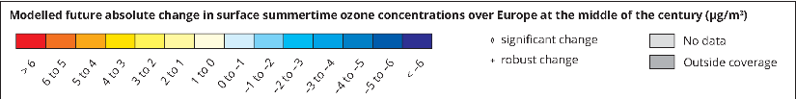
Climate impact on ozone
Magnitude of the penalty
  +2 to 3ppb locally by 2050 in medium scenario (A1B, 9 models, 144 simulated years)
  +2ppb widespread in Europe if global warming reach 4K
  NB: the average reduction in O3 peaks (4MDA8) is 4ppb since 20yr with ambitious emission reductions !
Colette et al. ERL, 2015
http://www.eea.europa.eu/data-and-maps/
indicators/air-pollution-by-ozone-2/assessment
From Augustin Colette

Slide 6
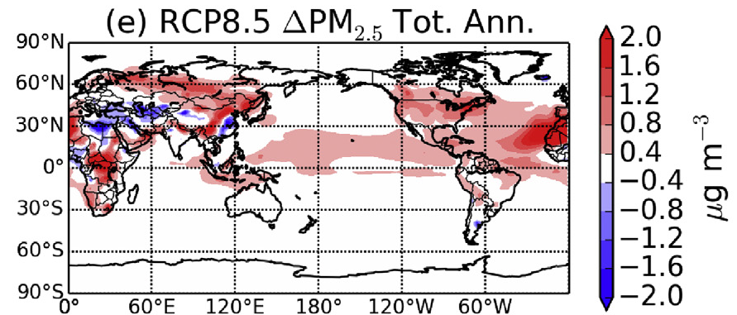
PM_{2.5} climate penalty under extreme warming scenario
Change in annual mean PM_{2.5}from 2006-2015 to 2091-2100
Averaged over 3 ensemble members in GFDL CM3
with aerosols held fixed at 2005 levels (RCP8.5_2005Aer)
From Arlene Fiore
Westervelt et al., Atmos. Environ., 2016

Slide 7
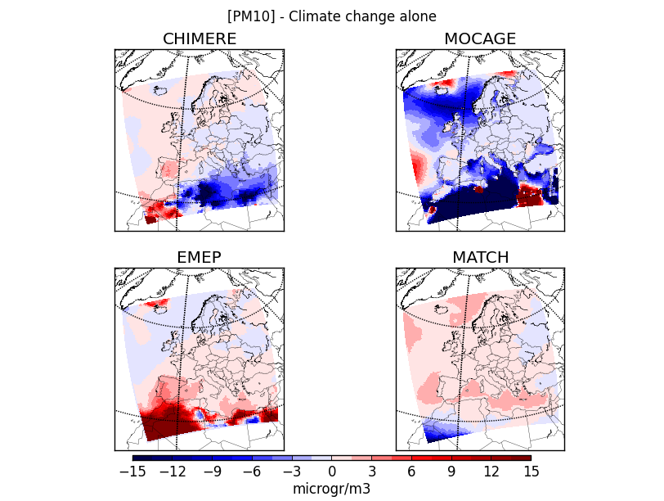
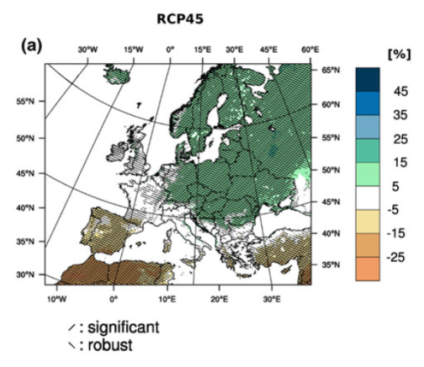
Climate impact on PM
Increase in Southern Europe
Uncertain/small elsewhere
Correlation with precip. change
Large model uncertainty
Change in PM10
Precipitation change by 2070-2011 vs 1970-2000 in the cordex ensemble (Jacob et al. 2013)
Lacressioniere, et al., AE 2017
From Augustin Colette

Slide 8
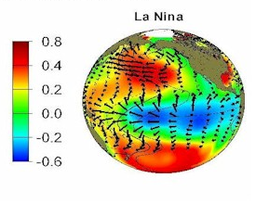
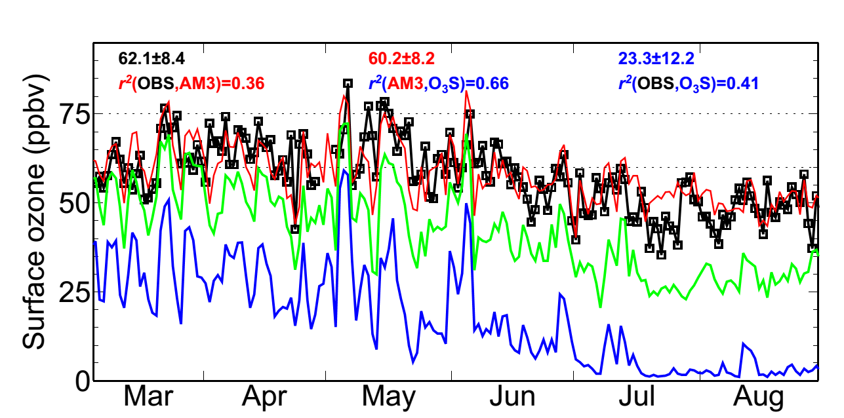
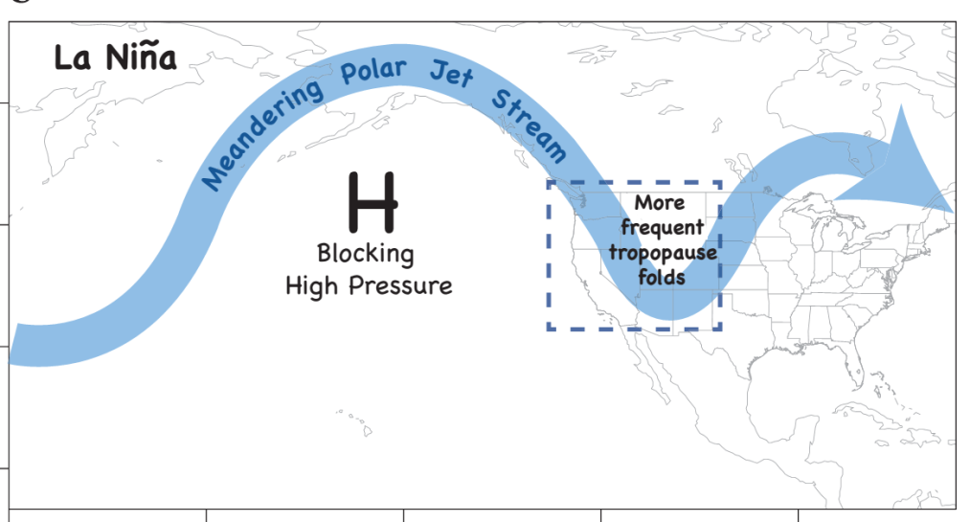
Climate variability can modulate WUS background ozone:
Frequency of deep stratospheric intrusions over WUS tied to known mode of climate variability (La Niña)
Tropical SST cooling typically
peaks in winter
More frequent stratospheric intrusions the following spring over WUS?
SST (C)
http://www.enr.gov.nt.ca/state-environment/22-pacific-decadal-oscillation-index-and-el-ninola-nina
MDA8 O₃ (ppb)
MDA8 O₃ (ppb)
La Niña
1999, Gothic in CO Rocky Mtns
May offer a few months lead time to plan for an active stratospheric intrusion season (protect public health, identify exceptional events)
From Arlene Fiore
M. Lin et al., Nature Communications, 2015
Notes:
Used TOMS + AIRS to extend further back

Slide 9
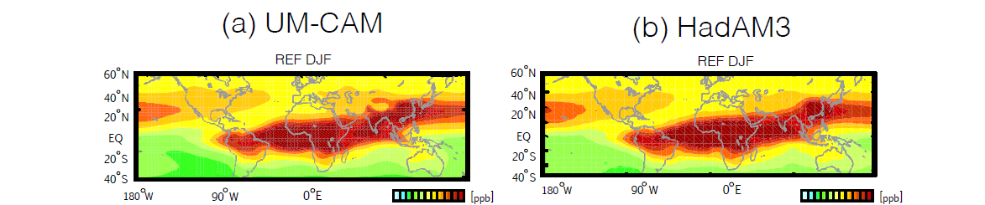
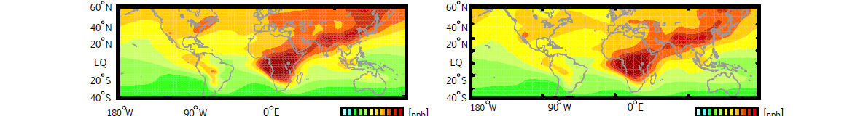
Atmospheric Chemistry & Climate Model Intercomparison Project (ACCMIP) CO-like Tracer Analysis
From
Ruth Doherty
DJF
JJA
Climate change …
decreases tropical upper tropospheric CO tracer mixing ratios and convective mass fluxes, likely related to a weakened Hadley Cell circulation
Increases in CO-tracer near the tropopause most likely related to a rise in tropopause height
Shifts midlatitude jets poleward, maybe important for CO-tracer changes in the extratropical upper troposphere
Impacts are determined by transport processes affecting emissions source regions-strong seasonally transport and emission variation

Slide 10
Lessons Learned and Opportunities
Impacts of climate change on air quality involves a complex array of factors - most studies only focus on subsets of factors making comparison overall difficult.
  Metrics and averaging periods are often different, some recommendations on which ones to take would be useful to reach comparability.
Statistical analysis of large scale synoptic variability and trends both in the USA and Europe are becoming more prominent. Further lessons are available to be learned.
Objective, robust and accepted methods to estimate climate penalty across North America and Europe, would provide important information for the global climate discussion.
  Opportunity for TFMM and TFHTAP to link to global efforts under AerChemMIP and regional efforts under EuroDelta, AQMEII, and MICS.

