Slide 1
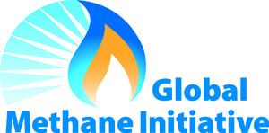
Global Methane Initiative & Govt. of India-Central Mine Planning & Design Institute Joint Cooperation for CMM Project Development
Presented By:
Ms. Monica Shimamura
U.S. Environmental Protection Agency
International Workshop on Best Practices in
Methane Drainage and Use in Coal Mines
9-10 March, 2017
Ranchi, India
Notes:
1

Slide 2
Background
The U.S. EPA and India’s government agencies have a long and productive history of cooperation in the area of CMM/CBM resource development;
Informal efforts were initiated in 2001, culminating in the establishment of the CMM/CBM Clearinghouse in 2008, at CMPDI (HQ) in Ranchi (Jharkhand);
The Clearinghouse has facilitated numerous efforts to promote CMM/CBM development in India, including workshops and conferences, training and site visits, and technical studies.
Notes:
2
2

Slide 3
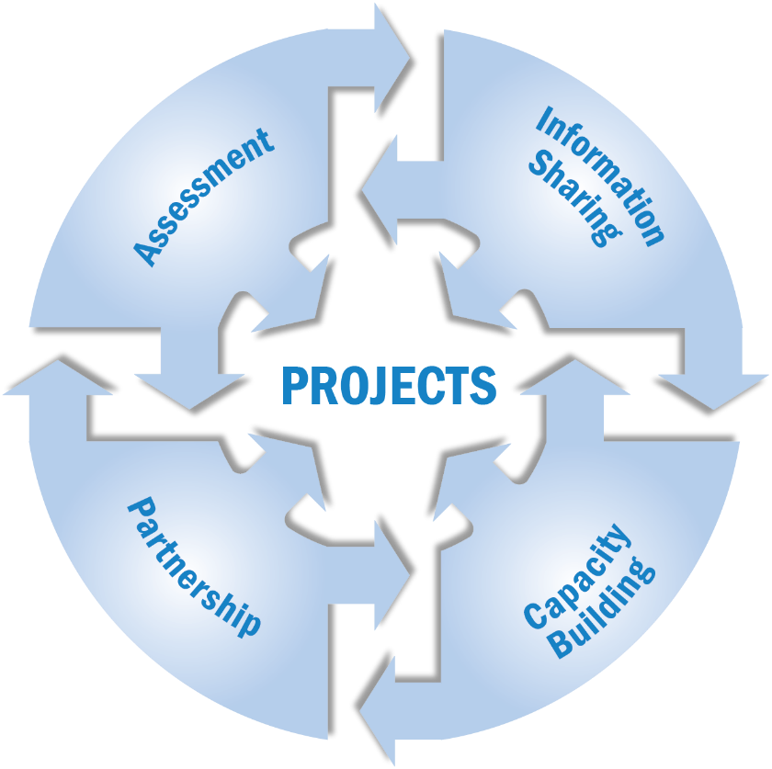
Global Methane Initiative (GMI)
GMI is a voluntary, multilateral partnership that aims to reduce methane emissions and to advance the abatement, recovery and use of methane as a clean energy source.
Established in 2004 , with U.S. and India among 14 founding partners
42 partner countries + EC
Targets five sector-specific areas for methane reduction
Agriculture
Coal Mines
Municipal Solid Waste
Municipal Wastewater
Oil & Gas Systems
Notes:
3
GMI focuses on five sectors: agriculture, coal mines, municipal solid waste, municipal waste water, and oil and gas systems.
The GMI is focused strategically on building capacity – trying to help country partners identify projects with the most potential and to enable them to bring these projects forward to project developers and technology providers.
To this end GMI works on:
Resource Assessments – an assessment of methane opportunities in any given sector within a developing country
Feasibility and Pre-feasibility studies – Analysis of specific project opportunities to help countries understand which are optimum for development
Tools development – technology database and financial model
Training and Workshops – Reaching out directly to owners and operators and sector specific audiences to teach them about methane reduction opportunities and tools and techniques.
- Study Tours and Clearing Houses – bringing people to see model methane projects and setting up information clearing houses in developing countries to serve as a one-stop-shop on methane abatement for specific sectors.

Slide 4
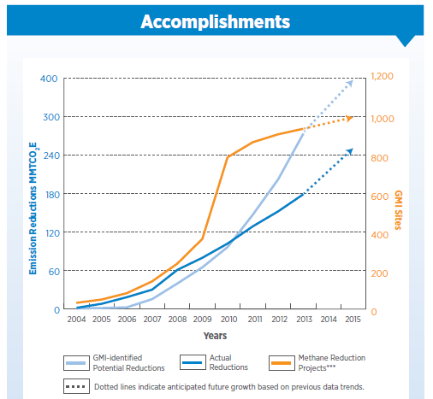
GMI Accomplishments
GMI has supported over 300 resource assessments and feasibility studies, conducted 240 workshops and trainings, and ultimately supported over 600 actual projects, reducing global methane emissions by a total of nearly 300 MMTCO₂E.

Slide 5
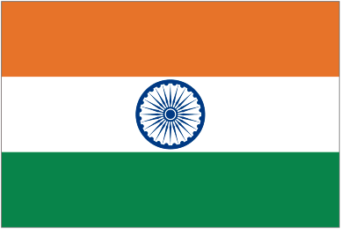
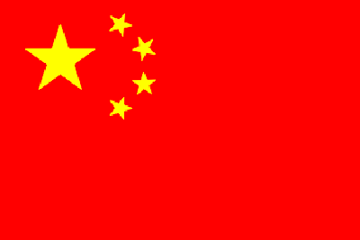
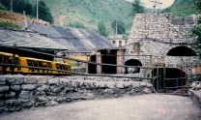
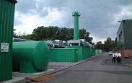
Coal Mines Subcommittee
Coal mine methane sector activities focus on recovering methane that is released from coal seams as a result of mining activities.
The Subcommittee has:
Developed comprehensive profiles that characterize the coal and coal mine methane sectors of 37 countries (29 Partners)
Completed country-specific action plans for ten Partners
Showcased 100+ project opportunities and success stories at Methane Expos in China, India, and Canada
Showcased nearly 40 project opportunities and success stories at the 2010 Methane Expo, New Delhi, India.
Hosted meetings and workshops in more than a dozen countries
Developed numerous technical resources and tools
Coal Subcommittee Statement of Purpose and Action Plan: http://www.globalmethane.org/sectors/index.aspx?sector=coal
Notes:
In the coal sector, our Subcommittee members, chaired by China, India and the U.S., are working in partnership with our Project Network to advance the capture and use of methane that is vented from coal mining operations.

Slide 6
GMI Coal Mines Subcommittee: Collaboration with UNECE
Best Practices Guidance for Effective Methane
Drainage and Use in Coal Mines
Drafted by international CMM technical experts; peer reviewed
Updated in 2016
Collaborative project between GMI and UNECE Group of Experts on CMM
U.S. EPA financially supported outreach workshops organized by UNECE in China (Oct 2010), Kazakhstan (May 2011; Oct 2016), Ukraine (Sept 2011), and India (March 2017)
Guide can be found at: https://www.unece.org/energy/se/cmm.html
GMI Coal Subcommittee Meetings
Graciously hosted by UNECE in Geneva
Next joint meetings scheduled for 23-25 October 2017

Slide 7
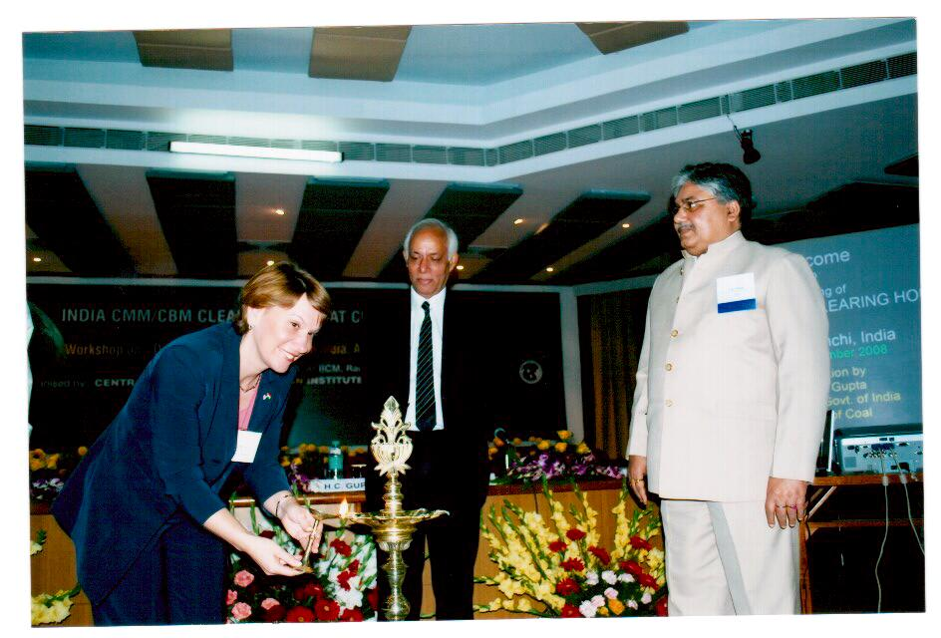
India CMM/CBM Clearinghouse
Established in November, 2008, with partner funding from U.S. EPA (25%) and Coal India, Ltd. (75%) under aegis of Ministry of Coal;
Initially established for a three-year term;
Two subsequent extensions take the term up to 2018;
It is a non-profit and non-governmental organization with the aim to promote the development of CMM/CBM in India;
Intended to be the public face of the CMM/CBM industry in India through its communication and outreach efforts;
Initial point of contact for foreign and domestic investors.
Notes:
7
7

Slide 8
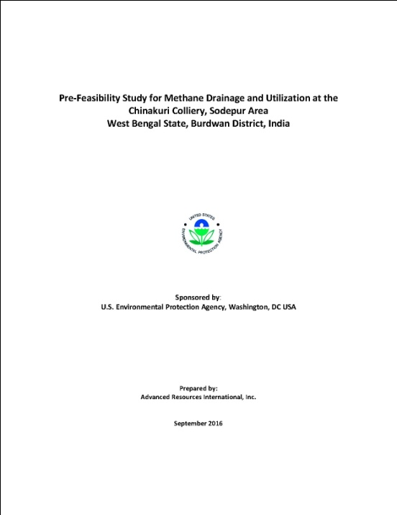
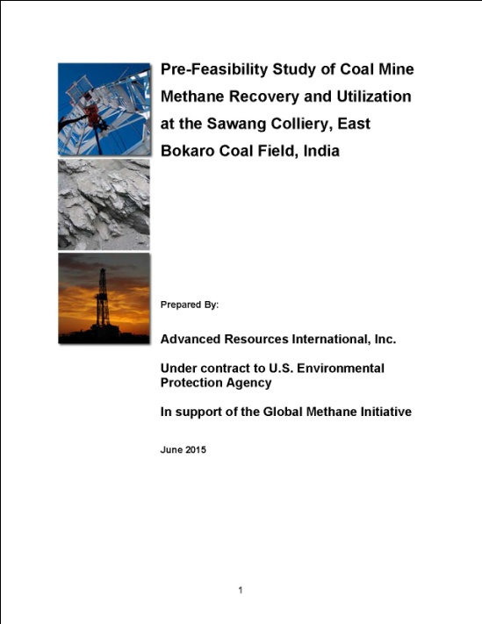
Technical and Economic Studies
The Clearinghouse has supported two technical and economic pre-feasibility studies funded by the U.S. EPA
The two studies conducted were:
Sawang Colliery, East Bokaro coalfield 2013
Chinakuri Coal Mine, Raniganj coalfield 2015
Notes:
8
8

Slide 9
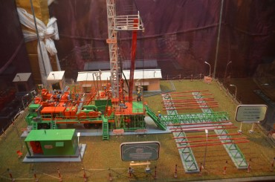
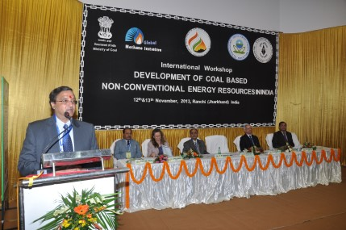
Workshops and Conferences
November, 2008: Following the inauguration of the Clearinghouse, a two-day workshop entitled “CMM Development in India: An Opportunity Area” was held in Ranchi;
March, 2010: Supported the 2010 Methane to Markets Partnership Expo in Delhi, presented various prospect opportunities, and created working models of CMM/CBM operations;
November, 2013: The India Clearinghouse hosted an International Workshop entitled “Development of Coal-Based Non-Conventional Resources in India”;
March, 2017: CMPDI Hosted an International Workshop on “Best Practices in Methane Drainage and Use in Coal Mines” in conjunction with the UNECE.
Notes:
9
9

Slide 10
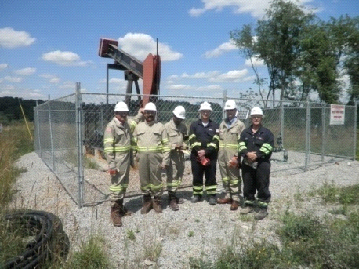
Training and Technology Transfer
Since the establishment of the Clearinghouse in 2008, coal industry personnel have visited the U.S. to learn about a number of areas of CMM/CBM development, including:
CBM drilling and completions techniques;
In-mine directional drilling;
Development of CMM/CBM in active oil and gas fields;
Legal and regulatory aspects of CMM/CBM development
End-use technologies for CMM/CBM
Recently, a high-level delegation visited in-mine drilling operations at the Warrior Met Coal mine in Tuscaloosa, AL, as the geology and mine conditions are similar to the Moonidih mine of the Jharia Coalfield, an area actively being pursued for CMM development by CIL
Notes:
10
10

Slide 11
Future Activities
With the recent permission by the Government of India to Coal India Limited to explore and develop CBM from areas under coal mining leases held by CIL and its subsidiaries , the Clearinghouse will continue to serve as a catalyst for Indian CMM/CBM development
Future activities will include:
Organizing in-house training and workshops for capacity building of Coal India Limited, Government officials, Industry personnel, and other stakeholders involved with CMM/CBM development;
Organizing international seminars and technical workshops in India for exploring the existing opportunities in the development of CMM in India;
Gathering the latest technical information on CMM/CBM development and enhancing international exchange and cooperation in CMM/CBM development;
As the first commercial CMM projects are developed, the U.S. EPA looks forward to continued cooperation with the India CMM/CBM Clearinghouse in association with CIL- CMPDI under aegis of MoC.
Notes:
11
11

Slide 12
Contact Information – U.S. EPA
Monica Shimamura
Director, Administrative Support Group
Global Methane Initiative (GMI)
+1 (202) 343-9337, Shimamura.monica@epa.gov
Felicia A. Ruiz Coalbed Methane Outreach Program (CMOP), U.S. EPA
Co-Chair, Global Methane Initiative (GMI) Coal Subcommittee
+ 1 (202) 343-9129, ruiz.felicia@epa.gov
www.globalmethane.org
www.epa.gov/cmop

