Slide 1
International Workshop on Best Practices in
Methane Drainage and Use in Coal Mines
9-10 March, 2017
Ranchi, India
CMPDI’s ROLE IN DEVELOPMENT OF CBM/CMM IN INDIA
Shekhar Saran
CMPDI-CIL

Slide 2
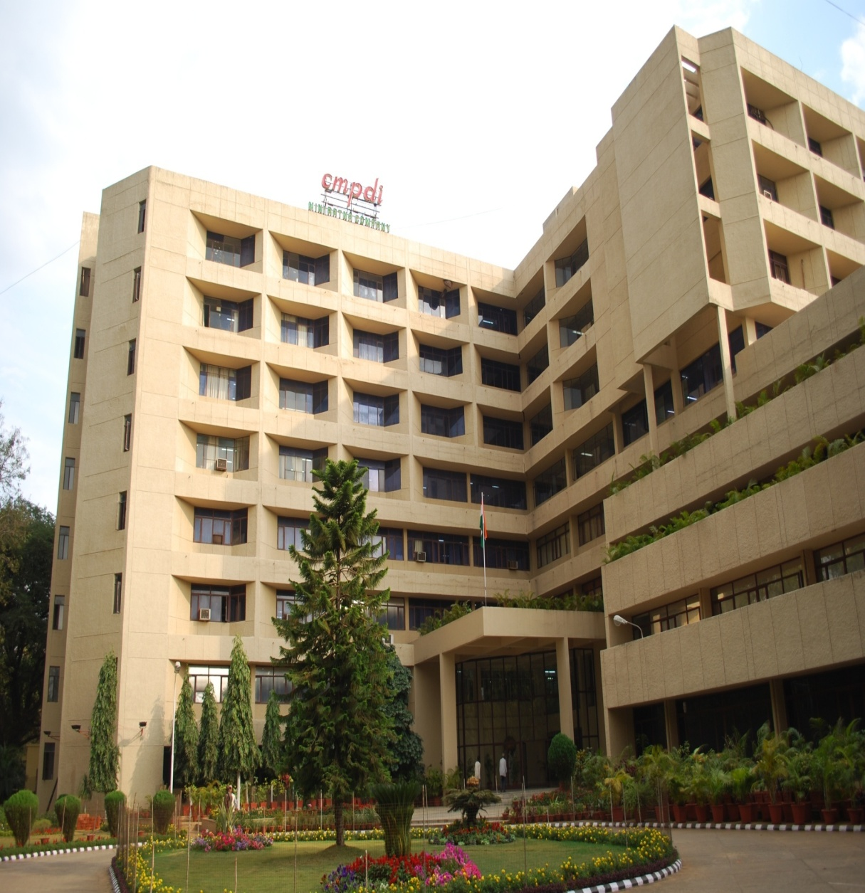
  CMPDI: Concept to Commissioning
  Providing complete range of Services to mineral, mining and allied sectors

Slide 3

Profile of Business
CMPDI provides its services to
Coal India Ltd
& its Subsidiaries
Ministry of Coal & Govt. Agencies
Outside-CIL Clients

Slide 4
CMPDI: An Introduction
CMPDI is a Government of India Schedule-B company having its Corporate headquarters at Ranchi (Jharkhand) India;
Fully owned subsidiary of Coal India Limited (CIL), established in 1975;
A Mini-Ratna Company providing consultancy services to various government & private organizations in exploration, mine planning and allied engineering services;
Accredited with ISO-27001 Certificate by Certification International (UK);
Environmental and Chemical Laboratories are accredited to National Accreditation Board for Testing and Calibration Laboratory (NABL) - ISO/IEC 17025:2005;
Certified to Operate "Health and Safety Management System" from OHSAS- ISO 18001:2007.

Slide 5
CMPDI: An Introduction …
In-house consultant to CIL & its subsidiary companies in Exploration, Mine Planning, Environmental Management and allied Engg Services
Imparts technical support to Ministry of Coal (MoC)
In Promotional Exploration & Detailed Exploration in Non - CIL blocks;
Identification of Captive Coal blocks;
For auction/allocation of captive coal blocks;
Coal based Non-conventional energy resources like CBM/CMM, UCG etc
Nodal agency for
Research Projects under S&T scheme of MoC;
CIL R&D Projects;
Development of CMM in India;
Development of UCG in India;
India CMM/CBM Clearinghouse under the aegis of MoC and US EPA is functioning from CMPDI.

Slide 6
CMPDI: A Registered International Consultant
CMPDI a registered consultants to:
  World Bank, Washington;
  Asian Development Bank, Manila;
  United Nations Development Programme (UNDP);
  National Development Corporation, Tanzania;
  Ministry of Mines & Petroleum, Muscat, Sultanate of Oman;
  Ministry of Coal Industry, Peoples' Republic of China;
  African Development Bank, Abidjan.

Slide 7
CMPDI: SPECIAL ACHIEVEMENTS
Adjudged the Best performing Subsidiary Company of CIL for the year 2008-09 as per MoU rating;
India CMM/CBM Clearinghouse is functioning in CMPDI, Ranchi (Jh) since November 2008 at the instance of CIL under the aegis of MoC and US EPA;
Awarded the Commendation Certificate of SCOPE Meritorious Award for R&D, Technology Development & Innovation for the year 2009-10;
Established state-of-the-art CBM Lab in 2008, conducting CBM/CMM and Shale Gas related studies;
Received Geospatial World Excellence Award 2012 in recognition of excellent usage of Geospatial technology for Land Reclamation Monitoring of Coal Mines;
Successfully implemented the UNDP/GEF-GoI funded demonstration project titled “CBM recovery and its Commercial Utilization” at Moonidih mine of BCCL (a subsidiary of CIL).

Slide 8
Network of CMPDI in India
Manpower (as on 01.3.2017)
Executive : 919
Non-Executive : 2589
Total : 3508
No. of Drilling Camps : 17
No. of Drill Machine : 64
Notes:
8

Slide 9
Coal: The Primary source of Energy in India
Main source of energy supply: meets about 53% needs of commercial energy
Coal plays a dominant role in energy supply of India
61% share in Power Generation
76% of Coal consumed in Power Generation
Studies indicate that coal will continue to be main source of energy in the foreseeable future

Slide 10
DEVELOPMENT OF CBM / CMM IN INDIA
CMPDI’S ENDEAVOR

Slide 11
CBM/CMM Development
CBM related studies by CMPDI started in early 1990s;
Thrust for CBM development came with pronouncement of CBM Policy in 1997 by the Govt of India;
MoP&NG was made administrative Ministry and DGH the Nodal agency for development of CBM in India;
Policy outlined attractive fiscal incentives & mode of CBM blocks allotment for commercial development through global bidding;
CMPDI played key role in identification and carving of the prospective CBM blocks;
Being repository of massive exploration and mine related data, CMPDI was assigned responsibility of identification of prospective CBM blocks and preparation of Data Dossiers for DGH;
CMPDI prepared most of the Data Dossiers of the awarded 33 CBM blocks in 4-rounds of bidding by the MoP&NG between 2001 to 2009.

Slide 12
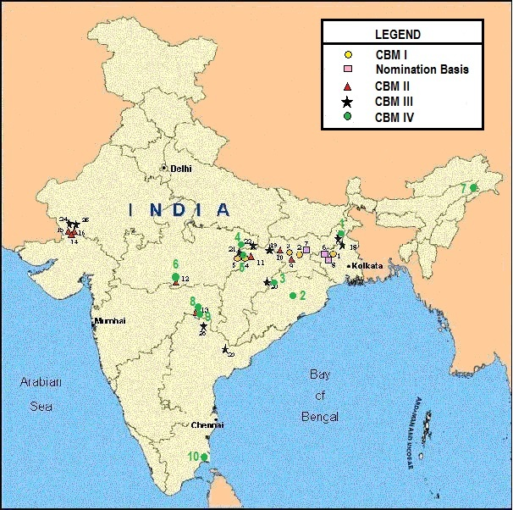
CBM Development in India: Present Status
Status of CBM development
33 CBM blocks awarded: Area 16613 Sq. Km;
Prognosticated Resource: 1.7 TCM (62.4 TCF);
Established GIP: 280 BCM (9.9 TCF);
Commercial Production since July 2007;
CBM Wells drilled: 926;
Blocks in Development/Exploration Phase: 9;
Many allotted blocks are under relinquishment or relinquished;
Current Production: 1.7 MMSCMD from 4 CBM blocks.

Slide 13
CBM/CMM Development: CMPDI’s Endeavour
CIL/CMPDI is pursuing commercial development of CBM in collaboration with ONGC in two CBM blocks namely Jharia and Raniganj North, both of which are in Development Phase;
These blocks were awarded to the consortium of CIL & ONGC on nomination basis in 2003. ONGC is the Operator for both the blocks;
The Field Development Plan (FDP) of both CBM block was approved in 2013;
PML for the Jharia CBM block granted in 2015 by Govt of Jharkhand. Incidental production is going on and full scale commercial production will start soon after resolving overlap / co-development issues.

Slide 14
Opportunities in CBM/CMM Development by CIL
India is bestowed with substantial reserves of coal (308 BT)
India is the 3rd largest producer of coal in the world;
CIL produced 536.5 MT of coal during FY 2015-16 contributing 84% of India’s total coal production of 639 MT;
Many of the Coalfields store high rank and Gassy coal seams, posing challenges in coal mining;
CMPDI plays proactive and important role which has facilitated CBM/CMM development in the country.

Slide 15
Opportunities in CBM/CMM Development by CIL
CIL operates about 413 coal mines of which 102 are Degree-II and 18 are Degree-III mines;
Since mining operation in CIL areas is very old, a good understanding has been developed regarding geo-mining conditions;
Target seams for CMM development are Virgin Coal seams lying below the active mining/ worked out/ goaved/ abandoned areas;
CIL is putting thrust on Mining of Deeper Coal deposits in near future;
Considering safety of mine personnel and enhance mine production safely Pre-drainage of methane will be taken up initially in gassy seams;
Further Corporate Objective of CIL is Green Mining, harnessing and utilization of Methane is priority.

Slide 16
CBM/CMM Development: CMPDI’s Endeavour
Successful Implementation of UNDP/GEF-GoI funded demonstration project on CBM/CMM by CMPDI & BCCL in Jharia coalfield proved the efficacy of CBM Technology in Indian Geo-mining conditions;
CMPDI also successfully implemented CIL R&D Project on Development of CMPDI Capacity for delineation of viable CMM/AMM blocks in the existing and would be mining areas in partly de-stressed coal and virgin coal seam;
Potential CMM blocks are identified and Data dossiers are under preparation for commercialization;
Towards capacity building and to acquaint with the processes of concurrent exploitation of coal and CMM/AMM, officials from CMPDI, BCCL, CCL visited operational sites of CBM, CMM/AMM and VAM projects in USA.

Slide 17
CBM/CMM Development: CMPDI’s Endeavour
Generates CBM specific data during exploration stage under Promotional Regional Exploration (PRE) Scheme;
CBM Lab Services: State – of – Art Laboratory established for CBM & Shale Gas parametric studies and Mine air analysis.
Generating CBM/Shale gas data under PRE
Coal/Lignite fields
State of art CBM Lab
CBM studies
Mine air analysis
Shale Gas studies

Slide 18
R&D Efforts for Development of CBM/CMM
R&D Projects on CBM/CMM in progress under Coal S&T Grant of MoC :
S&T Project on “Capacity Building for Extraction of CMM Resource within CIL Command Areas”; Implementing Agency - CMPDI and Sub Implementing Agency - CSIRO, Australia;
S&T Project on “CBM Reserve Estimation for Indian coalfields”: Principal Implementing Agency – IISTE, Shibpur; Sub Implementing agencies: NGRI Hyderabad, TCE Kolkata & CMPDI;

Slide 19
Development of CBM/CMM: Recent Initiatives by
CIL - CMPDI
Primafacie, Damodar Valley Coalfield appears promising for CBM/CMM development;
Initial steps have been taken up for commercial exploitation of CMM/CBM from Raniganj CF(Eastern Coalfields Ltd.) and Jharia CF(Bharat Coking Coal Limited);
Initiatives for Pre-drainage of methane from working seam in Moonidih mine taken up and an EoI has been invited with due date to receive offers on 10th March 2017.

Slide 20
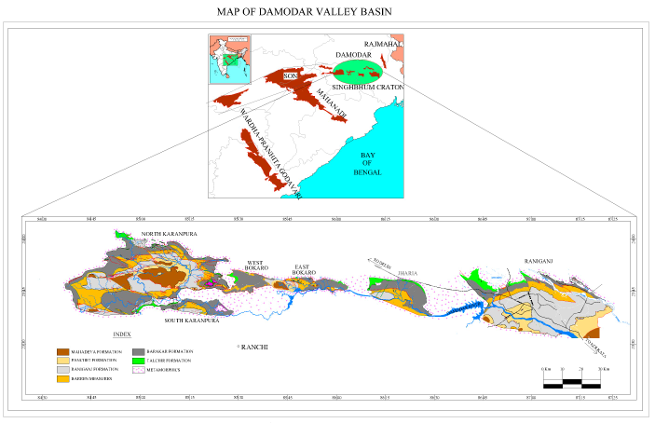

Slide 21
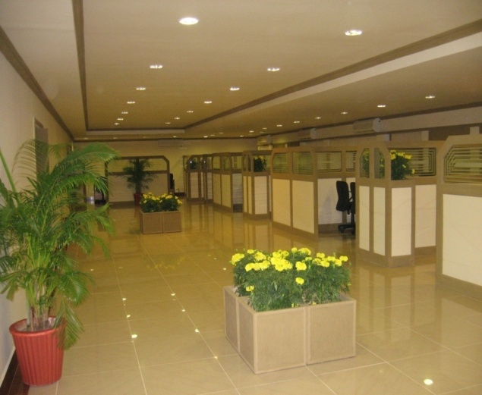
Thank You

