Slide 1
UN/CEFACT Projects in Confluence (new ODP)
http://www1.unece.org/cefact/platform/display/CNP/CEFACT+New+Projects
User Guidelines:
http://www1.unece.org/cefact/platform/display/CNP/User+Guidelines

Slide 2
Creation of new projects
After the approval of the Project proposal, the responsible PDA Vice Chair will request the UNECE secretariat to create the framework for the new Project into the Confluence system.
Once the empty project structure has been created into Confluence, the project editor/leader must fill in the appropriate project data.

Slide 3
Maintaining Project Information
To edit any information in Confluence, you need to log in with your ID and password.
Only selected accounts have edit rights.
The maintenance of Project Information is done at two levels (not automatically synchronized):
- Projects Overview
- Project Details

Slide 4
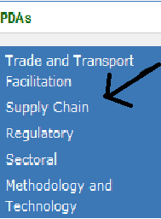
Maintaining Projects Overview Page
To edit the projects overview page, you need to navigate to the PDA where the project is located.
Click on the relevant link on the left, in the navigation menu (ex. Trade and Transport Facilitation, Supply Chain, etc)
Once the appropriate PDA page is displayed, you need to click on the
PDA XX – Project List hyperlink at the bottom of the page, in the children section of the page:

Slide 5
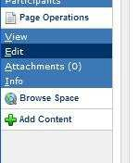
Maintaining Projects Overview Page
You have now reached the Projects Overview page of the appropriate PDA
To edit information on this page, click on Page Operations and
then Edit in the lower part of the left navigation panel

Slide 6
Maintaining Projects Overview Page
The Projects List can be edited via dropdown menus, by selecting the appropriate values and then by saving your changes, using the Save button on the top right of the page

Slide 7
Maintaining Projects: Projects List 1/2
In the Projects List you can edit and update the following information for each project:
Project Name the complete name or title of the project
Project Chair the name of the project chair, which must be one name of the list of registered users. If a project chair is not identified, please use "unknown".
Project Initiator name and contact of the person/organization that has requested the project, "unknown" otherwise.
Supporters if there is any supporter in the project. This is a hyperlink to the Supporters section of the Project Details page. The field has two possible values: yes if there are supporters, and no in the opposite case.

Slide 8
Maintaining Projects: Projects List 2/2
Extra Budgetary Resources if these are resources contributed to a UN Trust fund established in support of a project. Total budget available must be inserted here.
Start Date the official start date of the complete project.
End Date the approximate or official end date of the project. Whereby the end date is the end date of ODP Stage 7. It is the approximate end date as long as the ODP Step 7 is not finalized.
ODP1 - 7
Once all changes have been completed, please save the changes to the page using the Save button on the top right of the page.

Slide 9
Maintaining Projects Details Page
The project details page can be opened by clicking on the Project Number hyperlink in the PDA Project List Page

Slide 10
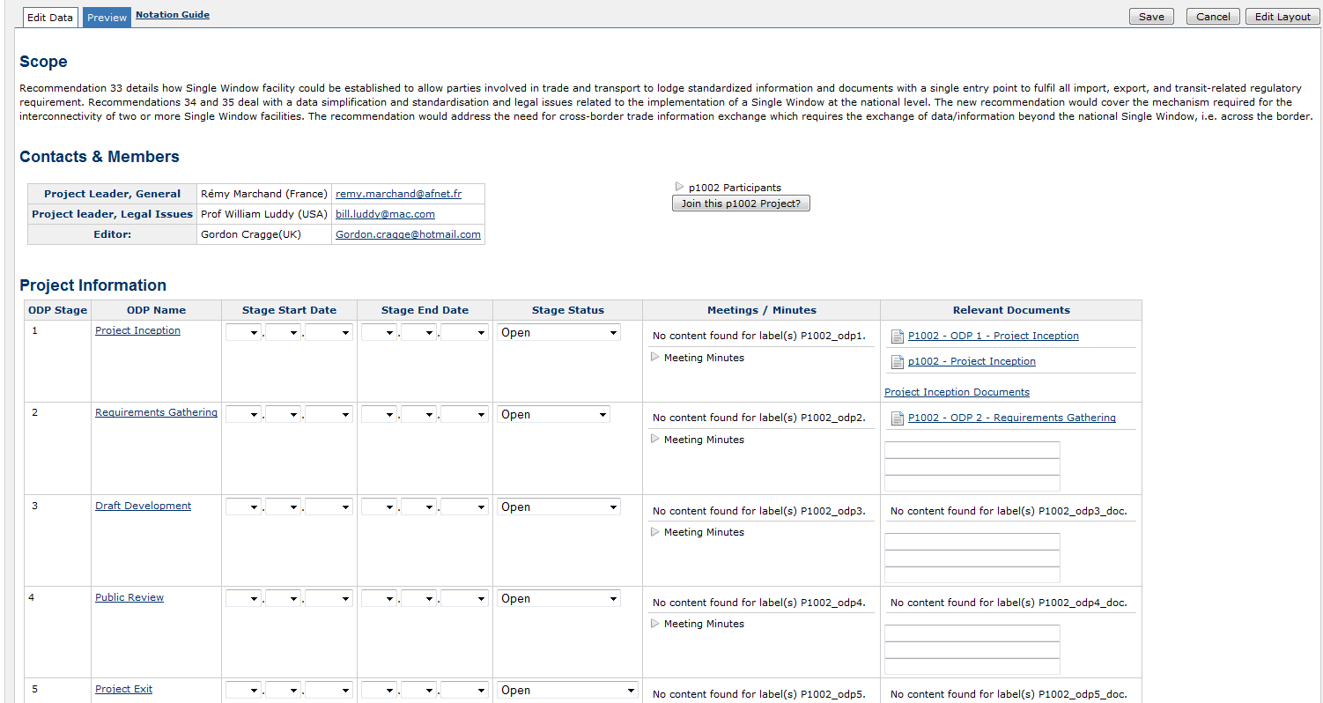
Maintaining Projects Details Page
The page will turn to edit mode and will appear like the following picture:

Slide 11
Maintaining Projects Details Page
To edit this section, the dropdown lists will help you. For each ODP stage, you can indicate the ODP stage Start and End Dates together with the planned dates and the stage status.
To add a document click on «Attachments»
and follow the instructions
Don’t forget to save your changes with the Save button at the top-right end side of the page.

Slide 12
For any other additional information:
maria.ceccarelli@unece.org

