Slide 1
25th UN/CEFACT Forum FLUX Project

Slide 2
1. State of Play

Slide 3
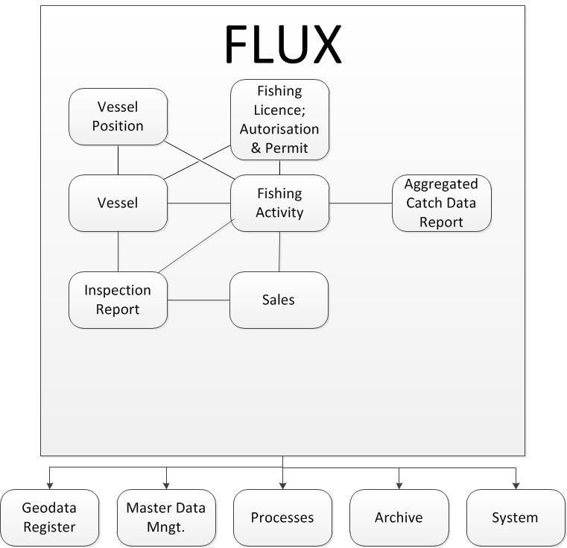
FLUX Business sub-domains
P1000 - 1; General principles
P1000 - 2; Vessel domain
P1000 - 3; Fishing Activity (FA) domain
P1000 - 5; Sale domain
P1000 - 7; Vessel Position domain
P1000 - 8; Inspection Report domain
P1000 - 9; Fishing Licence; Authorisation & Permit (FLAP) domain
P1000 - 10; Master Data Mngt. (MDM) domain
P1000 - 11; System domain
P1000 - 12; Aggregated Catch Data Report (ACDR) domain

Slide 4
FLUX Business sub-domains
P1000 - 1; General principles
P1000 - 2; Vessel domain
P1000 - 3; Fishing Activity (FA) domain
P1000 - 5; Sale domain
P1000 - 7; Vessel Position domain
P1000 - 8; Inspection Report domain
P1000 - 9; Fishing Licence; Authorisation & Permit (FLAP) domain
P1000 - 10; Master Data Mngt. (MDM) domain
P1000 - 11; System domain
P1000 - 12; Aggregated Catch Data Report (ACDR) domain

Slide 5
FLUX Business sub-domains
P1000 - 1; General principles
P1000 - 2; Vessel domain
P1000 - 3; Fishing Activity (FA) domain
P1000 - 5; Sale domain
P1000 - 7; Vessel Position domain
P1000 - 8; Inspection Report domain
P1000 - 9; Fishing Licence; Authorisation & Permit (FLAP) domain
P1000 - 10; Master Data Mngt. (MDM) domain
P1000 - 11; System domain
P1000 - 12; Aggregated Catch Data Report (ACDR) domain

Slide 6
UN/CEFACT Standardisation state of play
UN/CEFACT Standard – CCL 13B
P1000 - 1; General principles
P1000 - 7; Vessel Position domain
P1000 - 12; Aggregated Catch Data Report domain
UN/CEFACT Standard – CCL 14A
P1000 - 10; Master data register domain
UN/CEFACT Standard – CCL 14B
P1000 - 2; Vessel domain

Slide 7
Scheduled standardised domains
CCL 15A (in progress)
P1000 - 2; Vessel v2
P1000 - 9; Fishing Licence; Authorisation & Permit (FLAP) domain
P1000 - 5; Sales domain
CCL 15B
P1000 - 3; Fishing Activity domain
P1000 - 11; System domain
P1000 - 7; Vessel Position domain Upgrade (Including Query mechanism)

Slide 8
2. Fishing Activity (FA)

Slide 9
Business Requirements
Based on reporting of vessel activities (eLogbook)
From the vessel departure to return to port
Includes Landing & Transshipment
Transmission between Fisheries Monitoring Centers (FMCs)
Vessel reports to FMC.
FMC transmits reported (enriched) information to others.
Two ways transmission
Reporting & Query/Response messages.

Slide 10
Information Requirements
Vessel activities events (not exhaustive):
Departure
Return to port
Fishing Operation: report on daily activity or after catch operation (haul-by-haul).
Enter into/Exit from area: entering or leaving a particular fishing zone (e.g.: NAFO regulatory area)
Loading/Unloading operation:
Landing
Transshipment
Relocation
Discard At Sea

Slide 11
Reported data
Fishing data
Species & quantity.
Catch area.
Event date & time
Gear used.
Added data (link to other domains)
Vessel identification
Link to vessel characteristics (FA -> FLUX Vessel domain).
Licence/Authorization Document
Link to FLAP document (FA -> FLUX FLAP domain).
Trip identification
Grouping events to clearly identify dependencies. (to be used by other domains for linking to FA).

Slide 12
Notification vs. Declaration
Fishing Activity Events can be either:
Notification: event will happen in the future
Declaration: event has already happened.
Event | Notification | Declaration
Departure | X | X
FishingOperation |  | X
ReturnToPort | X | X
EntryIntoArea | X | X
ExitFromArea | X | X
Unloading - Landing - Transhipment - Relocation - DiscardAtSea | X X X | X X X X
Loading - Transhipment - Relocation | X X | X X

Slide 13
Workflows
2 ways of exchanging data
Reporting of Fishing Activity messages by the flag state
Notifications
Logbook data
Landing & Transshipment declarations
Querying for of Fishing Activity by the Coastal State or RFMO
Only for logbook data
Landing & Transshipment declarations

Slide 14
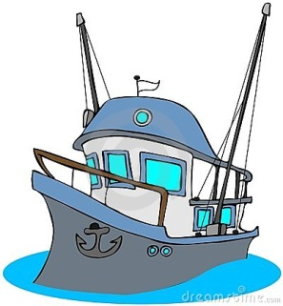
Workflow Push (Report)
HTTPS
SOAP
FLUX Network (Transport Layer)
Transmission @event
Transmission daily
RFMO
FLUX FA
(XML)
Vessel
Coastal State
FLUX system
Flag State
FLUX system
Performing
Fishing Activities
=> events

Slide 15
Workflow Pull (Query)
FLUX Network (Transport Layer)
Query
Vessel
Period
…
Coastal State
FLUX system
Response
eLOG
Flag State
FLUX system
Logbook data

Slide 16
Assumptions
Report ownership
One and only one report owner.
The authority providing FA information takes the ownership of the data.
Report Date & Time
Only one.
When the report has been received and confirmed by authority.
Trip identification
Minimum one & more
e.g.: RFC 4122
Human readable
Can be centrally registered.
Coherency control.

Slide 17
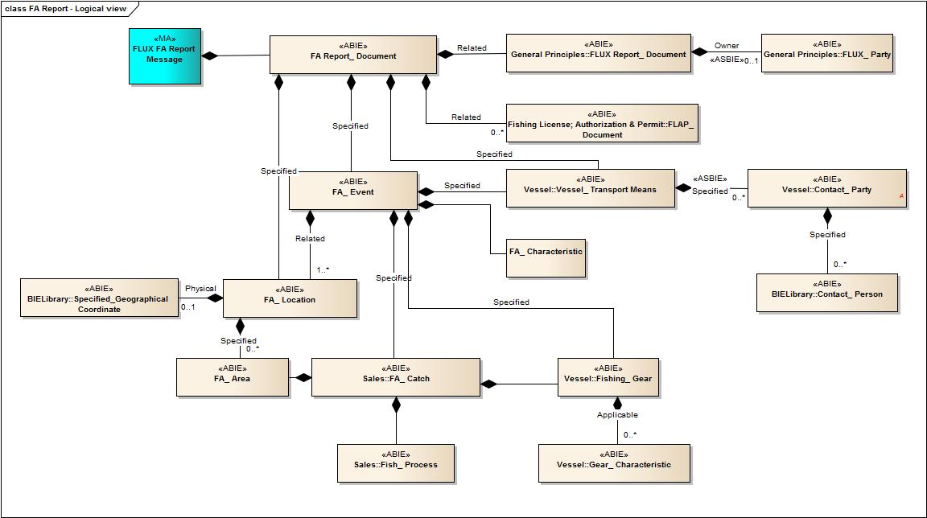
Report logical view
General Principles
FLAP
Vessel

Slide 18
3. System domain

Slide 19
Business Requirements
Auditing FLUX implementation
What version of FLUX standard is implemented?
What part of FLUX standard (profile) is implemented?
Handshaking protocol before exchanging messages e.g. What mechanism is used for providing FA data (Push only – Push/Pull – Pull only)
Informative messages
Downtime period.
Contact person.

Slide 20
Reported data
Flexibility
Similar to Master Data Management (MDM) data model.
Type + Value mechanism.

Slide 21
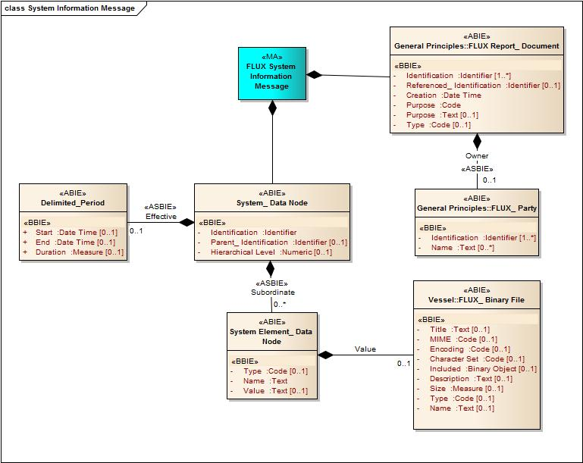
FLUX System Report Data Model

Slide 22
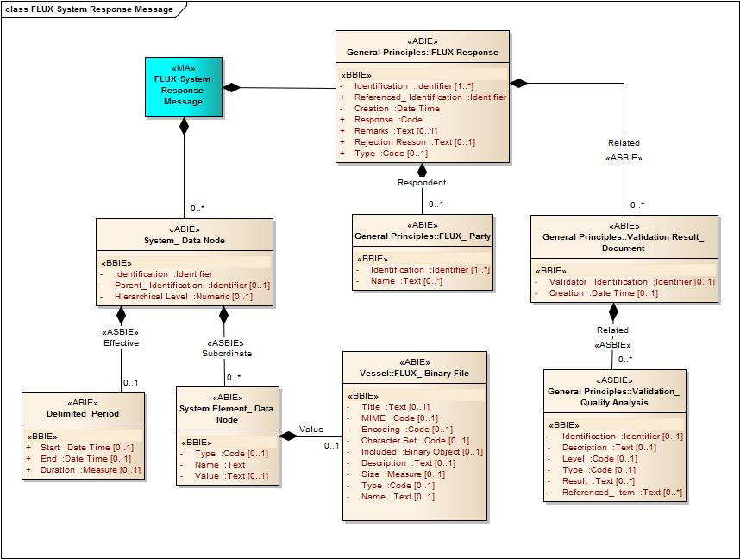
FLUX System Response Data Model

