Slide 1
Innovation policy for sustainable development by Azerbaijan Rashad Azizov Head of Innovational Development Department Ministry of Transport, Communication and High Technologies Regional Capacity Building Workshop on “Innovation Strategy, Technology Applications and Infrastructure for the SDGs” (Baku, Azerbaijan, July 4th ,2018)

Slide 2
INNOVATION POLICY OF AZERBAIJAN: challenges & opportunities
SDG

Slide 3
INNOVATION POLICY OF AZERBAIJAN: challenges & opportunities
The principles of the innovative policy aimed at achieving of SDG in the SPEСA countries
 | Basic principles | SDG
 |  | 1 | 2 | 3 | 4 | 5 | 6 | 7 | 8 | 9 | 10 | 11 | 12 | 13 | 14 | 15 | 16 | 17
 | Expansion and deepening of a role of innovations in policies in the field of sustainable development | х | х | х | х | х | х | х | х | х | х | х | х | х | х | х | х | х
 | Innovations for the policies in the field of sustainable development have to be inclusive and collaborative | х |  | х |  | х | х |  | х |  |  |  |  |  |  |  | х
 | Stimulation of elimination of backlog in technological development as the engine of growth and a push to achievement of SDG |  | х |  |  |  |  | х | х | х |  | х |  | х
 | Strengthening of the productive capabilities of the country necessary for innovations and innovative development |  |  | х | х | х |  | х | х |  |  |  |  |  |  |  | х
 | Support of the business connected with innovative initiatives in the field of sustainable development. | х |  | х | х |  |  | х |  | х | х
 | Assistance to access to financing for innovative initiatives in the field of sustainable development |  | х |  |  | х |  |  | х | х |  | х
 | Innovations in agriculture for achievement of SDG | х | х |  |  | х |  |  | х |  | х |  | х
 | Based on innovations policy program, supported by measures depending on the demand |  |  | х |  |  | х | х | х | х |  | х | х | х
 | The solution of the common cross-border problems by means of the coordinated joint efforts and cooperation |  | х |  |  |  | х | х |  |  |  |  |  | х |  | х | х | х
 | Involvement of the key parties interested in joint innovative initiatives in the field of sustainable development by means of cooperation |  |  |  |  | х | х |  |  | х |  |  | х | х |  | х |  | х
 | Increase of awareness on the role of innovations in efforts of the countries of SPECA on achievement of SDG | х | х | х | х | х | х | х | х | х | х | х | х | х | х | х | х | х

Slide 4
INNOVATION POLICY OF AZERBAIJAN: challenges & opportunities
GOAL 9. TARGETS
Enhance scientific research, upgrade the technological capabilities of industrial sectors in all countries, in particular developing countries, including, by 2030, encouraging innovation and substantially increasing the number of research and development workers per 1 million people and public and private research and development spending
Support domestic technology development, research and innovation in developing countries, including by ensuring a conducive policy environment for, inter alia, industrial diversification and value addition to commodities

Slide 5
INNOVATION POLICY OF AZERBAIJAN: challenges & opportunities

Slide 6
INNOVATION POLICY OF AZERBAIJAN: challenges & opportunities
The roadmap of innovation for Azerbaijan

Slide 7
INNOVATION POLICY OF AZERBAIJAN: challenges & opportunities
The roadmap of innovation for Azerbaijan

Slide 8
INNOVATION POLICY OF AZERBAIJAN: challenges & opportunities
Defining Strategic Objectives of innovation policy shall focus on 5 main points
Growth of Non-Oil Economy.
Informatization.
Agriculture.
ICT Startups.
Manufacturing.

Slide 9
INNOVATION POLICY OF AZERBAIJAN: challenges & opportunities
SWOT Analysis
(Strengths, Weaknesses, Opportunities, Threats)
S
STRENGHTS
W
WEAKNESS
O
OPPORTUNITIES
T
THREATS
Strong Executive Branch of Government
Strong Organizational Capabilities for National Scale Infrastructure Projects
Ample Capital for Investment in Infrastructure
Using a Cooperative Internal Market to Stimulate Innovation
Competition and Duplication Between Ministries
Intellectual Property Creation and Protection
Available Economies of Scale
Capital Formation in Private Sector
Language
Entrenched Educational Establishment and Development of Human Resources
Instability in Price of Oil and Gas
Depletion of Reserves
Brain Drain
Powerful Neighbors; Unstable Neighbors
Emergence of Global Industrial Networks
XaaS Infrastructure and Supercomputing Platform
Artificial Intelligence.
MOOCs

Slide 10
INNOVATION POLICY OF AZERBAIJAN: challenges & opportunities
Internal Strengths
Strong Executive Branch of Government
Strong Organizational Capabilities for National Scale Infrastructure Projects
Ample Capital for Investment in Infrastructure
Using a Cooperative Internal Market to Stimulate Innovation

Slide 11
INNOVATION POLICY OF AZERBAIJAN: challenges & opportunities
Internal Weakness
Competition and Duplication Between Ministries
Intellectual Property Creation and Protection
Available Economies of Scale
Capital Formation in Private Sector
Language
Entrenched Educational Establishment and Development of Human Resources

Slide 12
INNOVATION POLICY OF AZERBAIJAN: challenges & opportunities
External Opportunities
Emergence of Global Industrial Networks
XaaS Infrastructure and Supercomputing Platform
Artificial Intelligence.
MOOCs

Slide 13
INNOVATION POLICY OF AZERBAIJAN: challenges & opportunities
External Threats
Instability in Price of Oil and Gas
Depletion of Reserves
Brain Drain
Powerful Neighbors; Unstable Neighbors

Slide 14
INNOVATION POLICY OF AZERBAIJAN: challenges & opportunities
RoadMap for National Planning

Slide 15
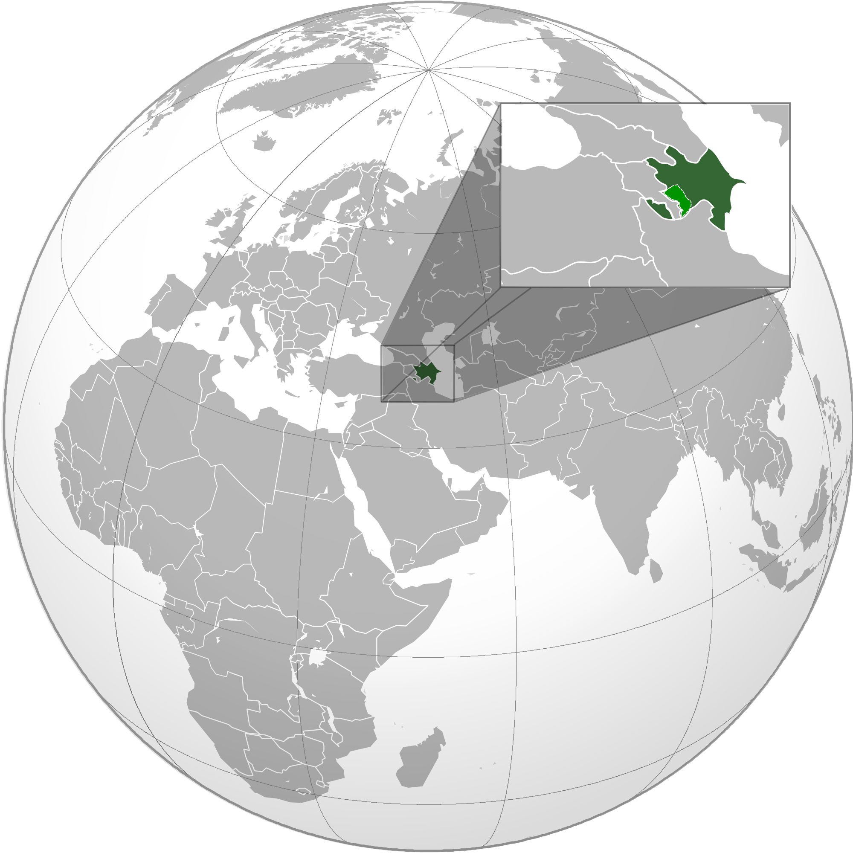
INNOVATION POLICY OF AZERBAIJAN: challenges & opportunities
The key task of innovative policy is not only to integrate innovation and new technology into Azerbaijan’s economy, but instead the task is to integrate Azerbaijan’s economy into the global economy.

Slide 16
INNOVATION POLICY OF AZERBAIJAN: challenges & opportunities
Thanks for your attention!

