Slide 1
Informal document GRSG-117-05
(117th GRSG, 8-11 October 2019
Agenda item 19)
Chinese Mandatory National Standard
GB “Automobile Event Data Recorder system”

Slide 2
Framework
发展历程
发展历程
Terms and Definitions
Technical Requirements
Appearance and Identification
Test Methods and Requirements
C-EDR
Manual
Implementation
Annex
Type Inspection

Slide 3
Content
发展历程
发展历程
Technical Requirements
Impact Event Requirements
Data Record Requirements
Data Function Requirements
Data Retrieval Requirements

Slide 4
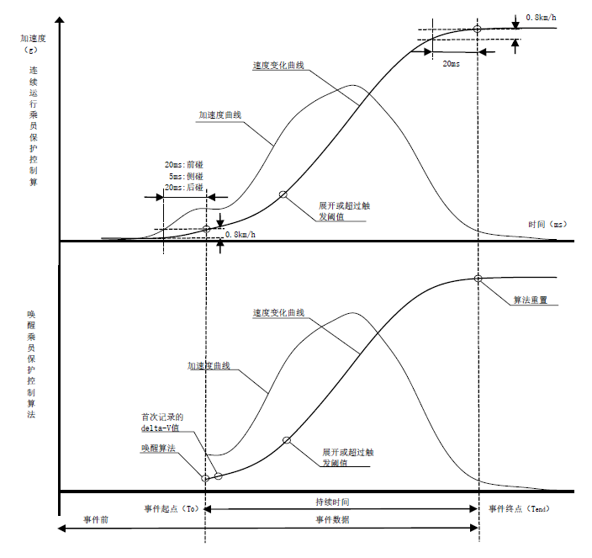
Content
发展历程
发展历程
IMPACT EVENT REQUIREMENTS
Trigger Threshold
Locking Condition
Beginning of Event
End of Impact Event

Slide 5
Content
DATA RECORD REQUIREMENTS
Relevant data that can be recorded when the vehicle is featured with specific functions or equipped specific devices.

Slide 6
Content
DATA RECORD REQUIREMENTS
Longitudinal
acceleration
Lateral
acceleration
Lateral
delta-V
Maximum Recorded
Lateral delta-V
Square of Maximum
Recorded Resultant
delta-V
Time to Maximum
Recorded delta-V
lateral
B
Time to Maximum Recorded delta-V，Resultant
Pre-event
synchronization
timing time
Yaw Angle
Velocity
Steering
Angle
Steering Lamp
Status
Working status and event status
Tend
Gear
Position
Engine Throttle Position
Brake Pedal
Position
Parking System
Status
Occupant Protection
System Warning Status
Tire Pressure Monitoring System
Warning Status
Braking System Warning
Status
Level B Data
Element
Driver’s front airbag
Deployment time （phase I）
Driver’s front airbag
Deployment time
（phase II）
Front-row passenger
seat belt Status
Driver’s seat belt pretensioner
Deployment time
Driver’s side air curtain
Deployment time
Driver’s side airbag
Deployment time
Restraint system
Front-row passenger seat belt pretensioner
Deployment time
Front-row passenger ‘s front airbag suppression status
Front-row passenger ‘s front airbag
Deployment time(phase I)
Front-row passenger ‘s front airbag
Deployment time（phase II）
Front-row passenger’s side airbag
Deployment time
Front-row passenger’s side air curtain
Deployment time
Active system
Cruise Control
system status
Adaptive Cruise
Control system status
Anti-brake system
status
AEB status
Electronic stability
control system status
Traction control
system status
Time
Year
Month
Day
Hour
Minute
Second

Slide 7
Content
DATA RECORD FUNCTION REQUIREMENTS
Storage media and storage frequency requirements
Learning from relevant research, 94% of the accidents will be covered when EDR records 3 events , while only 84% when EDR records 2 events.
Depends on different forms or phases, an accident can be recorded as several events.
Non-volatile storage medium
At least 3 times of impact event data.

Slide 8
Content
DATA RECORD FUNCTION REQUIREMENTS
Storage coverage mechanism requirements
Power-off storage requirements
Unlocked event data should be overwritten by subsequent un-locked event data, in chronological order.
Locked event data should not be overwritten by data from subsequent events.
For unlocked events, the manufacturer is allowed to set other storage coverage mechanisms.
Data before T0 and after T0 to (150±10) ms should be recorded.

Slide 9
Content
DATA RETRIEVAL REQUIREMENTS
Unified data retrieval protocol
2
1
Unified data retrieval connector
GB/T 34589-2017“Road Vehicles diagnostic connector”
√ Use diagnostic service 0x22“ReadDatabyIdentifier“ in ISO 14229 “Road Vehicles unified diagnostic service " to retrieve EDR data.
√ compatible with CAN bus and k-line.
√ Compatible with functional addressing and physical addressing
√ Compatible with 11-bit and 29-bit CANID
3
Unified data retrieval ID
0xFA13, 0xFA14 and 0xFA15
Where,
0xFA13 for the most recent event,
0xFA14 for the second event from the bottom,
0xFA15 for the third event from the bottom.
Unified data arrangement
4
Unified data range, accuracy, resolution and data arrangement order

Slide 10
Content
TEST METHODS
Test Methods
MEASURE
IMPACT TEST
DRIVER OPERATION DATA TEST
BENCH TEST
After the existed mandatory impact test, following two requirements are checked:
(1) Requirement conformance of post crash time-series
data (EDR delta-V or acceleration data ): the EDR output is compared with the reference
accelerometer sensor data.
And there is no delta-V data clipping, or acceleration data outrange
(2) Survivability: the EDR system shall completely record all data.
After the EDR is triggered, the requirement conformance of pre-crash driver operation data elements are checked.
Pedal：certain stroke
Steering wheel： certain angle
Safe belt buckle：locked
Lamp：ON
Electronic/electric systems recorded by EDR shall be set and kept on
Note: the EDR can be triggered in any way, e.g.
-- impact the vehicle
-- fix the vehicle on the trolley, and impact the trolley
-- physically trigger the EDR
-- input trigger signal to the EDR
The following EDR requirements are checked :
EDR trigger performance
Event storage times
Storage overwrite mechanism
Power off storage performance
by thrusting the EDR controller using a electromagnetic thruster to physically generating relevant impact waveform.
Note: A test box is required to simulate the real vehicle peripheral signals or loads except for the EDR delta-V or acceleration signal during bench test.

Slide 11
Summary
When we developed the C-EDR standard , the following factors were considered:
International standards and regulations;
Chinese traffic condition;
Requirements of Traffic Accident Identification Agency and Ministry of Public Security
……
A large number of vehicle manufacturers and component suppliers all over the world have been taken part in this standard's development.
We would like to share the experience of C-EDR standard development to WP.29 .

Slide 12
Thank you for your attention!

