Slide 1
Transport statistics during COVID19-crisis in Finland
Sami Lahtinen & Matti Kokkonen 17.6.2020

Slide 2
Start of the crisis
Finland’s government declared state of emergency in March 16 to prevent COVID19 epidemic break out
Schools were closed for two months
Biggest region Uusimaa was locked down for 19 days
Travelling was banned
Hotels were closed, only take-away meals
Otherwise Finnish society remained open
Shops were open and there was no curfew

Slide 3
Situation now in society
Arrangements were effective and there was no COVID19 epidemic broke out in Finland during spring
Finnish society is now moving to state of normal at this moment
Government takes actions according to how the situation is developing

Slide 4
Transport statistics
Transport statistics in Finland is mainly based on register data
Working from home has been succesful
transport statistics production has been at quite normal level
Freely available open data on
ship movements
air, road and rail traffic

Slide 5
Transport indicators
Road traffics flows have been followed in media to monitor
at first if there is a big fall-off in traffic
then how recovery proceeds
Use of mobile phone data to map distribution of crowd and movements between regions
anonymous data
to help government’s decision-making

Slide 6
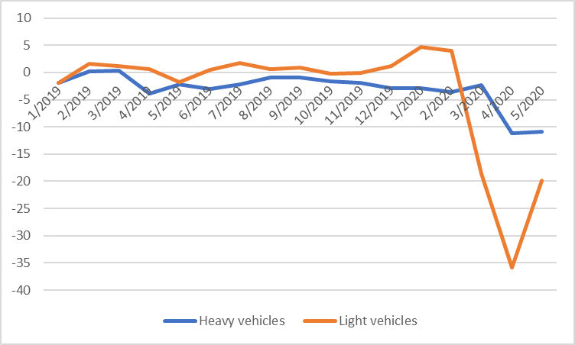
Monthly change (%) of traffic flows in Finland from the corresponding month of the previous year.

Slide 7
Statistics Finland nowcasting the real output of Finland
open traffic flow data of trucks from 120 automatic responders in the region Uusimaa
Eurostat economic sentiment indicator (ESI)
to nowcast the real output in Finland, monthly development of the national economy
Results published monthly for previous and for the current month (5-8 days since beginning of month)
High correlation between Trend indicator of Output and traffic flows of trucks
The model used is a random forest model from program R caret package. The estimate uses only one model.

Slide 8
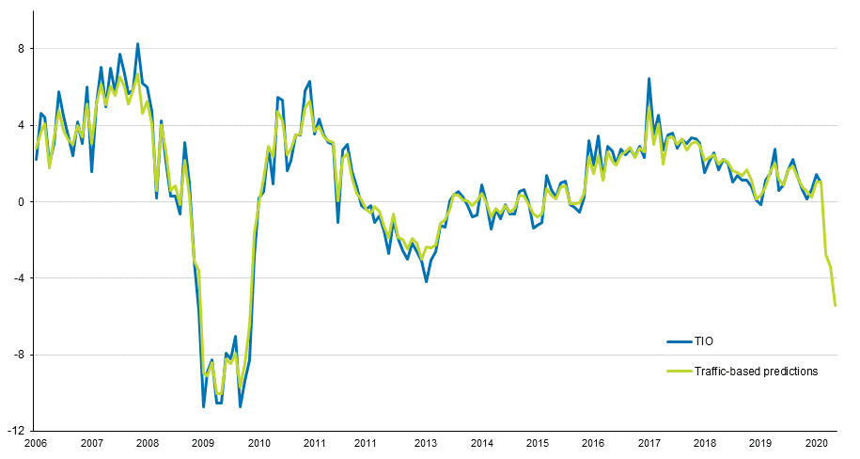
Year-on-year growth rate of the trend indicator of output (TIO) and predictions obtained from the model. Both are expressed in percentage points.

Slide 9
More information and the results on TIO indicator can be found from Statistics Finland website
For more information:
sami.lahtinen@stat.fi
matti.kokkonen@stat.fi

