Slide 1
Please keep your microphone muted
Veuillez désactiver votre microphone
Пожалуйста, отключите микрофон

Slide 2
Session 3 (Friday 11:00)
Urban transport statistics
UNECE collection of tram and metro statistics.
Netherlands’ efforts to obtain public transport data.
Administrative and Programme management
Realigning our work to the ITC strategy to 2030
Chair election
Two business-critical decisions. See draft decisions in informal doc 3.
Views on a draft publication: measuring and monitoring SDGs in the ECE region
Member state ideas for future meeting topics

Slide 3
Housekeeping
Please keep your microphone muted at all times, unless speaking.
Turning video off typically means your sound quality will be better.
Audio issues? https://statswiki.unece.org/display/MWHW/Webex+Audio+Troubleshooting
Use raise my hand to request an intervention, or ask directly in chat.
Use the chat function. While presentations are ongoing, the chat can be used to share questions and interventions, but also quick comments, remarks, links etc. This makes for a more interesting meeting.

Slide 4
Overview
Background: formal document 5. See unece.org/trans/main/wp6/doc_2020.html
Need for Data
Pilot Questionnaire
Measurement
Public transport data confidentiality
Dissemination of the results
What next?

Slide 5
Urban mobility
Understanding urban mobility crucial to achievement of SDGs.
City-specific data lose value when combined at the national level. Public transport levels in one city may be insignificant on a national basis, even when the principal form of mobility in one or more cities. E.g. the tube is “only” about 10% of public transport journeys in England by distance, and ≈1.5% of all journeys.
No tram or metro statistics collected at the international level, despite being principal mode of transport in many cities.
Data for buses are hard to split between urban/local and inter-urban/long distance. Tram and metro systems don’t have this problem.
Timely public transport data even more crucial in post-lockdown world.

Slide 6
UNECE Pilot Questionnaire
Based on discussions at 2019 meeting, UNECE sent out a survey to NSOs on the number of tram and metro systems, and if data were available. Data availability was typically excellent. Data available for 25 countries, 140+ cities.
(Albania, Cyprus, Lithuania, Moldova, North Macedonia, Slovenia etc. have no operational tram or metro systems).
Questionnaire was kept SIMPLE. Just passenger numbers and passenger-km, for each separate system.

Slide 8
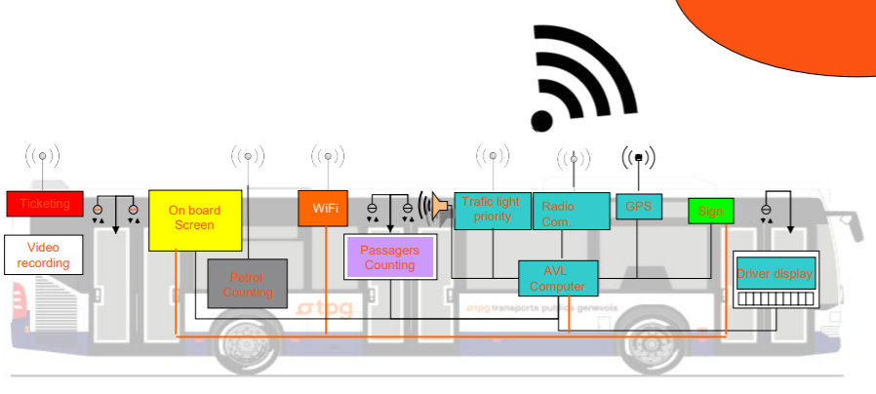
Source: TPG www.unece.org/fileadmin/DAM/trans/doc/2019/wp6/Presentations/TPGED-_274000-v1-Pr%C3%A9sentation_UNECE_-_GT_Statistiques_transport_-_12_jui....pdf

Slide 9
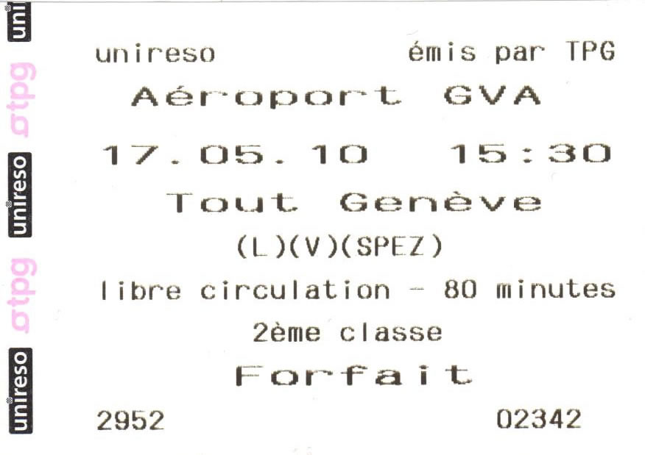
Comparability challenges
How are passenger numbers collected?
5 countries: ticket sales only
8 countries: sensors, supplemented with ticket information
4 countries: only surveys
5 countries: sales and surveys
Will ticket sales data be comparable with sensor data? Depends if the sensor data are adjusted for transfers, or how the ticketing system works?
No significant difference in average journey length found between these cases.
Passenger data mixed with other transport modes (bus, ferries)
Inevitable if urban transport operations are integrated.
Are estimates of each mode available from sensors or service levels?
Data summed for the entire country, and/or completely confidential.

Slide 10
Data Validation
Without any history of data collection, data validation was limited:
Order of magnitude checks fixed some countries (x1000, missing digits etc.) Most of the data seemed reasonable, based on city/system size/population. Some checking against known country sources done.
Check of passenger-km per passenger highlighted a few series to question.

Slide 11
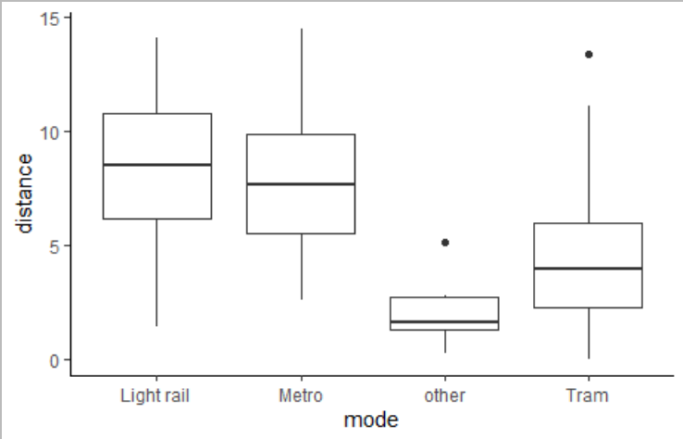
Average distances higher for metro and light rail than tram journeys. Light rail systems in Denmark, UK and US only. But definition issues (Sheffield “Supertram” is classed as light rail.)

Slide 12
Cities with both tram and metro systems, passenger distances

Slide 13
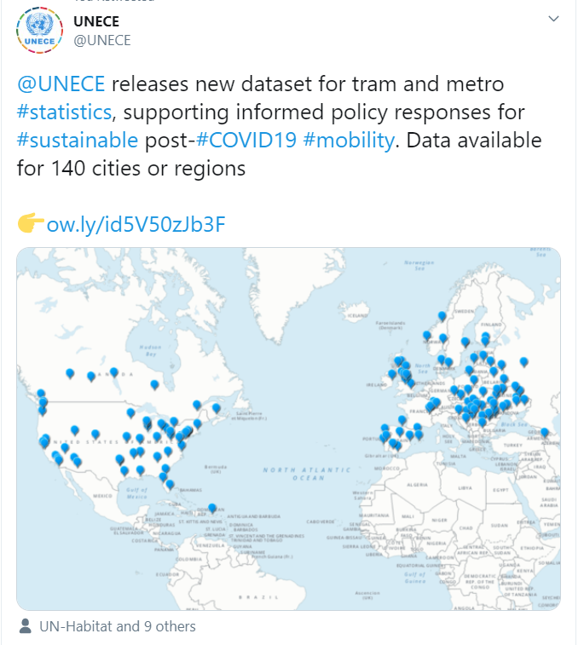
Dissemination
Due to city-breakdown, data cannot be disseminated using normal structured cubes.
So a simple CSV file was disseminated.
Is this sufficient for analytical needs?
Any suggestions for dissemination improvements?
https://unece.maps.arcgis.com/apps/webappviewer/index.html?id=921546a18d184a6aa96904cb4eb0f37a

Slide 14
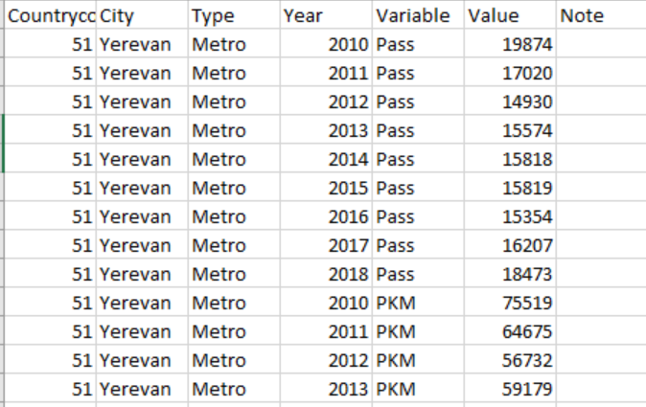
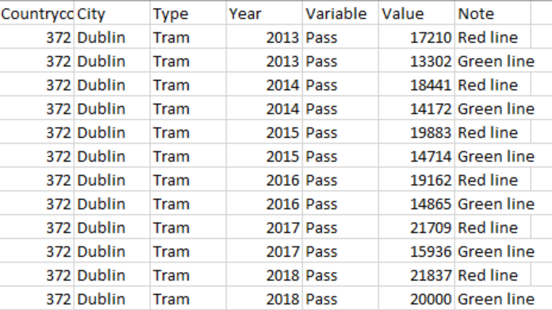
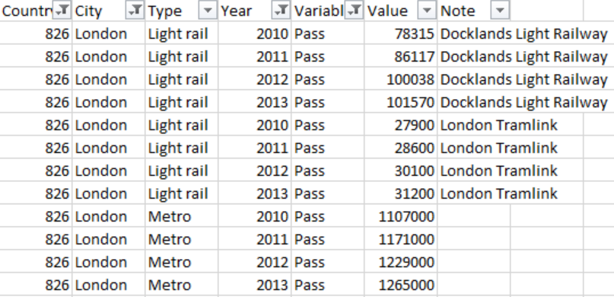
City/system type combination normally enough to identify a system. (E.g. Geneva/Tram). If not, the Note column was used (to e.g. distinguish the DLR from South London tramlink).

Slide 15
A Few Results
LONDON: passenger numbers show that the Underground and Docklands Light Rail are the transport modes that have most increased since 2010.
Latvia: Tram journeys were the second most frequented public transport mode in Latvia (after buses), beating trolleybuses, rail and air.
Out of 36 metro systems, 25 saw growth in recent years whereas 11 saw decreases. London, Warsaw, Helsinki, Sofia and Cleveland (US) all saw passenger numbers grow by more than 25%.
For trams, the picture was more mixed. 22 cities saw passenger numbers grow, whereas 25 saw passenger numbers decrease. Among the strongest growers were cities in Sweden, Ukraine and also San Francisco and Seattle. Dublin’s tram system ,which only opened in 2004, has grown strongly since 2010, with a 52% increase in passenger numbers.

Slide 16
Confidentiality
Shouldn’t public transport data be public?
When a monopoly operates a metro system, with no real competition and subsidized by the government, should normal confidentiality rules apply?
Some “confidential” data are openly published on transport company websites.
Do countries have experience in resolving this?

Slide 17
What next?
This is a very easy dataset to collect, with important uses for monitoring sustainable travel, post-COVD19 response, SDGs 9.1.2 and 11.2.1.
Even if comparability affects cross-country comparisons, growth rates are very useful.
UNECE is open to changing the collection structure to help countries. Any well-structured data files (or API links) would work well for us.
What about timeliness? If these are coming from admin data sources is there any way to speed things up, or have monthly/quarterly updates?
What do you think?

