Slide 1
UNECE Informal Meeting of the Working Party on Transport Statistics: Housekeeping and SDG Introduction

Slide 2
Meeting Format
Without interpretation, the “meeting” proper cannot be held.
The meeting will therefore be informal. There will be no meeting report.
Our discussions will be summarized and can inform any subsequent session of WP.6.
Only business critical decisions will be taken, which are subject to a 10 day silence procedure, after having been circulated to all in English/French/Russian (see informal document 3).

Slide 3
Housekeeping
Please keep your microphone muted at all times, unless speaking.
Audio problems? Try this page statswiki.unece.org/display/MWHW/Webex+Audio+Troubleshooting
Turning video off typically means your sound quality will be better.
Use the raise my hand function to request an intervention.
Use the chat function. While presentations are ongoing, the chat can be used to share questions and interventions, but also quick comments, remarks, links etc. This makes for a more interesting meeting.
For technical questions, send us a private chat message.

Slide 4
Meeting Agenda (all times are Geneva time)
Session 1 (Wednesday 10:30)
Transport Related SDGs
Update from the Secretariat on Data production for SDG 3.6.1
Canada Transport SDG Monitoring (11.2.1)
SLOCAT update on Voluntary National Reviews
Secretariat methodology work on 9.1.2
ReCAP update on work on rural access 9.1.1
Session 2 (Wednesday 14:30)
Country experiences in using transport statistics to track COVID19
Ireland
United Kingdom
United States
Canada
Russian Federation
Netherlands
Sweden
Finland
Canada
UNECE wiki data collation
General discussion, and road safety focus
Session 3 (Friday 11:00)
Urban transport statistics
UNECE collection of tram and metro statistics.
Netherlands’ offorts to obtain public transport data
Administrative matters
Realigning our work to the ITC strategy to 2030
Chair election
Two business-critical decisions. See draft decisions in informal document number 3.
Views on a draft publication: measuring and monitoring SDGs in the ECE region

Slide 5
WP.6: a Forum to discuss transport SDG monitoring
Achieving the SDGs is central to UNECE Inland Transport Strategy to 2030
WP.6 role until now: producing relevant, accurate and timely statistics on 3.6.1 and 9.1.2.
WP.6 role in future: helping countries improve their sustainable transport monitoring activities.
Countries are encouraged to share their experiences of including transport in their Voluntary National Reviews, National Reporting Platforms, SDG reports etc.
Further discussions on this can be facilitated throughout the year. Methodology work can be shared through the UNECE wiki.

Slide 6
3.6.1: Road safety: Halving the number of road accident fatalities by 2020 by 2030.
UNECE Publication, data disaggregation & focus on vulnerable road users
Timeliness of road safety data (afternoon session)
9.1.2: Resilient infrastructure: Passenger and freight volumes, by mode of transport.
UNECE Work on 9.1.2 methodology
Promoting this indicator for use as a post-lockdown modal split tracker
9.1.1: Resilient infrastructure: Proportion of the rural population who live within 2km of an all-season road
ReCAP: Rural Access Index
11.2.1: Public transport access: Proportion of urban population within 500m of a transport stop.
Tracking public transport use (UNECE Tram and Metros) (Friday session)
Canada work on public transport proximity
SLOCAT: Monitoring Transport in VNRs

Slide 7
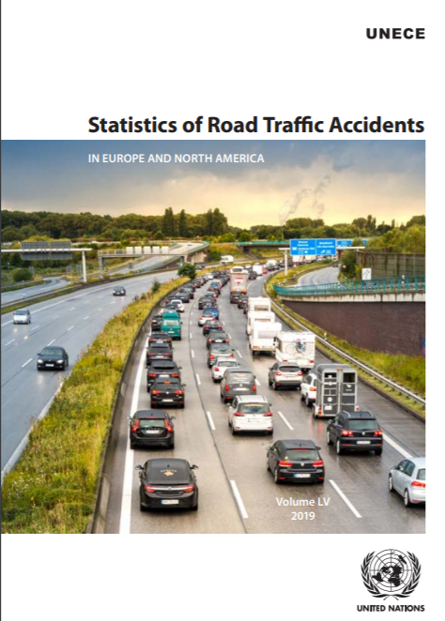
UNECE Work on SDG 3.6
Latest publication released in April 2020, data up to 2018.
Excellent official data availability, with 54 of 56 ECE countries having top-level data for 2017, many with 2018 data.
Tables updated to concentrate on indicators that most countries have data for.
Historically our data tables have been updated every two years, for this publication. This year we will move towards annual updates.

Slide 8
UNECE Regional Progress to Achieve 3.6.1
2017 was a 10% reduction compared to 2010 (SDG base year). No indication (before COVID) that the 50% target would be met by 2020.
Brilliant progress (+40% reductions) in some countries show what is possible.
But increases in some countries since 2010…

Slide 9
No-one Left Behind: Vulnerable road users
Change in fatality numbers of different road users *Average of available UNECE countries
Source: UNECE database

Slide 10
Importance of data disaggregation
Three quarters of road fatalities are men (but pedestrian fatalities are closer to 50/50). Disaggregated data means policy tools can be better formulated and targeted.
41 ECE countries have gender breakdown in 2017; 43 break down road user.
Fatalities in Austria, 2017

Slide 11
UNECE Statistics New Dissemination Tools
https://w3.unece.org/SDG/Home

Slide 12
Road accidents: What’s Happening in 2020?

