Slide 1
Informal document GRBP-71-06
Agenda item 5 (d)
Standard Reference Test Tyre replacement
GRBP session 71, January 2020
European Tyre and Rim Technical Organisation

Slide 2

Replacement SRTT
  Background
  Current Situation
  Activities from ASTM F1805 snow spin traction test
  ETRTO activities for R117 snow braking test – test matrix
  Result analysis
  Conclusions
  Recommendations
European Tyre and Rim Technical Organisation

Slide 3
Replacement SRTT
1. Background
C1- SRTT14 (ASTM E1136) will be phased out:
  Production will stop mid of 2020
  Sales end is approximately end of 2021
Snow performance test in R117 currently requires SRTT14 as a reference tyre
➔ SRTT14 needs to be replaced and test procedure amended
SRTT16 (ASTM F2493) is already available and used for Wet Grip test in R117
Approach is to establish a calculation factor to correlate results vs SRTT16 with those vs SRTT14 and keep current thresholds:
European Tyre and Rim Technical Organisation

Slide 4
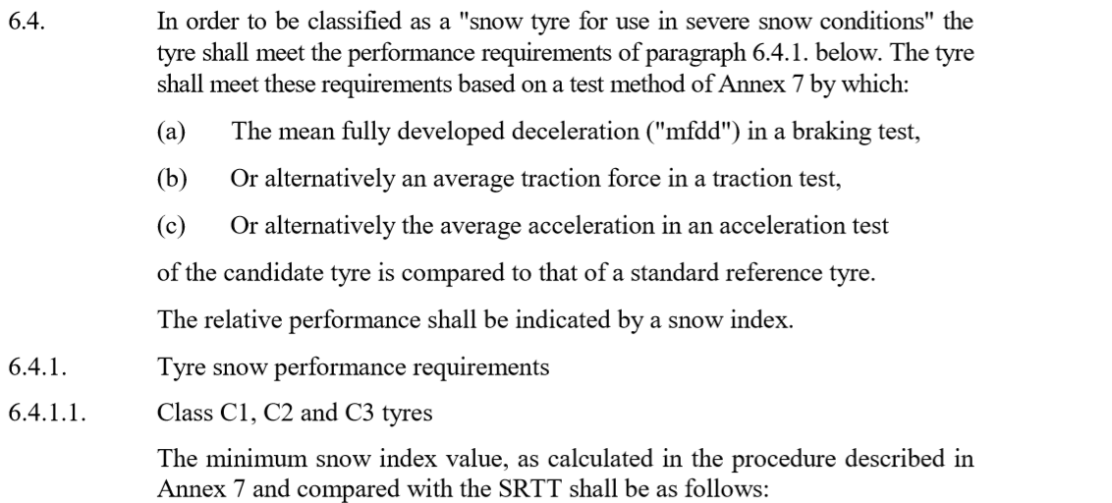
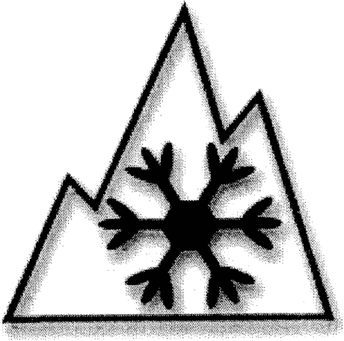
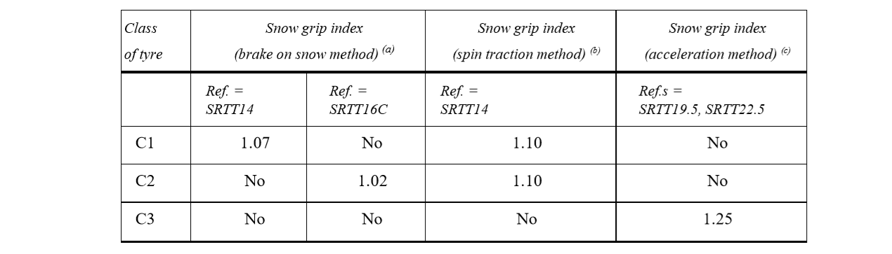
Replacement SRTT
2. Current Situation - Specifications according to UN R117
C1 Braking test
C1/C2 Spin traction test
European Tyre and Rim Technical Organisation

Slide 5
Replacement SRTT
2. Current Situation - Specifications according to UN R117
Braking on Snow Method for C1 :
Vehicle: market available vehicles
Reference Tyre: SRTT14 (P195/75 R 14 Tiger Paw)
Tyre Configuration: all axle positions
Tyre Condition: broken-in
Snow surface: packed snow with CTI 75 – 85
Ambient Temperature: -2°C to -15°C
Surface Temperature: -4°C to -15°C
Initial Speed: higher than 28 km/h
Braking down to min. 8 km/h or less
Recorded Measure: Average deceleration form 25 down to 10 km/h
European Tyre and Rim Technical Organisation

Slide 6
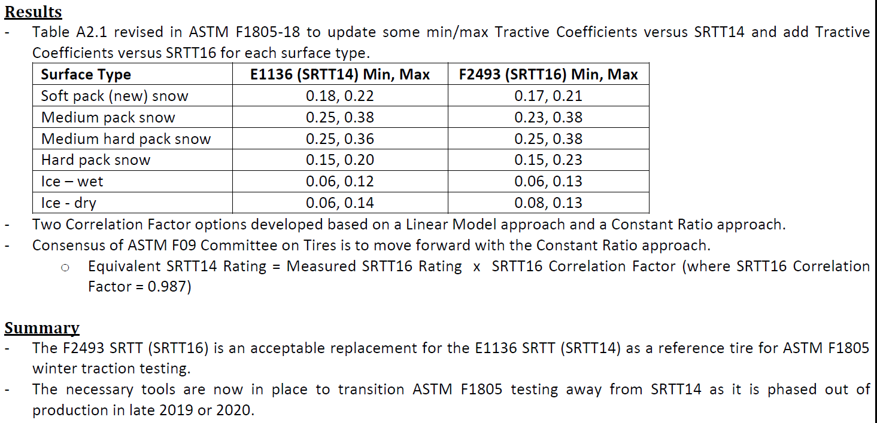
Replacement SRTT
3. Activities of ASTM for spin traction test method
ASTM is going to replace SRTT14 by SRTT16 by establishing
a correlation factor for medium packed snow
Considered SRTT16 µ coefficient of 0,23-0,38 an
the calculation of the average SRTT16 / SRTT14 ratio yields a value 0,987 as shown in the below
section from ASTM report on E1136 to F2493 SRTT Transition for ASTM F1805
European Tyre and Rim Technical Organisation

Slide 7
Replacement SRTT
4. ETRTO activities for R117 snow braking test
Test Program with ETRTO Members (SRTT14 replacement by SRTT16)
(Direct comparison: Reference set is the ASTM SRTT (P195/75 R 14 92S = 100%)
Temperature variation: 4 temperature segments are used from -2°C down to < -21°C
Snow compaction (CTI) variations: results are generated in a range from CTI 73 to 88
  in order to cover the legal R117 range (75 to 85 CTI)
  and to generate sufficient overlap with the ASTM F1805 test method
    medium packed snow → CTI 70 .. 80
    medium hard packed snow → CTI 80 .. 84
    Hard packed snow → CTI 84 .. 93
Indoor / Outdoor (land/lake) test location are used
8 different tire companies produced 55 test results with 38 results within the allowed range of testing conditions for temperature and snow compaction of R117. Temperature range was extended to ensure the stability of the correlation.
R117 range
European Tyre and Rim Technical Organisation

Slide 8
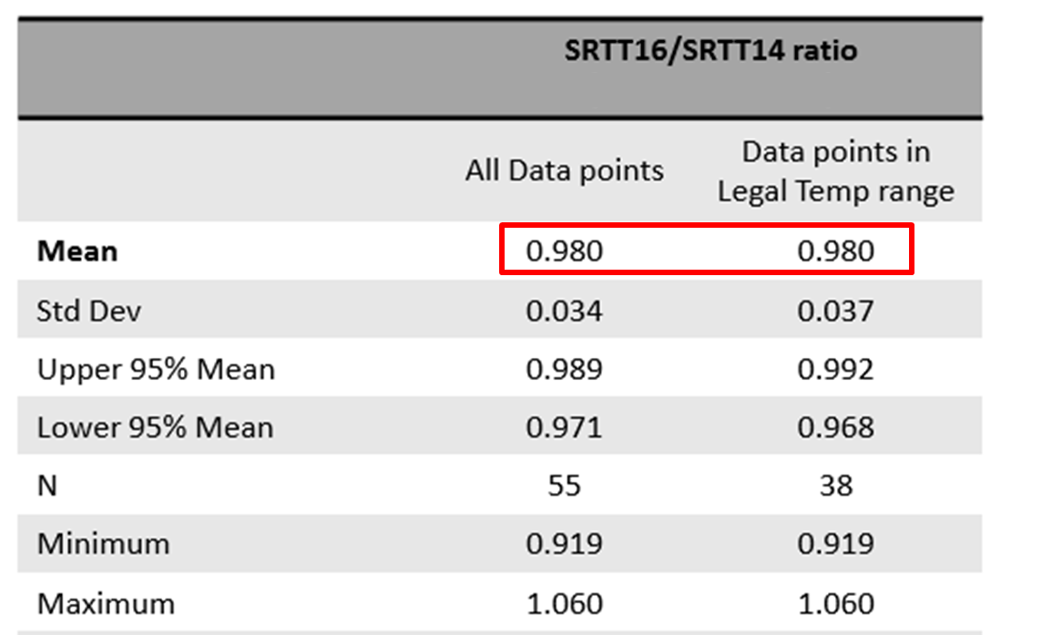
Replacement SRTT
5. Result Analysis – Statistical Analysis
European Tyre and Rim Technical Organisation

Slide 9
Replacement SRTT
6. Conclusions
After deep analysis of all available data and taking into consideration the statistical analyses, the following agreed conclusions can be stated:
  Average snow performance (SGI) of SRTT16 is 0.98 for snow braking method
  (vs. SRTT14, excl. outliers)
  This result is very close to the ASTM spin traction study → factor = 0,987
➔ Calculation factor method is also possible for snow braking test so that exisiting threshold (107% vs. SRTT14) can be kept.
European Tyre and Rim Technical Organisation

Slide 10
Replacement SRTT
7. Recommendations
  Use for both test methods (snow braking and spin traction) the calculated corresponding correlation factors (SRTT14 – SRTT16) in order to keep both thresholds
  (spin traction snow: 110%; snow braking: 107%) untouched!
  That means to introduce a calculation formula for snow braking test with a similar correlation factor than ASTM spin traction test:
    SGI₍₁₄₎ = SGI₍₁₆₎ x 0,980
    SGI₍₁₄₎ = snow grip index of candidate vs. SRTT14 (calculation reference)
    SGI₍₁₆₎ = snow grip index of candidate vs. SRTT16 (test reference)
    0,980 = correlation factor for change to SRTT16
    Transition provision proposal:
      Adequate transitional provisions need to be considered
      It is recommended to use the SRTT14 not longer than until September 2024
      During this period both SRTTs can be used for performing snow performance tests
      (in case of using SRTT14: w/o calculation formula)
    A working document will be presented at the next GRBP session in September 2020
European Tyre and Rim Technical Organisation

Slide 11
Appendix
European Tyre and Rim Technical Organisation

Slide 12
Replacement SRTT
Motivation
Motivation for Replacement SRTT14
C1- SRTT14 will be phased out:
  Michelin will stop production mid of 2020
  Sales end is appr. end of 2021
  → replacement is needed
Feasibility of using (C1) SRTT16 (P225/60R16 Tiger Paw) as replacement of (C1) SRTT14
  Worldwide availability is given
  SRTT16 already in use for R117 wet grip testing
Creating data base for assessment (and further correlation with ASTM results)
  Conduction snow braking tests under different conditions
  Developing a robust correlation formula/factor for future use
European Tyre and Rim Technical Organisation

Slide 13
Replacement SRTT
Result Analysis – Overview Test Results
European Tyre and Rim Technical Organisation

Slide 14
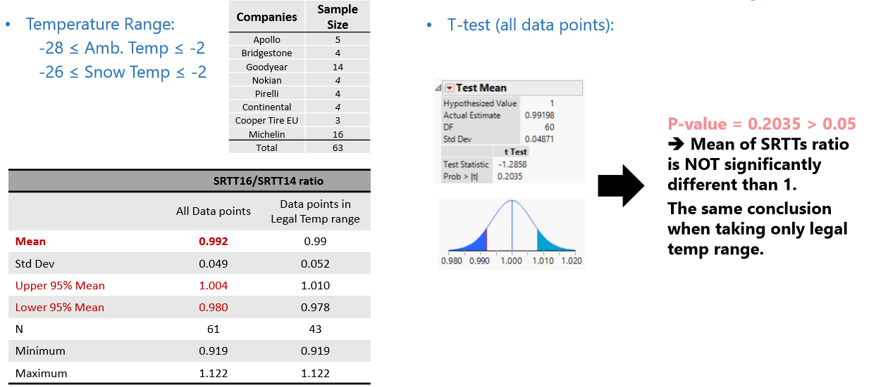
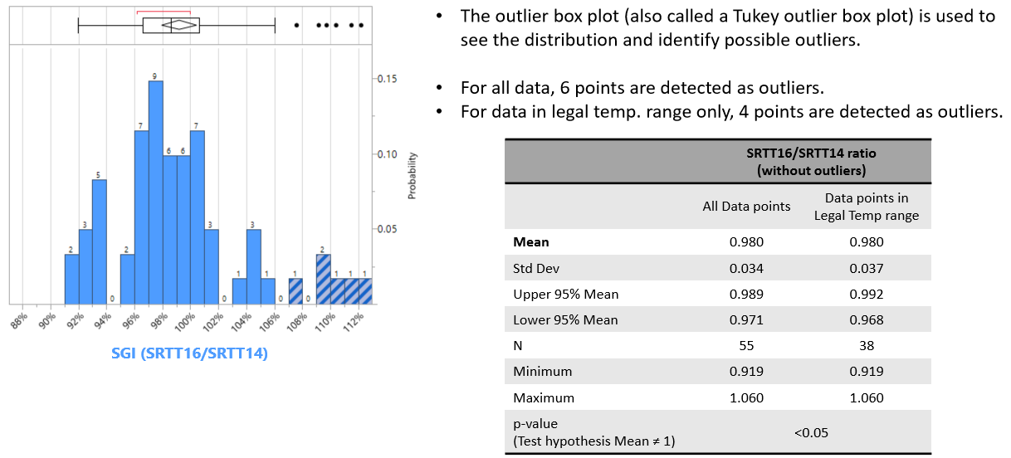
Replacement SRTT
Result Analysis – Deeper Statistical Analysis
A
B
C
D
E
F
G
H
European Tyre and Rim Technical Organisation

