Slide 1
Submitted by the experts from CLEPA | Informal document GRAV-04-27 GRAV-04, 23 -27 September 2019 Agenda item 8(c)
UN R13 and Electro Mechanical Brakes

Slide 2
UN R13 and Electro Mechanical Brakes (EMB) Introduction
UN Regulation 13 defines:
Transmission means the combination of components comprised between the control and the brake and linking them functionally. The transmission may be mechanical, hydraulic, pneumatic, electric or mixed.
Control Transmission - means the combination of the components of the transmission which control the operation of the brakes, including the control function and the necessary reserve(s) of energy.
Energy Transmission - means the combination of the components which supply to the brakes the necessary energy for their function, including the reserve(s) of energy necessary for the operation of the brakes.
→ The transmission may be mechanical, hydraulic, pneumatic, electric or mixed.
UN R13 was updated in 1990s to account for an electronic “Control Transmission” but still assumes Pneumatic “Energy Transmission” in the service braking system.
Pneumatic Energy limitation is shown in two ways: Design Specifications – E.g. Where limits are in kPa. Design Limitations – E.g. Where it is assumed air is the medium.

Slide 3
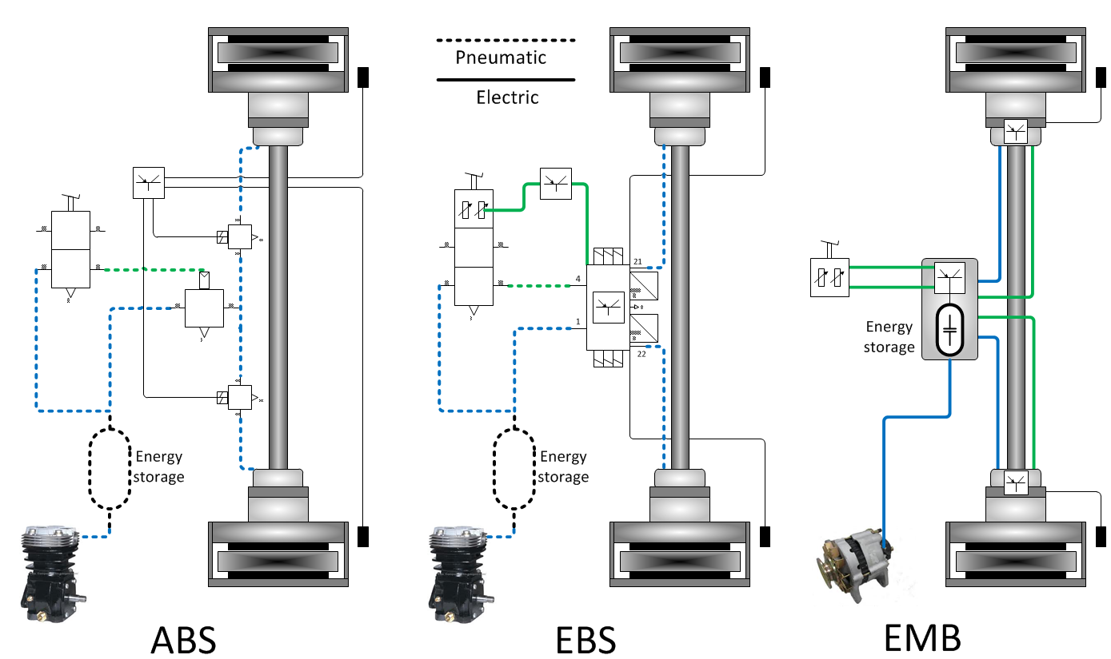
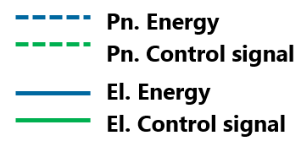
UN R13 and Electro Mechanical Brakes (EMB) Development steps comparison
*
* Other architectures or different Energy storage strategy are possible (e.g. EHB - Electro-Hydraulic Brake, EMB double axle and double battery)

Slide 4
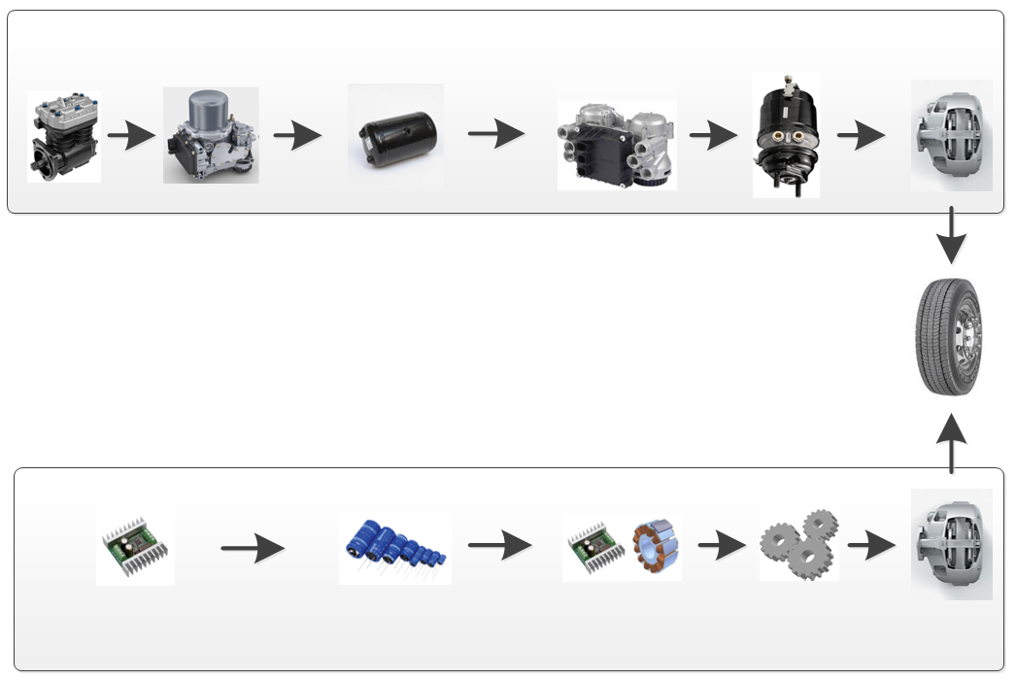
UN R13 and Electro Mechanical Brakes (EMB) Schematics of brake Systems
Compressor
E-APU
Air reservoir
storage
EBS Modulator
Actuator
Caliper
Pneumatic
Energy
EBS
Annex 7 part A
Energy supply
Energy storage
Actuation
EMB
Annex 7 new part D
New 5.2.1.34.
Electric
Energy
DC/DC
Electric energy storage
Drive and Motor
Gears
Caliper
4

Slide 5
ECE-R13 and Electro Mechanical Brakes (EMB) Main parts to be amended
2. Definitions
New paragraphs defining Electric Energy Transmission ( e,g Energy Source, Electrical Storage device, Electrical Supply device)
5.1.4.6 Reference Braking forces
New paragraph 5.1.4.6.2.
Reference braking forces for electro-mechanical braking system using a roller brake tester shall be defined according to the following requirements.
5.2 Characteristics of Braking Systems.
New paragraph 5.2.1.34.
Special additional requirements for service braking systems with electric control and energy transmissions.
Annex 7, (provisions relating to energy supply and storage)
New Part D
Electro-mechanical Braking system

Slide 6
UN R13 and Electro Mechanical Brakes (EMB) Summary and outlook
Expected advantages by introducing Electric Energy Transmission to UN R13
Improved energy efficiency in EV´s (vs. air compressor).
Improved braking control.
Elimination of noise from pneumatics.
A proposal for amending the text of UN R13 is in preparation by the Industry (brake system suppliers supported by vehicle manufacturers )
Initial focus on motor vehicles
Inclusion of Electric Energy Transmission in service braking systems
Comments from the delegates of GRVA are welcome before end of November
Industry will introduce an informal document for GRVA 05 in February 2020

