Slide 1
Proposals from the Informal Working Group on AEBS
Informal Working Group on AEBS for Light Vehicles
New Regulation
Informal document GRVA-02-28
2nd GRVA, 28 Jan. - 1 Feb. 2019, Agenda item 6
For a
New UN Regulation
Chair and Secretary IWG AEBS – GRVA 02

Slide 2
Informal Working Group on AEBS for Light Vehicles
New Regulation
This presentation show the proposal for a new UN Regulation on AEBS (GRVA-2019-05)
The objective is a vote in GRVA in January 2019 for the first stage of this Regulation. Pending and open issues are clarified by GRVA.
Guidance from GRVA
Especially the red frame in this ppt shows that guidance from GRVA is necessary.
Chair and Secretary IWG AEBS – GRVA 02

Slide 3
Informal Working Group on AEBS for Light Vehicles
Activities based on TOR (GRRF-84-03)
IWG meetings 3rd meeting in Brussels (19-20 February 2018)
4th meeting in Tokyo (16-17 May 2018)
5th meeting in London (26-27 June 2018)
Draft proposal for 1st GRVA in September 2018
(Informal document GRVA-01-02)
IWG meetings 6th meeting in Paris (1-2 October 2018)
7th meeting in Geneva (13-14 November 2018)
Proposal for 2nd GRVA in January 2019 as Working document (GRVA-2019-05)
Chair and Secretary IWG AEBS – GRVA 02

Slide 4
Informal Working Group on AEBS for Light Vehicles
GRVA-2019-05 - Draft Proposal for a new UN Regulation on AEBS (M1/N1)
Scope
Definitions
Specifications
General
Car to Car (C2C) scenario
Car to Pedestrian (C2P) scenario
Car to Bicycle (C2B) scenario
Interruption by the Driver
Manual deactivation
Warning Indication
Provisions for the Periodic Technical Inspection
Test Procedure for each scenario
Failure Detection Test , Deactivation Test
Green means common specifications in each scenario
Chair and Secretary IWG AEBS – GRVA 02

Slide 5
Summary of Guidance from GRVA
Manual deactivation
Requirement of N1 full cab vehicle
3. Implementation of Car to Pedestrian scenario
4. Maximum Impact Speed above 45 km/h
for Car to Pedestrian scenario in 2nd step
5. Reference of standards
Chair and Secretary IWG AEBS – GRVA 02

Slide 6
Informal Working Group on AEBS for Light Vehicles
Specifications - Manual deactivation
Guidance from GRVA
The group also discussed the possibility of a manual deactivation of the AEBS function. The compromise reached was that such a switch could be allowed but switching off the AEBS should not be too easy. However this compromise was not unanimously supported by all Contracting parties.
Chair and Secretary IWG AEBS – GRVA 02

Slide 7
Informal Working Group on AEBS for Light Vehicles
Specifications - Car to car scenario – Rear-end collision
z
z
z
Moving and Stationary targets
1st Stage
Collision Warning
Collision warning:
At the latest 0,8 seconds before the start of emergency braking
Activation Speed:
The system shall be active at least within the vehicle speed range between 10 km/h and 60 km/h and at all vehicle load conditions
2nd Stage
Emergency Braking
Emergency Braking:
A braking demand of at least 5.0 m/s² to the service braking system of the vehicle
Damage Mitigation or Collision Avoidance
Chair and Secretary IWG AEBS – GRVA 02

Slide 8
Informal Working Group on AEBS for Light Vehicles
Specifications - Car to car scenario - Speed reduction by braking demand
Collision avoidance for M1 vehicle:
Stationary: until 40km/h (Laden), until 42km/h (Unladen)
Moving: until 40km/h (Laden), until 42km/h (Unladen)
Collision avoidance for N1 vehicle:
Stationary: until 38km/h (Laden), until 42km/h (Unladen)
Moving: until 38km/h (Laden), until 42km/h (Unladen)
Maximum relative Impact Speed (km/h) for N1 vehicle
Maximum relative Impact Speed (km/h) for M1 vehicle
Relative Speed (km/h) | Stationary |  | Moving
 | Laden | Unladen | Laden | Unladen
10 | 0.00 | 0.00 | 0.00 | 0.00
15 | 0.00 | 0.00 | 0.00 | 0.00
20 | 0.00 | 0.00 | 0.00 | 0.00
25 | 0.00 | 0.00 | 0.00 | 0.00
30 | 0.00 | 0.00 | 0.00 | 0.00
35 | 0.00 | 0.00 | 0.00 | 0.00
40 | 0.00 | 0.00 | 0.00 | 0.00
42 | 10.00 | 0.00 | - | 0.00
45 | 15.00 | 15.00 | - | -
50 | 25.00 | 25.00 | - | -
55 | 30.00 | 30.00 | - | -
60 | 35.00 | 35.00 | - | -
Relative Speed (km/h) | Stationary |  | Moving
 | Laden | Unladen | Laden | Unladen
10 | 0.00 | 0.00 | 0.00 | 0.00
15 | 0.00 | 0.00 | 0.00 | 0.00
20 | 0.00 | 0.00 | 0.00 | 0.00
25 | 0.00 | 0.00 | 0.00 | 0.00
30 | 0.00 | 0.00 | 0.00 | 0.00
35 | 0.00 | 0.00 | 0.00 | 0.00
38 | 0.00 | 0.00 | 0.00 | 0.00
40 | 10 | 0.00 | - | 0.00
42 | 15 | 0.00 | - | 0.00
45 | 20.00 | 15.00 | - | -
50 | 25.00 | 25.00 | - | -
55 | 35.00 | 30.00 | - | -
60 | 40.00 | 35.00 | - | -
Chair and Secretary IWG AEBS – GRVA 02

Slide 9
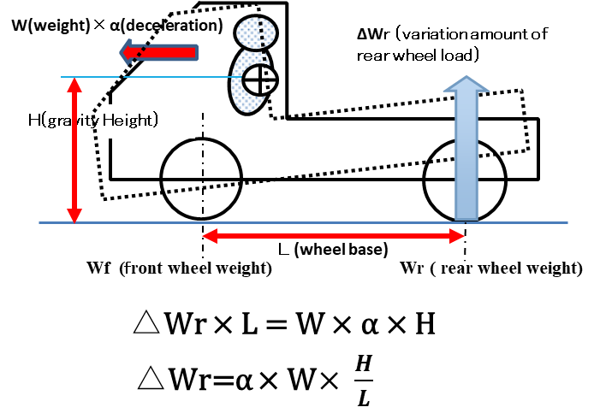
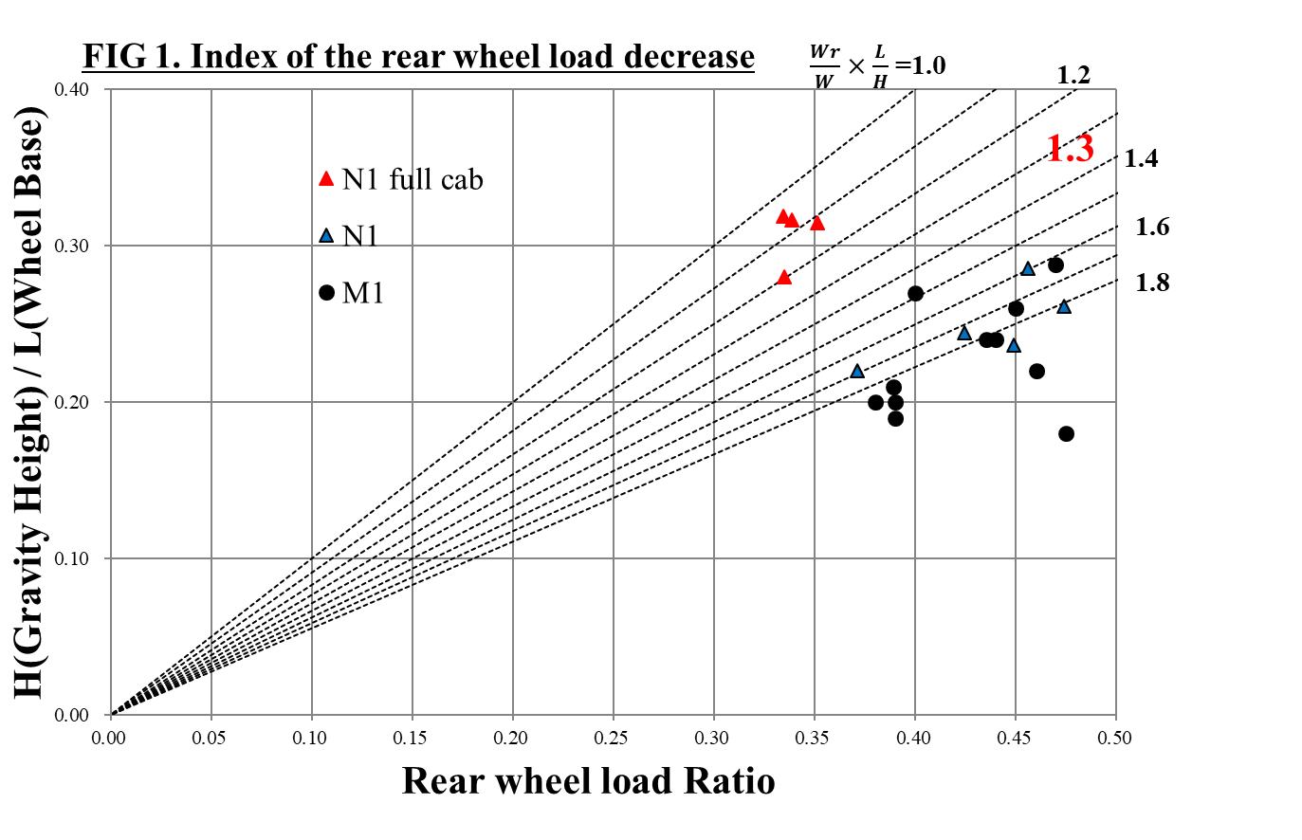
Informal Working Group on AEBS for Light Vehicles
Specifications - Car to car scenario - Speed reduction by braking demand
Collision avoidance for N1 full cab vehicle:
Stationary: until 30km/h (Laden), until 35km/h (Unladen)
Moving: until 30km/h (Laden), until 35km/h (Unladen)
Informal document AEBS-07-10(OICA-CLEPA):
N1 full cab vehicle need to limit deceleration at 7m/s for avoiding the rear wheel load.
The light truck must be limit the rear wheel braking force in order to avoid rear wheel locking for the light vehicle.
Proposal:
In case of “ α = $\frac{Wr}{W}×\frac{L}{H}$ ≦ 1.3 “ α =1.3 means N1 full cab vehicle
Maximum relative impact speed is 35km/h @unladen
Guidance from GRVA
The group discussed this issue.
The requirement of N1 full cab vehicle is open issue.
Chair and Secretary IWG AEBS – GRVA 02

Slide 10
Informal Working Group on AEBS for Light Vehicles
Specifications - Car to pedestrian scenario – Crossing collision
Walking speed: 5 km/h
Collision Warning:
When the AEBS has detected the possibility of a collision with a pedestrian crossing the road at a constant speed of 5 km/h, a collision warning shall be provided, and shall be provided no later than the start of emergency braking intervention.
Emergency Braking:
When the system has detected the possibility of an imminent collision. there shall be a braking demand of at least 5.0 m/s² to the service braking system of the vehicle.
Activation Speed:
The system shall be active at least within the vehicle speed range between 20 km/h and 60 km/h and at all vehicle load conditions
Chair and Secretary IWG AEBS – GRVA 02

Slide 11
Informal Working Group on AEBS for Light Vehicles
Specifications - Car to pedestrian scenario - Speed reduction by braking demand
Collision avoidance for M1 vehicle:
Requirement A : until 30km/h (Laden), until 30km/h (Unladen)
Requirement B : until 40km/h (Laden), until 42km/h (Unladen)
Collision avoidance for N1 vehicle:
Requirement A : until 30km/h (Laden), until 30km/h (Unladen)
Requirement B : until 40km/h (Laden), until 42km/h (Unladen)
Collision avoidance for N1 Full Cab vehicle:
Requirement A : until 20km/h (Laden), until 25km/h (Unladen)
Requirement B : until 30km/h (Laden), until 35km/h (Unladen)
Guidance from GRVA
N1 full cab vehicle are also issues of Guidance from GRVA.
Chair and Secretary IWG AEBS – GRVA 02

Slide 12
Informal Working Group on AEBS for Light Vehicles
Specifications - Car to pedestrian scenario - Speed reduction by braking demand
IWG discussed two requirements for car to pedestrian.
Guidance from GRVA
There are 2 options.
Requirement B* apply from 2023.
(2) Two requirements as step approach
Requirement A apply from 2020.
Requirement B apply from 2023.
Industry hopes option (2) in order to have more technical development term for the requirement B.
*Difference between the requirement A and B is the volume of speed reduction.
Chair and Secretary IWG AEBS – GRVA 02

Slide 13
Informal Working Group on AEBS for Light Vehicles
Specifications - Car to pedestrian scenario - Speed reduction by braking demand
Maximum Impact Speed (km/h) for M₁ - second step
Maximum Impact Speed (km/h) for N₁ - second step
Guidance from GRVA
Maximum Impact Speed above 45 km/h in 2nd step have a square bracket.
Chair and Secretary IWG AEBS – GRVA 02

Slide 14
Informal Working Group on AEBS for Light Vehicles
Specifications - Car to bicycle scenario
For car to cyclist, the group agreed from accident data that the two most relevant scenarios are a cyclist crossing (similar to pedestrian scenario) and a cyclist driving in the same direction as the car (similar to car to car scenario). However, for the latter, it seems that steering is much more efficient than braking, so the usefulness of such a braking test needs to be checked again.
The group still faces difficulty in agreeing on performance requirements for the car to bicycle collision given the lack of vehicles with this technology on the market (only several vehicle was tested under EuroNcap in 2018).
Proposal to GRVA
The informal working group agreed to consider Car to Bicycle at a later stage (e.g. 3rd GRVA: September 2019), when more data is available.
Chair and Secretary IWG AEBS – GRVA 02

Slide 15
Informal Working Group on AEBS for Light Vehicles
Specifications - Car to bicycle scenario – Crossing and Same direction
Speed of bicycle: 15 km/h
Crossing
Same direction
Activation Speed:
The system shall be active at least within the vehicle speed range between 20 km/h and 60 km/h and at all vehicle load conditions
Chair and Secretary IWG AEBS – GRVA 02

Slide 16
Informal Working Group on AEBS for Light Vehicles
Outside test conditions
One major issue is the minimum requirements that shall be required when the vehicle is outside test conditions (e.g. different mass, different road conditions).
Part of Para. 5.2.1.4.
The system shall not deactivate or drastically change the control strategy in these other conditions. This shall be demonstrated in accordance with Annex 3 of this Regulation.
Chair and Secretary IWG AEBS – GRVA 02

Slide 17
Informal Working Group on AEBS for Light Vehicles
Test procedure - Targets
Target | ISO Number
Car | ISO 19206-1 (Publication date: 2018-12)
Pedestrian | ISO 19206-2 (Publication date: 2018-12)
Bicycle | ISO/CD 19206-4 (This isn’t final version)
Reference to ISO standards:
The group agreed to refer a fix version of ISO, and copy/paste in the regulation the content of the ISO standard.
Guidance from GRVA
Reference of standard:
The group would also need guidance on the way to refer to targets (ISO standard or copy/paste requirements) to ensure a coherent practice across the different GRs (e.g. target used for cyclist detection by trucks currently discussed in GRSG).
Chair and Secretary IWG AEBS – GRVA 02

Slide 18
Informal Working Group on AEBS for Light Vehicles
Thank you
for your attention
IWG meetings 8th meeting in Japan (Tokyo)
(15-16 May 2019)
Chair and Secretary IWG AEBS – GRVA 02

