Slide 1
ADB on leaning motorcycles
Transmitted by the expert from IMMA
Informal document GRE-82-46-Rev.1
(82nd GRE, 22-25 October 2019,
agenda item 7 (b))

Slide 2
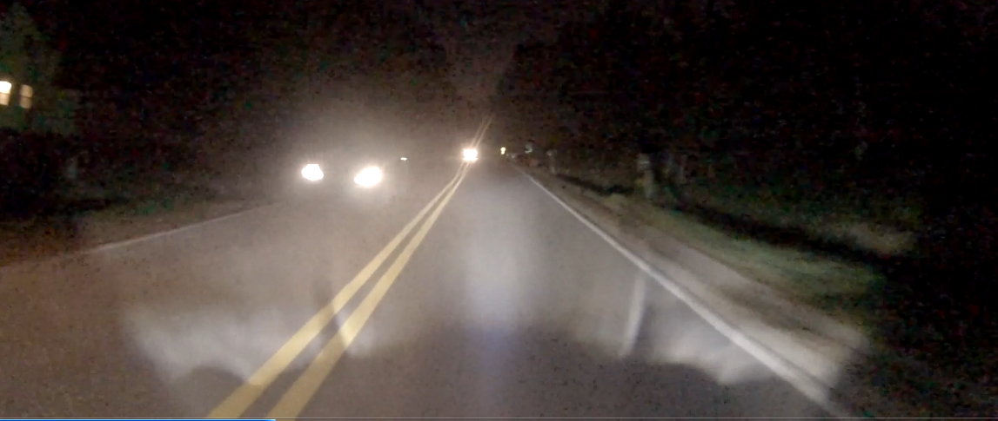
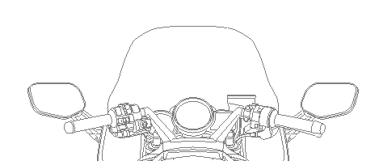
【Non-leaning condition】
The ADB lamp turns off its segment which provides illumination to the direction or the area where an onboard camera has detected preceding and/or oncoming vehicle(s).
This is the same provision as with car regulation and thus the proposal for motorcycle regulation applies the same content.
①：Camera detection area.
②：The area detecting the light from preceding and/or oncoming vehicle(s). The illumination of the detected segment is turned off.
①
②

Slide 3
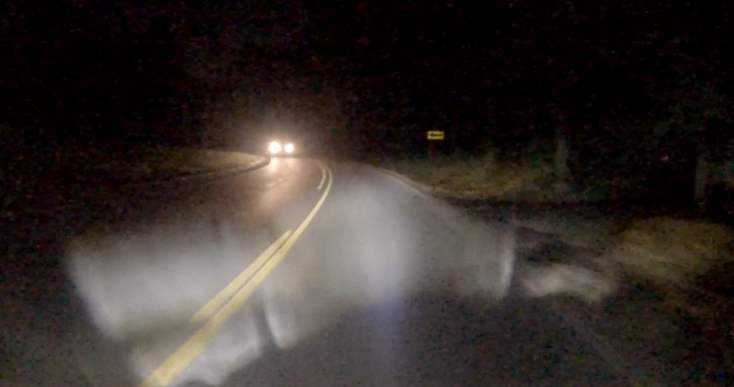
【Leaning condition】
In the leaning condition, the operation of the ADB lamp and its effect do not change from the non-leaning condition which turns off the segment where a camera has detected preceding and/or oncoming vehicle(s).
Therefore, there is no additional requirement for the leaning condition.
①：Camera detection area.
②：The area detecting the light from preceding and/or oncoming vehicle(s). The illumination of the detected segment is turned off.
②
①

