Slide 1
GRE Task Force
LED Substitutes / Retrofits (TFSR)
Status report for GRE82
Submitted by TF SR
Informal document GRE-82-17-Rev.2
(82nd GRE, 22-25 October 2019,
agenda Item 5)
2019-10-14
K. Manz, DE (Chairman)
Ph. Bailey, UK (Vice-Chairman)
Ph. Plathner, IEC (Secretary)

Slide 2
Meetings
1st meeting: 2017-12-14, Aachen (report: TFSR-01-11)
2nd meeting: 2018-02-06, Bonn (report: TFSR-02-05)
3rd meeting: 2018-03-27, Brussels (report: TFSR-03-09)
4th meeting: 2018-06-06 Brussels (report: TFSR-04-09)
5th meeting: 2018-01-30 Aachen (report: TFSR-05-09)
6th meeting: 2019-05-15 Paris (report: TFSR-06-06)
7th meeting: 2019-07-18 Karlsruhe (report: TFSR-07-07)
8th meeting: 2019-12-10 Bonn (scheduled)
Two-step approach:
Step 1: LED Substitutes
  Step 1A: light signaling applications
  Step 1B: road illumination applications
Step 2: LED Retrofits
  Step 2A: Administrative items
  Step 2B: Technical items

Slide 3
Step 1A: LED Substitutes for light signaling applications
Package of documents approved by GRE80
  R128
  RE5
  R148 (LSD)
  Installation Regulations
Approved by WP29 in March 2019 (R128, RE5)
Enter-into-force October 2019 (R128, RE5)
STEP 1A
✓

Slide 4
Step 1B: LED Substitutes for road illumination applications
Detailed discussion started in the 5th TFSR meeting in Aachen
and continued in the 6th TFSR in Paris
Documents for submission to GRE82 approved during 7th TFSR meeting in Karlsruhe:
  GRE/2019/19 to amend R-149 (RID)
  GRE/2019/21 to include H11/LED into RE5
  GRE-82-03 to extend the equivalence criteria documents

Slide 5
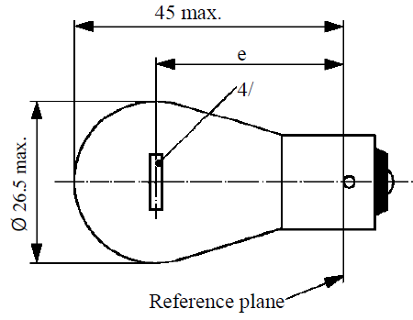
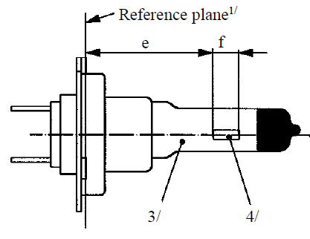
Extended equivalence criteria for road illumination applications
To remind from
GRE-81-14
GRE-82-03
Specific intensity distribution
Specific homogeneity of LEA
Contrast
…
GRE-80-02
Test voltage
Luminous flux
…
Intensity distribution
Homogeneity of LEA
…
Spectral content
Thermal behavior
…

Slide 6
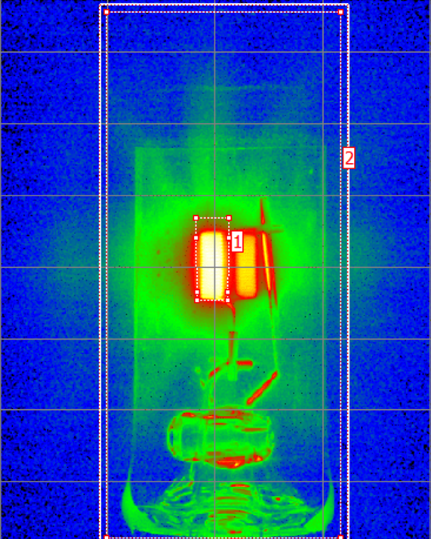
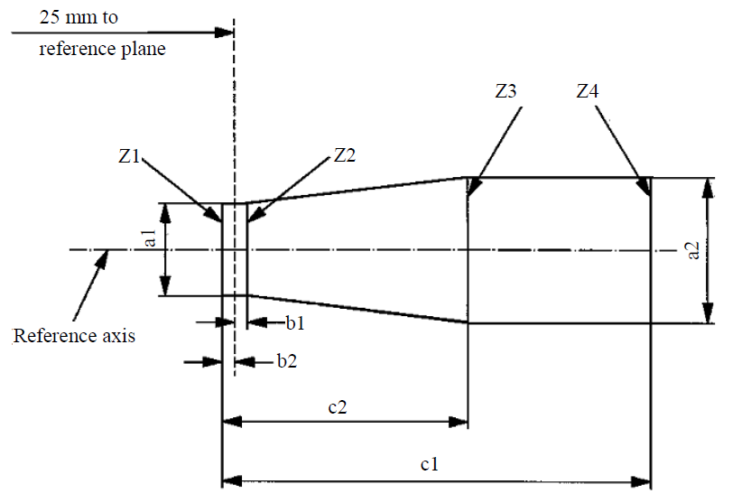
Specific aspects for road illumination
Source
GRE-81-14
Distortion free area
Black top
Metal free zone
Controlled
ghost image
Contrast
Tighter tolerances on
filament shape, dimension, position and homogeneity

Slide 7
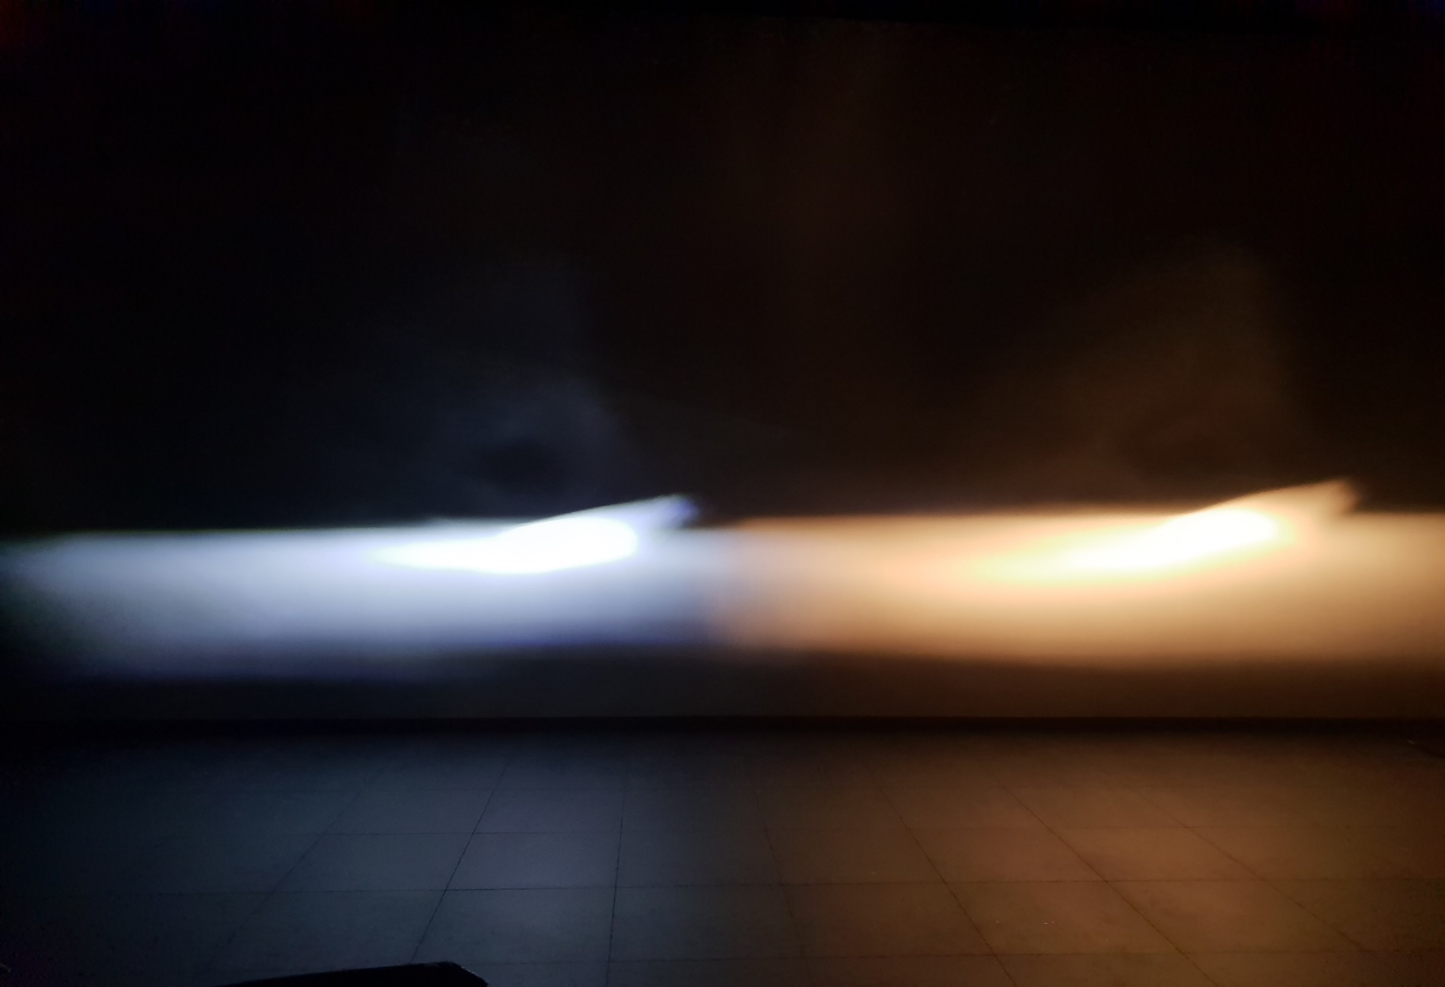
Demonstration of H7 headlamp
Source
GRE-81-14
H7 Substitute “H7/LED”
H7 filament acc. to R37
Prototype fulfilling all proposed
equivalence criteria; TFSR-05-04
Besides the color temperature, more or less the same beam. All beam details are traceable !

Slide 8
Step 2: “LED retrofits”:
Step 2A: Administrative items
First discussion on “administrative equivalence” in 6th TFSR meeting Paris
Continued in 7th meeting in Karlsruhe
Target: achieve “administrative” equivalence, i.e. by making R37 “technology neutral” and allow interchange of R37-approved light source of the same category, independent of the technology used for light generation
Conclusions:
  Stop activity to include LED retrofits in R128
  Start activity to make R37 performance based and technology neutral
    By amending the scope of R37 to include also other light generating technologies e.g. LED

Slide 9
The new document scope
R37
Filament Light Sources
By thermal radiation (incandescence) By other technology e.g. LED
R99
HID light sources
R128
LED light sources
LED substitute light sources
R.E.5 Category sheets
Filament light sources by thermal radiation
Filament light sources by other technologies e.g. LED
HID light sources
LED light sources, including LED substitute light sources

Slide 10
Step 2: “LED retrofits”:
Step 2B: Technical items
Photometric equivalence is taken over from LED substitute discussion
Other technical items need to be addressed (detailed discussion not started yet)
  Electrical
  Thermal

Slide 11
Request for Guidance from GRE
Can the TF SR proceed with the proposed way forward:
  Open the scope of R37 to allow other technologies; i.e. achieve administrative equivalence between the different technologies (Step 2A)
  Further develop the necessary criteria for technical equivalence (Step 2B)
Next meeting of the TFSR will be on 10 December in Bonn

Slide 12
Possible proposal to Regulation No. 37
New Title of the Regulation:
Uniform provisions concerning the approval of filament light sources for use in approved lamps of power-driven vehicles and of their trailers
Same for the Scope.

Slide 13
Possible proposal to Regulation No. 48
Definition in R 48:
2.9.1.4. "Filament light source “ means a light source where the only element for visible radiation is one or more filament(s) producing visible light.
Such a Filament light source could be either:
- a filament lamp or
- a Filament light source type LED.
2.9.1.4.1. "Filament lamp" means a light source where the only element for visible radiation is one or more filaments producing thermal radiation.
2.9.1.4.2. "Filament light source type LED“ means a light source where the only element(s) for visible radiation is one or more filament(s) where the visible light is generated by LED only.

Slide 14
The intention for the usage of this nomenclature in Regulation No. 37 is:
filament light sources - for all general paragraphs idependent of the technology;
filament lamp - for all specific procedures for filament lamps;
filament light sources
type LED - for all specific procedures for filament light sources where the light is produced by LED;
+ Requirements for necessary objective evidences for:
- lighting Performance → solved by the substitutes
- list → solved by the substitutes
- by check list → for the proper functioning in existing approved lamps e. g.
– thermal behavior, defogging , etc. ….

