Slide 1
Improving Rail freight competitiveness at a national level
25.11.2019
René Sigrist

Slide 2
Swiss people adopted the Alpine Initiative 1994 - 25 years of Swiss modal shift policy
Swiss modal shift policy
Art. 84 Para. 2 of the Federal Constitution of the Swiss Confederation:
“Transalpine goods traffic shall be transported from border to border by rail. [...]”

Slide 3
Timeline and key elements: support of population, building infrastructure and financing it
Swiss modal shift policy
1992 | New Railway Link through the Alps (NRLA) popular vote
1994 | Alpine Initiative popular vote
1999/2002 | Bilateral agreement Switzerland-EU on land transport, Law on modal shift
2001-2004 | Introduction of Heavy Vehicle Fee
2008 | Opening of Lötschberg Base Tunnel
2016 | Opening of Gotthard Base Tunnel
2020 | Opening of Ceneri Base Tunnel & 4-Meter Corridor

Slide 4
Beside the NRLA, other infrastructure was further developed to improving rail freight competitiveness
Other Infrastructure investments
New Railway Link through the Alps (NRLA) as core element to support shift to rail by reducing production costs and increase capacity
4-meter corridor on the Lötschberg / Simplon and the Gotthard axis
Expansion step 2025
Expansion step 2035
Investment grants for Terminals within Switzerland and abroad
Notes:
◾Modernisation of the rail infrastructure: For about CHF 24 billion, Switzerland is building the NRLA and the 4-metre corridor on the Gotthard route. The base tunnels on the Gotthard, Ceneri and Lötschberg, and the uniform profile mean that freight trains are able to travel under simplified conditions. Journey times between north and south are becoming shorter.

Slide 5
Rail infrastructure expansion STEP planning process adaptive planning based on demand forecast
Expansion STEP
Demand forecast
Securing Results
(Offer, Infrastructure and spatial planning)
Cost - Benefit Assessment
Demand analysis
Supply
Infrastructure
Rolling stock

Slide 6
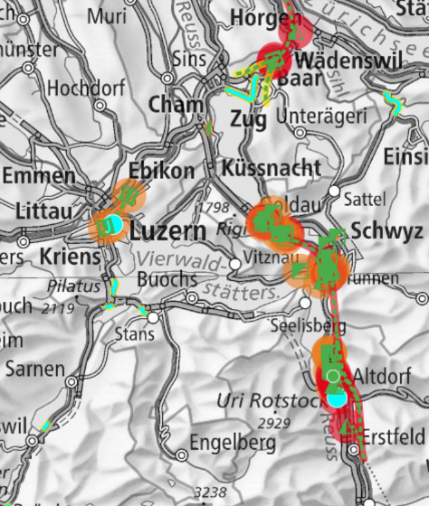
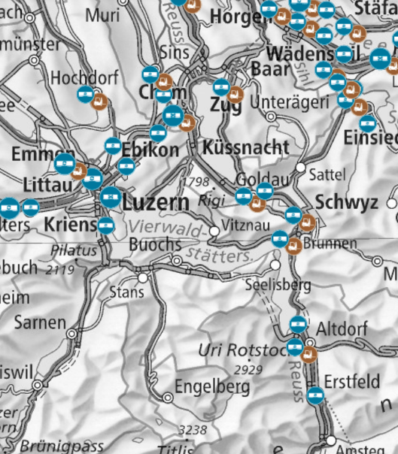
Future routes as well as existing freight facilities are secured in spatial planning
Securing investments
Existence of rail freight traffic systems, concept for freight transport by rail
Spatial planning:
binding restriction on public authorities
Sector plan on transport,
rail infrastructure section
Notes:
The concept for freight transport by rail is a concept in accordance with Art. 3 of the Swiss Goods Carriage Act (GCarA, SR 742.41) and Art. 13 of the Swiss Spatial Planning Act (SPA, SR 700). The concept defines the most important federal government interests which must be taken into account when planning rail freight traffic systems and also contains an index of the rail freight traffic systems already in place at the time the concept was adopted.

Slide 7
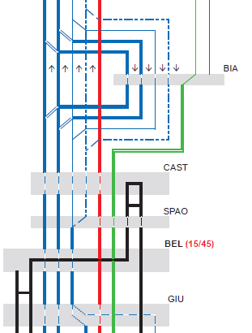
How to secure investments in a network: I. Network Utilisation Concept
Securing investments
Based on a the last expansion step
Defines the use of the network in a standard hour for the future network
Shows dedicated capacities for Passenger and Freight traffic
Considers future infrastructure and offer
Can contain functional requirements on rolling stock and infrastructure
Notes:
Defines the use of the network in a standard hour for the future network
Shows dedicated capacities for Passenger and Freight traffic
Decided new infrastructure is taken into account
Can contain functional requirements concerning rolling stock and infrastructure, e.g.
Track utilization in bigger stations
Vmin/Vmax, Acceleration
Train regime, Braking regime

Slide 8
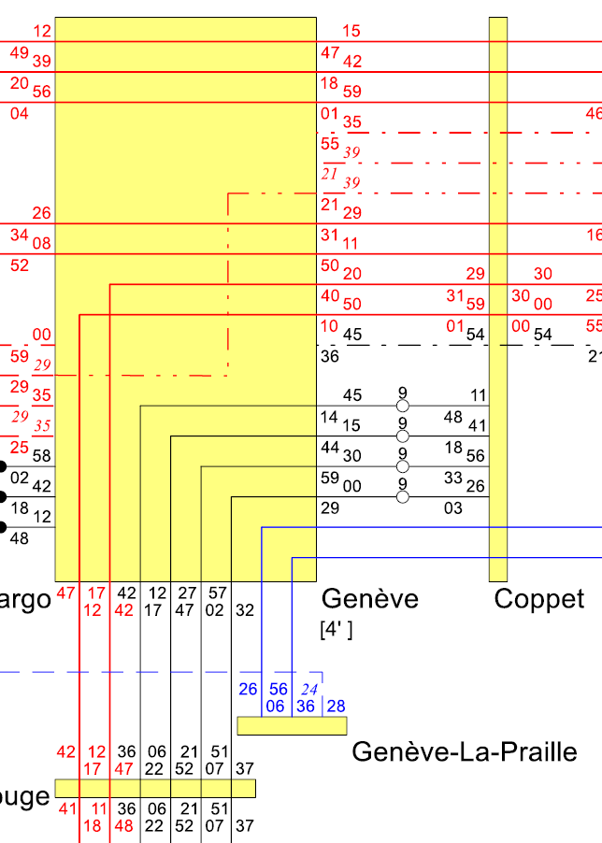
How to secure investments in a network: II. Network Utilisation Plan
Securing investments
Plans exist for the next six years and are updated as needed
Basis for the yearly timetable and path allocation by the train path allocation body
Detailed plan with time indication
Restrictions do to construction works
Differentiates rush hour and off peak times as well as weekday and weekend

Slide 9
How to secure investments in a network: II. Network Utilisation Plan
Plans exist for the next six years
Secured is only what’s decided
Real capacity should be higher
Capacity
Capacity
Capacity
Concept 2025
Capacity
Capacity
Timetable 22
Timetable 23
NUC
Timetable 20
Timetable 21
NUP
22
NUP
23
NUP
20
NUP
21

Slide 10
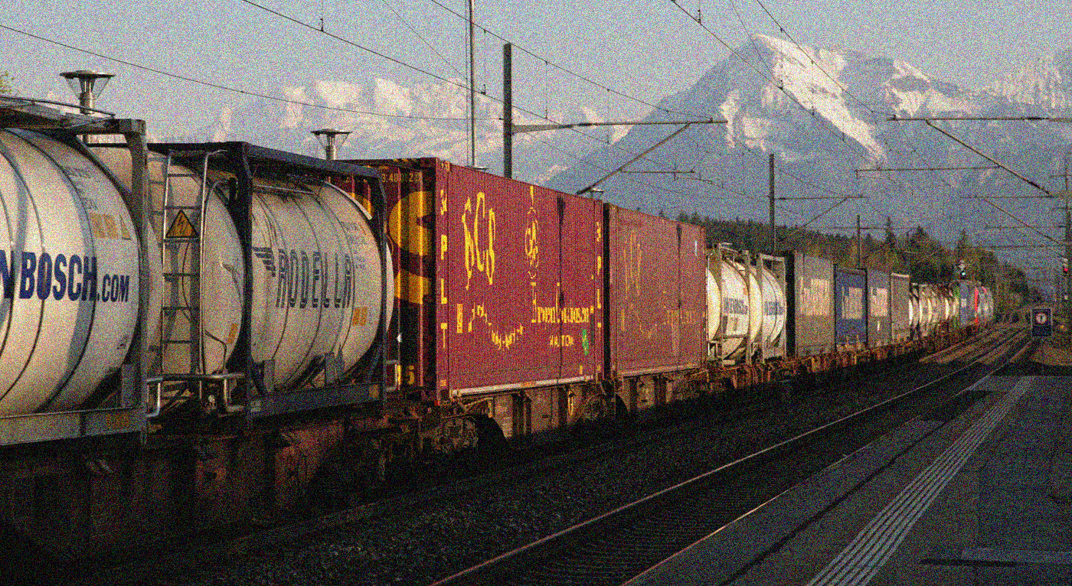
Outlook: Reliable planning for all stakeholders - Supported by Swiss population
Rail Infrastructure Fund to develop and maintain infrastructure
Guarantee planning reliability for all stakeholders
Integrated planning of infrastructure (STEP)
Manage future capacities:
Network Utilisation Concept
Network Utilisation Plans
Equal status for passenger and freight transport
Notes:
STEP = (strategic enlargement program): Planning of rail-related infrastructure Long-term development of rail infrastructure
Network Utilization Concept
Long-term
Takes into account decided new infrastructures
Defines the use of the network in a standard hour for the future network
Shows dedicated capacities for Passenger and Freight traffic
Network Utilization Plans
Breaks down Network Utilization Concept in detail for the respective annual timetables
Basis for the annual timetable and path allocation by the train path allocation body
Distinguishes between rush hour and off peak times as well as weekday and weekend.

Slide 11
Thankyou!
René Sigrist
Federal Office of Transport FOT
Division Financing
Section Freight Transport
Muehlestrasse 6, CH-3063 Ittigen
rene.sigrist@bav.admin.ch

