Slide 1
TSG R129.02 & R129.03 series Approval Label Updates Explanatory Notes (GRSP-64-07 to GRSP-64-09)
Informal Document GRSP-64-10
(64th GRSP, 11-14 December 2018,
agenda item 19)

Slide 2
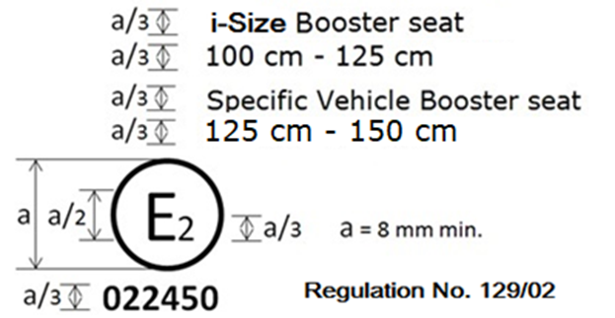
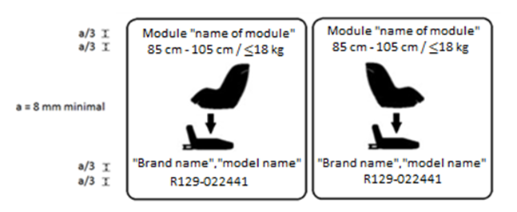
Approval Label Updates R129.02
Approval mark for combinations
Current Text
No text
Revised module mark
Current Text
Proposed Change
Justification
Combining approval marks, to save space on the ECRS
Modify shape of module label & include text dimension requirements, consistent with R129.03

Slide 3
Approval Label Updates R129.03
Approval mark for combinations
Current Text
No text
Justification
Combining approval marks, to save space on the ECRS

Slide 4
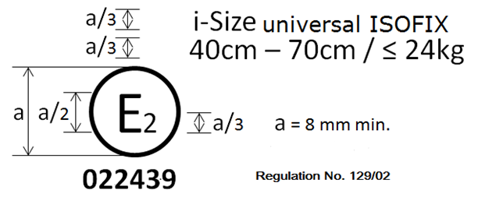
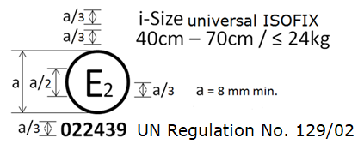
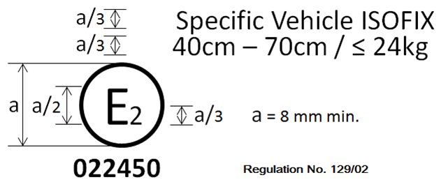
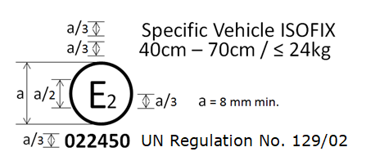
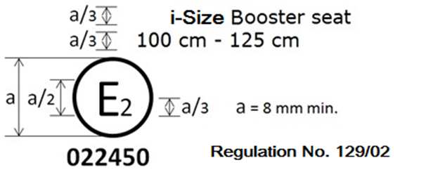
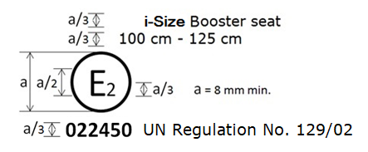
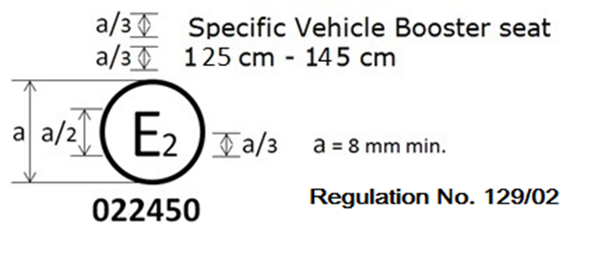
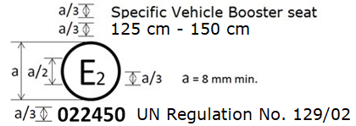
Approval Label Updates R129.02
Approval mark correction
Current Text
Proposed Change
Justification
Approval number text size missing
“UN” missing

Slide 5
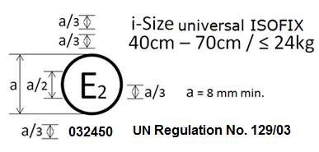
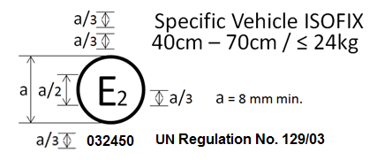
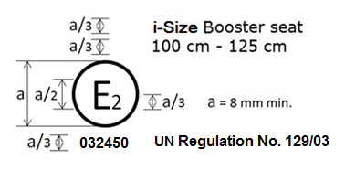
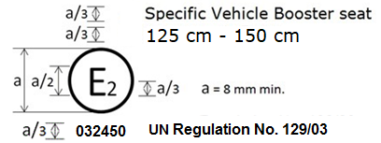
Approval Label Updates R129.03
Approval mark correction
Current Text
Proposed Change
Justification
Approval marks not updated to 03
Approval number text size missing & “UN” missing

Slide 6
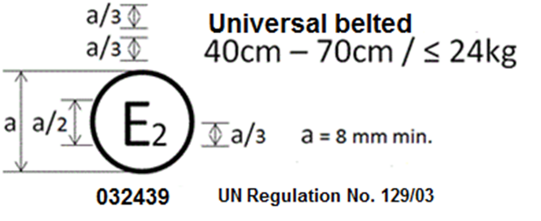
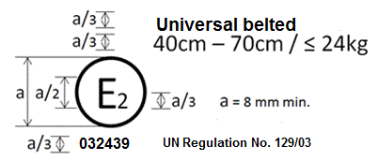
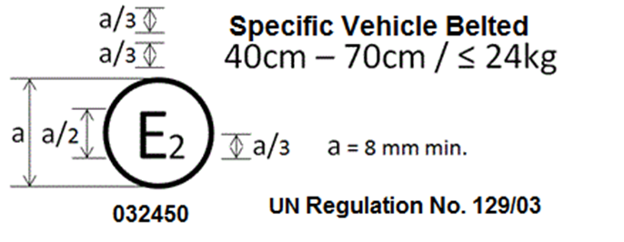
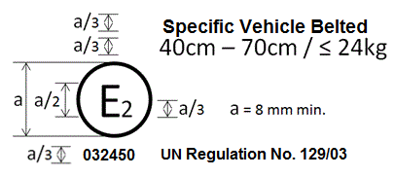
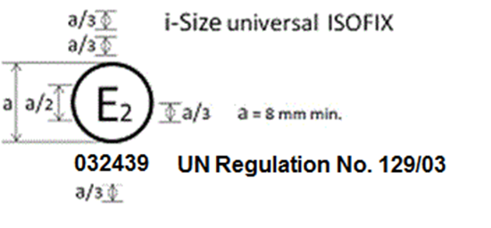
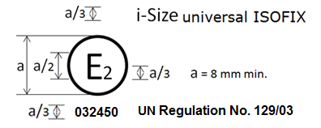
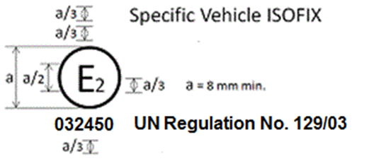
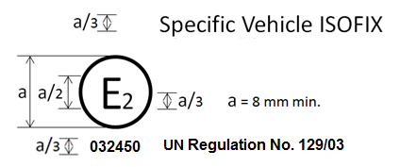
Approval Label Updates R129.03
Approval mark & Module mark correction
Current Text
Proposed Change
Approval Mark
Correction
Module Mark
Correction
Justification
Approval number text size missing

