Slide 1
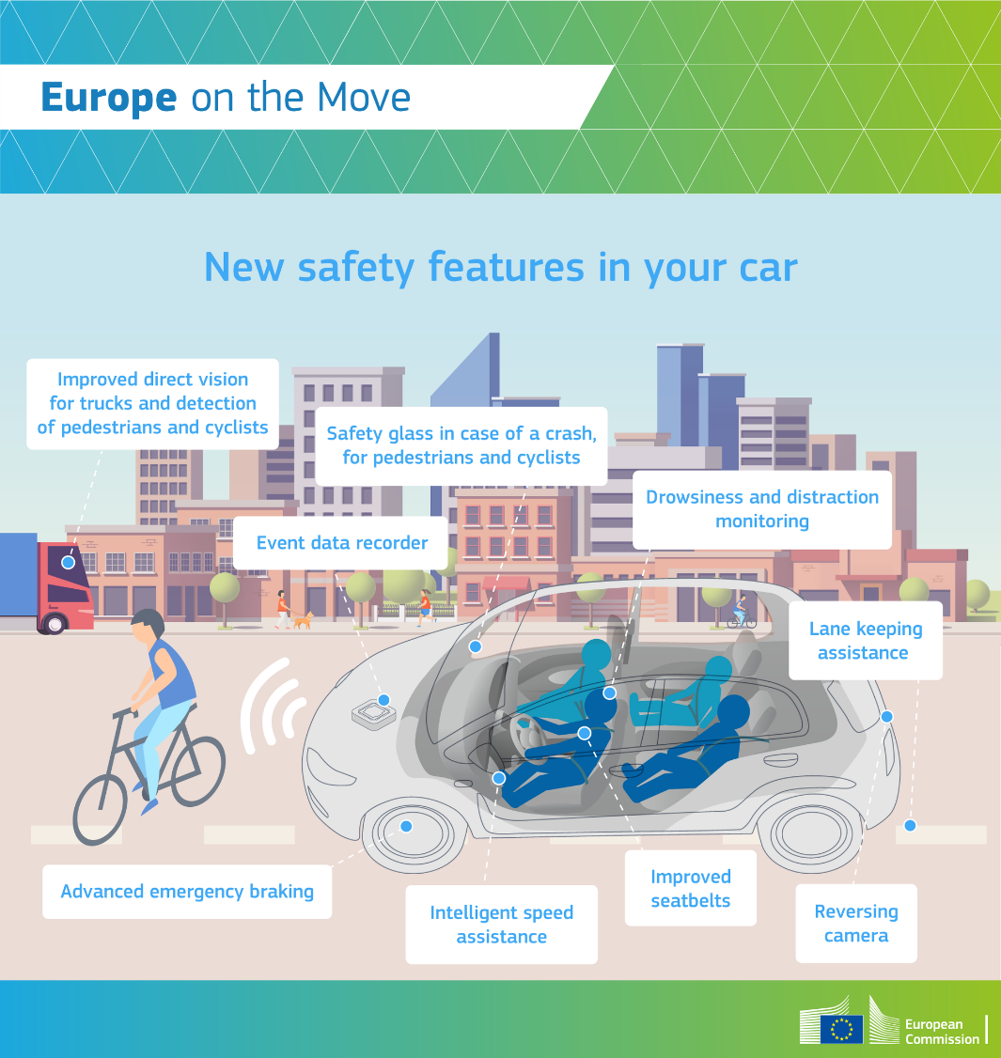


Informal document GRSP-63-31
(63rd GRSP, 14-18 May 2018
Agenda item 26(a))
Revision of the EU General Safety Regulation and Pedestrian Safety Regulation
© AC.nl
17 May 2018 – GRSP 63rd session
Directorate-General for Internal Market, Industry, Entrepreneurship and SMEs
Automotive and Mobility Industries Unit

Slide 2
The existing Framework
Framework Directive 2007/46/EC – soon to be replaced with new and improved Type-Approval Framework Regulation (after dieselgate).
Prescribes mandatory rules for vehicles including vehicle safety requirements contained in the GSR adopted in 2009

Slide 3
Vehicle safety requirements in the EU
In principle applicable for all categories of vehicles covered by the Framework:
  Passenger Car, Small Bus, Large Bus
  Light Commercial Vehicle, Medium Size truck, Heavy Goods Vehicle
  Light Trailer, Large Trailer
Detailed mainly in General Safety Regulation (EC) No 661/2009 and Pedestrian Safety Regulation (EC) No 78/2009

Slide 4
Main achievements
GSR introduced more advanced features such as stability control, safety belt reminder, electric shock protection, …
  Also Advanced Emergency Braking and Lane Departure Warning on all new trucks and buses
Measures still being phased in until 2023 (tyres noise, rolling resistance, etc).
PSR introduced child/adult head impacts on bonnet, legs impact on front bumper, mandatory Brake Assist System (BAS).

Slide 5
State of play
GSR Phase-in mostly completed, but many exceptions for heavy M₁ passenger cars (SUVs) and N₁ light commercial vehicles (vans).
PSR Phase-in mostly completed from 2011 onwards, but not yet for heavy M₁ passenger cars (SUVs) and N₁ light commercial vehicles (vans), mandatory in 2019.

Slide 6
Reporting obligations
General Safety and Pedestrian Safety Regulations required to report to the European Parliament and the Council on progress on safety technology
Including monitoring and assessment of new advanced safety features, their cost effectiveness and feasibility for possible inclusion in the regulations on general vehicle safety and on the protection of pedestrians and other vulnerable road users.

Slide 7
Studies
A preliminary study (published March 2015) contained a review of over 50 possible safety features for legislation
Outcome was 'short list' used for Commission Report Saving Lives: Boosting Car Safety in the EU adopted on 12/12/2016
2 follow-up studies to obtain individual cost-benefits and also for clusters of safety features
Finalisation of Impact Assessment, passed the Regulatory Scrutiny Board in January 2018

Slide 8
The need for a revision
Improvement of annual number of road deaths stagnating since 2013, EU targets will not be reached.
Clear call from numerous stakeholders for Commission to take action through revising vehicle safety rules.
Malta Valletta declaration of ministers.
Repeated request for action by EP for resolute and determined action by the Commission.

Slide 9
The way forward (1)
New Commission proposal on General Vehicle Safety was adopted as part of the 3rd Mobility Package on 17 May 2018.
Focus on new accident avoidance systems and improved active and passive safety measures, both for Occupant protection in frontal, side and rear impact as well as for pedestrian and cyclist protection in frontal, side and rear impacts.
All details available here http://europa.eu/rapid/press-release_IP-18-3708_en.htm

Slide 10
The Way Forward (2)
An ambitious strategy that will cover all categories of vehicles.
A proposal that will pave the way to Connected and Automated Driving and focus on the human factor
Part of the Safe System approach (Road and Tunnel safety)
Simplification by combining current separate legislation on GSR, PSR and Hydrogen vehicle safety

Slide 11
 | Passenger cars | Light commercial vehicles | Buses | Trucks and trailers
 | M₁ | N₁ | M₂ & M₃ | N₂ & N₃
Advanced emergency braking (cars/vans) | Phase 1 | Phase 1 | already | already
Advanced emergency braking for pedestrians and cyclists | Phase 2 | Phase 2 | - | -
Alcohol interlock installation facilitation | Phase 1 | Phase 1 | Phase 1 | Phase 1
Drowsiness and attention detection | Phase 1 | Phase 1 | Phase 1 | Phase 1
Distraction recognition / prevention | Phase 2 | Phase 2 | Phase 2 | Phase 2
Event (accident) data recorder | Phase 1 | Phase 1 | - | -
Emergency stop signal | Phase 1 | Phase 1 | Phase 1 | Phase 1
Frontal crash protection updates | Phase 1 | Phase 1 | - | -
Head impact zone enlargement for pedestrians and cyclists (to include the windscreen area) | Phase 2 | Phase 2 | - | -
Intelligent speed assistance (through non-intrusive haptic feedback) | Phase 1 | Phase 1 | Phase 1 | Phase 1
Notes:
Phase 1 is 3 years after the adoption of the GSR revision by the Council and EP (target is end of 2021)
Phase 2 is 5 years (target is end of 2023)
Phase 3 is 7 years (target is end of 2025)
These dates are for new vehicle types. All new vehicles will come with 2 years delay for phases 1 and 2, with a 3 year delay for phase 3.

Slide 12
 | Passenger cars | Light commercial vehicles | Buses | Trucks and trailers
 | M₁ | N₁ | M₂ & M₃ | N₂ & N₃
Lane keeping assist (emergency lane keeping system that intervenes only in case of an imminent threat such as leaving the road, or leaving the lane with oncoming traffic) | Phase 1 | Phase 1 | already LDWS | already LDWS
Side crash protection updates | Phase 1 | Phase 1 | - | -
Reversing camera or detection system | Phase 1 | Phase 1 | Phase 1 | Phase 1
Tyre pressure monitoring system | already | Phase 1 | Phase 1 | Phase 1
Vulnerable road user detection and warning on front and side of vehicle (trucks and buses) | - | - | Phase 1 | Phase 1
Vulnerable road user improved direct vision from driver’s position (trucks and buses) | - | - | Phase 3 | Phase 3
Rear crash protection updates | Phase 1 | Phase 1 | - | -

Slide 13
Advanced Emergency Braking Systems
Autonomous Emergency Braking Systems for vehicle-to-vehicle collisions combines sensing of the environment ahead of the vehicle with the automatic activation of the brakes in order to mitigate or avoid a collision.
From 1 November 2015, fitment of AEBS on new trucks and buses already mandatory in EU.
Effective accident avoidance measure.
Autonomous function (without driver input).

Slide 14
Alcohol Interlock Installation Facilitation
Alcohol Interlock Devices require a vehicle operator to provide a breath sample or use a finger touch sensor and prevent the vehicle ignition from operating if alcohol above a pre-defined threshold is detected.
Interlock Devices in all motor-vehicles is not part of the proposal.
Requirements to facilitate easier fitment of aftermarket Alcohol Interlocks Devices.

Slide 15
Drowsiness and Distraction Monitoring and Detection
Increasingly autonomous functions may stimulate over-reliance by drivers to 'watch the road' by themselves.
Distraction because of 'connected vehicles' and 'smartphone use' while driving.
Technology available that monitors erratic steering behaviour.
Technology available that instantly detects inattention.
Technology available to prevent distraction.

Slide 16
Event (Accident) Data Recorder
Crash Event Data Recorders record a range of vehicle data over a short timeframe before, during and after a triggering, usually by the deployment of an airbag, caused by a vehicle crash. The EDR stores critical crash-related information such as vehicle speed, state of restraints and braking systems as well as other relevant vehicle data at the time of the collision.
Need for detailed assessment of effectiveness of (new) safety measures.
Need for much better EU-wide in depth accidentology data.

Slide 17
Emergency Stop Signal
Emergency Braking Display or Emergency Stop Signal provides rapid blinking stop lamps (4 Hz) in case of high retardation or ABS activation.
Permitted on motor-vehicles.
Detailed rules already exist on 'if-fitted' basis.

Slide 18
Frontal Crash Protection Updates
Currently, only frontal off-set crash 40% overlap mandatory for passenger cars with permissible total mass of up to 2,5 tonnes (2500 kg).
To abolish the above 2,5 tonnes exemption (notably for SUVs).
To include light commercial vehicles (notably delivery vans).
Introduction of full with crash test with advanced dummies

Slide 19
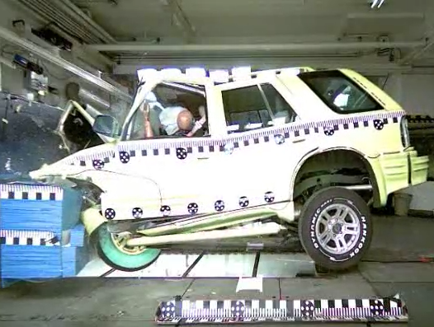

Slide 20
Pedestrian/cyclist windscreen hits
Research shows that notably cyclists tend to impact their heads further rearward than pedestrians.
Current head impact test zone is limited to the rear edge of the bonnet.
Also pedestrian fatalities point to head contact with the windscreen between A-pillar region.
To extend the test zone to include windscreen between the A-pillar area.

Slide 21
Intelligent Speed Assistance
Assistance function versus advisory function.
System to work with the driver, by prompting, not going against the driver (driver always in full control of speed)
Camera based technology and/or map based info.
Harmonisation of traffic signs preferable.

Slide 22
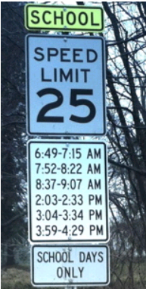
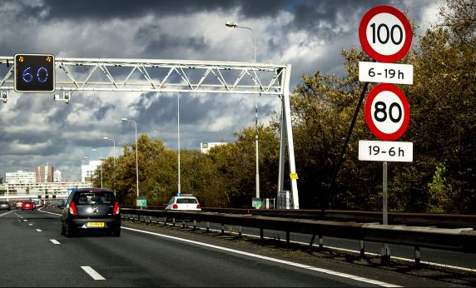

Slide 23
Lane Keeping Assist
Lane Keeping Assist monitors the position of the vehicle with respect to the lane boundary and actively applies a torque to the steering wheel, or pressure to the brakes, when a lane departure is about to occur while on collision course with imminent impact.
Autonomous function (without driver input).
From 1 November 2015, fitment of Lane Departure Warning System (i.e. not LKA as above) on new trucks and buses already mandatory in EU.

Slide 24
Side Crash Protection Updates
Currently mandatory for passenger cars and light commercial vehicles, provided that the seating position is low (hip point not below 700 mm above ground level).
Assesses occupant injuries, but also fuel system integrity and high voltage electric safety after a side impact.
To abolish the exemptions to ensure safety of rescue workers and post-crash fire prevention.
To add Pole Side Impact test.

Slide 25
Reversing Camera and Detection systems
Sensing systems that increase the view of drivers or otherwise warn them of persons or obstacles behind reversing vehicles.
Particularly vulnerable in this context are short, crouching or slow moving people, such as the elderly and children.
Consideration of cameras as well as indirect devices e.g. detection systems for EU application.

Slide 26
Tyre Pressure Monitoring
Tyre Pressure Monitoring Systems (TPMS) report tyre-pressure information to the driver of the vehicle, either via a gauge, a pictogram display, or a simple low-pressure warning light.
Currently mandatory for passenger cars.
Proposed expansion to all motor-vehicles as well as large trailers.
Technology neutral: indirect or direct TPMS, provided that the system is realiable.
Must work under normal road and driving conditions.

Slide 27
Vulnerable Road User Detection and Warning for the front and side
To protect Vulnerable Road Users, including pedestrians and cyclists involved in collisions.
Indirect vision requirements exist: Mirrors.
It takes a long time for drivers to scan and interpret images seen in multiple external mirrors.
Camera/monitor systems and/or detection systems for pedestrians and cyclists around the cab to lessen the burden for drivers and to clearly signal where dangerous situations arise.

Slide 28
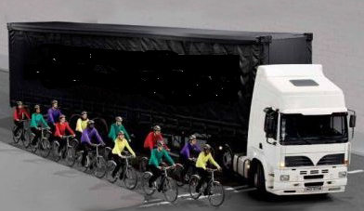
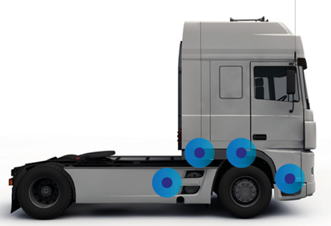

Slide 29
Vulnerable Road User Improved Direct Vision by Truck/Bus Drivers
Improving direct vision and awareness of pedestrians and cyclists in close proximity of the driver's cab, by the driver.
Eye contact by pedestrian or cyclist, for confirmation of being seen.
In low speed manoeuvres, driving forward and while turning a corner.
Structural changes required to truck cabs.

Slide 30
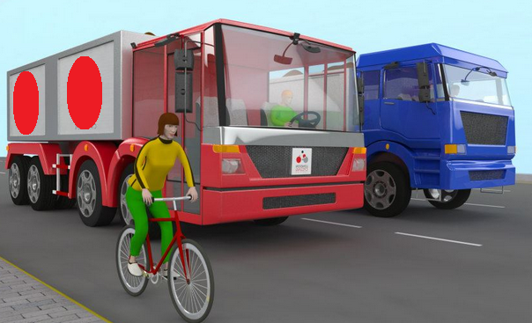
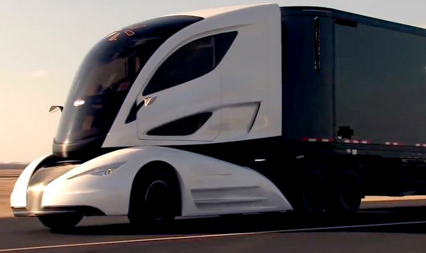

Slide 31
Rear Crash Protection Updates
Rear crash test is actually not mandatory in EU.
Comprehensive requirements exist in other world regions based on UNECE Regulation No 34.
R34 is applied in the EU on a mandatory basis, but only the parts for component level testing (i.e. fuel tank)
To assess fuel system integrity but also high voltage electric safety after a rear impact.
No electric safety included yet. To be updated.

Slide 32
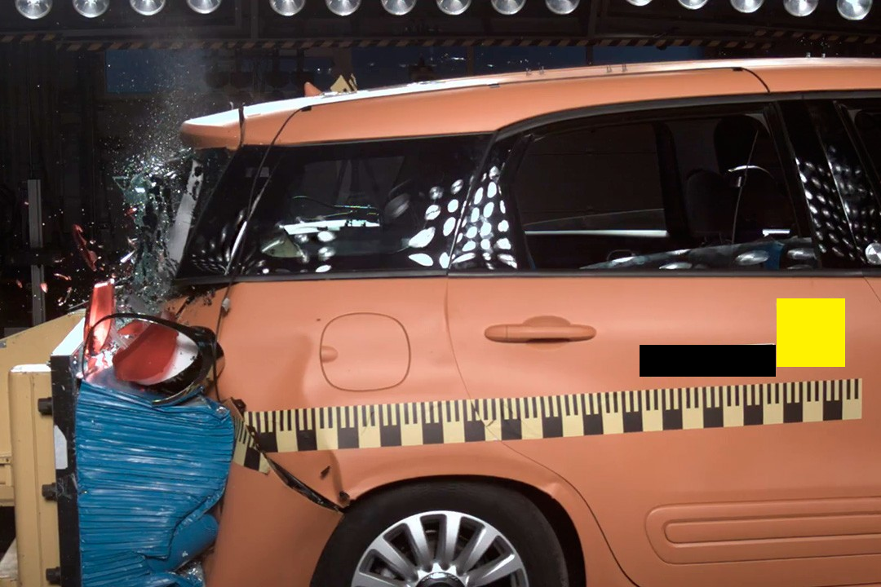

Slide 33
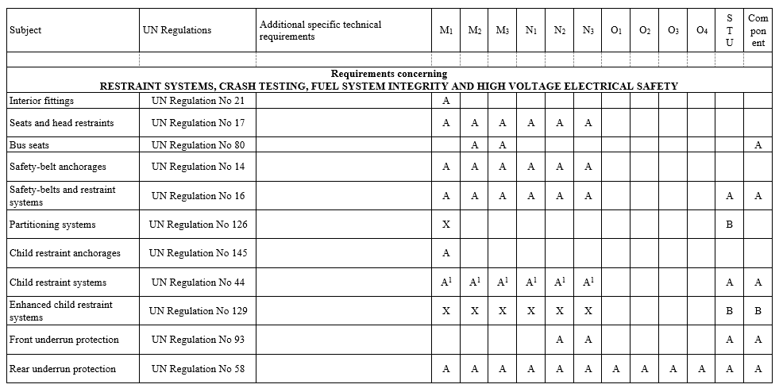

Slide 34
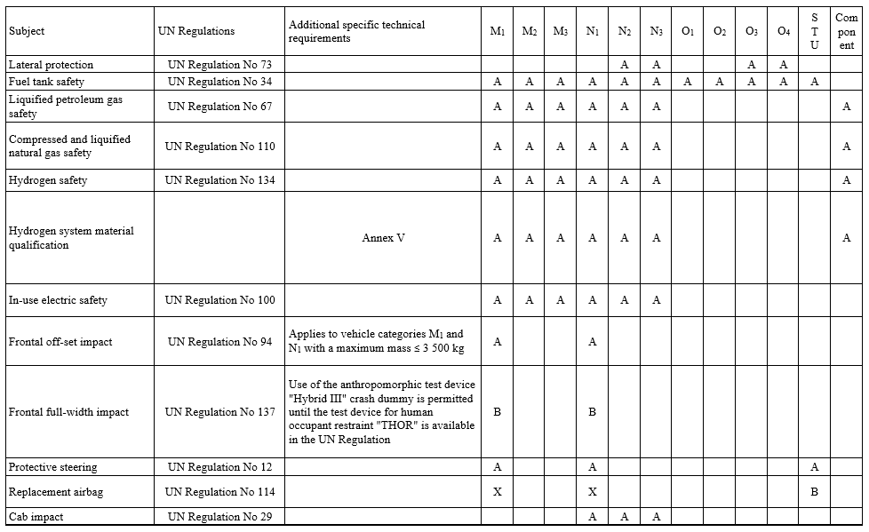

Slide 35
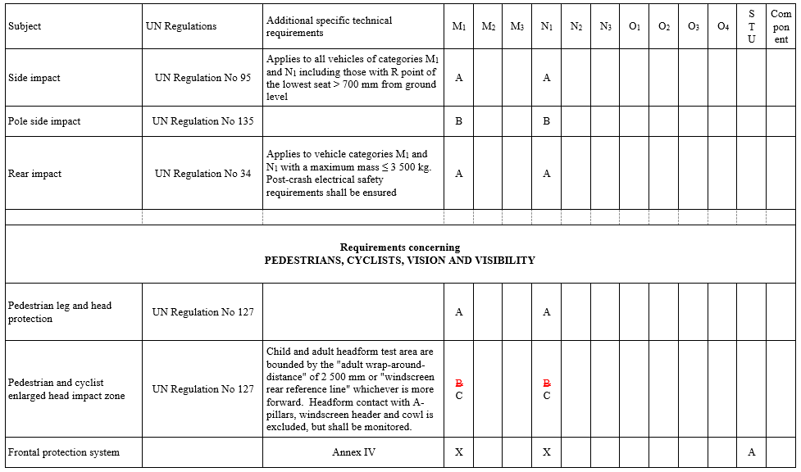

Slide 36
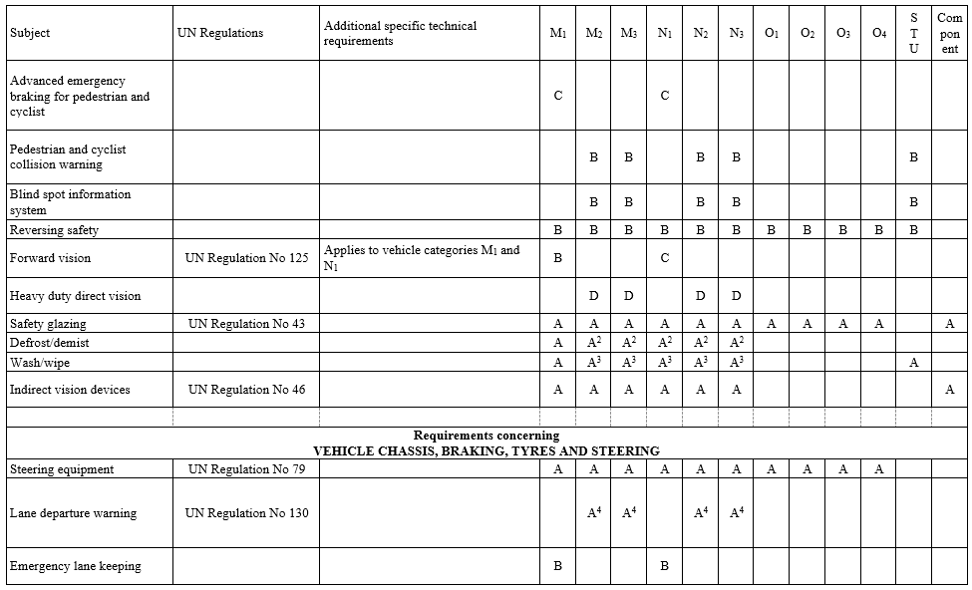

Slide 37
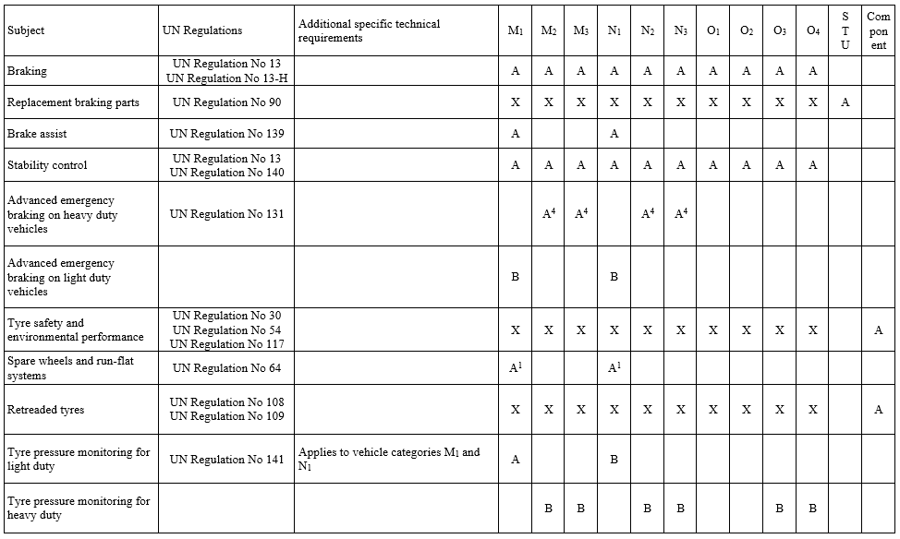

Slide 38
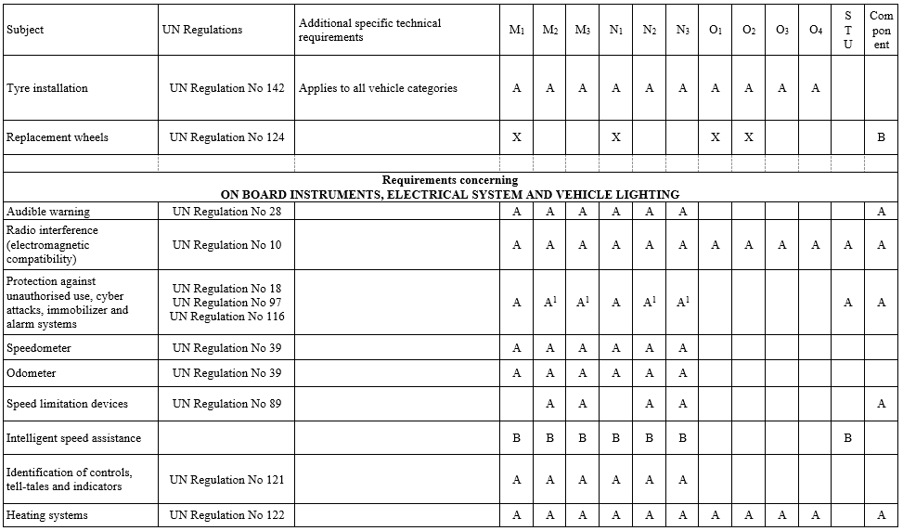

Slide 39
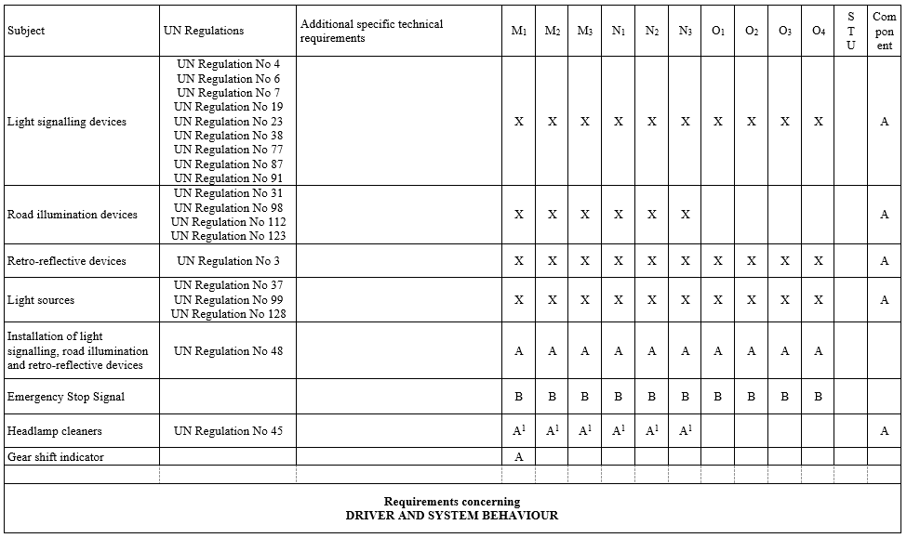

Slide 40
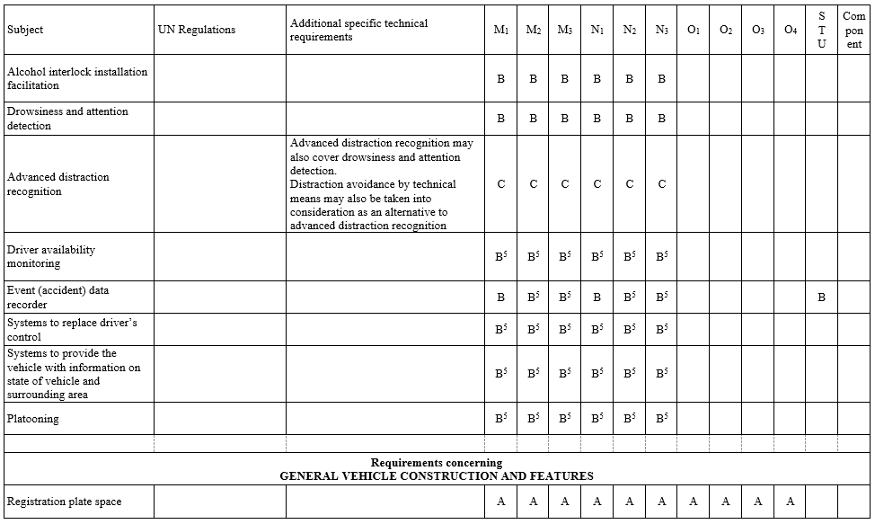

Slide 41
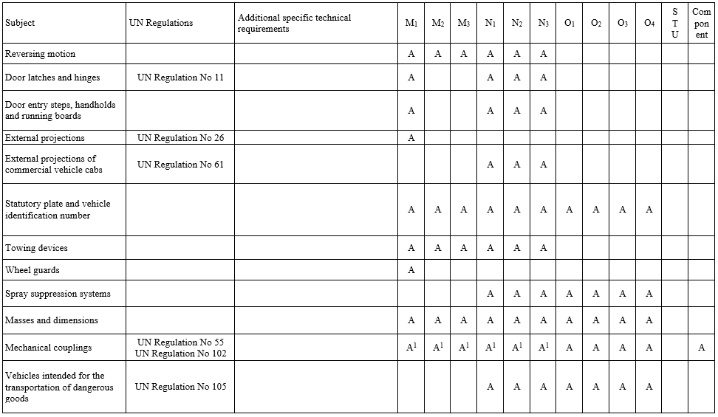

Slide 42
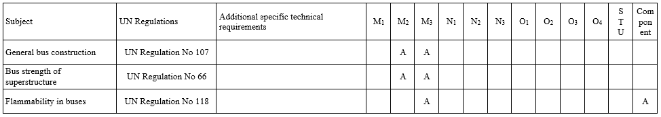
A: Carried over from current GSR, PSR or HSR
  A applies as from 3 years after adoption, i.e. immediately upon date of application, for all new vehicles
B: New requirement
  B applies as from 3 years after adoption for new types and as from 5 years for all new vehicles
C: New requirement
  C applies as from 5 years / 7 years after adoption
D: New requirement
  D applies as from 7 years / 10 years after adoption

Slide 43
For further information
http://ec.europa.eu/growth/sectors/automotive
Status of EU legislation, links to Regulations and other useful information.
https://circabc.europa.eu/w/browse/b2bc6bdb-7e39-48cd-9f16-079703cd82e6
Studies carried out by the Automotive and Mobility industries unit of DG GROW

Slide 44
European Commission
Directorate-General for
Internal Market, Industry, Entrepreneurship and SMEs
Automotive and Mobility Industries Unit
Thanks for your attention
Images in this presentation are anonymised, for illustrative purposes only and subject to the respective copyrights of the owners

