Slide 1
FIA MOBILITY & TOURISM
Gerd Preuss, FIA Representative at UNECE, WP 29 ECE-TRANS-WP29 2018-10-24 LED Replacement Light Sources
Informal document GRE-80-30
(80th GRE, 23-26 October 2018,
agenda item 5)

Slide 2
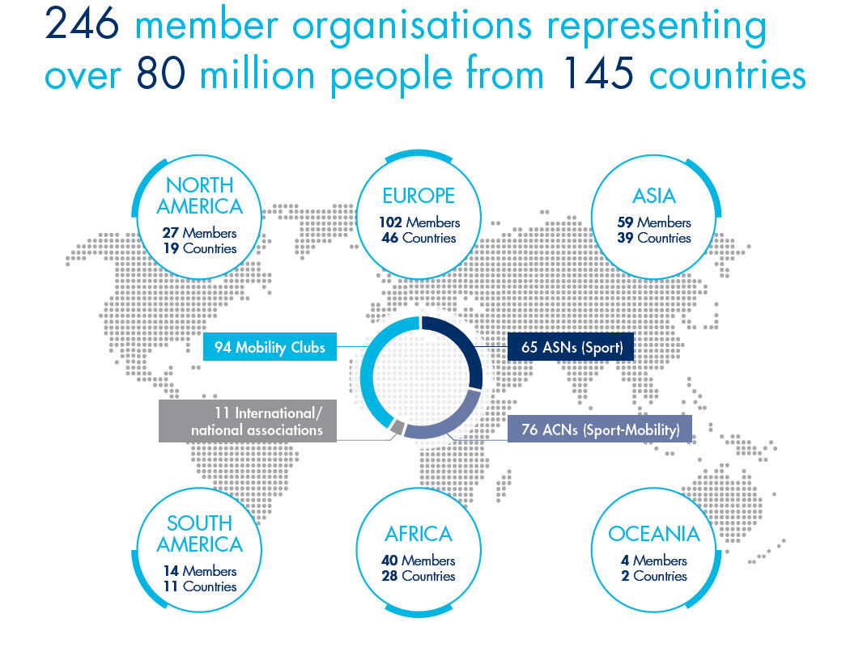
Introduction
Notes:
National Automobile Associations (ACN)
Clubs, Associations or Federations (ASN)

Slide 3
FIA Region I Policy priorities
Connecting Vehicles
Ensuring smooth development of future car connectivity, while providing motorists with informed free choice
Safeguarding mobility
Supporting efficient and affordable mobility for all
Protecting the environment
Offering intelligent mobility solutions that mitigate the impact
of transportation on the environment
Increasing road safety
Promoting 5-star drivers in 5-star cars on 5-star roads Light Sources are means to increase road safety

Slide 4
LED Replacement Light Sources
FIA supports a Regulation on Technical Requirements for LED Replacements
Technical Arguments for LED:
Higher Safety with LED
Disadvantages of Incandescent Lamps
Advantages of LED lamps
Consumer Views

Slide 5
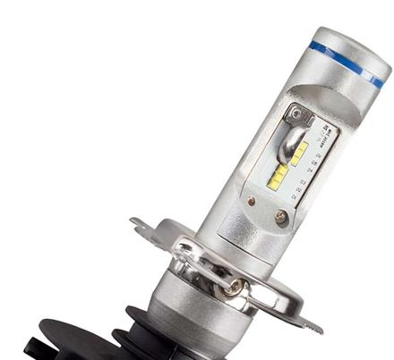
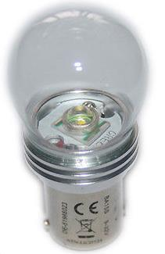
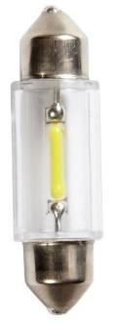
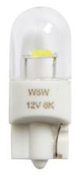
LED Replacement Light Sources as Replacement for Incandescent Lamps
LED Replacement Light Sources
FIA supports a proposal submitted by the Task Force on Substitutes and Retrofits (TF SR) which introduces requirements for the use of light emitting diode (LED) substitute light sources in the new LSD UN Regulation

Slide 6
LED Replacement Light Sources
Technical Arguments: Higher Safety with LED
15,5 % of all vehicles have one or more lamp defects
13,1 % of all vehicles equipped with lamp diagnostic systems have also one or more lamp defects
70 % to 87 % of all car head lights in Germany are equipped with incandescent lamps
The risk of fatal accidents is three times higher during night than by daylight (Source: DESTATIS)
ADAC lighting check 2017 on 5.819 vehicles in Germany (October 2017)
Notes:
https://www.adac.de/infotestrat/ratgeber-verkehr/sicher-unterwegs/lichttest/lichttest_2017.aspx?ComponentId=306758&SourcePageId=8749&quer=lichttest
Es wurden im Oktober 2017 über 5.800 Fahrzeuge (n=5.819) untersucht im Rahmen des ADAC Licht-Tests.

Slide 7
LED Replacement Light Sources
Technical Arguments: Higher Safety with LED
Test: LED Replacements switch on faster than incandescent lamps
Time advantage up to 260ms to full brightness
Distance advantage up to 3,5m at 50 km/h, leads to less time loss in response time for the driver/vehicle behind
Time Delay of Break Light with Incandescent Lamp compared to LED
Incandescent Lamp
time in ms æ

Slide 8
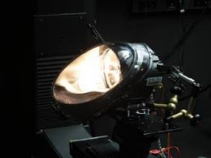
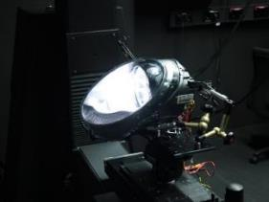
LED Replacement Light Sources
Technical Arguments: Higher Safety with LED
Replacements in Low Beam Head Lights
More brightness
Better contrast
Higher range
LED Replacements fulfill already many requirements in light distri- bution of UNECE regulations for incandescent filament lamps
Halogen
BMW MINI with Philips H4 Halogen
BMW MINI with
Nighteye H4 LED light source
Notes:
Welche Anforderungen, welche Artikel und welche Paragraphen?

Slide 9
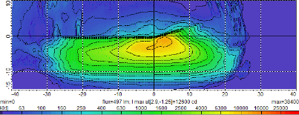
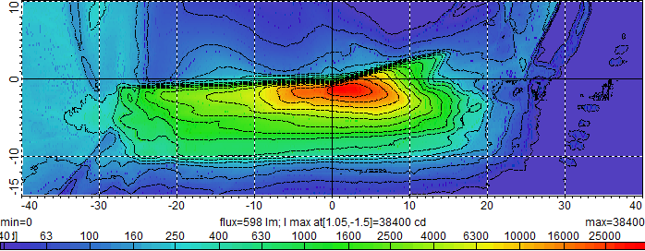
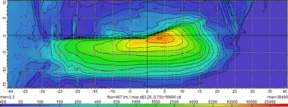
LED Replacement Light Sources in Vehicles
Technical Arguments: Higher Safety with LED
Tested with Free-form Reflector: BMW MINI (H4)
Light Distribution Low Beam – Driver´s View
Philips H4 Halogen
Philips H4 Halogen
Philips H4 LED light source
Philips H4 LED light source
Nighteye H4 LED light source
Nighteye H4 LED light source
Notes:
Driver view

Slide 10
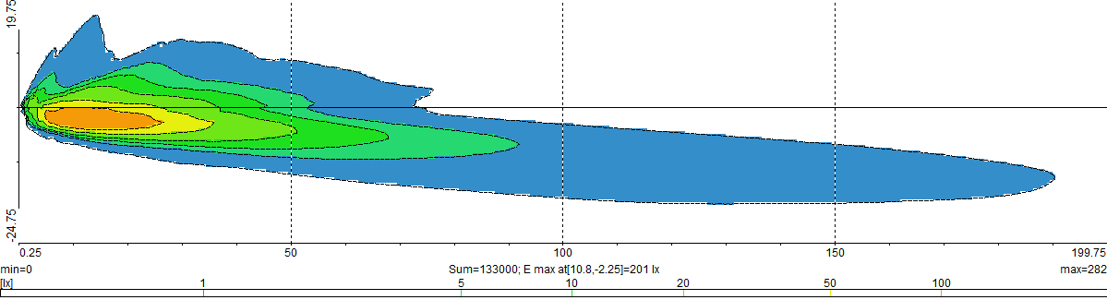
LED Replacement Light Sources
Technical Arguments: Higher Safety with LED
Test: Free-form Reflector in BMW MINI (H4) with Bird’s Eye View and Low Beam Range
Philips H4 Halogen
1lux isoline till 140 m
Philips H4 LED light source
1lux isoline till 190 m
Nighteye H4 LED light source
1lux isoline till 172 m

Slide 11
LED Replacement Light Sources
Technical Arguments: Higher Safety with LED
Free-form Reflector: BMW MINI (H4)
Table UN ECE Reg. 112 Low Beam
Functions | Min [cd] | Max [cd] | Philips H4 Halogen [cd] | N.i.O | Philips H4 LED light source [cd] | N.i.O | Nighteye H4 LED light source [cd] | N.i.O
Range:
75R | 10100 | - | 8605 | * | 16959 |  | 9274 | *
50R | 10100 | - | 10841 |  | 29970 |  | 13925
50V | 5100 | - | 6022 |  | 21536 |  | 4836 | *
25L | 1700 | - | 2631 |  | 6793 |  | 3274
25R | 1700 | - | 3324 |  | 7241 |  | 7788
Zone IV | 2500 | - | 12520 |  | 39143 |  | 16468
Glare Values:
B 50L | - | 350 | 251 |  | 163 |  | 190
BR | - | 1750 | 199 |  | 205 |  | 316
75L | - | 10600 | 2434 |  | 5670 |  | 890
50L | - | 13200 | 4733 |  | 11932 |  | 2894
Zone III | - | 625 | 548 |  | 681 | * | 3760 | *
Zone I | - | 2*E(50R) | 11978 |  | 35887 |  | 12455
Visibleness Values:
1 (8L - 4O) | 65 | - | 77 |  | 67 |  | 106
2 (H - 4O) | 65 | - | 116 |  | 93 |  | 133
3 (8R - 4O) | 65 | - | 136 |  | 64 | * | 232
4 (4L - 2U) | 125 | - | 166 |  | 92 | * | 140
5 (H - 2U) | 125 | - | 205 |  | 120 | * | 164
6 (4R - 2U) | 125 | - | 201 |  | 153 |  | 273
7 (8L - V) | 65 | - | 290 |  | 325 |  | 339
8 (4L - V) | 125 | - | 309 |  | 490 |  | 238
Notes:
glare values = Blendwert
Sichtbarkeitswerte = visibleness values (der Scheinwerfer soll auch von der Seite sichtbar sein, um die Fahrzeugbegrenzung erkennbar zu machen. Dazu ist eine gewisse Lichtstreuung zur Seite erforderlich)

Slide 12
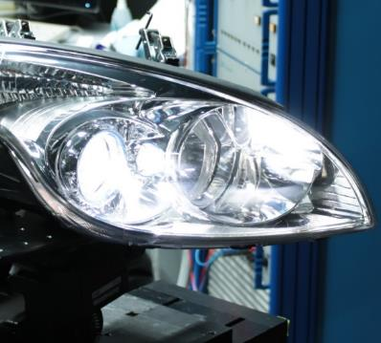
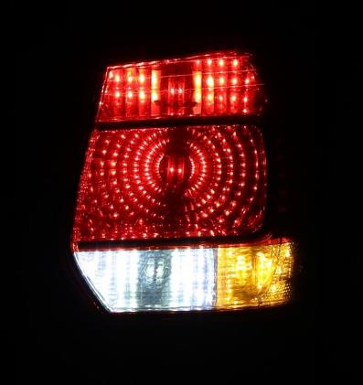
LED Replacement Light Sources
Technical Arguments: Higher Safety with LED
Lower failure rates
Better view at night
Easier detection of pedestrians
Higher protection for motorcycles
Faster signalling of braking procedures
Retrofitting for present vehicle fleet
Better equipment for older vehicles
Shock proof lamps for trailors
Osram H7 LED Retrofit lamp
in Hyundai i30 head light
Philips LED Replacement Light Sources in
VW Golf VI Variant rear light with clear cover

Slide 13
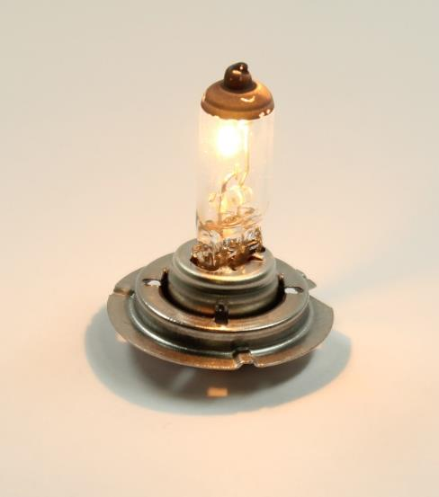
LED Replacement Light Sources
Technical Arguments: Disadvantages of incandescent lamps
Incandescent filament lamps are sensitive to
Voltage Fluctuation
Vibration
Shock Force
Life time requirements
This leads to defects of lamps and less safety if not replaced in time
H7 Halogen incandescent filament lamp

Slide 14
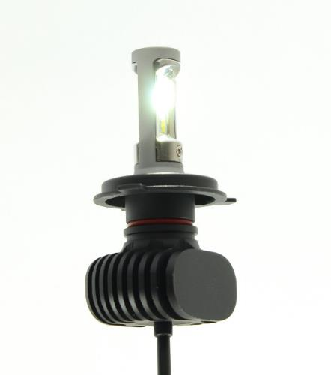
LED Replacement Light Sources
Technical Arguments: Advantages of LED lamps
LED lamps are robust in terms of
Voltage fluctuations
Vibrations
Shock forces
Life time requirements
Further advantages of LED lamps are
Lower power consumption
Less heat emission
NightEye H4 LED Retrofit lamp
All reports are available at (in german only):
https://www.adac.de/infotestrat/technik-und-zubehoer/licht/lichttechniken/
Notes:
e.g. Eco Innovation for LED in Europe

Slide 15
LED Replacement Light Sources
Consumers View
LED Replacemts are already available on the market and in some markets outside Europe, they are already „allowed“
Consumers have no understanding for prohibition of LED Replacements in vehicle use in Europe
Consumers in Europe cannot make a distinction betwenn good and bad performing LED replacement light sources, due to missing regulative technical requirements
A Regulation for LED Replacements developed by GRE, will give industry safety guidelines with benefits for both: the consumer and the vehicle safety
R22 Example (Helmets)

