Slide 1
GRE Task Force LED Retrofits / Substitutes (TFSR) Status report for GRE79
Submitted by TF SR
Informal document GRE-79-16
(79th GRE, 24-27 April 2018, agenda item 5)
2018-04-19
K. Manz, DE (Chairman)
Ph. Bailey, UK (Vice-Chairman)
Ph. Plathner, IEC (Secretary)

Slide 2
Meetings
1st meeting: 2017-12-14, Aachen (report: TFSR-01-11)
2nd meeting: 2018-02-06, Bonn (report: TFSR-02-05)
3rd meeting: 2018-03-27, Brussels (report: TFSR-03-09)
Planned:
4th meeting: 2018-06-06 Brussels
Two-step approach:
Step 1: LED substitutes
Step 2: LED retrofits (no detailed discussion started yet)

Slide 3
LED substitutes and LED retrofits
Both are intended as replacement parts for filament light sources (R37), fulfilling photometric equivalence
LED Substitute
Application: Original Manufacturer installation on vehicles approved according R48/R53/R74/R86 for use of these light sources:
Either initial approval or after approval extension for device and/or for vehicle
With standardised interlock-feature to prevent mis-use as “retrofit”
Interlock can be realized mechanically, electrically etc; defined per category in the R.E.5 sheet by reference to the relevant cap/holder sheets IEC 60061
LED retrofits
Intended to be installed on “existing” vehicles (i.e. installation on vehicles not type-approved according R48/R53/R74/R86 for the use of substitutes)
Using the same cap as existing filament light sources

Slide 4
Step 1: LED substitutes
Light sources approved according to R128 (initially proposed by GTB)
Categories defined in R.E.5, starting with PY21W/LED in new Group 4 (initially proposed by GTB)
A keying was requested by some delegations in GRE to prevent mis-use in existing vehicles (e.g. for PY21W/LED with an additional pin), defined in IEC 60061
Different possible solutions were discussed in the TF S/R (for details see next slide)
Devices approved according R-LSD for both filament and LED substitute (initially proposed by GTB) and having a “substitute holder”
Vehicle approved according to R48, R53, R74 or R86 for use of both filament and LED substitute, (initially proposed by GTB)

Slide 5
Step 1: LED substitutes possible solutions for keying- Details
Colour keying
- simple solution
- do not physically prevent mis-use
→ no sufficient support by GRE experts;
Physical keying as demonstrated in GRE 78
- safe solution to avoid mis-use
- not simple to carry out by finding useful technical solutions
- not applicable to all existing cap-holder systems (especially small light sources)
- industry has provided further investigations on several different cap-holder systems
→ the discussion results in the solution “standardized Interlock “.
Mechanical
Electrical
etc

Slide 6
Changes to R128 (see TFSR-03-02)
Additional requirements for LED substitutes
User information on the package
User instruction in the package and at the point-of-sales
Website with approved application
Warning message for intended use
Information symbol on the product and on the package
Specification of minimum and maximum electrical current
Compliance with technical requirements of R10 (ESA)
No light in first 2ms
Testing at elevated temperature (80°C, see R.E.5)
White light <3000K

Slide 7
Changes to R.E.5 (see TFSR-03-03)
Introduction of Group 4: “LED substitute light source categories¹ only for use in lamps approved with filament light source(s) of its counterpart light source category “; with list of counterpart filament category
A new sheet for each new substitute category (starting with “PY21W/LED”)
Specifying essential electrical and photometric characteristics (based on equivalence principle)
Referring to a “special” cap/connector/interface in IEC 60061
Specifying dedicated minimum and maximum current for “normal operation” and “failure”

Slide 8
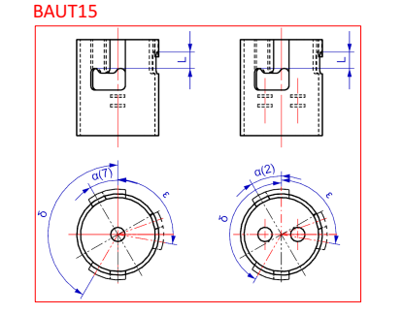
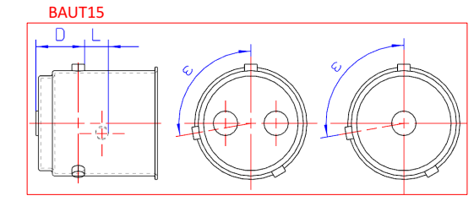
Mechanical “interlock” for PY21W/LED with a an additional pin
BAUT15
Preventing insertion of an PY21W/LED in existing (“filament only”) holders
Allowing the insertion of PY21W in the substitute-holder
Substitute-Cap
Substitute-Holder

Slide 9
Changes to R-LSD (see TFSR-03-04)
Adding option of additional approval with LED substitute
Additional photometric and colorimetric testing during type-approval with LED substitute
COP testing only with filament light source
Light source marking visible when installed (only for LED substitutes)

Slide 10
Changes to R48, R53, R74 and R86 (see TFSR-03-05)
Optional allowance of lamps that have been approved for LED substitutes
The use of lamps approved for and equipped with LED substitute light source(s), is allowed exclusively in the case when a the statement in the communication sheet is present and positive.
both at the type approval and in the conformity of production, the presence of the marking on the lamps related to the use of LED substitute light source(s) shall be checked.

Slide 11
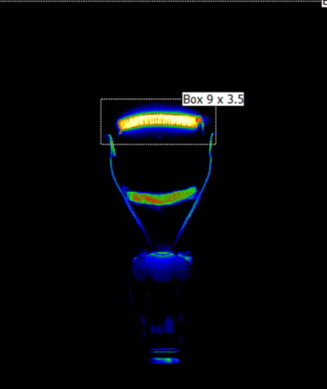
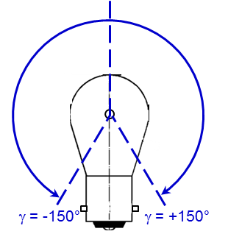
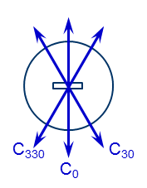
Guidance Document on Equivalence (see TFSR-03-06)
Geometric
Light center length
Mechanical
Cap/interlock
Photometric
Luminous flux
Colour
Near-field characteristics
Far-field characteristics
Electrical
Connector
Power consumption

Slide 12
Step 2: LED retrofits
No detailed discussion yet;

