Slide 1

Informal document GRB-69-08
(69th GRB, 22-25 January 2019,
agenda items 7 (c))
Amendment to regulation UN 117
Introduction of worn tyre performances
69th GRB January 2019

Slide 2
Why to approve worn tyre?
New EU regulation on type-approval requirements:
(19) The Union should continue to promote the development of technical requirements for tyre noise, rolling resistance and wet grip performance of tyres at the United Nations level. This is because UN Regulation No 117 now contains these detailed provisions. The process of adapting the requirements on tyres to take account of technical progress should continue at United Nations level, in particular to ensure that tyre performance is also assessed at the end of a tyre's life in its worn state and to promote the idea that tyres should meet the requirements throughout their life and not be replaced prematurely. Existing requirements in Regulation (EC) No 661/2009 relating to tyre performance should be replaced by equivalent UN Regulations.
Worn state tire shall be tested
69th GRB January 2019

Slide 3
Not be replaced prematurely:
Current removing practice :
50% of the Tyres are removed before 3 mm tread depth!!
Current regulation (e.g. UN 30 for passenger cars) and consensus :
Depth of the sculpture : 1,6 mm -0/+0,6
Effects on environment:
      Due to the over-production of tyres:
depletion of resources (deforestation),
waste (+25%),
greenhouse gas emissions
+6,6 Mt CO2 eq
(*)
      Due to the over-consumption of the vehicle:
greenhouse gas emissions
Current value of tread wear indicator (<= 2,2mm) shall be kept
(*) Ernst & Young study:
Planned obsolescence is not inevitable - June 2017
69th GRB January 2019

Slide 4



Worn Tyre Performances: Noise?, Rolling Resistance? Wet Grip?
Noise Performances :
    On average, noise decreases by 1 dB between the new and the worn tyre state.
Rolling Resistance Performances:
    Rolling resistance decreases by about 20% between the new and the worn tyre state.
Wet Grip Performances :
    Wet grip deteriorates systematically between the new and the worn tyre state.
New
Only wet grip performances shall be taken into account
Worn
69th GRB January 2019

Slide 5
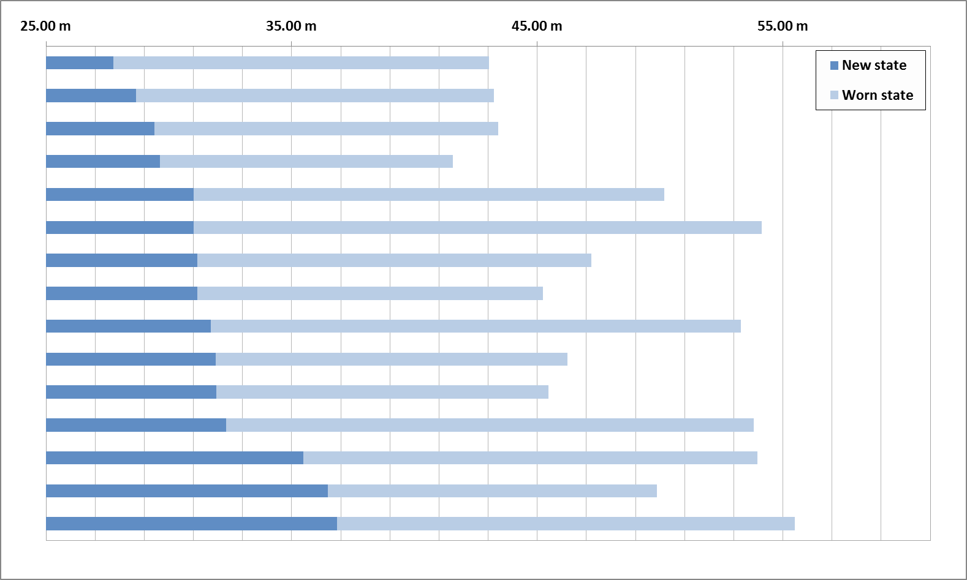
Does it exist a relationship between the wet grip performances at new tyre state and worn tyre state?
Wet braking distance (15 tyres)
Tyre performance at new state
doesn’t give an indication of the
tyre performance at worn state
The both configurations shall be tested
69th GRB January 2019

Slide 6

How to approve the tires in both configurations (new and worn state)?
If possible by using a method based on the same principle (avoid to create a burden for the tire manufacturers and the technical services)
Current regulatory methods described in UN 117 regulation.
Trailer method
Or
Vehicle method
New tyre to be approved in comparison to the new reference tyre (SRTT)
Wet grip index_{new} : G_{N}
Worn tyre to be appoved in comparison to the worn reference tyre (SRTT)
Wet grip index_{worn} : G_{W}
69th GRB January 2019

Slide 7
Which level of performance can we require?
The same limits of wet grip index (G) than those defined in the regulation UN 117
without severisation for the worn state
Normal tyre | Snow tyre | Snow tyre for use in severe snow conditions | Special use tyre
≥ 1.1 | ≥ 1.1 | ≥ 1.0 or ≥ 0.9* | Not defined
*: depending on the speed symbol
Same relative performance for the worn tyres
69th GRB January 2019

Slide 8
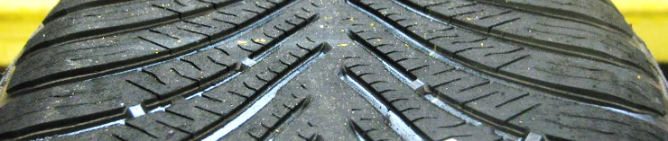
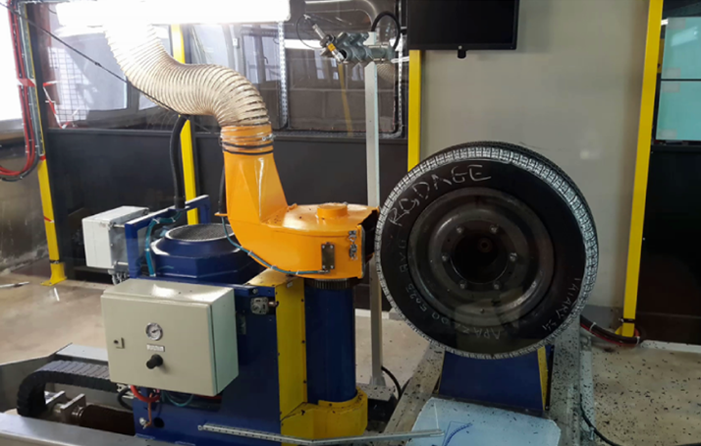
How to obtain the worn tyre state?
By using a standardized method: ASTM F1046-01(2015)
The wear is obtained artificially through a buffing of the tread pattern
New state
-X %
X% Reduction
2 mm +/-0,2
69th GRB January 2019

Slide 9
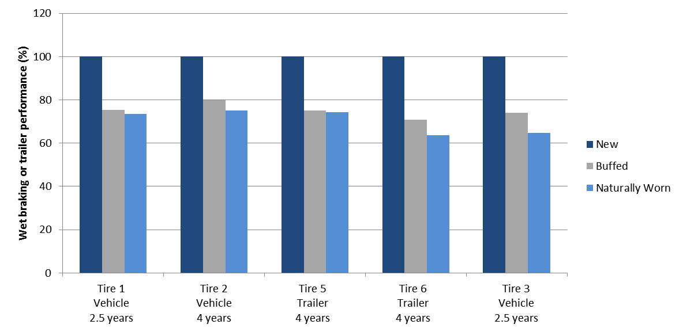
Is this method representative of a natural wear?
Loss of braking performance of worn tire (buffed or naturally worn) versus new tire (%)
The buffed tyre performance is very close to the naturally worn tyre
69th GRB January 2019

Slide 10
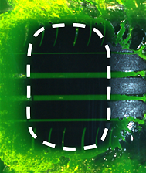
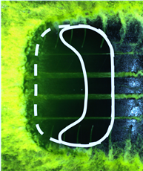
Conditions of tests: Are they representative of the mechanisms involved in the contact area?
Main mechanism in R117 for the new state : pure grip (full contact patch)
Worn tyre : balance of two mechanisms (grip + hydroplaning)
Grip
aera
Hydroplaning
area
Braking
80 km/h
40 km/h
20 km/h
Test conditions are relevant for the worn tyre testing , in terms of mechanisms balance
69th GRB January 2019

Slide 11



Conditions of tests: Are they relevant also for worn tyre testing ?
Height of water: 1mm +/-0.5 (value in regulation UN 117)
Water depth distribution when road is wet
0.5 mm
1 mm
82%
17 %
< 1%
Test Speeds: 80 Km/h (Vehicle) or 65 km/h (Trailer) in regulation UN R117
Percentage of cases where the initial speeds were before the accidents
< 65 km/h | < 80 km/h
81.9% | 89.1%
Water height and speeds are relevant to measure grip performance and hydro performance in the worn state.
69th GRB January 2019

Slide 12
When could we apply the new amendment of regulation UN 117?
From the date of entry into force of the new amendment:
Voluntary application (upon the wish of the tire manufacturer):
69th GRB (2019)
[Entry into force ( 2021)]
[71 th GRB (2020)]
Adoption
[WP29 (June 2020)]
Vote
Mandatory date for new type of tyre upon the request of CP’s :
[ 1st September 2026]
Mandatory date for new tyre upon the request of CP’s :
[ 1st September 2029]
69th GRB January 2019

Slide 13
Conclusions
The assessment of the wet grip performance on tyres in worn state is relevant.
The UN 117 method used to evaluate the wet grip performance of new tyres can also be used for worn tyres.
The addition to the existing method is limited to a preparation of the tread of the tyres (candidate and SRTT).
The same limits in term of level of relative performance can be used both new and worn tyres.
The mandatory dates are proposed to apply this new amendment.
69th GRB January 2019

Slide 14
THANK YOU FOR YOUR ATTENTION
69th GRB January 2019

