Slide 1
TRANSPORT AND LOGISTICS IN REPUBLIC OF KAZAKHSTAN AND KYRGYZ REPUBLIC: STATUS AND PROSPECTS OF DEVELOPMENT
United Nations Economic Commission for Europe
Expert of the UNECE Sustainable Transport Department Head of the Department of Logistics of the Institute of Business of the Belarusian State University, Ph.D., professor Molokovitch Anatoli

Slide 2
CONTENTS
United Nations Economic Commission for Europe
CONTENTS OF THE SUBJECT OF RESEARCH
BRIEF ANALYSIS OF THE ECONOMIC STATUS OF THE REPUBLICS
ANALYSIS OF THE STATUS OF THE ROAD SECTOR AND AUTOMOBILE TRANSPORT
ANALYSIS OF THE STATE OF RAILWAY TRANSPORT
ANALYSIS OF THE STATE OF WATER TRANSPORT
ANALYSIS OF THE STATE OF CIVIL AVIATION
ANALYSIS OF LOGISTIC STATUS
LEGISLATIVE BASE IN TRANSPORTATION SPHERE
PROPOSALS FOR THE DEVELOPMENT OF TRANSPORT AND LOGISTICS

Slide 3
VOLUMES OF CARGO TRANSPORTATION
United Nations Economic Commission for Europe
CARGO TRANSPORTATION BY ALL TYPES OF TRANSPORT, mln. tons
KAZAKHSTAN
KYRGYZSTAN

Slide 4
STRUCTURE OF CARGO TRANSPORTATION
United Nations Economic Commission for Europe
STRUCTURE OF CARGO TRANSPORTATION BY TYPE OF MESSAGES

Slide 5
ROAD SECTOR
United Nations Economic Commission for Europe
STRUCTURE OF HIGHWAYS
Road of Kazakhstan | Total |  | With paved surface
 | km | % | km | %
Public roads | 95410 | 100,0 | 81814 | 85,7
Including:
national significance | 24100 | 25,3 | 22532 | 93,5
regional significance | 33120 | 34,7 | 31246 | 94,3
district significance | 38190 | 40,0 | 28036 | 73,4
Road of Kyrgyzstan | Total |  | With paved surface
 | km | % | km | %
Public roads | 18811 | 100,0 | 8089 | 43,0
Including:
international significance | 4090 | 21,7 | 3358 | 82,1
state significance | 5616 | 29,9 | 1600 | 41,0
local significance | 9105 | 48,4 | 1844 | 26,7

Slide 6
ROAD SECTOR
United Nations Economic Commission for Europe
QUALITY OF PUBLIC ROADS
Road of Kazakhstan | Total, km | By category, %
 |  | good | satisfactory | unsatisfactory
Public roads | 95410 | 38,5 | 49,4 | 12,1
Including:
national significance | 24100 | 51,0 | 35,0 | 14,0
regional significance | 72443 | 21,0 | 43,5 | 35,5
Road of Kyrgyzstan | Total, km | By category, %
 |  | good | satisfactory | unsatisfactory
Public roads | 18811 | - | - | -
international significance | 4090 | 82,1 | 17,7 | 0,2
international road corridors | 2232 | 100,0 | - | -

Slide 7
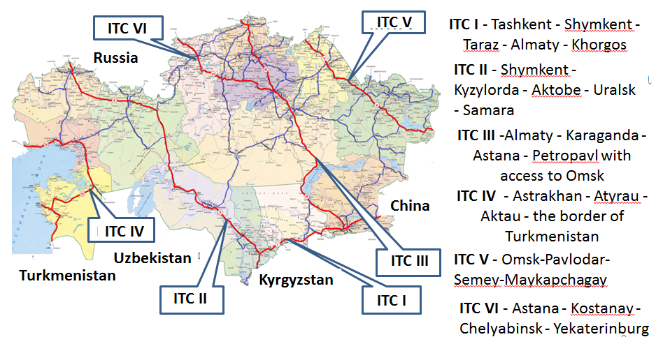
ROAD SECTOR
United Nations Economic Commission for Europe
INTERNATIONAL ROAD TRANSPORT CORRIDORS OF THE REPUBLIC OF KAZAKHSTAN

Slide 8
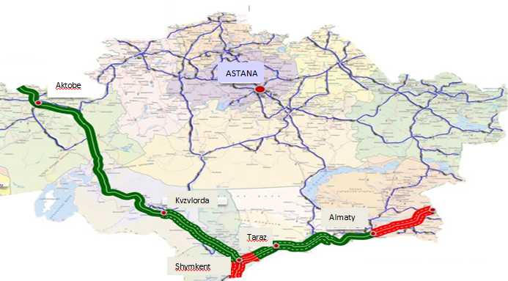
ROAD SECTOR
United Nations Economic Commission for Europe
KAZAKHSTAN SECTION OF THE TRANSCONTINENTAL CORRIDOR "WESTERN EUROPE - WESTERN CHINA"

Slide 9
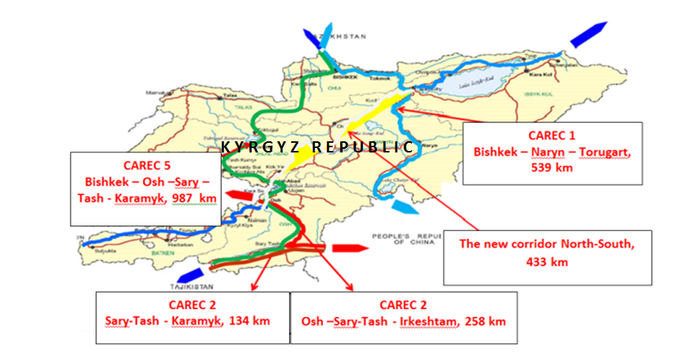
ROAD SECTOR
United Nations Economic Commission for Europe
CAREC TRANSIT ROADS PASSING THROUGH KYRGYZSTAN
3

Slide 10
ROAD SECTOR
United Nations Economic Commission for Europe
ALTERNATIVE NORTH-SOUTH HIGHWAY

Slide 11
TRANSPORT
United Nations Economic Commission for Europe
INDICES OF TARIFFS FOR FREIGHT TRAFFIC, %
Kazakhstan | 2012 | 2013 | 2014 | 2015 | 2016
Transport, total | 115,9 | 102,4 | 113,6 | 125,9 | 104,6
Including:
railway | 114,8 | 101,7 | 105,7 | 120,8 | 103,9
road | 105,0 | 101,4 | 103,2 | 98,4 | 101,6
internal water | 104,5 | 100,4 | 103,1 | 99,5 | 100,0
air | 104,3 | 100,0 | 100,0 | 100,0 | 122,3
Kyrgyzstan | 2012 | 2013 | 2014 | 2015 | 2016 | 2017
Transport, total | 99,7 | 109,8 | 126,5 | 114,5 | 113,6 | 105,5
Including:
railway | 99,3 | 110,3 | 128,8 | 116,0 | 115,4 | 106,2
road | 101,6 | 111,5 | 117,3 | 105,2 | 98,9 | 98,6
internal water | 104,9 | 96,1 | 108,9 | 100,0 | 100,0 | 100,0
air | 103,5 | 112,9 | 109,8 | 99,5 | 92,8 | 100,1

Slide 12
ROAD SECTOR
United Nations Economic Commission for Europe
RECOMMENDATIONS FOR THE DEVELOPMENT OF THE ROAD SECTOR
Continue the integration of the ITC into the Euro-Asian transport network.
Develop the road sector as an independent business structure based on PPP.
Continue the construction of new road sections to solve the problems of interregional automobile communication.
Expansion of toll road network.
Put in order roads with regulatory requirements.
Construction of bypass roads around major cities to reduce the negative impact of vehicles on the environment.
Provide road maintenance at a level that ensures safe, year-round transport of vehicles.
Stimulate the development of road infrastructure.
Creation of an effective control system for vehicle weight and dimensional parameters.

Slide 13
ROAD TRANSPORT
United Nations Economic Commission for Europe
RECOMMENDATIONS FOR THE DEVELOPMENT OF ROAD TRANSPORT
Make efforts to provide villages and small towns with quality transport services.
Develop public-private partnership in the field of road transport.
Continue liberalization of cabotage shipping within the framework of EEU.
Increase the share of domestic carriers in the national market of international road transport by reducing quotas for foreign carriers and developing forwarding services.
Increase the fleet of vehicles suitable for shipping of goods with a special temperature regime, increase the speed and safety of delivery of goods.
Reduce the share of transport costs in the cost of the final product due to the development of transport logistics.
Develop a flexible policy of transit tariffs to attract transit traffic.
Improve the quality of services provided by domestic operators in the field of international cargo transportation.
Develop container and combined transport to reduce the cost of transport services.
Implement an electronic document management system for the transport of goods, both internationally and in national connection.

Slide 14
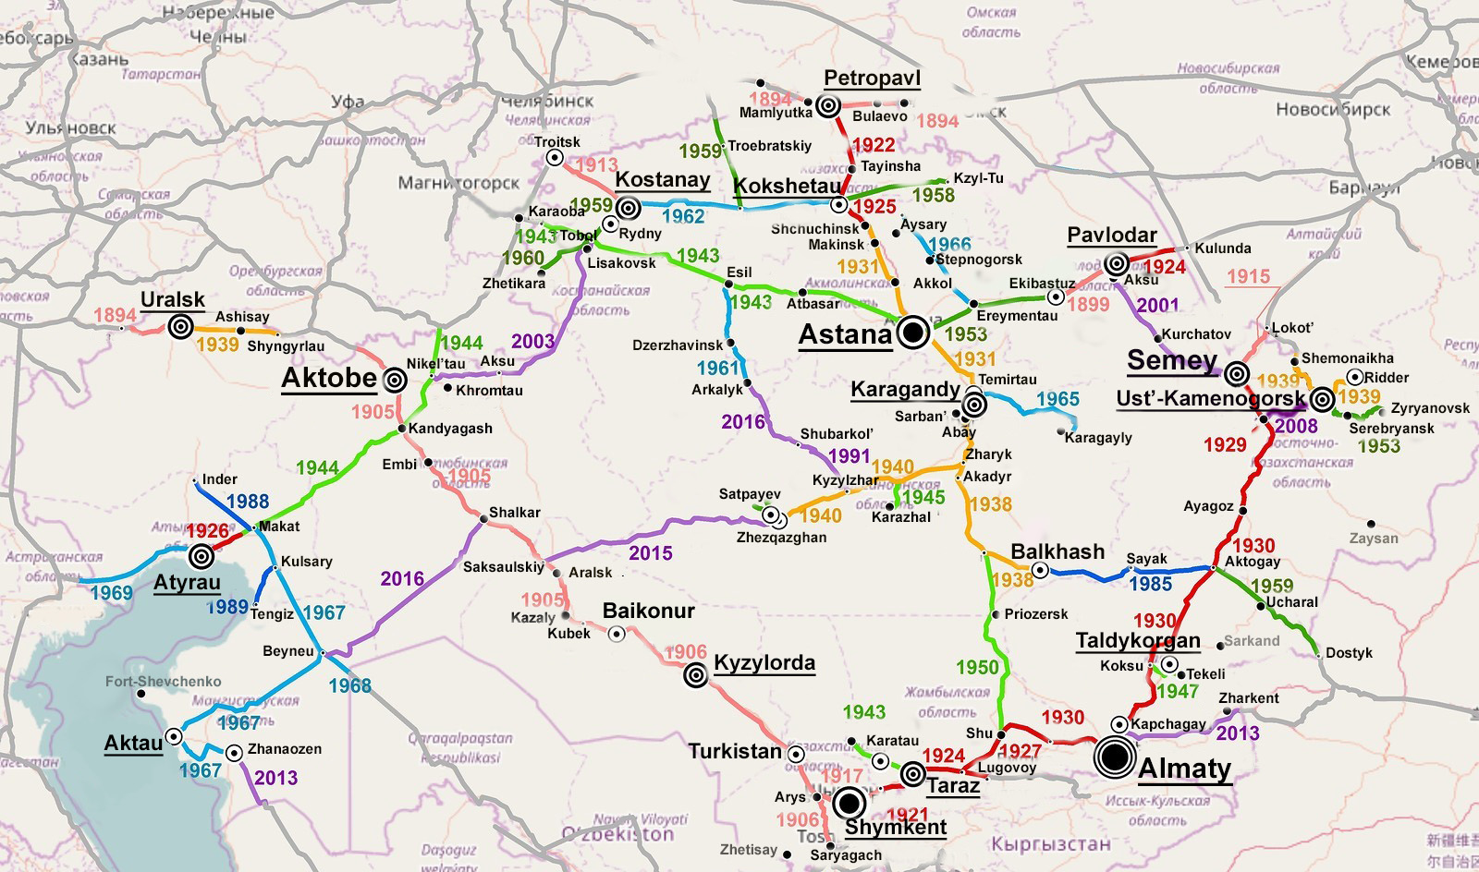
RAILWAY TRANSPORT
United Nations Economic Commission for Europe
THE SCHEME OF RAILWAYS OF THE REPUBLIC OF KAZAKHSTAN

Slide 15
RAILWAY TRANSPORT
United Nations Economic Commission for Europe
DYNAMICS OF FREIGHT TRANSPORTATION BY RAIL OF KAZAKHSTAN
 | 2012 | 2013 | 2014 | 2015 | 2016 | 2017
Cargoes transported, million tons | 294,8 | 293,7 | 275,3 | 341,4 | 338,9 | 378,8
Share in total traffic | 9,1 | 8,4 | 10,4 | 9,1 | 9,1 | 9,7
Share in the total freight turnover | 49,3 | 46,7 | 50,6 | 48,9 | 46,1 | 47,2
DYNAMICS OF CARGO TRANSPORTATION BY TYPES OF MESSAGES
 | 2012 | 2013 | 2014 | 2015 | 2016
Cargoes transported, million tons | 294,8 | 293,7 | 275,3 | 341,4 | 338,9
including by types of messages:
International | 46,1 | 46,8 | 44,0 | 40,1 | 38,5
CIS countries | 88,0 | 100,0 | 86,8 | 88,5 | 89,0
transit | 12,0 | - | 13,2 | 11,5 | 11,0
Inside the republic | 53,9 | 53,2 | 56,0 | 59,9 | 61,5

Slide 16
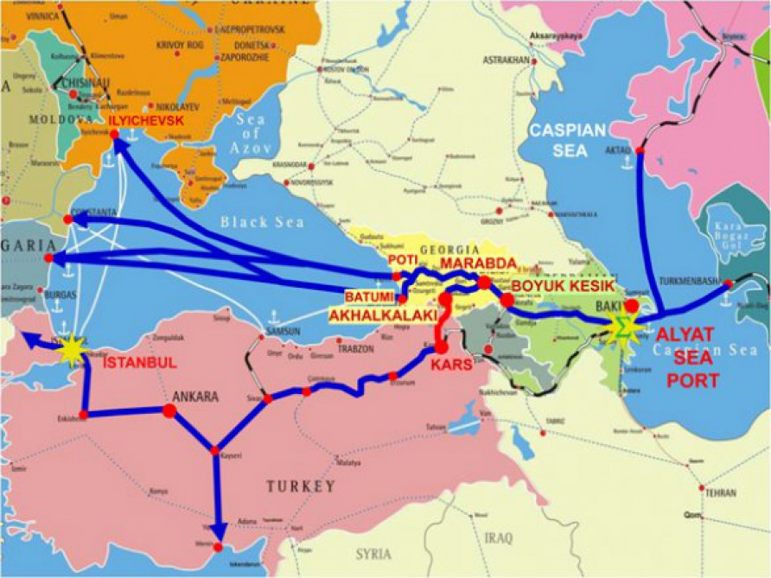
RAILWAY TRANSPORT
United Nations Economic Commission for Europe
TRANS-CASPIAN INTERNATIONAL TRANSPORT ROUTE

Slide 17
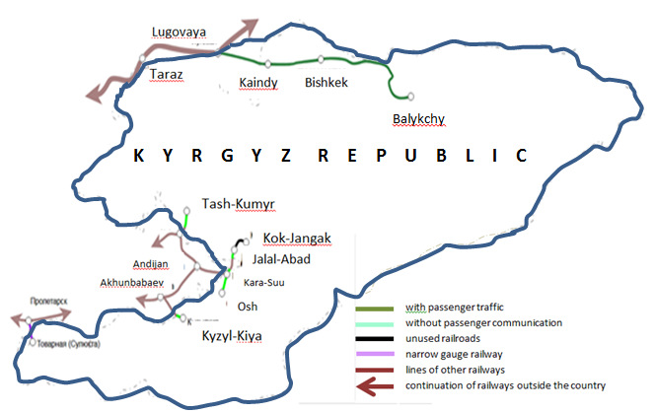
RAILWAY TRANSPORT
United Nations Economic Commission for Europe
THE SCHEME OF RAILWAYS OF THE KYRGYZ REPUBLIC

Slide 18
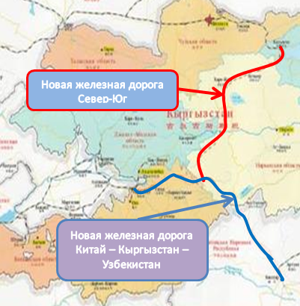
RAILWAY TRANSPORT
United Nations Economic Commission for Europe
RAILWAY PROJECTS “NORTH-SOUTH” AND “CHINA-KYRGYZSTAN-UZBEKISTAN”
New railway "North-South"
K Y R G Y Z S T A N
New railway "China - Kyrgyzstan - Uzbekistan"

Slide 19
RAILWAY TRANSPORT
United Nations Economic Commission for Europe
RECOMMENDATIONS FOR THE DEVELOPMENT OF
RAILWAY TRANSPORT
Continue work for organization of the carriage of goods by container trains in transit through Kazakhstan and Kyrgyzstan.
Fix unified competitive tariffs for a long period for the development of the Trans-Caspian route.
Organize high-speed freight trains to transport perishable goods from south to north and back.
Electrify main rail lines.
Build a second lines on the main rail routes.
Develop a system of freight forwarding services in railway transport.
Introduce a system of preliminary information on railway transport.
Implement a system for monitoring the movement of goods.
Expand the carriage of goods using the CIM / SMGS consignment note.
Search for investors to start construction of a transcontinental railway corridor “China - Kyrgyzstan – Uzbekistan”.
Create a unified railway network connecting the north and south of Kyrgyzstan

Slide 20
WATERWAY TRANSPORT
United Nations Economic Commission for Europe
DYNAMICS OF CARGO TRANSPORTATION VOLUMES BY INLAND WATERWAY TRANSPORT BY TYPE OF MESSAGES
IN KAZAKHSTAN
 | 2012 | 2013 | 2014 | 2015 | 2016
Cargo, luggage, transported, th. tons | 1290,7 | 1106,5 | 1320,8 | 1218,9 | 1188,6
including by types of messages:
International,% | 4,3 | 0,7 | 0,4 | - | -
CIS countries, % | 100,0 | 100,0 | 100,0 | - | -
Inside republic,% | 9,4 | 11,0 | 6,9 | 7,9 | 7,2
Suburban,% | 86,3 | 88,3 | 92,7 | 92,1 | 92,8

Slide 21
WATERWAY TRANSPOR
United Nations Economic Commission for Europe
RECOMMENDATIONS FOR THE DEVELOPMENT OF WATER TRANSPORT
Build in the port of Kuryk automobile berth and road from the village of Kuryk to the port of Kuryk for the development of multimodal transport.
Increase the number of self-propelled Ro-Ro type ships based on the volume of cargo traffic.
Build a “dry port” at the port of Aktau to increase the volume of transported goods.
Expand the range and improve the quality of logistics services provided in the sea and river ports.
Reduce the share of transportation costs in the cost of final products due to the development of multimodal transport involving sea transport.
Develop river-sea cargo transportation between Russia and Kazakhstan.
Increase the volume of cargo transportation in containers.
Develop a public-private partnership mechanism on water transport.
Develop forwarding services in water transport.
Build in the port of Kuryk shipbuilding and ship repair plant.
Adopt the Law on Inland Water Transport in Kyrgyzstan.
Create attractive conditions for investment development of water transport.

Slide 22
CIVIL AVIATION
United Nations Economic Commission for Europe
INCOME STRUCTURE OF AIR TRANSPORT ENTERPRISES

Slide 23
CIVIL AVIATION
United Nations Economic Commission for Europe
RECOMMENDATIONS FOR THE DEVELOPMENT OF CIVIL AVIATION
Improve national legislation in accordance with ICAO regulations.
Create a modern system of flight safety and aviation security.
Development of material base through the purchase of aircraft for long-haul transport and for small aircraft.
Ensure transport accessibility to remote regions.
Create cargo terminals at international airports to handle cargo traffic.
Create conditions for the development of competition in the field of air cargo.
Stimulation of multimodal transport of cargoes with the participation of air transport.
Develop transport and warehouse logistics in air transport.
Raise the level of staff qualifications for working at cargo terminals regularly.
Make efforts to use the airports of Astana, Almaty and Bishkek as transit hubs for cargo transshipment and aircraft maintenance.
Take measures to remove the Kyrgyz airline from the EU “black list”.

Slide 24
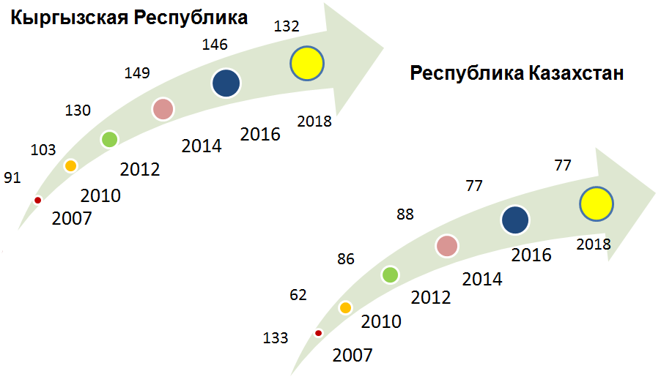
LOGISTICS
United Nations Economic Commission for Europe
LOGISTICS EFFICIENCY INDEX
KYKYRGYZSTANAN
KAZAKHSTAN

Slide 25
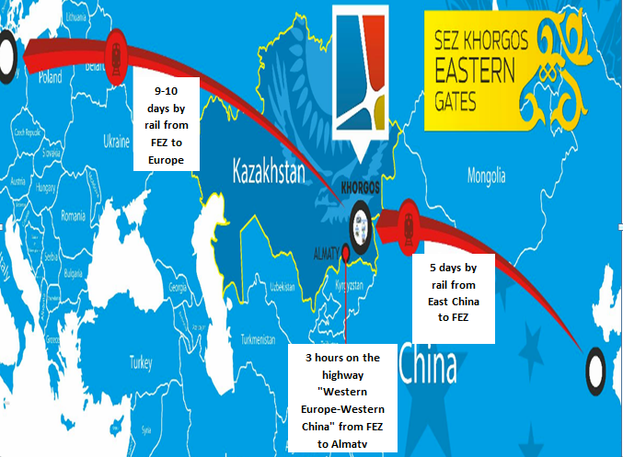
LOGISTICS
United Nations Economic Commission for Europe
STRATEGIC LOCATION OF THE FEZ "KHORGOS — EASTERN GATES"
99

Slide 26
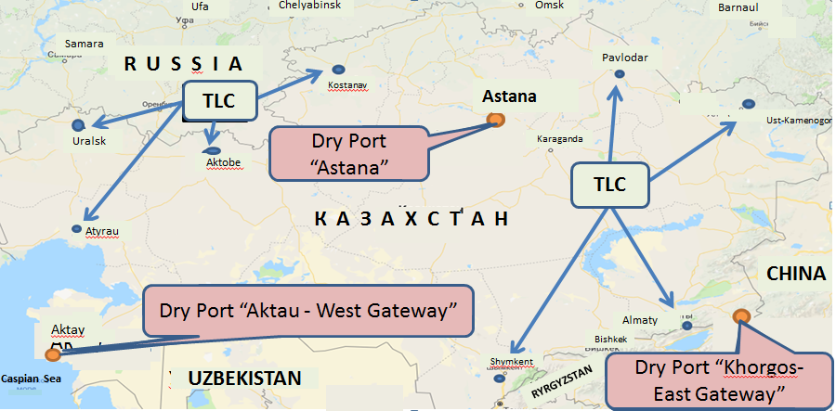
LOGISTICS
United Nations Economic Commission for Europe
CONCEPTUAL LOCATION OF DRY PORTS AND TLC
IN KAZAKHSTAN

Slide 27
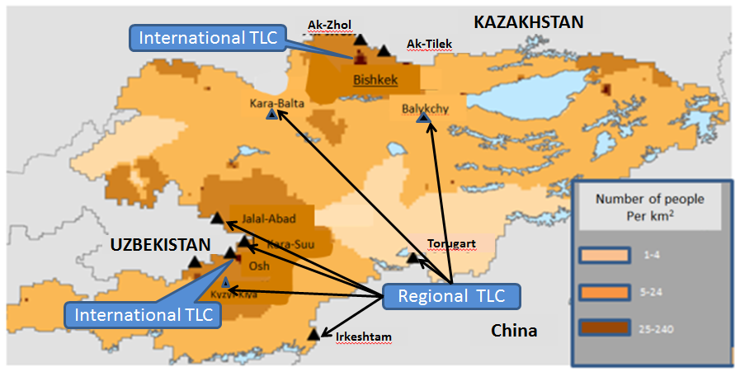
LOGISTICS
United Nations Economic Commission for Europe
PLANNED LOCATION OF LOGISTICS CENTERS IN THE KYRGYZ REPUBLIC

Slide 28
LOGISTICS
United Nations Economic Commission for Europe
RECOMMENDATIONS FOR THE DEVELOPMENT OF LOGISTICS
To provide state support for the integration of transport and logistics systems of countries in the Euro-Asian transport and logistics system.
Identify the organization responsible for the development of logistics.
Approve the form of reporting on logistics activities and oblige legal entities and individuals engaged in logistics activities to submit reports.
Establish tax and other preferences in the implementation of logistics activities.
Create state support at the stage of infrastructure creation.
Create a three-tier system of logistics centers: "dry ports", LC in large cities and a wide network of small LCs.
To continue the practice of creating logistics centers in the states where the main cargo flows are formed.
Considering the importance of the Trans-Caspian corridor, create an effective network of logistic operators at the points of formation and transshipment of goods.
Ensure the effective functioning of customs logistics.
Reduce logistics costs in supply chains.
Go from the practice of competition of transport routes to competition of supply chain logistics.
Open the specialty “Logistics” in universities.

Slide 29
United Nations Economic Commission for Europe
Thanks for attention

