Slide 1
UNECE SUSTAINABLE TRANSPORT DIVISION
Amendments to the AGN Agreement
Sixty-first session of the UNECE Working Party on Intermodal Transport and Logistics (WP.24) 19-21 November 2018

Slide 2
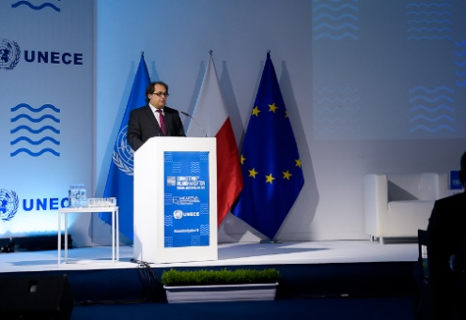
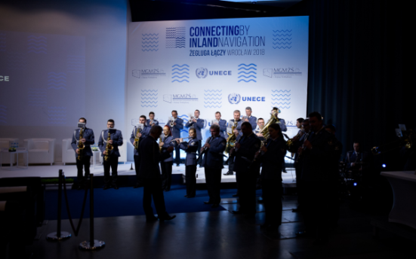
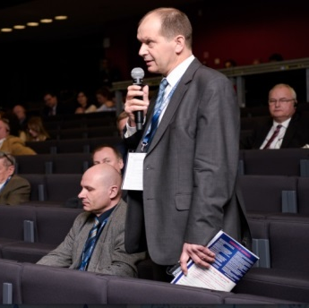
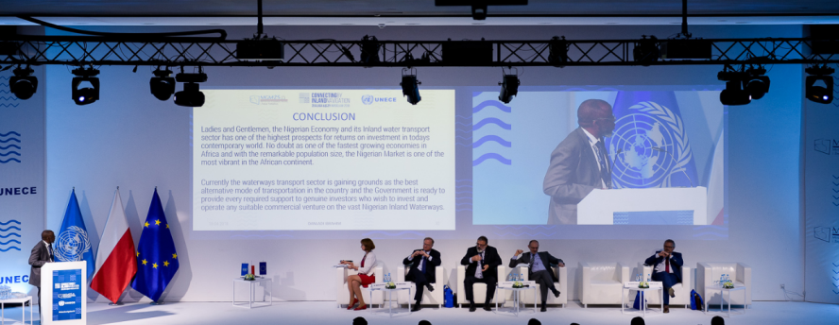
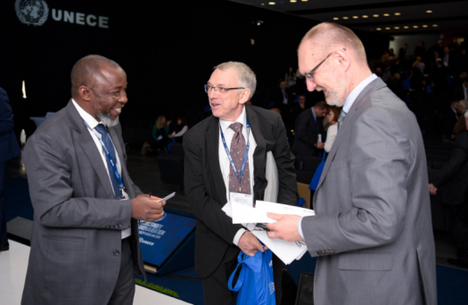
Wrocław, Poland, 18-19 April 2018
Organized jointly by UNECE and the Ministry of Maritime Economy and Inland Navigation of Poland
More than 400 participants from 24 countries
European Commission, River Commissions, international associations and organizations, basin authorities and other key players
Ministerial plenary session and six thematic panel discussions
Signing the Ministerial Declaration and a poster

Slide 3
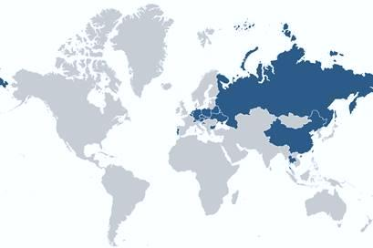
Ministerial Declaration “Inland Navigation in a Global Setting”
Signed already by 17 UN member States
Open for signature
Main objectives till 2023:
To foster the role of inland water transport as safe, environmentally sound and economically efficient
To address the challenges of sustainable development of mobility, also through inland water transport, by supporting intergovernmental multi-disciplinary cooperation in the field of transport
To encourage investment in the sector aimed at building and modernizing the inland waterway infrastructure, the fleet and ports as well as fostering innovation and using alternative fuels
To promote the attractiveness of the sector to the market and transport workers and increasing its competitiveness

Slide 4
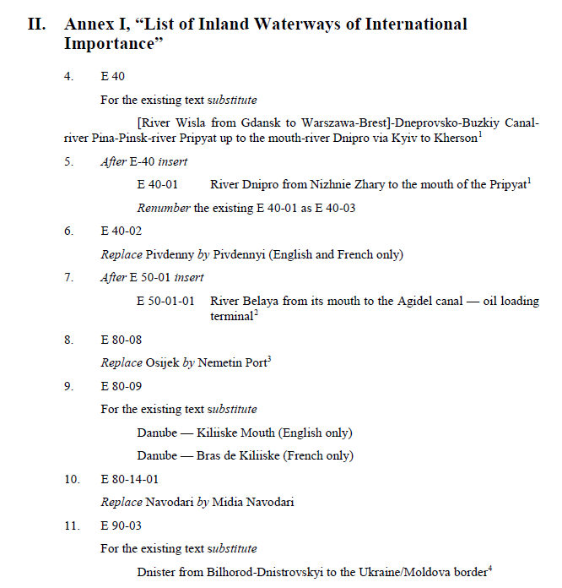
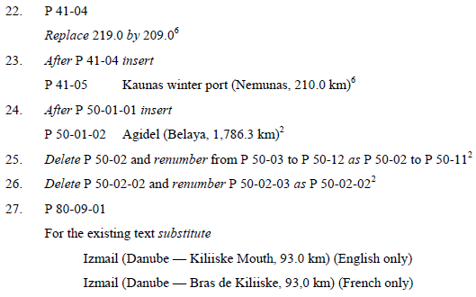
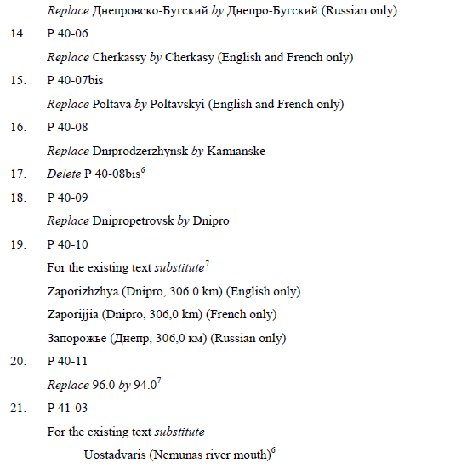
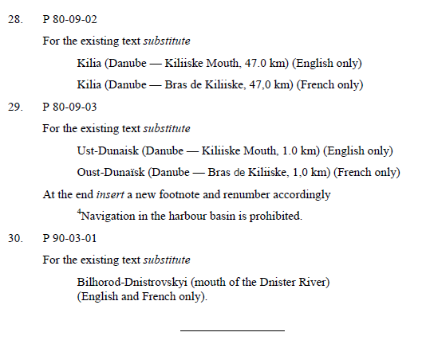
Amendments to AGN adopted in 2017 (ECE/TRANS/SC.3/2017/3)

Slide 5
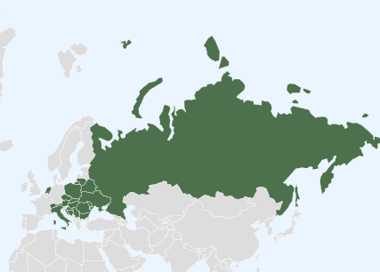
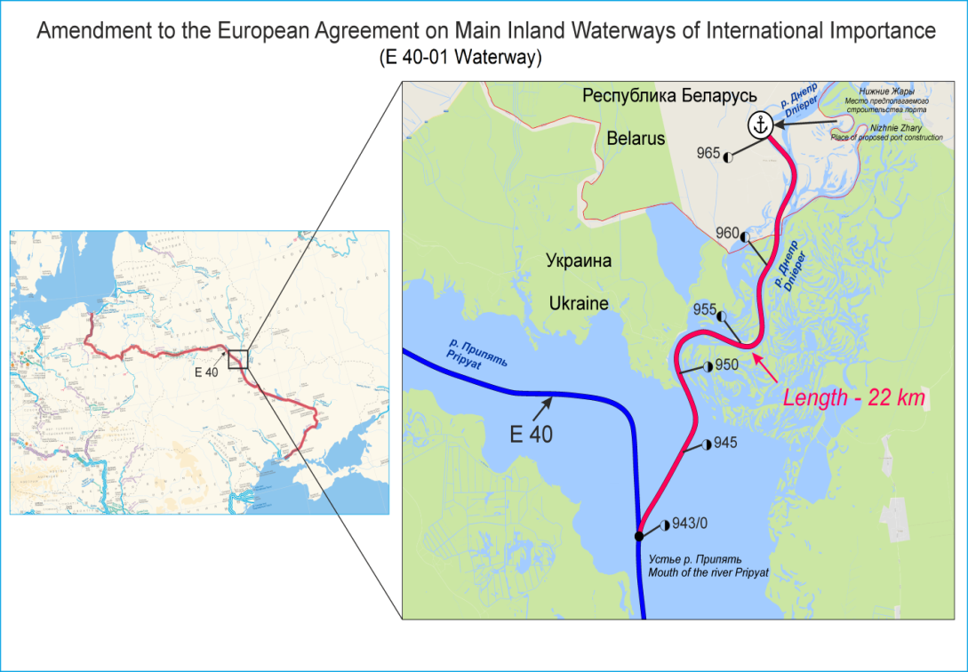
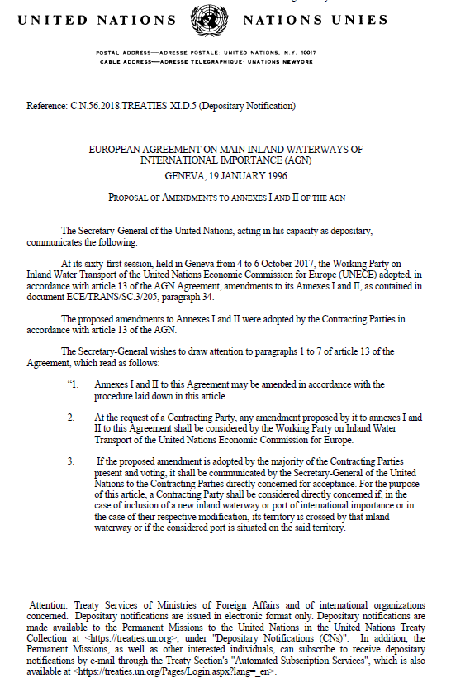
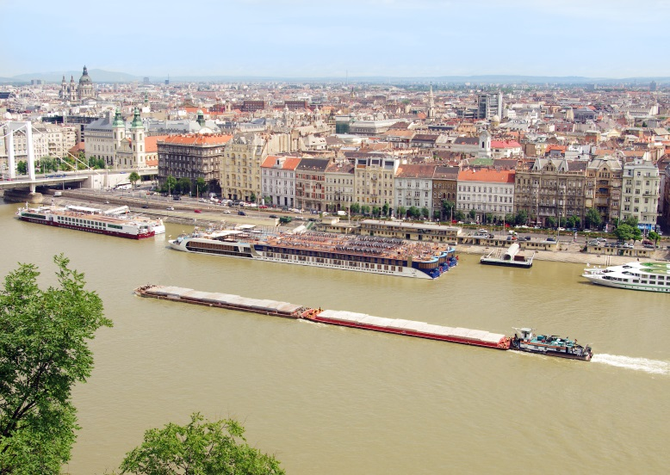
DEVELOPMENT OF IWT INFRASTRUCTURE AND AGN
European Agreement on Main Inland Waterways of International Importance (AGN), of 19 January 1996: 19 Contracting Parties
Recent amendments adopted at the sixty-first session of SC.3
A new waterway E-40-01

Slide 6
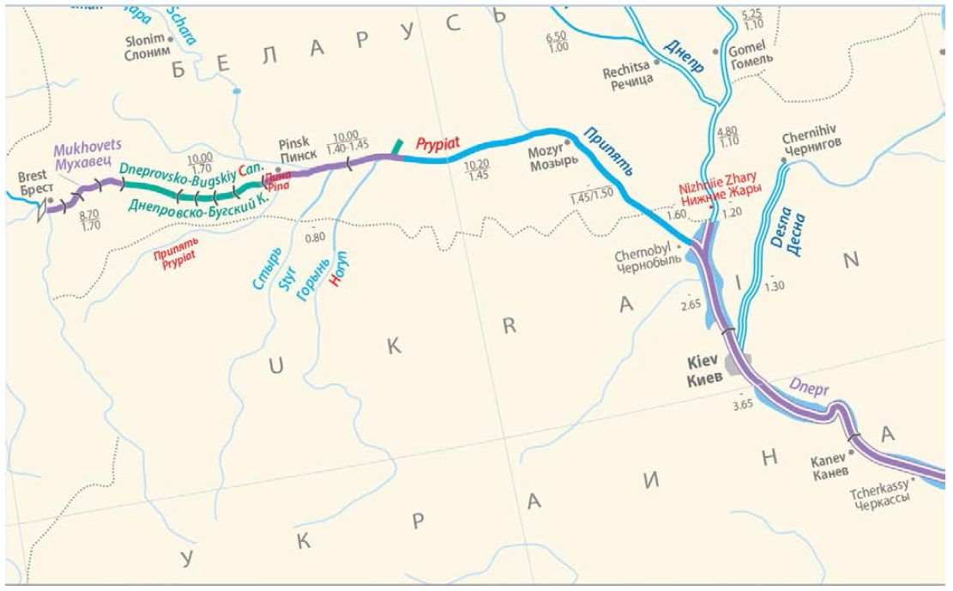
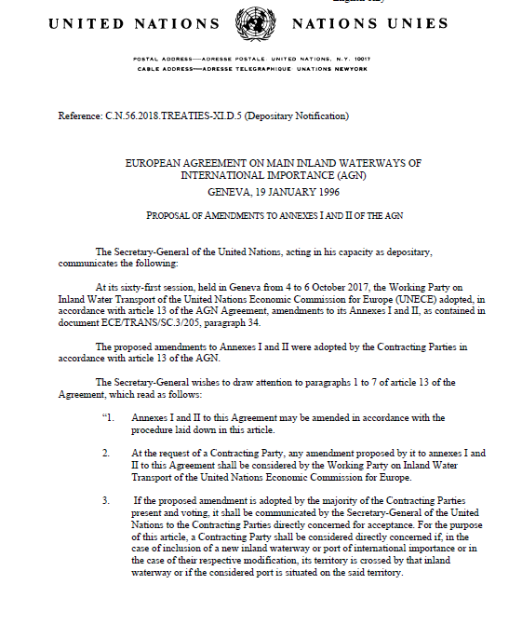
New waterway E 40-01
Entered into force on 8 November 2018

Slide 7
Updated AGN map
Available on the SC.3 website as a pdf version for printing and as an online GIS application linked to the Blue Book data

Slide 8
Thank you for your attention!
Website: www.unece.org/trans/main/sc3/sc3.html

