Slide 1
Innovation ecosystem of the Railway industries
Workshop for the Working Party on Rail Transport (SC.2)
Innovation in the railways: Making the railways of the future for the region
Julio Raffo
Innovation Economics Section, Head
WIPO
Geneva
November 21, 2018

Slide 2
Outline
What is WIPO?
How can we describe innovation patterns with patent data?
Analyzing the Railway innovation ecosystem
From Transport to Railway innovation
Main stakeholders of ecosystem
Dynamics and new players
Questions for the future of Railways Innovation

Slide 3

What is World Intellectual Property Organization (WIPO)?
What is WIPO?
WIPO is the global forum for intellectual property services, policy, information and cooperation. We are
a self-funding agency of the United Nations, with 191 member states.
Our mission is to lead the development of a balanced and effective international intellectual property (IP) system that enables innovation and creativity for the benefit of all. Our mandate, governing bodies and procedures are set out in the WIPO Convention, which established WIPO in 1967.

Slide 4
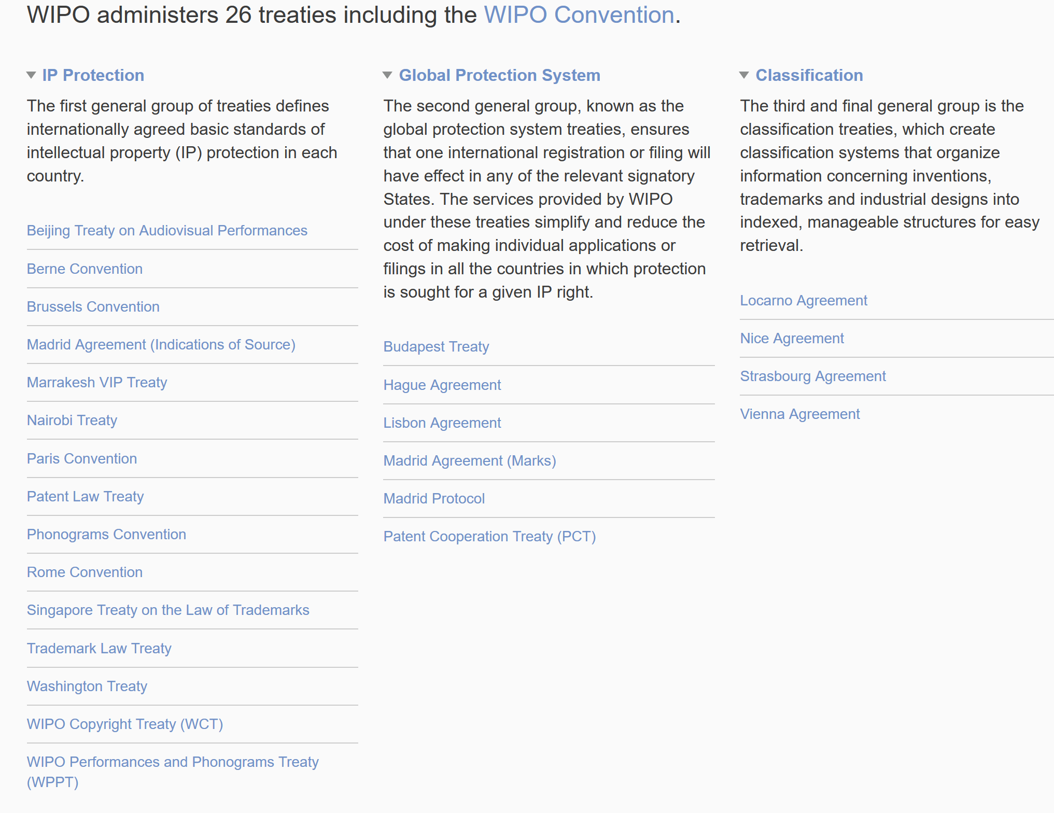

Slide 5




WIPO Economic and Statistics publications
Notes:
The World IP Report is produced every 2 years – the last edition was published in 2015 and focused on breakthrough innovation – it features 6 case studies: antibiotics, aviation, silicon chips and 3D printing, nanotech and robotics.
Every year WIPO produces WIPO IP Facts and Figures which tracks the use of IPRs around the world.
Every year the Organization published in-depth studies on developments in each of its Services/Systems.

Slide 6
Patents are policy instruments aiming to incentivize innovation
Patents give the applicant exclusivity rights to novel invention
  for a limited time (up to 20 years)
In exchange of:
  Disclosing the invention
  Defining the scope of invention
It allows for incremental innovation, technological transfer and division of labor

Slide 7
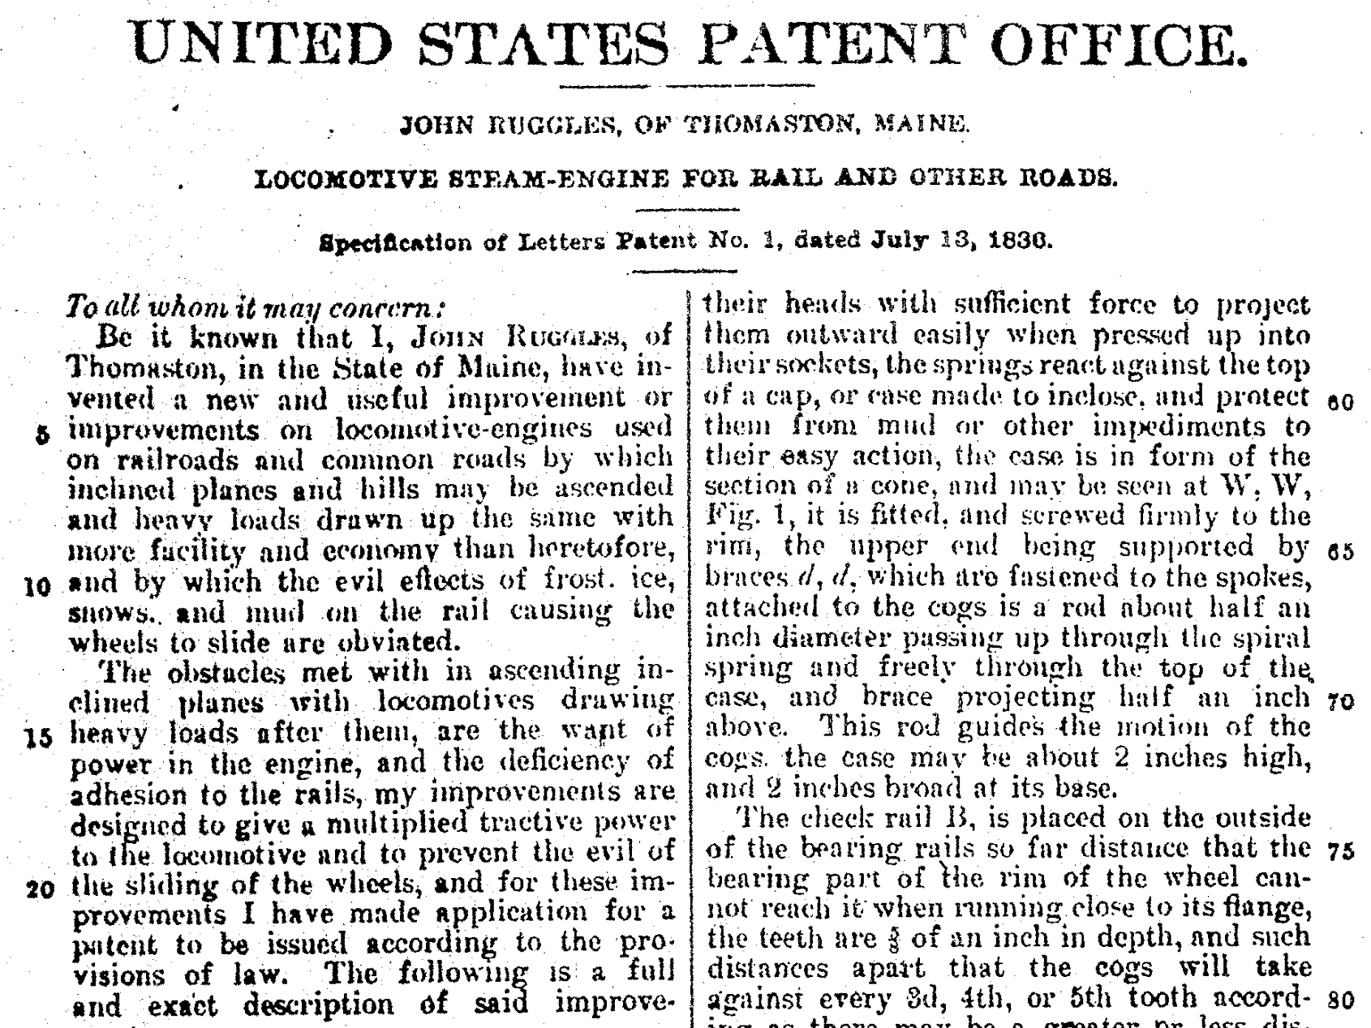
US Patent #1

Slide 8
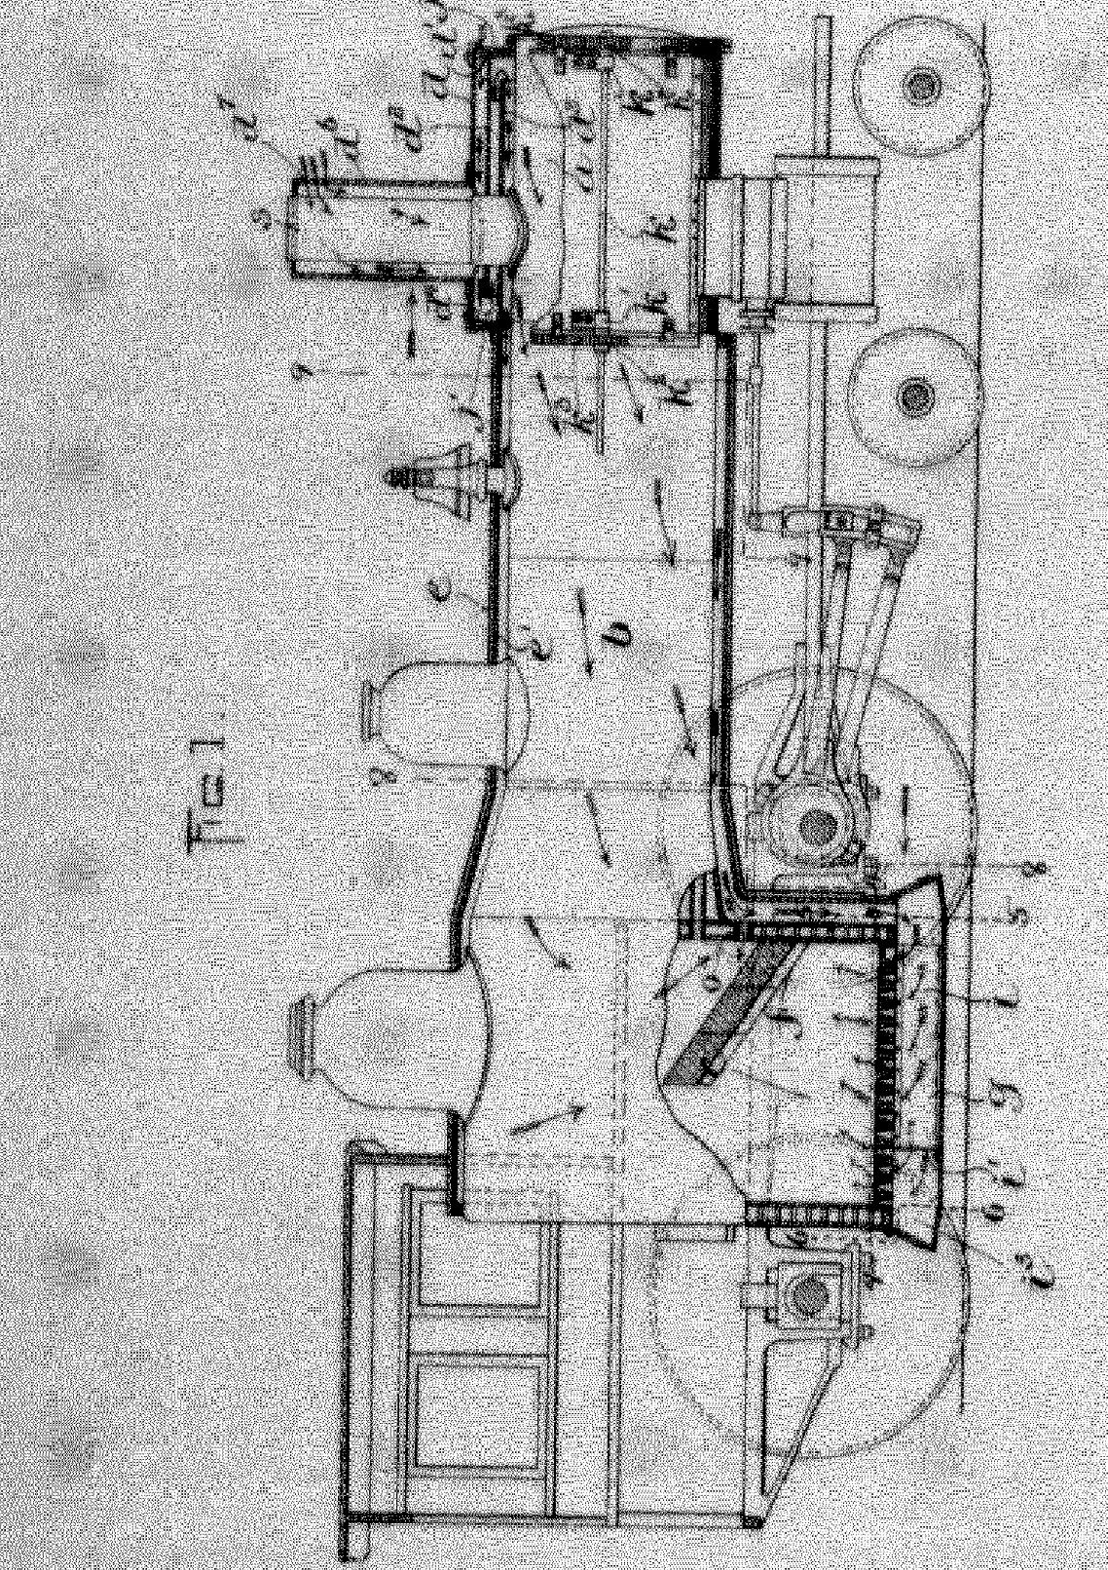
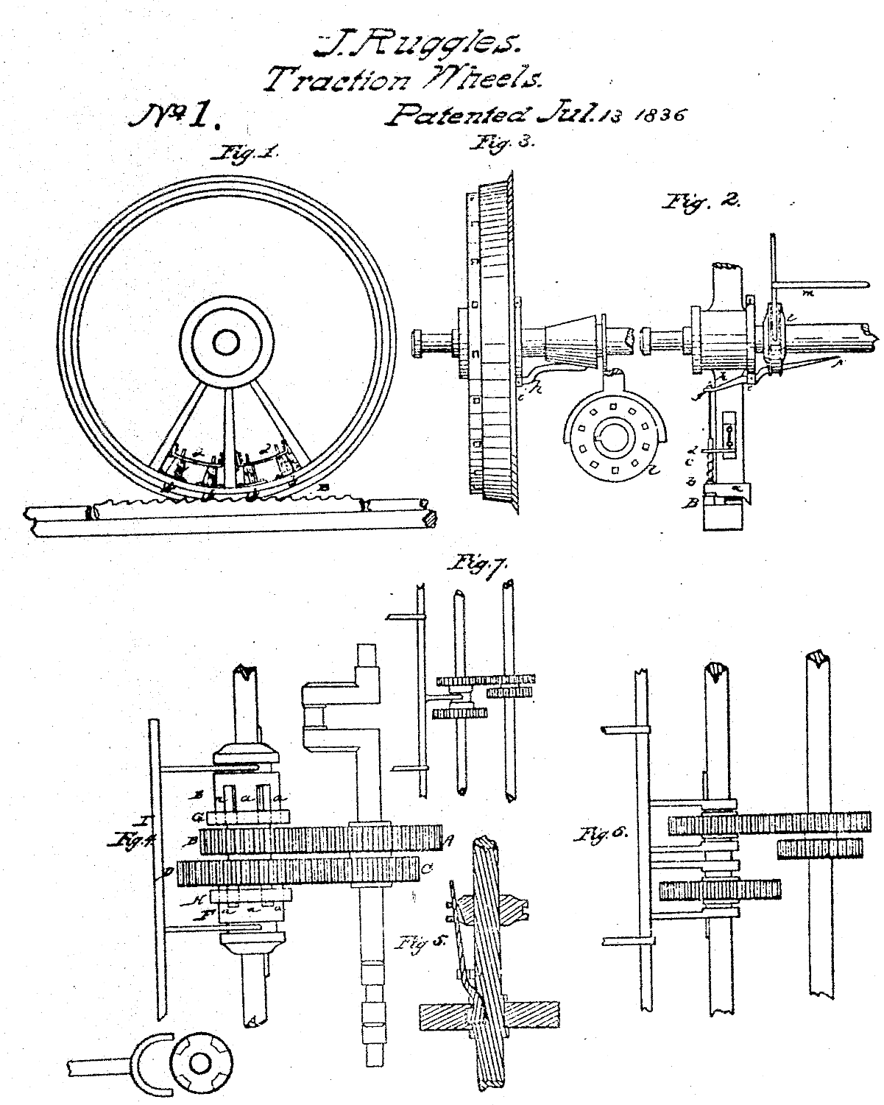
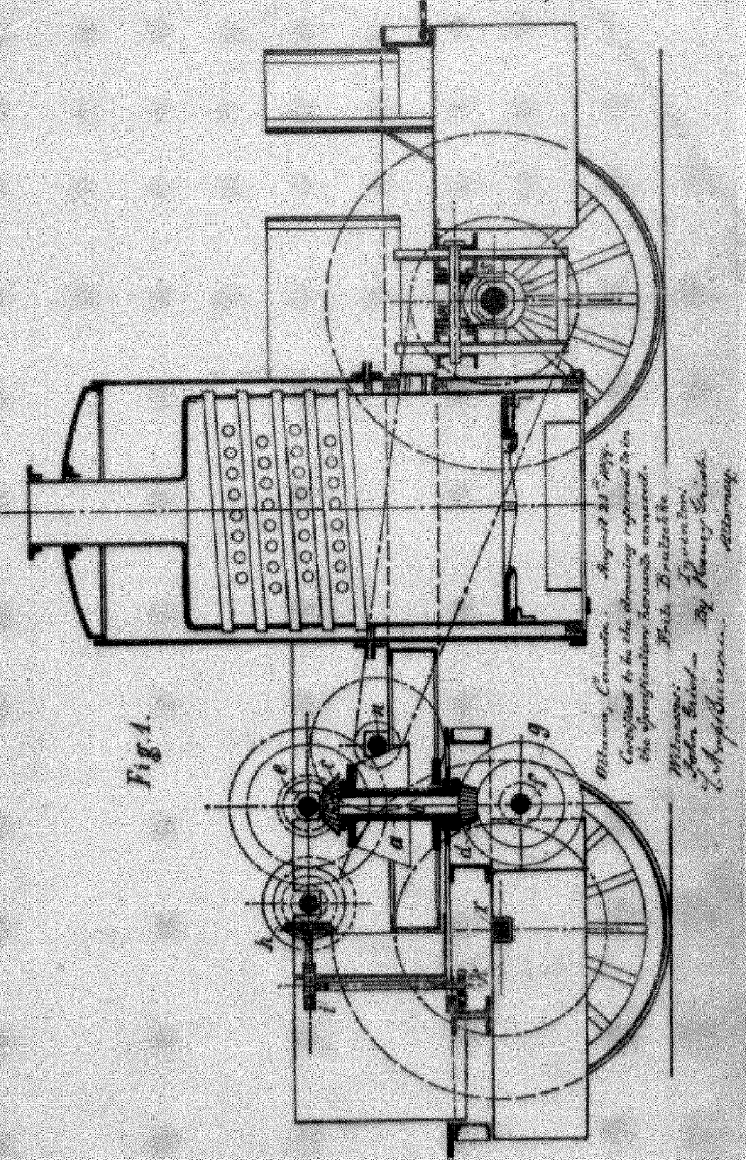
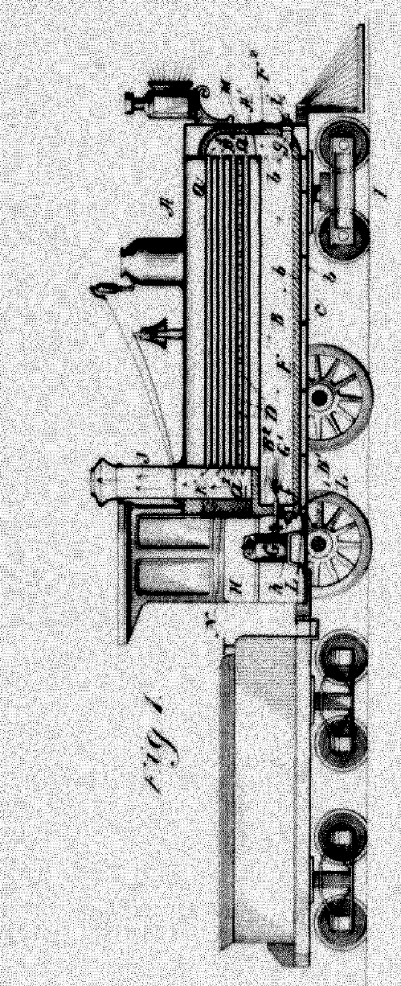
Patent drawings

Slide 9
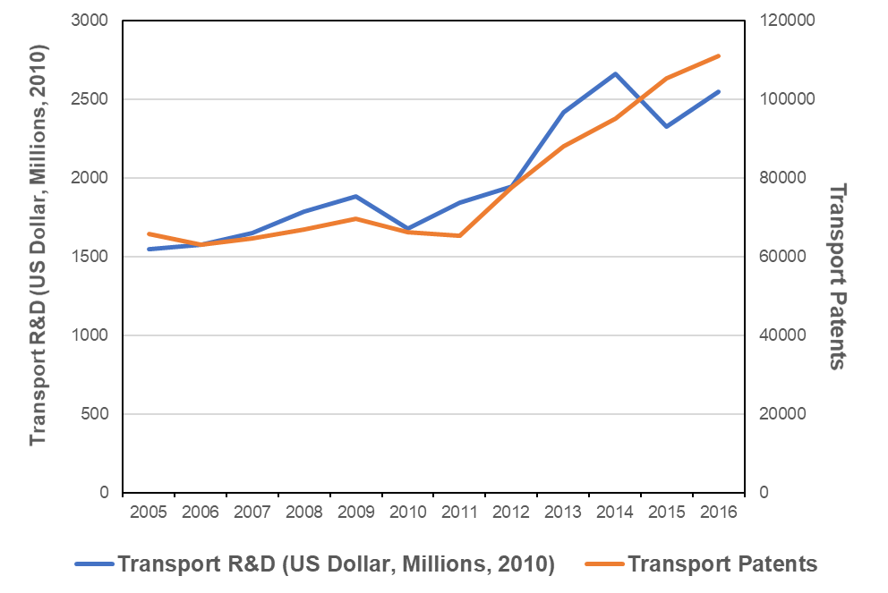
Patents and R&D follow the same trend
Averaging 40 million US dollars per patent
Source: OECD and WIPO Statistics Database, 2018

Slide 10
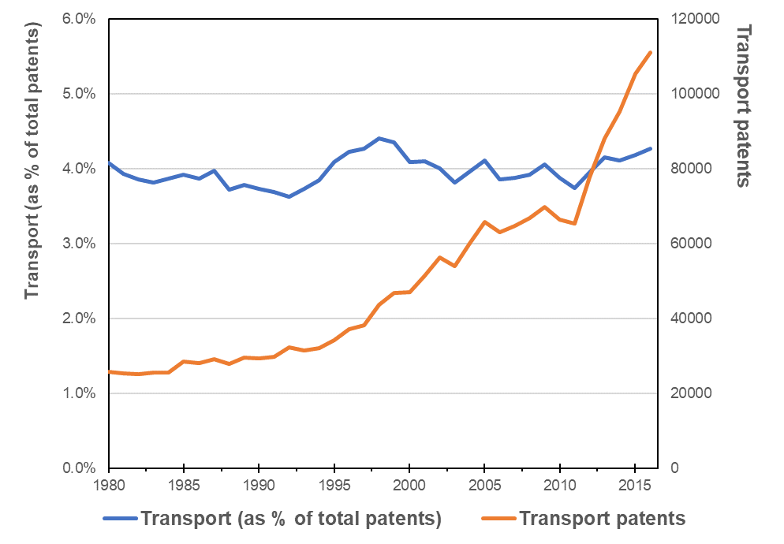
Transport patents on the rise, but as fast as the average
Source: WIPO Statistics Database, 2018

Slide 11
The Railway Innovation system

Slide 12
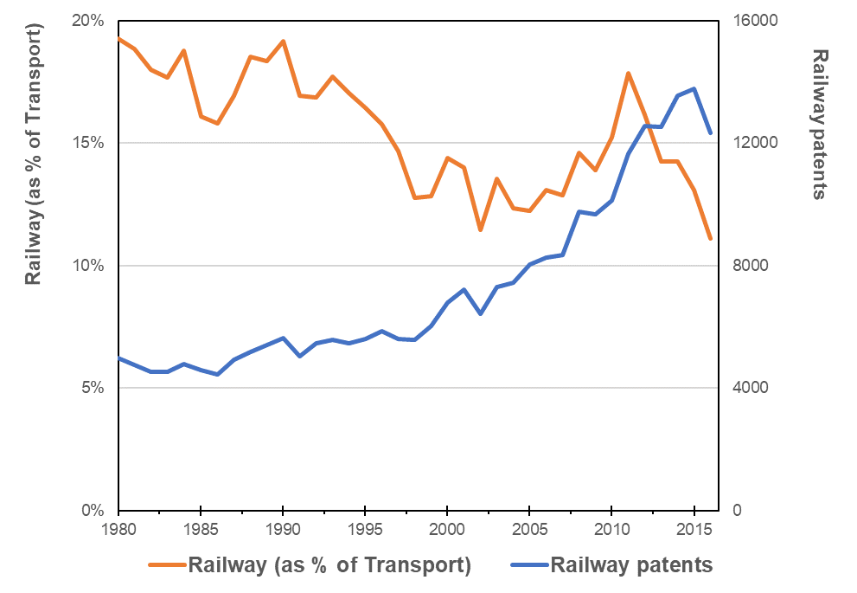
Railway technologies are about
10-20% of transport ones
In 2011, Railways recovered almost to 1980s rates, but the crisis plummeted the rate to a new low.
Source: WIPO Statistics Database, 2018

Slide 13
Historical trend is not encouraging
Source: WIPO Statistics Database, 2018

Slide 14
Last 35 years have been relatively stable
Source: WIPO Statistics Database, 2018

Slide 15
Innovation main origins: before 1990s
Source: WIPO Statistics Database, 2018

Slide 16
Innovation main origins: after 2009
Source: WIPO Statistics Database, 2018

Slide 17
Which are the main origins?
Source: WIPO Statistics Database, 2018

Slide 18
A company-driven innovation system
Source: WIPO Statistics Database, 2018

Slide 19
An increase of the academic share
Source: WIPO Statistics Database, 2018

Slide 20
Different national systems
Source:
WIPO Statistics Database, 2018

Slide 21
An endogenous innovation system
Source: WIPO Statistics Database, 2018

Slide 22
Limited internationalization
Source: WIPO Statistics Database, 2018

Slide 23
Concentration in a few offices
Source:
WIPO Statistics Database, 2018

Slide 24
Patent protection: Before 1990s
Source: WIPO Statistics Database, 2018

Slide 25
After 2010s
Source: WIPO Statistics Database, 2018

Slide 26
Conclusions: Questions for the future of Railways Innovation
Will Railways Innovation bounce-back?
  Increasing at average pace for the past 30 years
  Slowdown since 2011 economic crisis
Who will lead future Railways innovation?
  Technologies are created and protected in a few countries
  Asia is the most dynamic region followed by Europe, while North America is rather absent
How will Railways innovation ecosystems evolve?
  Stakeholders are mostly companies (and many of them SOE)
  There is little room for small companies and entrepreneurship
  Academia has been increasing lately
Will ICT revolution finally impact Railways Innovation?
  Railways are sourcing technologies mostly endogenously

Slide 27
Thank you!
Questions?
julio.raffo@wipo.int

