Slide 1
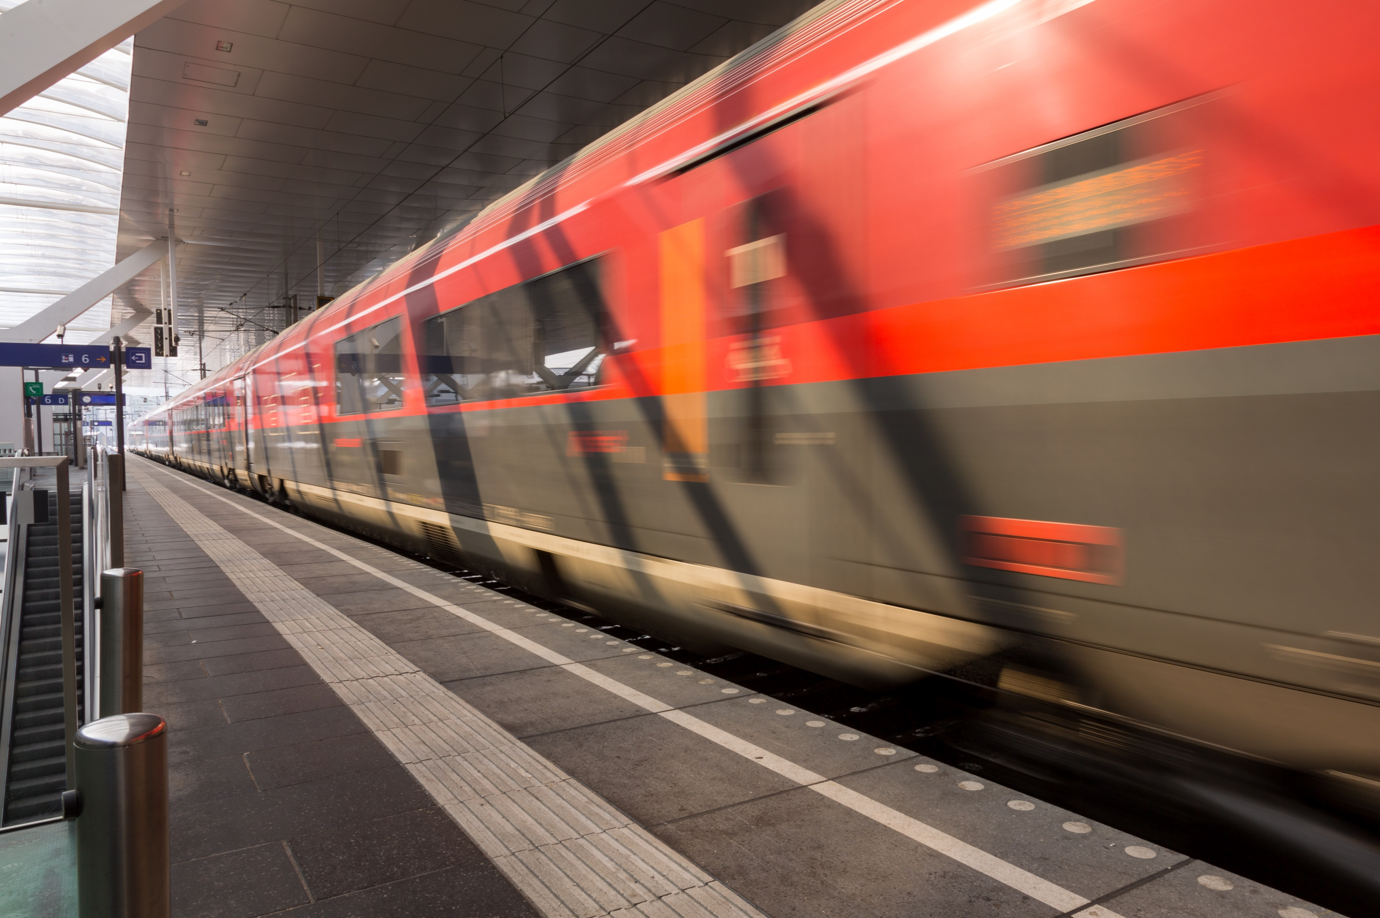
Decarbonization and Automation
Wolfgang Köstinger

Slide 2
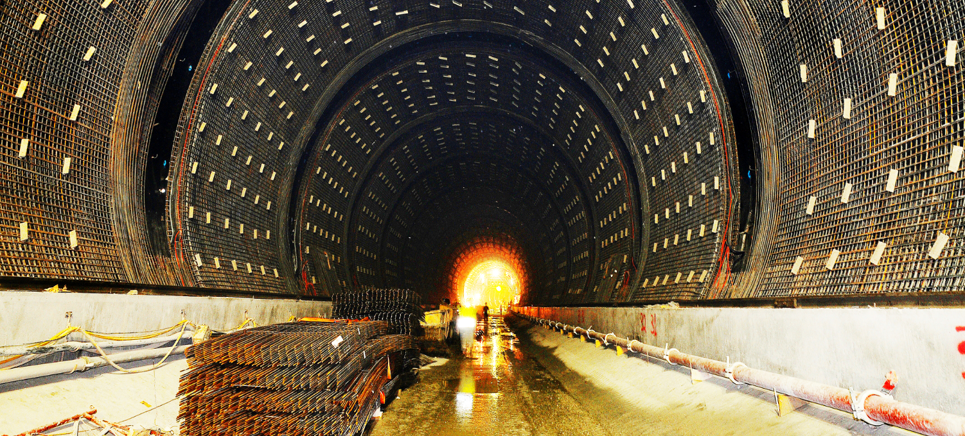
ÖBB plays an important economic role in Austria
4,826 rail network kilometers
With annual investments amounting to around EUR 2.5 billion, ÖBB is one of the country’s biggest contracting authorities and an important economic factor
459 million passengers per year
ÖBB is one of the biggest employers in Austria with around 41’000 employees
115 million net tonnes of transported goods per year
EUR 5.5 billion revenue
We create value for generations with our infrastructure projects

Slide 3
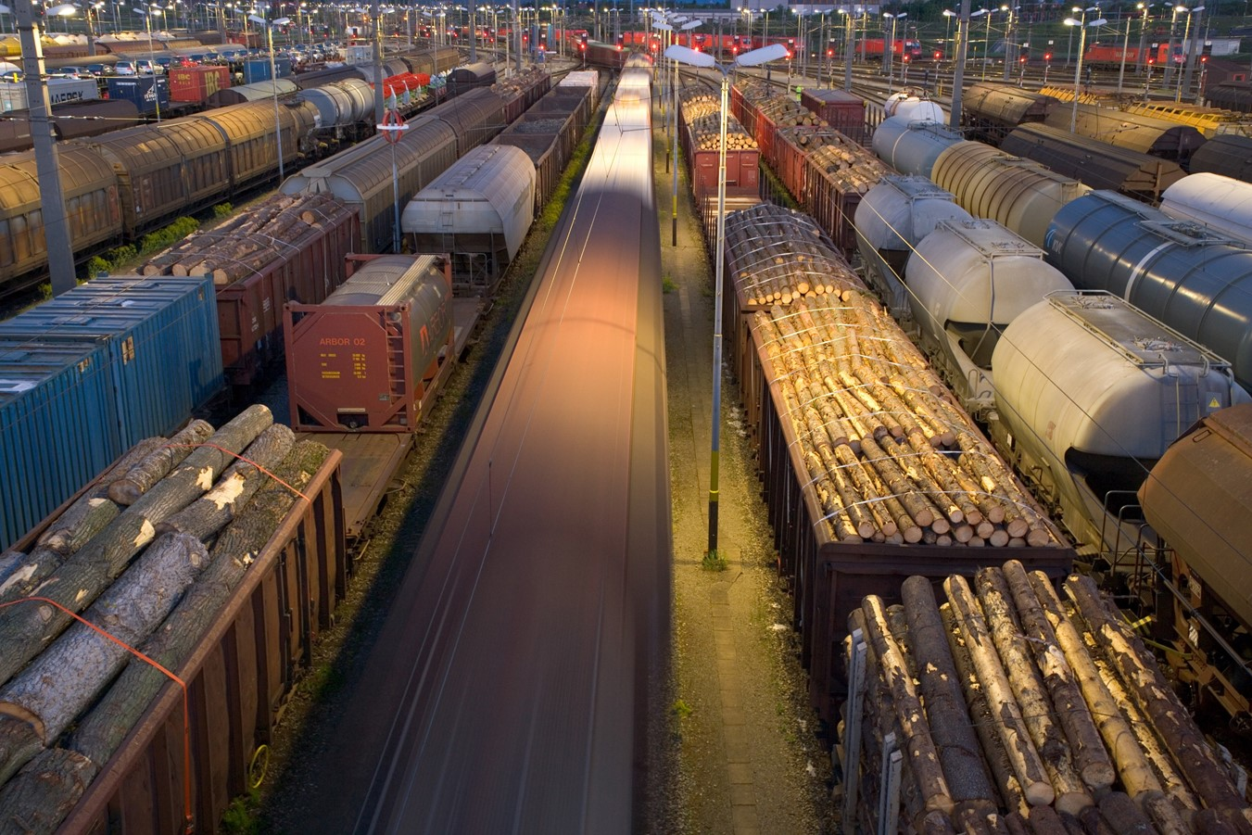
Despite our size, the challenges for the rail system are imminent
Capacity
Benefit cost ratio
Decarbon- ization
System complexity
Expensive infrastructure developments
Other transport modes
Source Code
Energy consumption
Increasing cost pressure
Level of maturity
Innovative capacity

Slide 4
ÖBB-Climate Strategy 2030 will contribute to reduce CO₂ emissions massively
1.
Railway Electrification
2. Bi-Mode Trains
ÖBB-Climate Strategy 2030
Railway Electrification Currently, 73% of the ÖBB rail network is electrified. ÖBB plans to electrify 85% of its network by 2030 and 89% by 2035.
Bi-Mode Trains For the remaining 11% of the network ÖBB plans to use alternative clean energy solutions. Bi-Mode Trains are one option among others.
Alternative Fuel Vehicles Alternative clean energy solutions are also in scope for ÖBB road vehicles.
Renewable Energy Since 2018 100% of traction energy ib obtained by renewables.
Energy Efficiency ÖBB will also improve its energy efficiency, not only of its rail operations but also of its stations and buildings.
Rail Relocation of Traffic In order to achieve an efficient modal shift to the rail system, ÖBB will ensure to offer competitive solutions.
3. Alternative Fuel Vehicles
4. Renewable Energy
✓
5.
Energy Efficiency
6.
Modal Shift

Slide 5
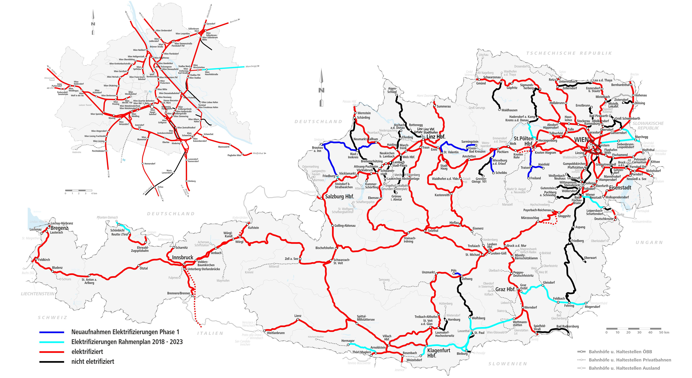
ÖBB will continue to electrify its rail network
ÖBB Electrified Network*
Existing electrified network of 73% in 2018
Electrified network of 85% by 2030
Electrified network of 89% by 2035
Alternative clean energy solutions for remaining 11%
2028
2028
2025
2020
2022
2027
2024
2025
2019
2026
2021
2027
2023
2019
2025
*Planned as of Nov. 2018

Slide 6
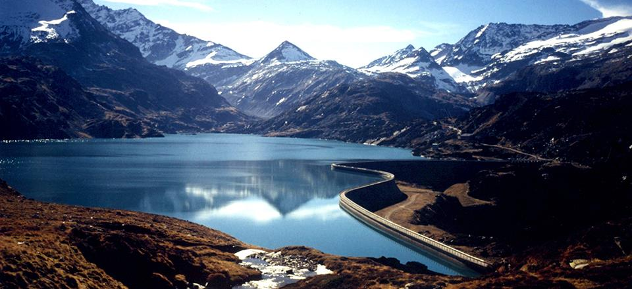
Nature loves train users: ÖBB already uses 100 percent of clean energy
The Rail Cargo Group operates between the North Sea, Mediterranean Sea and Black Sea – with subsidiaries and partner networks in Europe and beyond.
ÖBB is one of Europe’s most punctual and reliable rail operators. Overall punctuality
is 96.3%.
100 percent of the traction energy is obtained from renewables – including the use of eight ÖBB’s own hydroelectric power plants
Reduction of 2.3
million tonnes

Slide 7
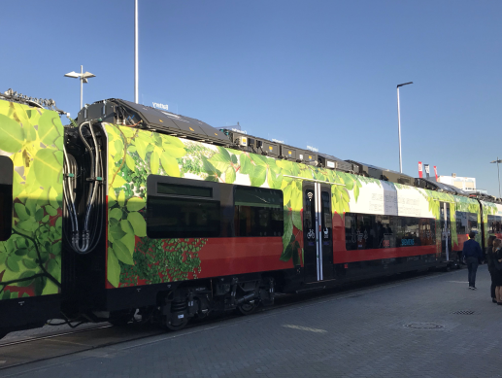
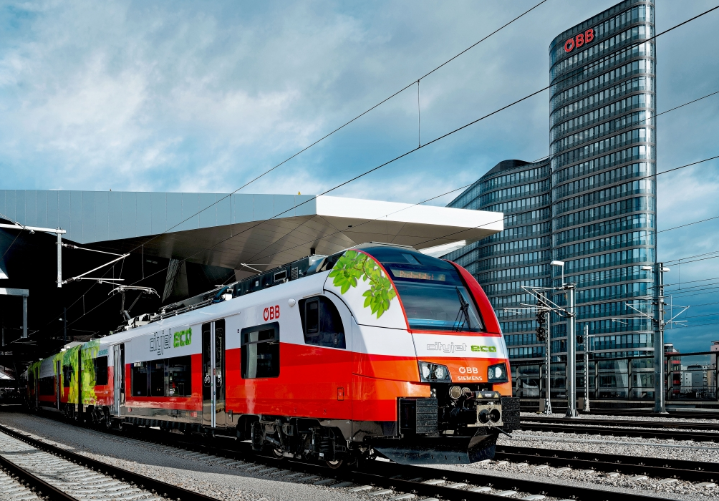
ÖBB Cityjet ECO as the prototype for a battery powered bi-mode train
Cityjet ECO @ Innotrans 2018
Facts
ÖBB Desiro ML 3-car Cityjet EMU equipped with additional battery power
Branded as CITYJET ECO, used on passenger services extending from electrified to non-electrified lines
Three battery blocks with a total capacity of 528kWh
Expected range on non-electrified lines: 80km
Prototype testing of Citjet ECO under real conditions during 2018/19
Subject to successful testing, ÖBB plans to introduce Cityjet ECO on two passenger lines in a first step

Slide 8
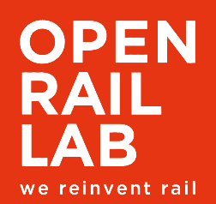
Use case orientation for automation of ÖBB‘s rail network
Use Cases
Use Case 1: Enhance the utilization of infrastructure capacity
Use Case 2: Steer a freight train in a path with the goal to optimize the capacity of infrastructure bottlenecks
Use Case 3: Reduce energy consumption along a rail freight corridor
Use Case 4: Reduce ride time reserves due to optimized operating quality
Use Case 5: Automatic handling of passenger traffic on rural lines
Use Case 6: Automatic handling of cargo traffic on last mile rural lines
Use Case 7: Flexible and cost effective shunting
Use Case 8: Automatic handling of empty rolling stock from a station to the depot and back
Use Case 9: Automatic train preparation
For ÖBB it is crucial to define to right level of automation

Slide 9
What we want to achieve with automation of the rail network
System tuning
Increase usage of infrastructure
Increase capacity
Reduce energy
Optimize operating quality
Smoothing of train speed curve
Gain experience with piloting
Next Generation Train Protection System

Slide 10
Railways need to tackle increasing system complexity and rising costs per unit despite higher capacity utilization, new technology and ongoing high investments in the rail system.
We need your support to achieve our goals

Slide 11
Thank you for your attention

