Slide 1
Innovation for passenger rail services
UN ECE: Working Party on Rail Transport
Geneva, 21st November 2018
01.11.2012, Hamm
Christopher Irwin // EUROPEAN PASSENGERS‘ FEDERATION
www.epf.eu

Slide 2
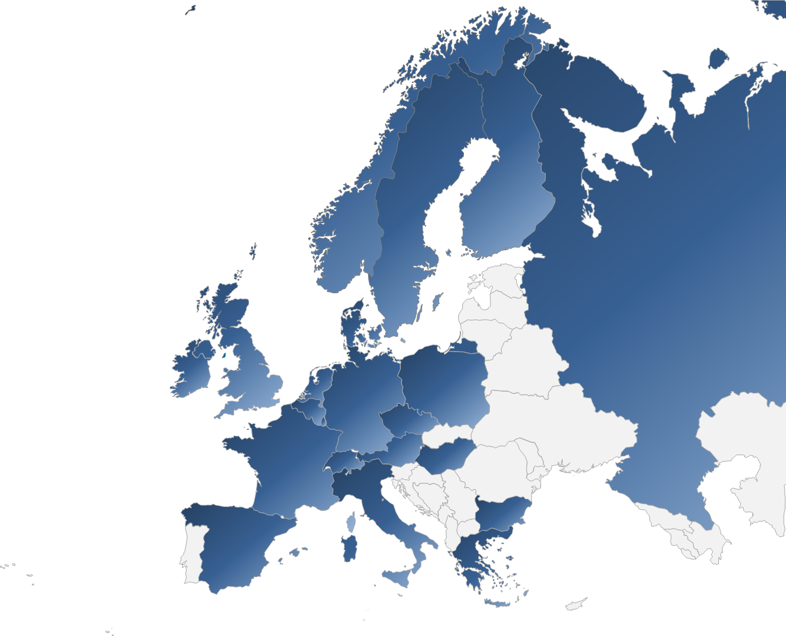
European Passengers’ Federation 2018
38 member & associate organisations
21 countries
Independent voice for public transport users on Europe

Slide 3
From innovation to implementation
Navigating the Valley of Death

Slide 4
Drivers of demand-led innovation
Responding to public policy challenges
Meeting end-users’ needs

Slide 5
Market levers and public policy
Responding to emerging priorities, e.g.:
More for less
Decarbonisation
Addressing public health concerns
More efficient land use/ relieving congestion
Addressing demographic change
Synchro-mobility and modal shift

Slide 6
From transport to mobility
Meeting end-users’ needs, e.g.:
Identifying passengers’ priorities
End-to-end journeys
Mobility as a service
Understanding the drivers of satisfaction
Passenger satisfaction
From distress purchase to mode of choice

Slide 7
Poor comparative user satisfaction EU Consumer Markets Scoreboard, 2018 – ‘To what extent did services/products offered live up to expectations?’
Notes:
Point of this slide is to show that air sector doing well when compared with land transport modes – in top quartile for passenger satisfaction. Nb Utilities

Slide 8
Drivers of passenger satisfaction: National Passenger Survey, Transport Focus, GB

Slide 9
Drivers of passenger dissatisfaction: National Passenger Survey, Transport Focus, GB

Slide 10
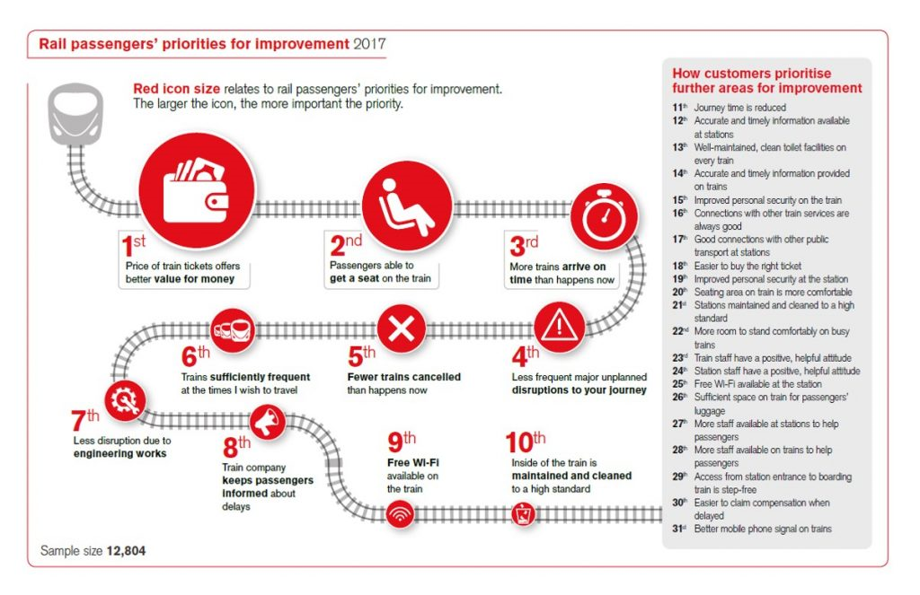
Rail passengers’ priorities for improvement

Slide 11
The key challenges for innovators: what passengers want
Better value (more for less)
Capacity (a seat when they want to travel)
Punctuality
Minimal disruption (reliability)
Dependability (fulfilled promise)
Improved asset reliability
Keeping passengers informed: better and usefully
Securing passenger safety

Slide 12
The key enablers – some examples
More for less: standardisation, low-cost solutions, intelligent vehicles, smart infrastructure
Capacity: automation, digitalisation, TMS, adaptable assets
Punctuality: capacity, asset reliability, discipline
Minimise disruption: advanced control systems, diversionary capacity
Improved asset reliability: Real-time health monitoring, low-cost short-life plug and play assets, smart technologies, mechatronics’ applications
Keeping passengers informed, better and usefully: real-time personalised information, open data access
User-centred: focus on systems’ interfaces, integrated cross-modal telematics; non-invasive security measures

Slide 13
The key question
What’s in it for the passenger
(and the tax-payer)?

Slide 14
Thank you for your attention!
www.epf.eu

