Slide 1
Innovation for passenger rail services
Prof. Dr. Andrea Giuricin
Special Advisor for the M.D. of NTV - ITALO
Senior Rail consultant at WORLD BANK
CESISP – at University Milan Bicocca
Adj. Prof. UMN, MSUC, University Southern California, Purdue University
Visiting Professor at China Academy Railway Sciences, Beijing, China
CEO - TRA Consulting
Geneva, 21st of November 2018

Slide 2
Experience of competition
The FIRST Private HSR in competition - ITALO and the first MRT operator in Italy
Working with main regulators:
ERA in Europe,
CNMC in Spain, RSR in South Africa, Etc..
Rail reform in Thailand – The WORLD BANK
South Korea – SRT VS KORAIL and rail reform in Europe
CHINA ACADEMY OF RAILWAY SCIENCES

Slide 3
Experience of competition - ITALY
There is the incumbent, a State Owned Entreprise, Ferrovie dello Stato (FSI) that control the Infrastructure Manager (RFI) and the Railway Undertaking (Trenitalia).
MINISTRY OF ECONOMY
FSI HOLDING
ITALO - NTV
TRENITALIA
RFI
8,2 Euro TKM
Access Charge
INDIPENDENT AUTHORITY FOR TRANSPORT

Slide 4
ITALO story
Oct 2015: Ordered 8 high-speed Alstom EVO
Sept 2016: Ordered 4 additional Alstom EVO
Dec 2006: Establishment of NTV SpA
Apr 2012: Launch of first commercial services on Rome-Milan route
Jun 2008: Financial agreements for approx. 700M€
Apr 2013: Full capacity with all Alstom AGV trainsets delivered
4Q 2017: Delivery of the first 4 EVO trainsets and launch new services on Milan-Venice
Jun 2009: Completion of the maintenance plant in Nola
Dec 2015: Launch of ItaloBus, the new Italo intemodal services
Nov 2007: Ordered 25 high-speed Alstom AGV (leasing)
Sep 2015: Debt restructuring and new 60M€ equity capital injection

Slide 5
ITALO story
Years 2008 – 2012 | (million of €)
Trains Investments | 625
Maintenance Facilities | 90
IT Investments | 11
Station Logistics | 25
Training | 26
Start-up | 62
Indirect Investment | 128
Total | 967
NTV started the operation on 28th of April 2012
Break Even Point in 2015
New Investment in 2015/2018 → 22 HS Train

Slide 6
Experience of competition
The new fleet of EVO (22 trainsets) in 2018 will permit to increase the frequency (business market) and to enlarge the network (new markets)
Bolzano
Brescia
Trento
CURRENT NETWORK: Three main routes served
Milano
Verona
Venezia
Backbone Turin-Salerno
Venice-Rome/Naples/Salerno
Verona-Rome/Naples
Torino
Reggio E.
Padova
Bologna
Ferrara
Rimini
Firenze
Pesaro
Ancona
NETWORK EXTENTION: Increase of daily frequencies on the current network and launch of services in new markets upon delivery of newly commissioned EVO fleet:
Roma
Caserta
Bari
Daily services per route
Napoli
Salerno
Current network
Seasonal services
60% of Italian population

Slide 7
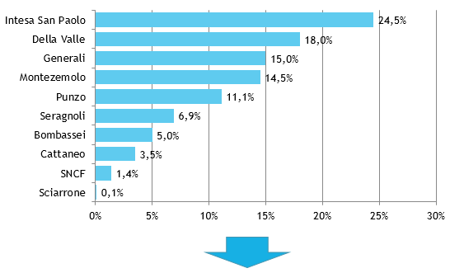
Experience of competition
GIP → Global Infrastructure Partner 100% nel 2018

Slide 8
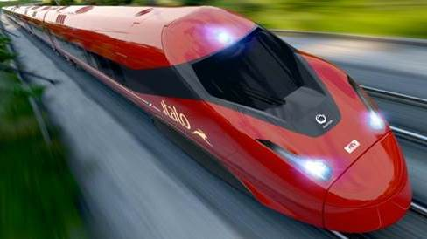
Experience of competition

Slide 9
Experience of competition

Slide 10
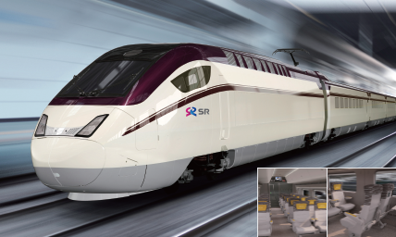
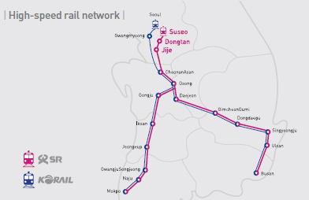
Experience of competition – S.KOREA
SRT started the operation in December 2016
SRT has two main lines (Seoul to Busan, Seoul to Mokpo), with an open access competition in the mayority part of the infrastructure
Maintenance from Korail (the incumbent)
32 Sets of train (22 leased by Korail)
New station in Seoul (Suseo)
MOU with NTV

Slide 11
INNOVATION AND TECHNOLOGY

Slide 12
Experience of competition
Comfort

Slide 13
Experience of competition
Club
Highest comfort and privacy
Customized service
At seat TV screens
Lounge option
Prima
High quality and comfort
At seat service
Smart
Quality + entry price
Special coach options: Cinema
Comfort
High quality and comfort

Slide 14
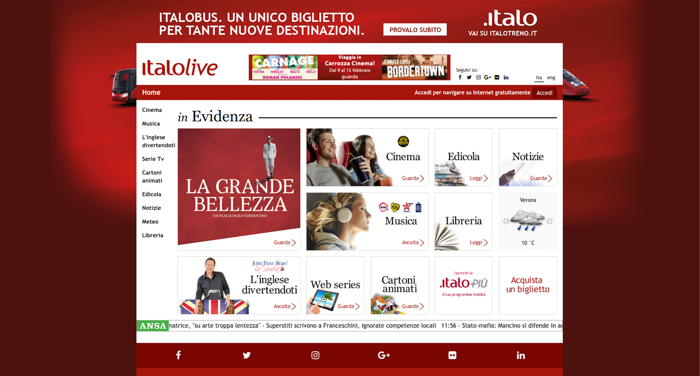
Experience of competition

Slide 15
Experience of competition
Specialist subsystems …
Front
Office
Dynamic Information
Distribution
CRM
Service-Oriented Architecture (SOA)
Circulation
Fleet & Crew
Control Room
Maintenance
Revenue Accounting
Back
Office
.. totally integrated with SOA Architecture.

Slide 16
Experience of competition
“Ambassador”
High value – Sponsor &Voice
(Trip Frequency, Spending, Loyalty Tier, Age & Potential)
“Supporter”
Frequent Traveler - Connoisseur
Retention Rate
“Friend”
Recorded & profiled Traveler
Registration
Disruption metrics (delays, CXL, complaints, exc) lived by each traveler (recorded in a personal profile CRM)
“Customer”
(non recorded Traveler)

Slide 17
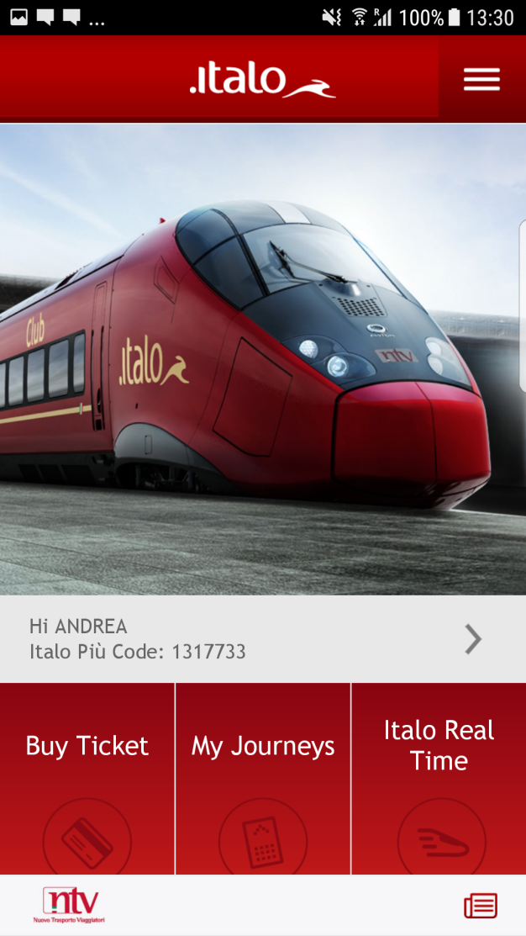
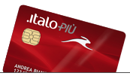
Experience of competition

Slide 18
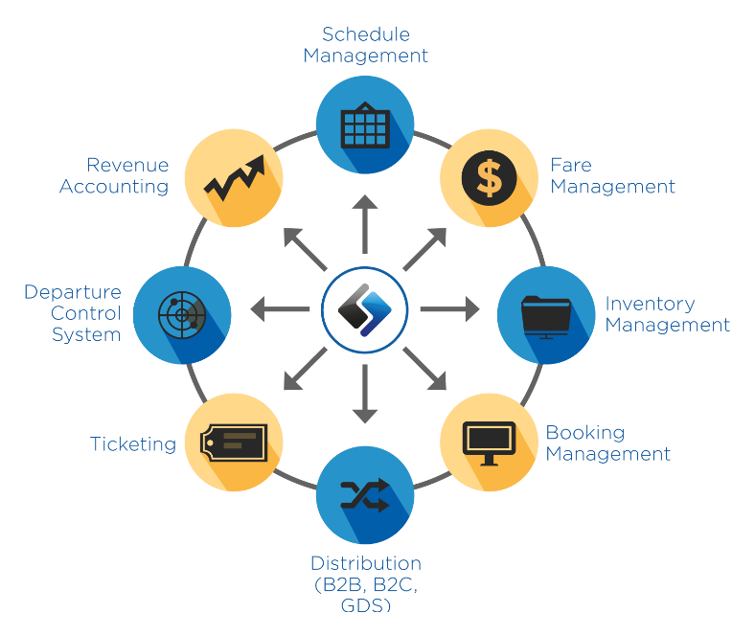
Revenue Management

Slide 19
Revenue Management
Ambience
Base
Economy
Low cost
Promo
PROMO

Slide 20
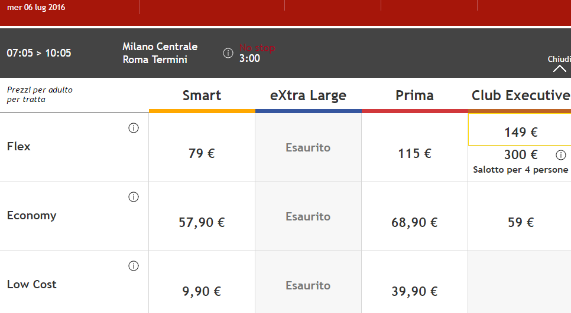
Revenue Management

Slide 21
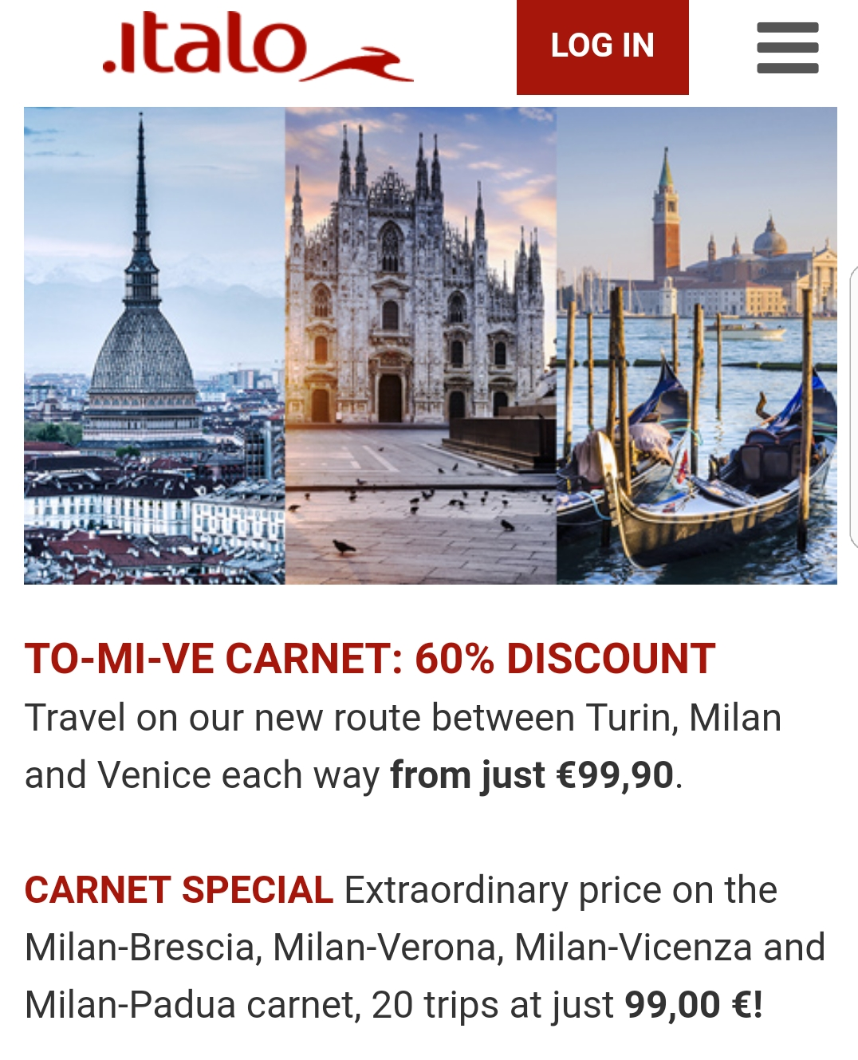
Experience of competition
TURIN – MILAN
LESS THAN 1 HOUR DISTANCE WITH HSR
TICKET PRICE LESS THAN 5.00 USD

Slide 22
WHICH KIND OF BUSINESS MODEL FOR THE HSR?

Slide 23
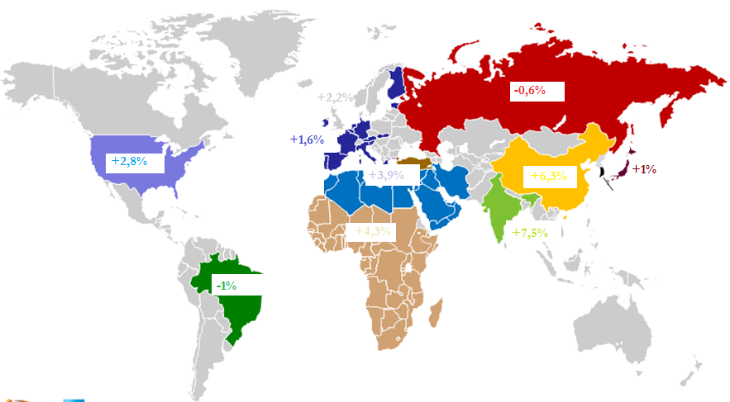
Which market mentality?
ME – Rail investment, but needs for experience
Chinese operator and market efficiency – S. Korea competition
HS European Market will open in 2020
Amtrak is SOE
Private Vertical integrated model
Strong potentiality of the rail market
Strong investment in Asia

Slide 24
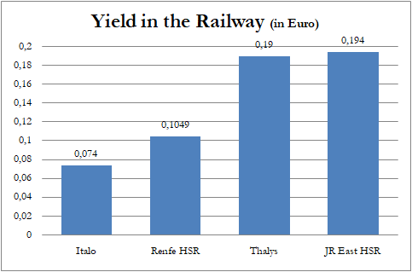
Experience of competition

Slide 25
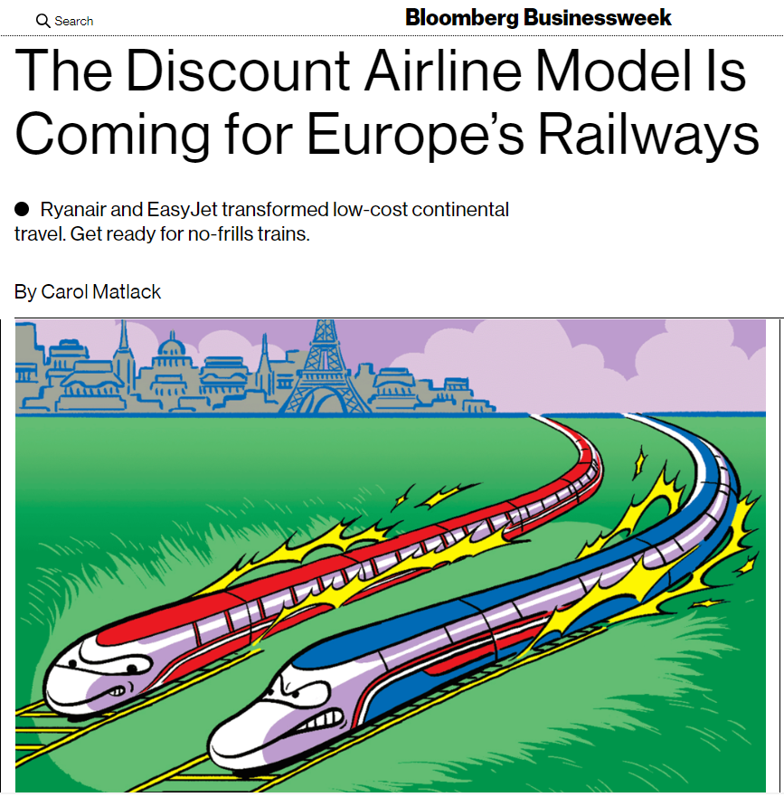
Experience of competition

Slide 26
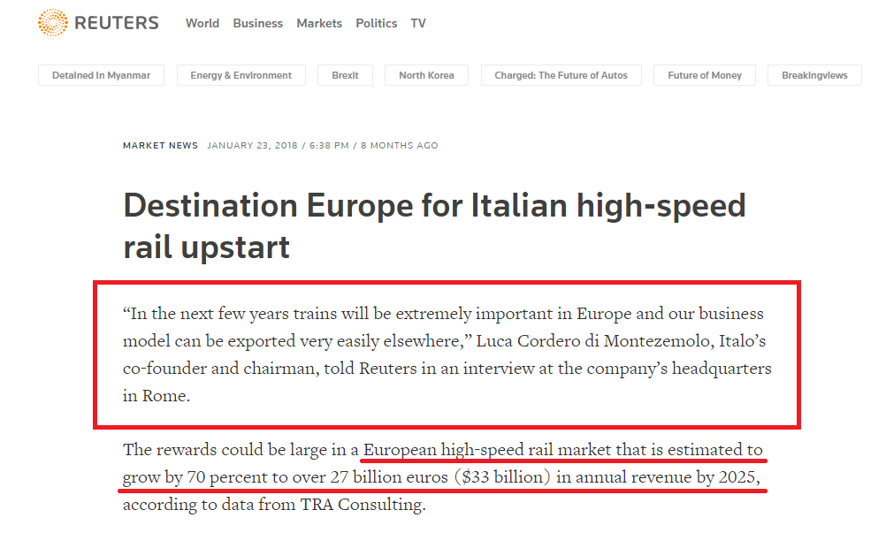
Experience of competition

Slide 27
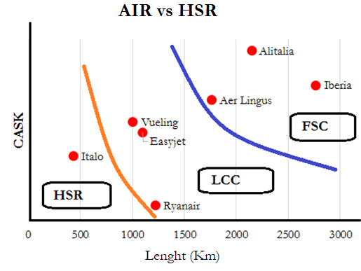
Experience of competition

Slide 28
Experience of competition

Slide 29
Experience of competition

Slide 30
THANK YOU FOR YOUR ATTENTION
Contact details:
Prof. Dr. Andrea Giuricin
Mob: +393386938369
Email: andrea.giuricin@unimib.it

