Slide 1
International efforts to foster innovation
21 November 2018

Slide 2
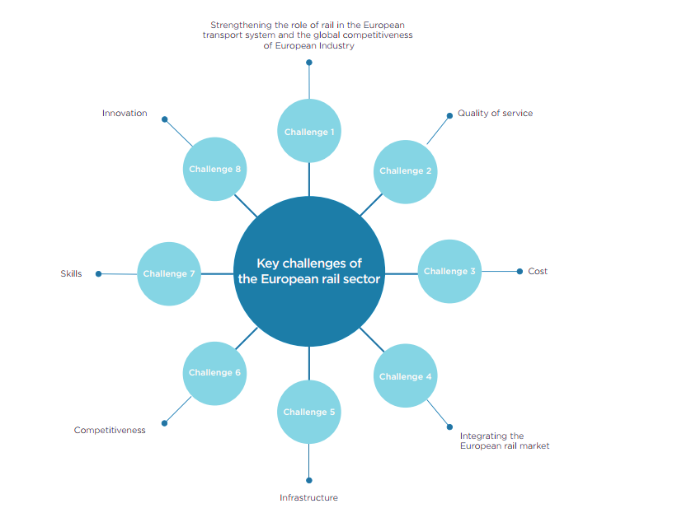

Slide 3
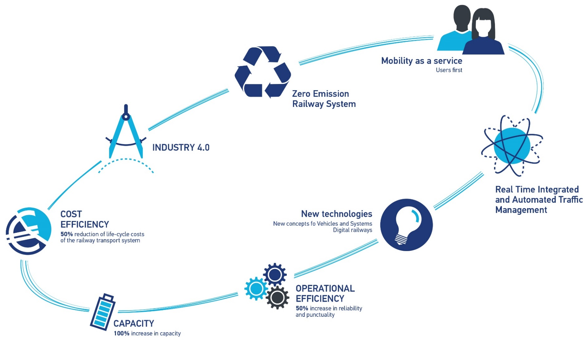
S2R VISION
€ 1BLN
A NEW APPROACH
TO R&I&D
innovation shaping the railway of the future
To deliver through railway research and innovation the capabilities to bring about the most sustainable, cost-efficient, high-performing, time driven, digital and competitive, customer-driven transport mode for Europe

Slide 4
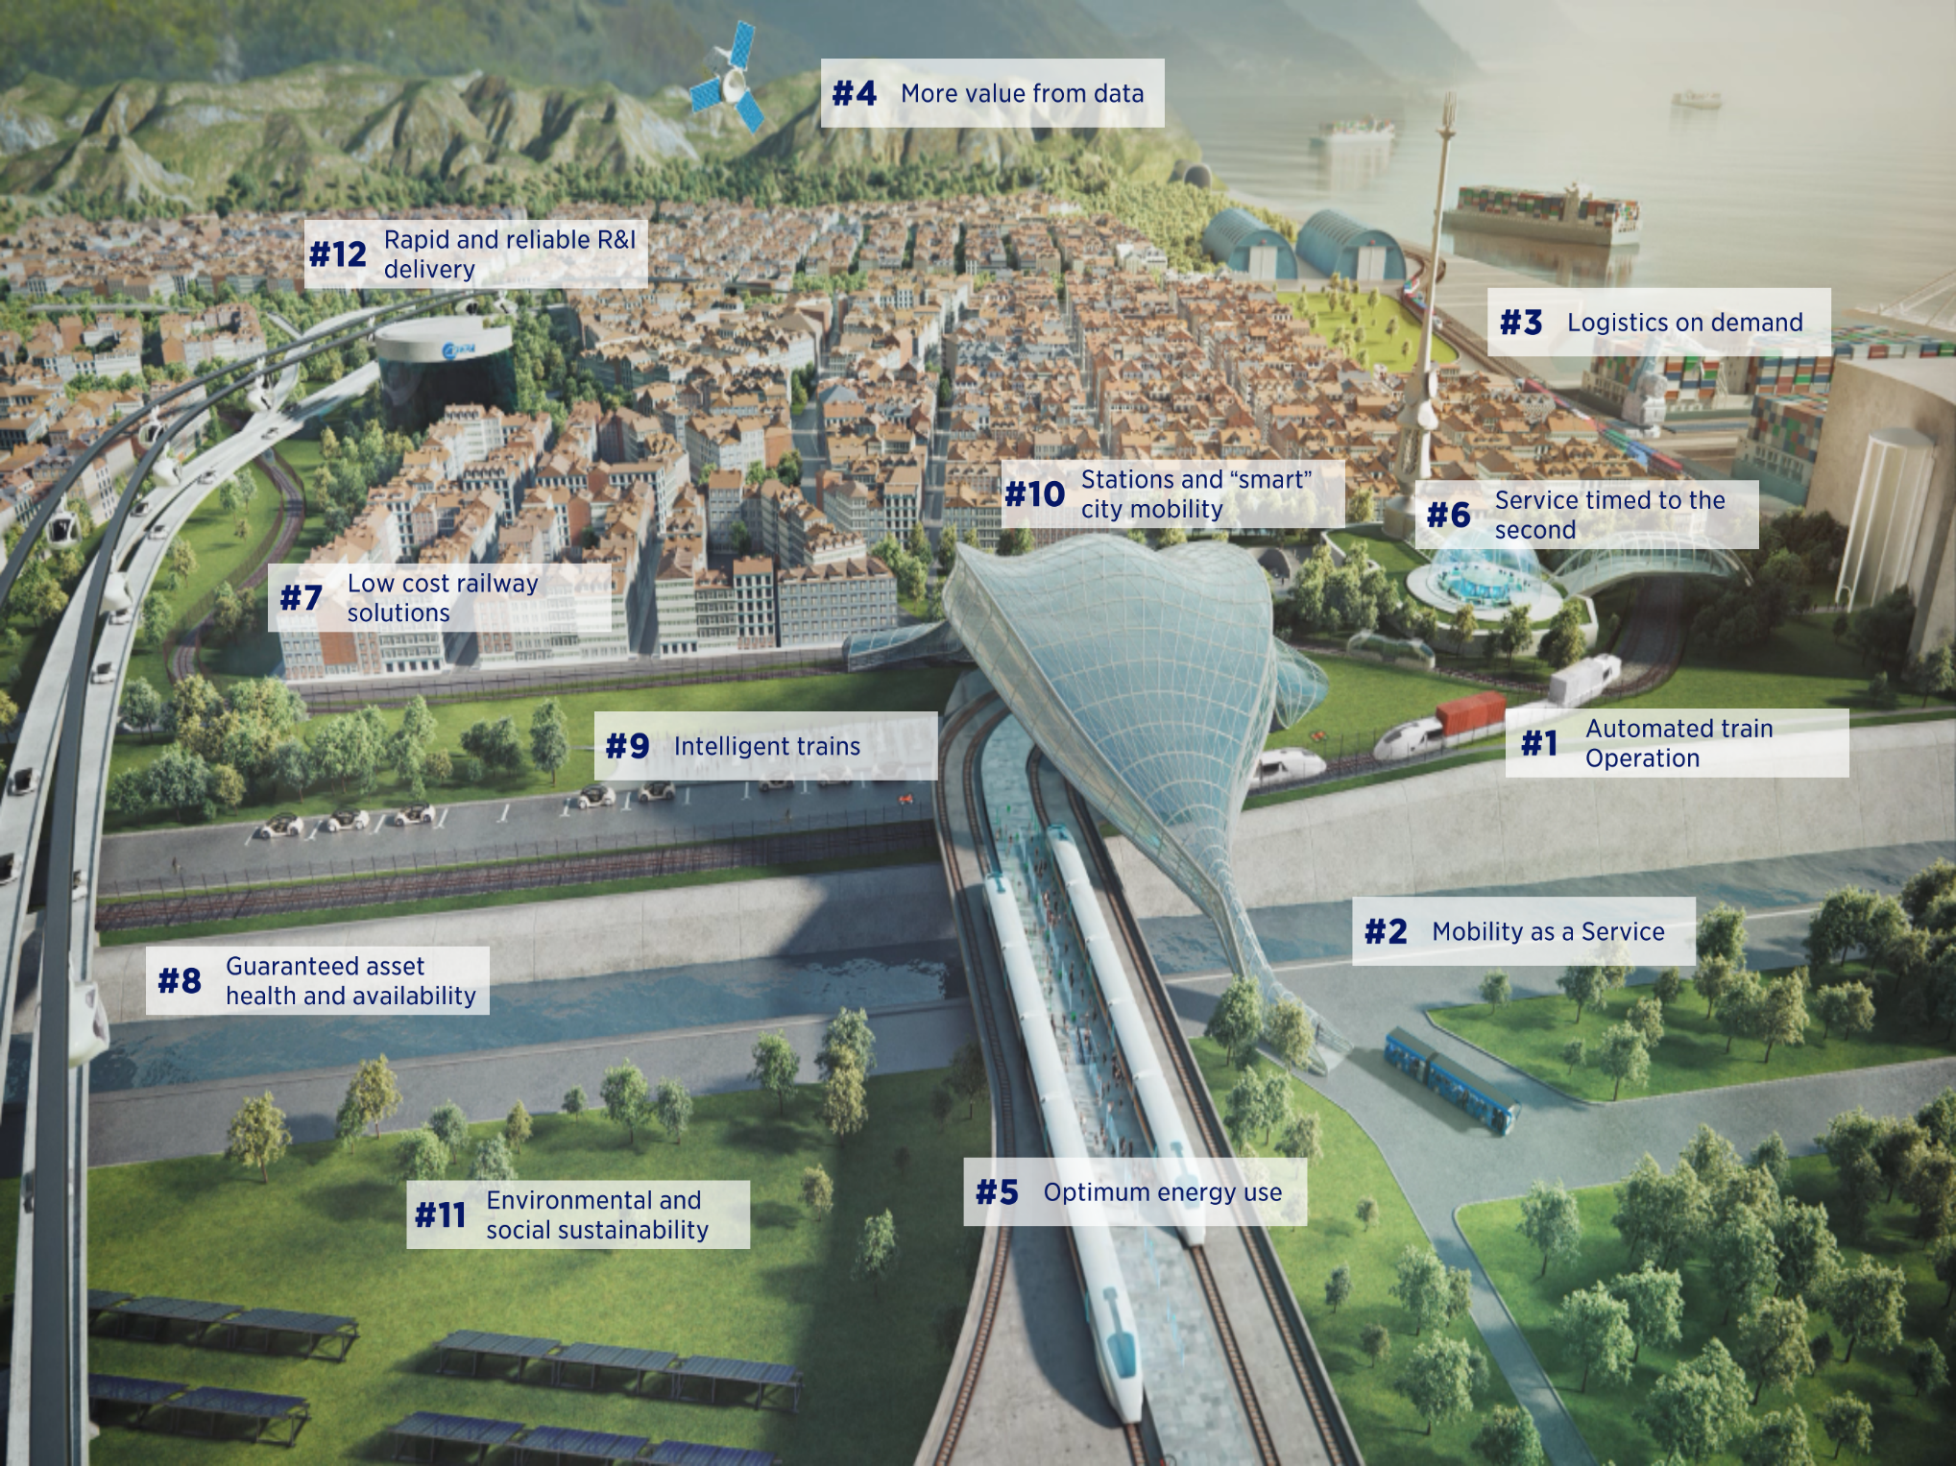
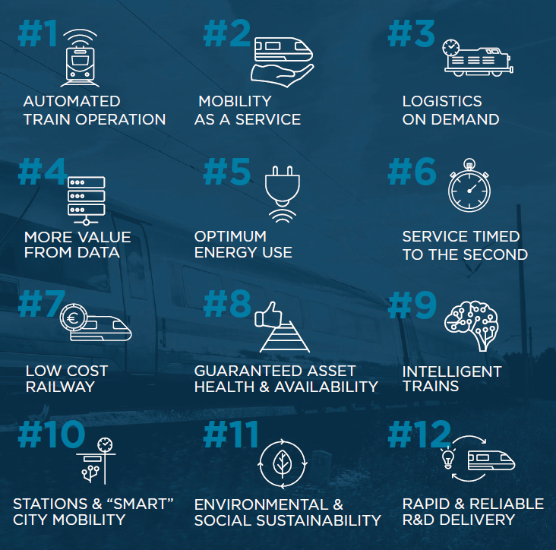
INNOVATION CAPABILITIES

Slide 5
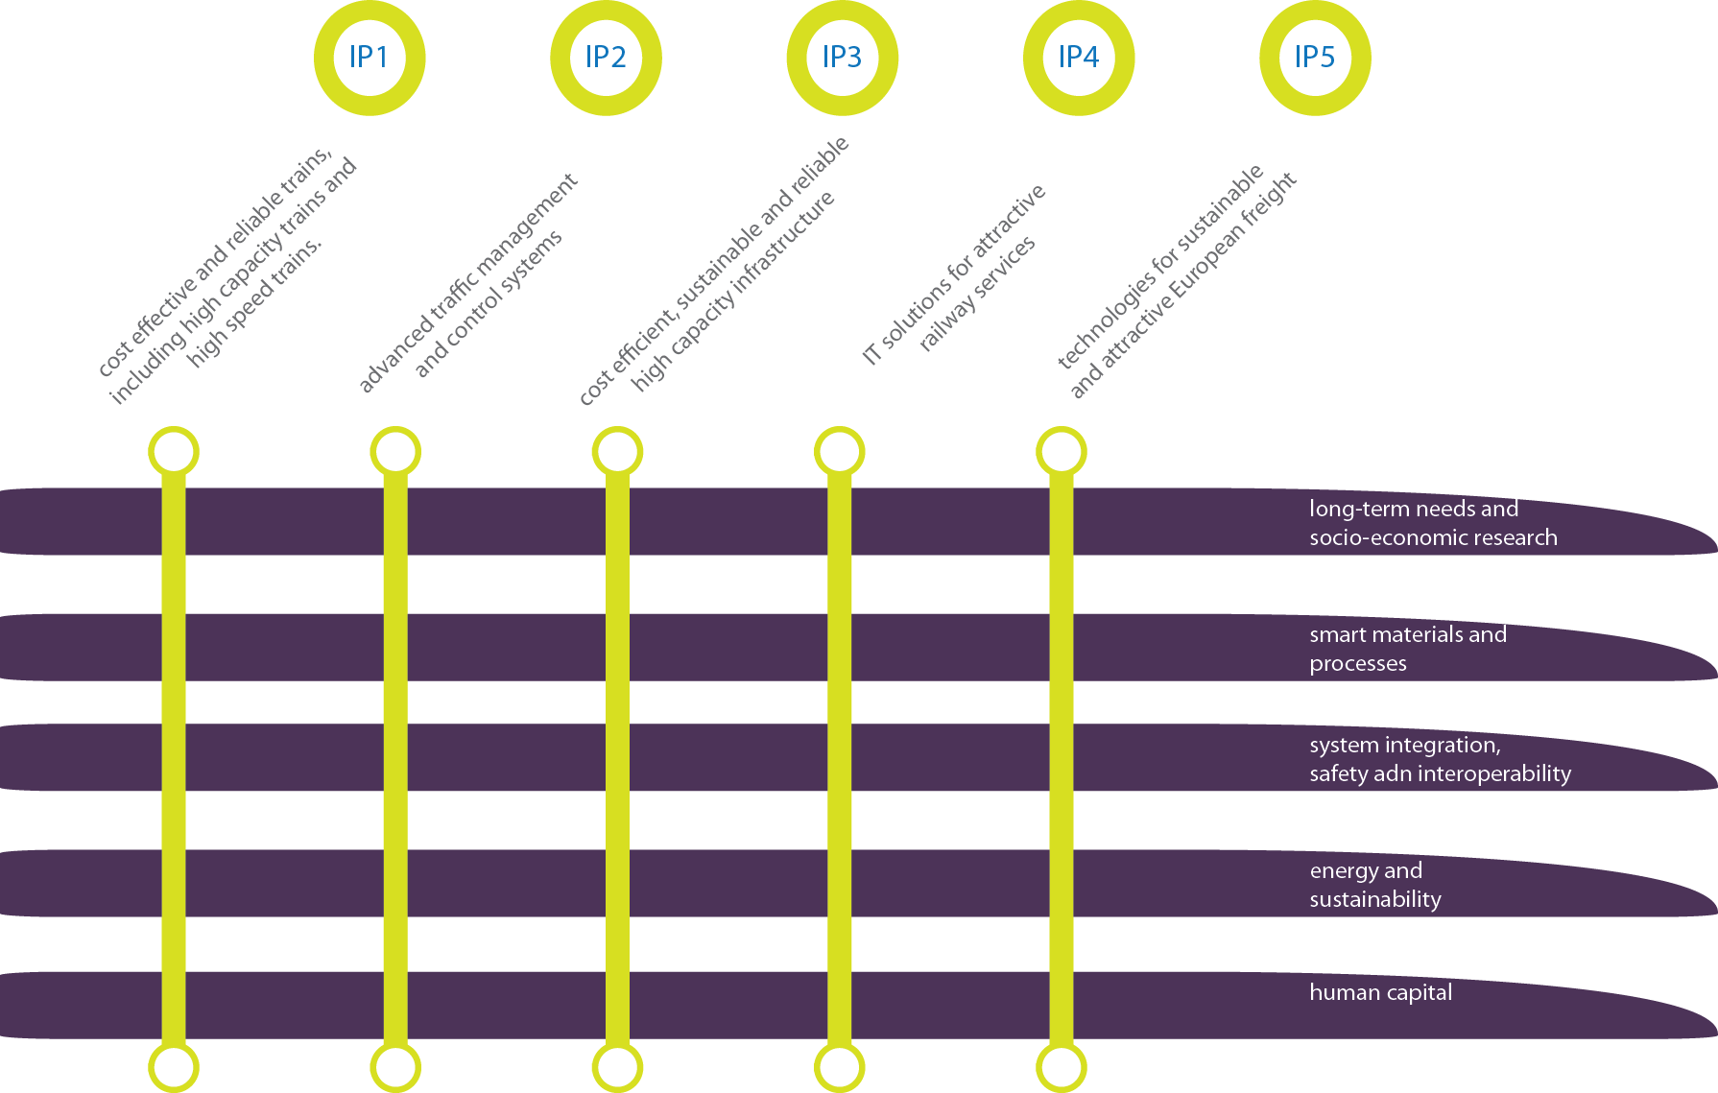
R&I for Innovation Capabilities
S2R PROGRAMME:
INTEGRATED
CONSISTENT
DELIVERY ORIENTED

Slide 6
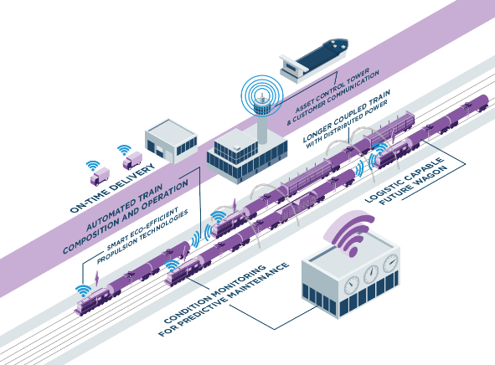
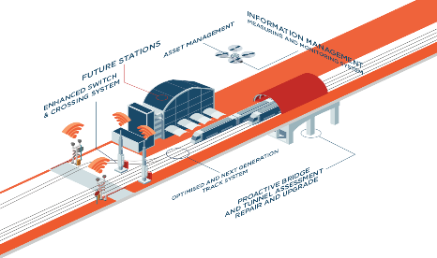
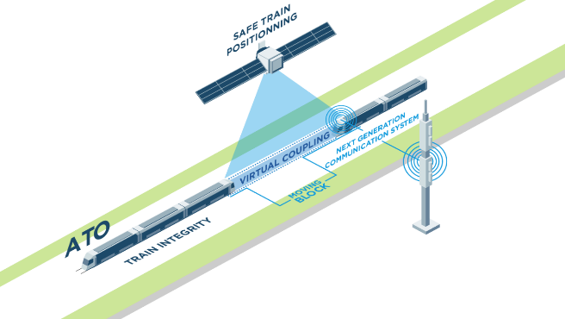
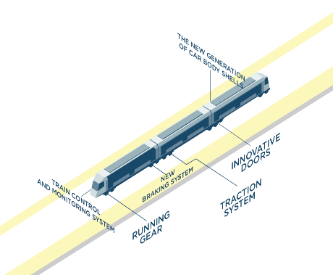
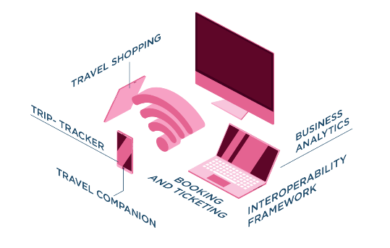

Slide 7
From a piecemeal to a System Architecture Approach
Innovation: evolutionary, by steps or disruptive
Time to market: moving from R&I to deployment => system approach to decrease fragmentation
“Do not reinvent the wheel”: Open System Interface (or interconnection) model
Innovation Skills and Competences : still the same needs in the Digital Railway?
the future rail system: trains maximizing the system performance by a combination of distributed intelligence and supervision
Enablers: digital technologies, automation, artificial intelligence, data, cloud and supercomputing, connectivity, satellite, but also new regulatory concepts and framework, traction, braking systems, etc….
Deployment: from zero on site testing through integrated testing to revenue
services testing, large real time demos, transition models

Slide 8
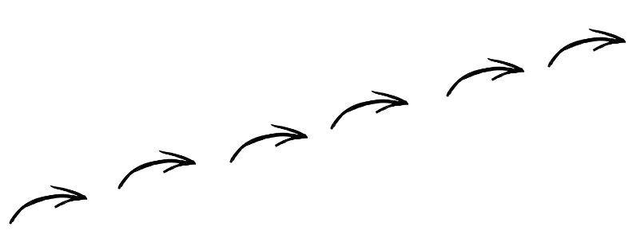
What’s ongoing
R&I BEYOND 2020
S2R
Europe
2030
ERRAC and ERA contributions
AWP
2019
CALL
2018
Co-funding
EUR 185.4 Mio
R&I activities proposed
18 topics
MAAP
PART B
Consultation
2nd half 2018
LP & first
S2R Projects’ closing
Projects’ Reviews
EUR 487 Mio
R&I activities
63% total budget committed
Around 50 ongoing Projects
standardization roadmap

Slide 9
S2R R&I results and process leading to standards and regulation
Stakeholders
e.g. ERRAC
RASCOP Platform
(chaired by EC)
Advisory task proposing guidelines for R&D leading to technical standards for interoperability and safety, after stakeholders consultation
Stakeholders
e.g. ERRAC
ERRAC
European Commission
Recommendation for TSI
Requests for TSI
Request for standards
mandate
S2R R&I results
S2R CCA
WA 3.2
S2R Rolling Innovation Plan
S2R
Develop
Maintain
ERA
input
Detailed
Guidance
JPC-R, Others, SSO
Shift2Rail internal process
CEN/CLC/ETSI
Assisting the S2R projects/TDs:
Overview of standardisation activities, ongoing and planned
Monitoring of progress
Assistance in the timely developmen tof appropriate standars
Close cooperation with relevant partners and organisations
Bring its input into the regulatory framework and standardization plan
Feed into
R&I to reg / stds formal process
ISO / IEC / ITU

Slide 10
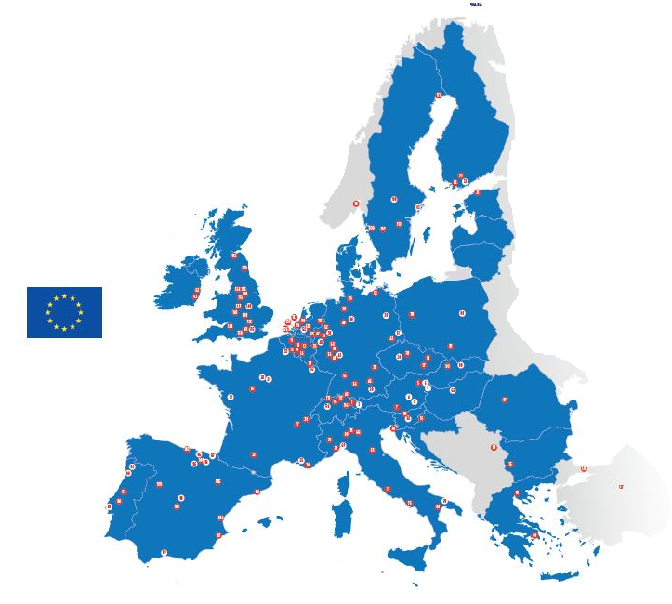
Participation per MS excluding Lighthouse Projects

Slide 11
S2R Next Generation 2021 - 2030

Slide 12
S2R Europe 2030 Research and Innovation beyond 2020
S2R 2 requires revised
Governance
membership vs participation
Content
ERRAC Vision 2050, Master Plan
Regulation & Administrative Simplification
No matrix approach, flexibility, clarity, … while maintaining legality/regularity and sound financial management
START-UPS
BLUE-SKY APPS
Feedback on 19 JUNE 2018
DIALOGUE CONFERENCE ON
S2R: THE FUTURE OF RAIL RESEARCH AND INNOVATION
a journey towards 2020 decision
FUNDAMENTAL RESEARCH
TRL: 0 -> 2
ad-hoc governance
open to all
APPLIED
RESEARCH
TRL: 3 -> 7
PPP membership with third parties
DEPLOYMENT
COORDINATION
open to all
Rail
« Blue
Sky »
R&I
DEMO
ERA authorization
S2R solutions with S2R JU supervision
Funding type: FP9 rules
Flat rate on entity accounting rules
Funding type: CEF/EIB/etc.

Slide 13
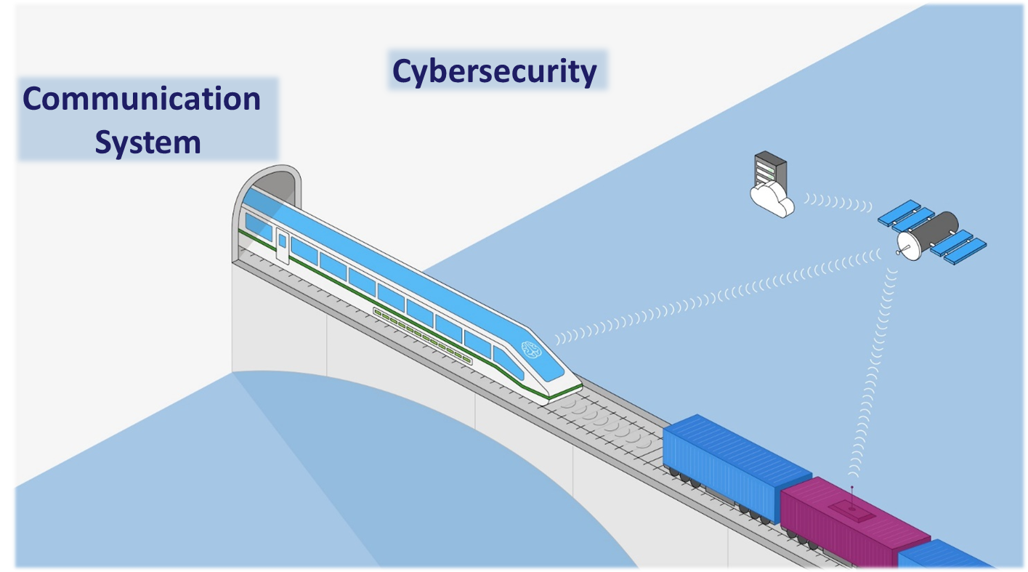
Automation, Digitalizationa and Sustainability: agree on the automation intelligence
on the vehicle
on infrastructure
a mix of both
shared intelligence between modes a railway could be responsible for example of the network management of automated car systems

Slide 14
Creation of new ICT ecosystem and connected business models
Few example are already visible at rail level crossing: a car automatically stops (or better slow down for energy efficiency) before reaching the signal as it is connected and can be positioned/controlled. Same for a boat and an automated drawbridge.
In the freight logistic chain automation at system level (blockchain?) would change the business model and the currently administrative bottlenecks could be solved by automated technology validations
Braking paradigms (AI capability?)
…and much more to be defined and worked out with you!

Slide 15
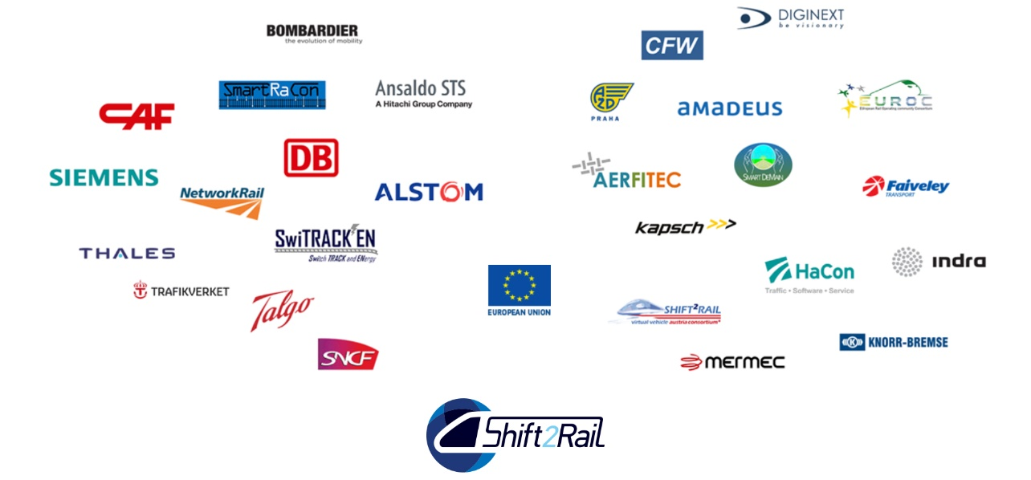
carlo.borghini@s2r.europa.eu

