Slide 1
Innovation in Railways
NTA Ireland
United Nations
Economic Commission for Europe
Working Party on Rail Transport (SC.2)
72nd Session November 21, 2018

Slide 2
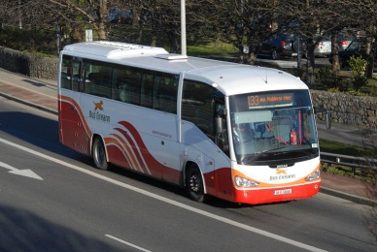
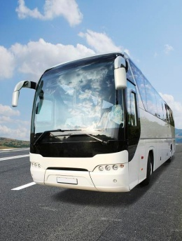
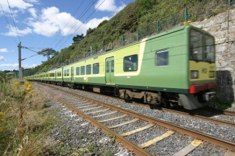
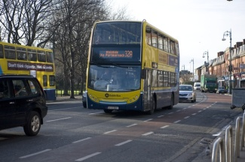
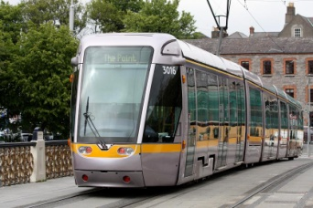
NTA - National Transport Authority of Ireland
National Transport Authority (NTA) is an Irish government agency under the responsibility of the Department of Transport Tourism and Sport.
NTA has responsibility for securing the provision of public passenger land transport services, including bus and rail services by Bus Éireann, Dublin Bus, Go Ahead, Luas (light rail) and Irish Rail (heavy rail).
Licenced Private Operators

Slide 3
Capital Investment
Capital Projects:
NTA funds investment in public transport:
Luas light rail “Cross City” project
MetroLink new metro system
Bus Connects bus network expansion
DART electrified heavy rail expansion programme
Leap Card integrated multi-modal multi-operator smart card ticketing system

Slide 4
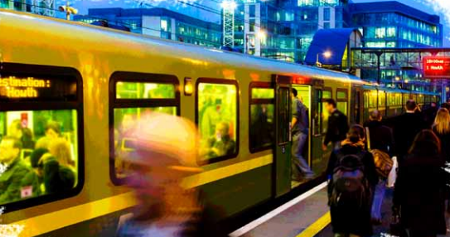
NTA’s Mission
Mission Statement:
“To provide high quality, accessible, sustainable public transport connecting people across Ireland”

Slide 5
Evolution of Public Transport
Public Transport has to evolve:
Congestion is increasing and is not sustainable
Environmental standards requires new approaches
Growing acceptance that the future of urban transit includes other forms of mobility – from autonomous vehicles through to car sharing/ride sharing
Smartphones and Mobile apps are creating new expectations
“Mobility As A Service” (MaaS) is an increasingly popular concept
So what is the role of NTA in the future of mobility?

Slide 6
Creating a Mobility Platform
To achieve our mission:
NTA’s role is to facilitate (and create where necessary) an environment where:
Multiple mobility service providers can co-exist, both publicly and privately run
Different service providers can be integrated
innovative business models can be catered for
Revenue assurance can be provided via appropriate governance and regulatory oversight arrangements
Mobility-As-A-Service (MaaS) will change how public transport is delivered and consumed, and MaaS will evolve as the infrastructure develops
Innovative new business models and mobility services will emerge if the conditions are right

Slide 7
How NTA will approach this
Ticketing as a catalyst:
NTA will use a nationwide account based ticketing system as the catalyst for a ‘Total Mobility Solution’
Providing for integration and convergence of
mobile ticketing, with
Enhanced national journey planning applications and real time information systems,
Single sign-on system for customer accounts, and
Comprehensive API’s made available to third parties
All working towards a converged mobile app and systems that provides a platform for co-existence of public & private mobility solutions – new business models, new pricing models, new sales channels

Slide 8
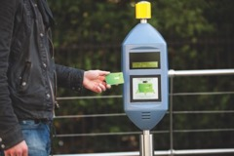
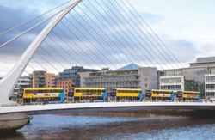
Future ‘Total Mobility Solution’
Across the Country using a Single Integrated Platform
NTA will open up the opportunities for a consumer to get a tram or bus to the city centre, take a city bike to the train station, take train to a regional city and then complete their final leg using a Go Car, including paying for parking at the final destination all using a single travel entitlement, with real-time updates as they travel and automated route recalculation if necessary, providing best value to the customer across both public and private transport providers.

Slide 9
Achieving the Total Mobility Solution
A Platform for Mobility As A Service (MaaS):
By providing a platform to allow public and private mobility offerings to co-exist, and NTA intends to facilitate innovation in the mobility market and beyond
By providing/facilitating a single integrated platform customers can seamlessly utilise the various modes of transport, both public and private
Covering from door-to-door, from the first kilometre to last kilometre
Providing for Cross-Border integration using a commonly accepted token
Creating a governance structure to provide revenue assurance for mobility service providers

Slide 10
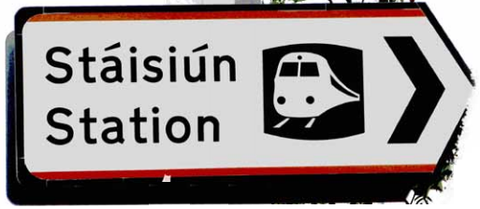
Key Principles for Future Mobility Solution
Key Principles:
Smartphones will be central to a successful mobility transformation, and is the main driver behind the transformation of the mobility landscape - Car Sharing, Bike Hire, Ride sharing etc.
Accessibility – access has to be simple and frictionless. Customers should not have to check multiple websites/apps for ticketing information
Integrated information - can no longer be standalone apps or systems for journey planning or ticketing or real time information or payment, now have to centralise across public and private providers
Integrated services – joint mobility offerings, covering from door-to-door, including the first Kilometre and last Kilometre will be important, across both public and private mobility providers

Slide 11
Steps to achieve the NTA Objective
In progress:
NTA has already linked Leap Card with Dublin Bikes (bike hire) and Go Car (car sharing)
New ticketing system to deliver greater choice for customers -
Choice of payment method
Integration with private mobility providers
Choice of ticketing media (proof of entitlement to travel)
Single-sign-on system being implemented
Convergence of apps being planned - national journey planner, real-time passenger information and ticketing
APIs to link with third party service providers included in all procurements

Slide 12
Steps to achieve the NTA Objective
Possible Next Steps:
Linkup with Car Parking for ‘Park and Ride‘ ticketing/payments
Digital “Proof of Entitlement” – to prove eligibility for certain services and/or discounted prices
Enable transport operators to offer products integrated with third parties
Migrate from current card based ticketing (Leap Card) to new nationwide account based ticketing

Slide 13
Policy and Regulation
Current Status:
Not aware of any national frameworks specifically defining direction for MaaS or role in any future ‘Smart Cities’
Some relevant EU legislation (multi-modal travel information services etc.)
The introduction of defined policies and regulations should help drive future innovation in this area – good governance around revenue allocation likely to be critical
Collaboration between government authorities and private agencies and technology partners would benefit from clear policies and regulations

Slide 14
Thank you for your time
Questions:
Barry.Dorgan@nationaltransport.ie

