Slide 1
GTB
Transmitted by the expert from GTB | Informal document GRE-77-03 (77th GRE, 4 - 7 April 2017, agenda item 5)
Substitute Light Sources
Equivalence Reports for C5W, PY21W, and R5W
In support of documents GRE/2017/2
and GRE/2017/3

Slide 2
Equivalence Report
C5W
According to Regulation No. 128
Equivalence Requirements GRE-77-02

Slide 3
Checklist for Equivalence of Parameters
C5W
Parameters Check
3.1. Parameters with the same values
3.1.1. Cap (as in in accordance with the given IEC Publication 60061) ⎫
3.1.2. Maximum lamp outline dimensions ⎫
3.1.3. Electrical connector n/a
3.1.4. Test voltage ⎫
3.1.5. Objective luminous flux ⎫
3.1.6. Colour of emitted light ⎫
3.1.7. Light centre length ⎫
3.1.8. Distortion free zone (if any) n/a
3.2. Parameters with similar values
3.2.1. Normalized luminous intensity distribution see page 3 ⎫
3.2.2. Size and position of the light-emitting-area see page 4 ⎫
3.2.3. Homogeneity of the light-emitting-area see page 4 ⎫
3.3. Parameters with different values
3.3.1. Maximum electrical power consumption 2W ⎫
3.3.2. The minimum voltage range R128 Annex 4 (9-16V) ⎫
3.3.3. The spectral content R128 par. 2.3.3. ⎫
3.4. Additional parameters
3.4.1. Thermal behaviour R128 Annex 4 ⎫
Requirements regarding failure detection
4.1 Failure detection 75 …. 170 mA ⎫
4.2 Failure behaviour below 25 mA ⎫
no flash R128 3.12.3. ⎫

Slide 4
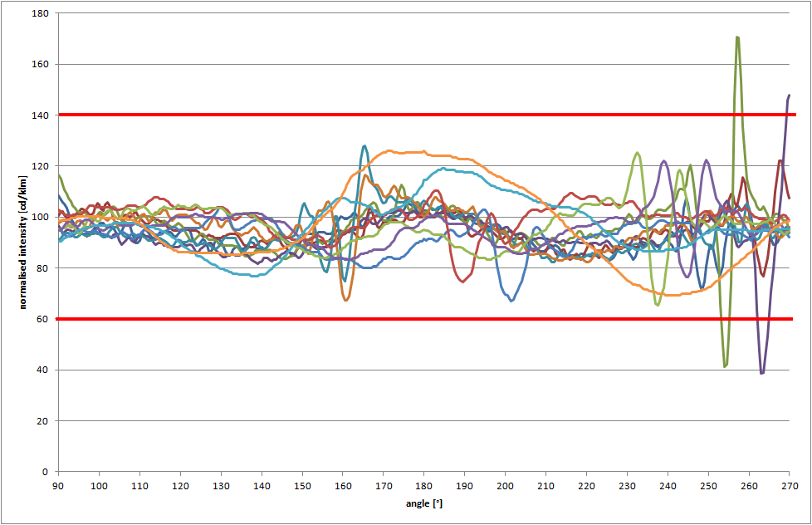
Normalised Intensity Distribution
C5W
C0

Slide 5
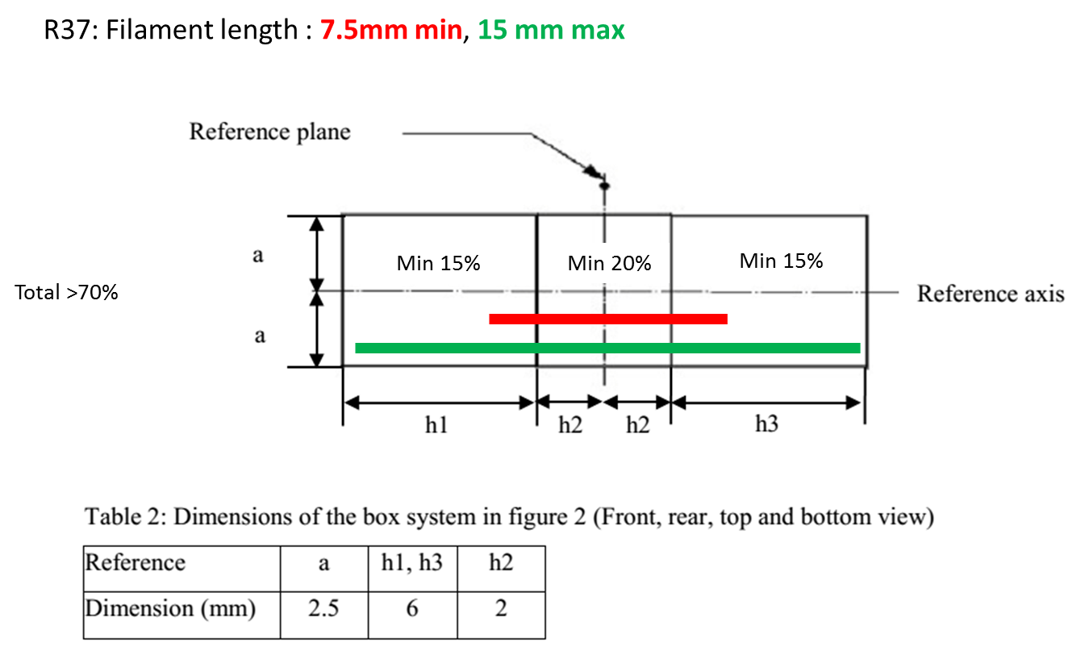
Size, Position and Homogeneity of the Light-Emitting-Area C5W

Slide 6
Equivalence Report
PY21W
According to Regulation No. 128
Equivalence Requirements GRE-77-02

Slide 7
Checklist for Equivalence of Parameters
PY21W
Parameters Check
3.1. Parameters with the same values
3.1.1. Cap (as in in accordance with the given IEC Publication 60061) ✓
3.1.2. Maximum lamp outline dimensions ✓
3.1.3. Electrical connector n/a
3.1.4. Test voltage ✓
3.1.5. Objective luminous flux ✓
3.1.6. Colour of emitted light ✓
3.1.7. Light centre length ✓
3.1.8. Distortion free zone (if any) n/a
3.2. Parameters with similar values
3.2.1. Normalized luminous intensity distribution see page 3 ✓
3.2.2. Size and position of the light-emitting-area see page 4 ✓
3.2.3. Homogeneity of the light-emitting-area see page 4 ✓
3.3. Parameters with different values
3.3.1. Maximum electrical power consumption 9W (12V), 10W (24V) ✓
3.3.2. The minimum voltage range R128 Annex 4 ✓ (9-16V)
3.3.3. The spectral content n/a for amber
3.4. Additional parameters
3.4.1. Thermal behaviour R128 Annex 4 ✓
4. Requirements regarding failure
4.1. Failure detection 150…750 mA ✓
4.2. Failure behavior below 50 mA ✓
no flash R128 3.12.3. ✓

Slide 8
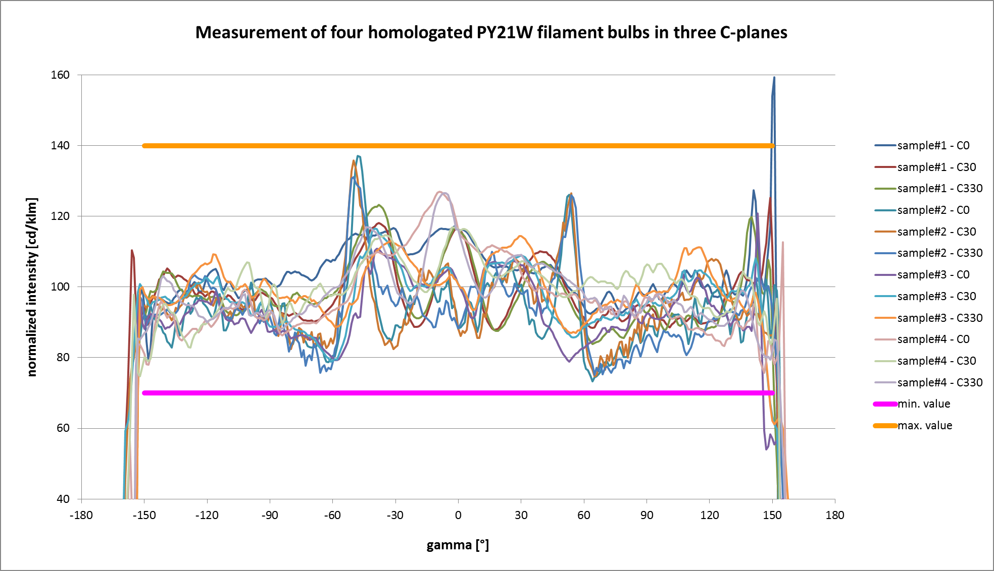
Normalised Intensity Distribution
PY21W

Slide 9
Size, Position and Homogeneity of the Light-Emitting-Area PY21W

Slide 10
Equivalence Report
R5W
According to Regulation No. 128
Equivalence Requirements GRE-77-02

Slide 11
Checklist for Equivalence of Parameters
R5W
Parameters Check
3.1. Parameters with the same values
3.1.1. Cap (as in in accordance with the given IEC Publication 60061) ⎫
3.1.2. Maximum lamp outline dimensions ⎫
3.1.3. Electrical connector n/a
3.1.4. Test voltage ⎫
3.1.5. Objective luminous flux ⎫
3.1.6. Colour of emitted light ⎫
3.1.7. Light centre length ⎫
3.1.8. Distortion free zone (if any) n/a
3.2. Parameters with similar values
3.2.1. Normalized luminous intensity distribution see page 3 ⎫
3.2.2. Size and position of the light-emitting-area see page 4 ⎫
3.2.3. Homogeneity of the light-emitting-area see page 4 ⎫
3.3. Parameters with different values
3.3.1. Maximum electrical power consumption 2W ⎫
3.3.2. The minimum voltage range R128 Annex 4 (9-16V) ⎫
3.3.3. The spectral content R128 par. 2.3.3. ⎫
3.4. Additional parameters
3.4.1. Thermal behaviour R128 Annex 4
Requirements regarding failure detection
4.1 Failure detection 75 …. 170 mA ⎫
4.2 Failure behaviour below 25 mA ⎫
no flash R128 3.12.3. ⎫

Slide 12
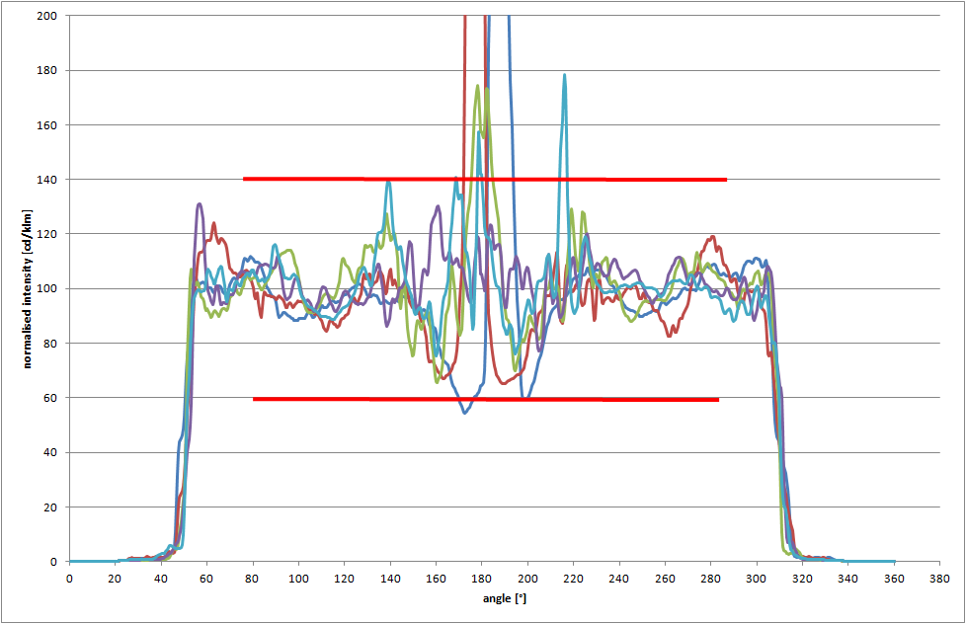
Normalised Intensity Distribution
R5W
C0

Slide 13
Size, Position and Homogeneity of the Light-Emitting-Area R5W

Slide 14
END

