Slide 1

Environmental Noise in the European Union
UN ECE WP29.GRB 66
Genève – 5 September 2017
Marco PAVIOTTI,
European Commission, DG Environment
Transmitted by the expert from the European Commission
Informal document GRB-66-18
(66th GRB, 4-6 September 2017,
agenda item 10)
#NoiseEU

Slide 2

Noise in Europe today
  More than 100 million people affected by noise from traffic
  At least 16 000 cases of premature death in Europe each year (real figure is higher)
  2nd most dangerous environmental hazard to people's health

Slide 3

Health effects
Annoyance
Sleep disturbance
Cardiovascular
diseases
Notes:
close attention to be paid to WHO Europe's work on producing revised Environmental Noise Guidelines for the European Region (expected in early 2016).
WHO Environmental noise guidelines for European Region are delayed and foreseen for the first half of 2016;
- formulas and values to assess health implications in this draft are given solely as examples;
- we intend to wait for the WHO to finalise the Noise Guidelines before proposing the final formulae and values.

Slide 4

Where do we want to go?
Environment Action Programme to 2020
'Living well, within the limits of our planet'
  significantly decrease noise pollution in the Union, moving closer to levels recommended by the WHO, by 2020

Slide 5

EU regulatory framework
Directive 2002/49/EC: achieve a common European approach to avoid, prevent or reduce the effects of exposure to environmental noise harmful for health
  Actions: noise mapping + action planning in 5-year cycles
  Excludes: limit values + prescribed measures

Slide 6
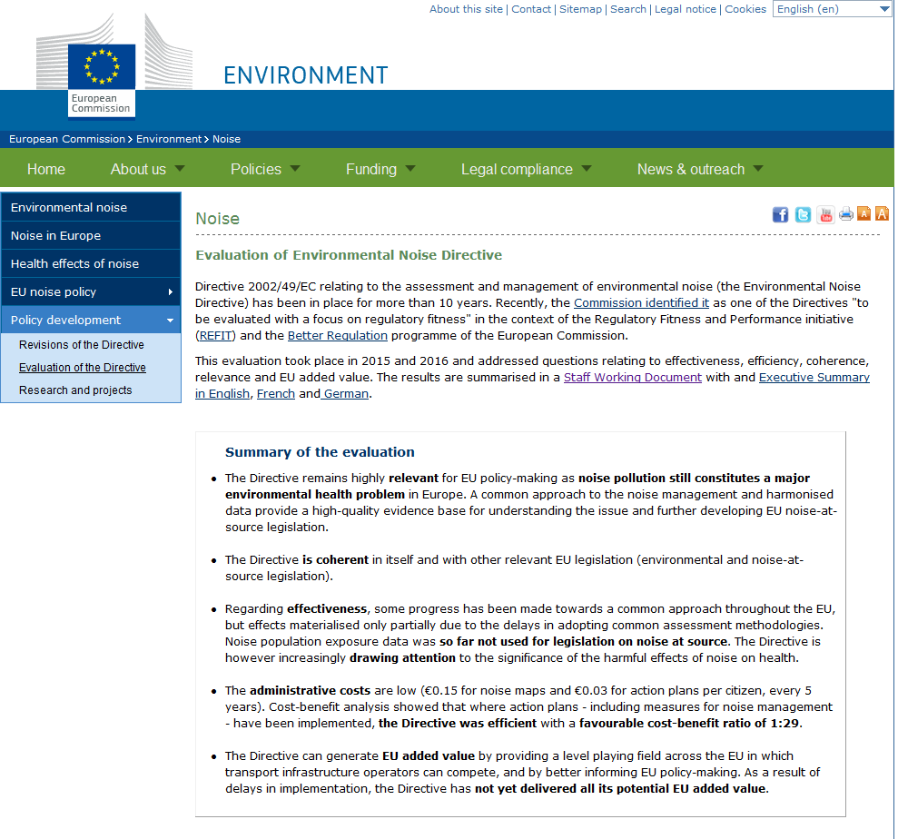

Slide 7
Annex II
Annex II
establish noise mapping methods
includes a road vehicle (acoustic) classification
includes a road surface (acoustic) classification
is mandatory for all roads of more than 3.000.000 vehicles/year

Slide 8
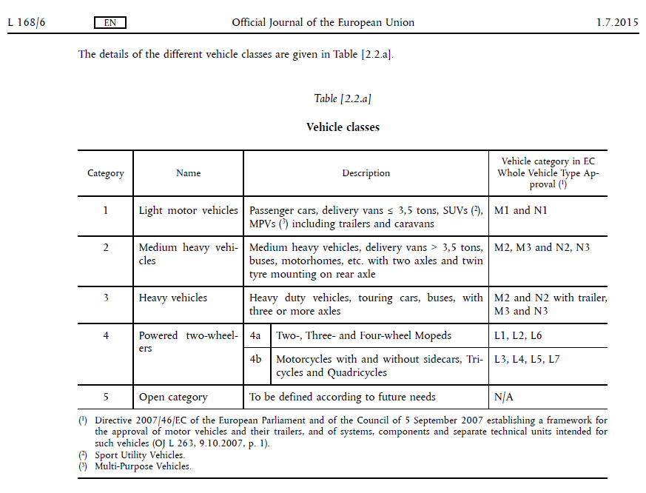

Slide 9
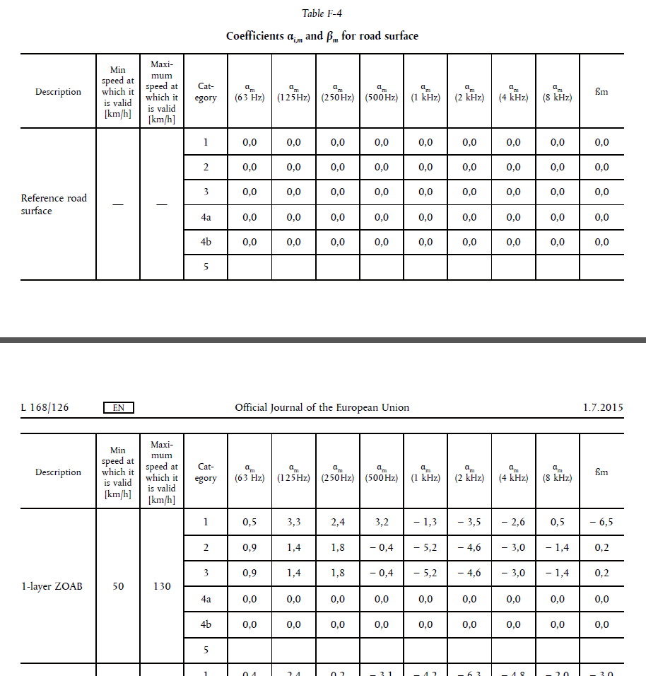
15 road surface types
(can be modified nationally)

Slide 10
Road (acoustic) classification
Annex II sets mandatory classification
  Road surface types not (mandatorily) standardised yet
Green Public Procurement
  EU Guidelines for road authorities
  Road surface is classified using ISO 11819-2
ISO 11819-2 and ISO/TS 11819-3
  for road surface acoustic characterisation
CEN/TC 227/WG 5
  is developing and EN standard for classification of road pavements

Slide 11
European Union
Noise Expert Group (NEG)
To allow detailed discussions with Member States and stakeholders on environmental noise policy issues, in particular in the context of the Environmental Noise Directive.
E.g.: providing guidance on noise action plans, producing recommendations for road surface, …

Slide 12
Conclusion
7th Environment Action Programme sets noise reduction targets;
Directive 2002/49/EC sets
  mandatory acoustic road surface classification;
  mandatory action plans that could include optimised road surfaces;
optimised road surfaces would better work with optimised tyres/vehicles (so, GRB matter!).

Slide 13
So, is there space for exchange of info between GRB and EU-Noise Expert Group?

Slide 14
Thank you

Slide 15

Implementation
  Combination of centralised and decentralised approaches
  Majority of MS (21) have noise limit values, but lack of enforcement in many MS
  Only 13 MS have designated quiet areas, in some cases to a limited degree
Notes:
Competency arrangements in the Member State (not defined by the Directive due to subsidiarity) are widely divergent, and sometimes complex. Where they are more complex/fragmented, we notice greater delays.

Slide 16
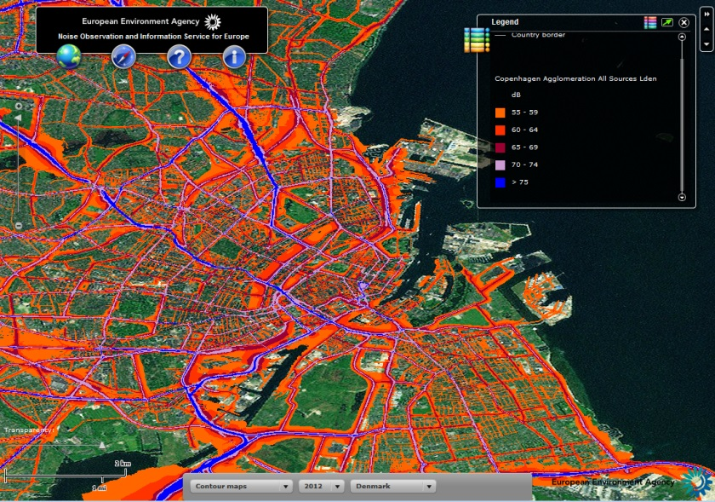
Implementation
Findings 3
Strategic noise mapping - issues
  Lack of human/financial resources
  Lack of input data
  Lack of coordination
  Data comparability issues
Action plans - issues
  Period between mapping
  and action planning too short
  Lack of enforcement
  mechanisms for noise-
  reducing measures
  Public consultation to be
  improved
Notes:
In terms of noise mapping, the point listed refer to the key reasons referrred to be stakeholders for causing delays. In addition, data comparability issues remain a problem, however these are expected to be largely resolved as CNOSSOS-EU comes into force.
In terms of action planning, there is wide agreement that the 1-year period between developing a noise map and an action plan is considered too short. Moreover, there is recognition that public engagement and consultation remains a weak spot and needs to be improved, but with no clear conclusion on how to move forward.

Slide 17
Evaluation
1
Relevance
  Objectives remain relevant
  non-stated, implicit
  objective: protection of
  citizens from excessive
  noise
  Necessary to combine at-source and local measures
Coherence
  Coherent with noise-at-source legislation
  Some small issues for improvement
Notes:
Relevance: The 2 objectives of the Directive remain relevant (common approach to noise assessment, inform source legislation). In addition, it would be necessary to spell out the implicit objective of the Directive, namely to protect citizens from excessive noise, which also is highly relevant. Some stakeholders advocate for limits, but the outcome is inconclusive.
Coherence: Directive overall coherent, some small issues could be improved (some definitions, logic in text etc.)

Slide 18

Findings Evaluation
2
EU added value
  level playing field
  inform source legislation
  Not yet delivering the EU
  added value that it could
  provide
Effectiveness
  Effects not fully materialised yet
  Introduction of CNOSSOS an important step
  Informing source legislation: not yet fully used
  Overall long-term effects of reduction measures
Notes:
EU added value: Overall EU involvement seen as crucial, important to inform source legislation and to have a clear picture of the situation. In many MS, EU action is seen as the key step for putting the issue on the political agenda.
Bnefits of most measures can only be seen over about 20 years due to progressive effect of the interventions.

Slide 19

Findings Evaluation
3
Efficiency
  Administrative costs low
    Noise mapping €0.15
    Action planning €0.03
    In total €18 million per year
Notes:
Efficiency: Administrative costs overall reasonable, declined in many MS from first round to second reporting round due to one-off costs.
The median costs per inhabitant (out of the total population of 11 EU MS who provided the necessary data) for noise mapping – circa €0.15 – and for action planning - €0.03 – were low.
The analysis revealed that the END has made a positive contribution to reducing population exposure to high levels of environmental noise. Whilst the magnitude of costs and benefits of noise mitigation measures was found to vary between countries and sources, a positive cost-benefit relationship was identified under a range of scenarios, where the scenarios reflect both differences in the underlying assumptions regarding the extent to which costs and benefits can be attributed to the END and the range of uncertainty in relation to the value of impacts on human health. The base case scenario results in a favourable cost-benefit ratio (of 1:29) overall, although the ratios vary substantially between measures. The benefits are likely to be understated, since the analysis only considered the effects of noise reduction on the ‘highly annoyed’ and ‘highly sleep disturbed’ populations. It should be noted that whilst the CBA is an important element of assessing efficiency, measure-level data only provides a proxy, since NAP measure implementation is not compulsory and does not take into account the strategic, qualitative benefits of the END (see impacts under “effectiveness”).

Slide 20
Findings Evaluation
4
Cost-benefit analysis
  Overall Costs
  Benefits: reduction
  of impacts on human
  health
  cost-benefit ratio of
  1:29 overall
  Ratios vary
  substantially between
  measures
Notes:
Efficiency: Administrative costs overall reasonable, declined in many MS from first round to second reporting round due to one-off costs.
The median costs per inhabitant (out of the total population of 11 EU MS who provided the necessary data) for noise mapping – circa €0.15 – and for action planning - €0.03 – were low.
The analysis revealed that the END has made a positive contribution to reducing population exposure to high levels of environmental noise. Whilst the magnitude of costs and benefits of noise mitigation measures was found to vary between countries and sources, a positive cost-benefit relationship was identified under a range of scenarios, where the scenarios reflect both differences in the underlying assumptions regarding the extent to which costs and benefits can be attributed to the END and the range of uncertainty in relation to the value of impacts on human health. The base case scenario results in a favourable cost-benefit ratio (of 1:29) overall, although the ratios vary substantially between measures. The benefits are likely to be understated, since the analysis only considered the effects of noise reduction on the ‘highly annoyed’ and ‘highly sleep disturbed’ populations. It should be noted that whilst the CBA is an important element of assessing efficiency, measure-level data only provides a proxy, since NAP measure implementation is not compulsory and does not take into account the strategic, qualitative benefits of the END (see impacts under “effectiveness”).

Slide 21

Next steps
The Implementation report – action plan
Infringements – Annex III – Reporting mechanism

Slide 22
Conference
Noise in Europe 2017
Conference on the negative impacts of transport noise on human health
24 April 2017 in Brussels
With the participation of three Commissioners, MEPs, Member States, WHO, EEA, scientisists and stakeholders

Slide 23
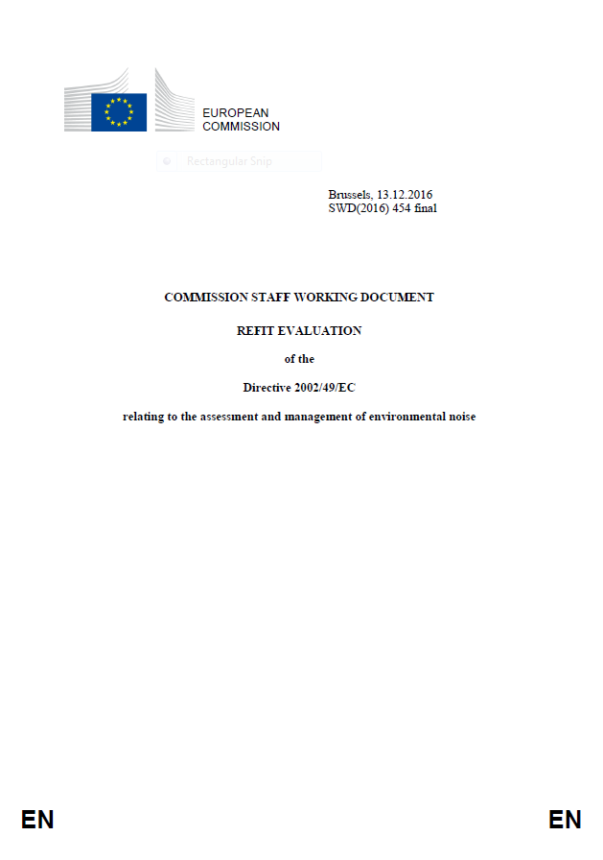
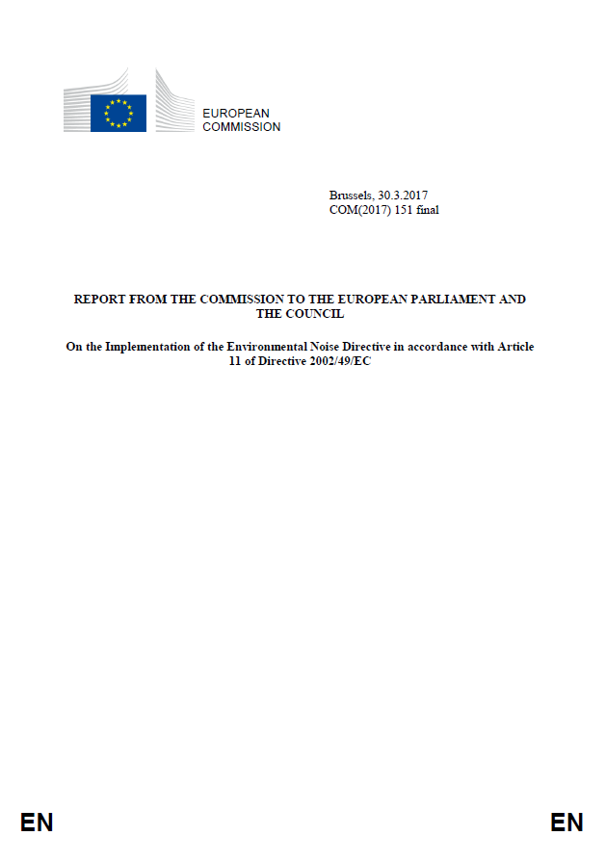

Slide 24
  "Among environmental factors in Europe, environmental noise leads to a disease burden
  that is second in magnitude only to that from
  air pollution" (WHO)
  More than 100 million people in the EU are affected

Slide 25
What have we achieved
A common method:
Cnossos EU..
..to better
inform
legislation
at source

Slide 26
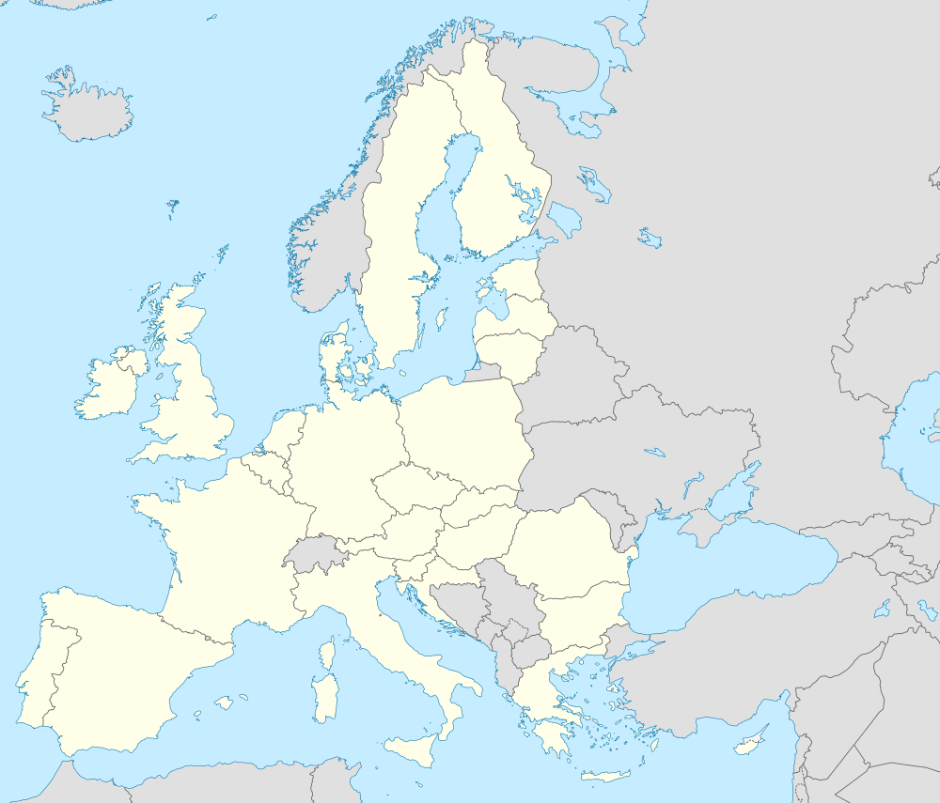
The implementation is delayed

Slide 27

Administrative costs
0,18 €/inhabitant

Slide 28

cost
1
benefit
29

Slide 29

    Cohesion
    Fund
    European
    Regional
    Development
    Fund
    Research and
    Innovation
    Urban policy

Slide 30

Reporting mechanism
Reporting
limits

Slide 31

    …und…
24 April 2017
Bruxelles

