Slide 1
Push and Pull for Noise Emission Reduction from Road Traffic in the NLs and EU
Transmitted by the expert from the Netherlands
Informal document GRB-65-27
(65th GRB, 15-17 February 2017,
agenda item 10)
Johan Sliggers
Ministry of Environment
The Netherlands

Slide 2
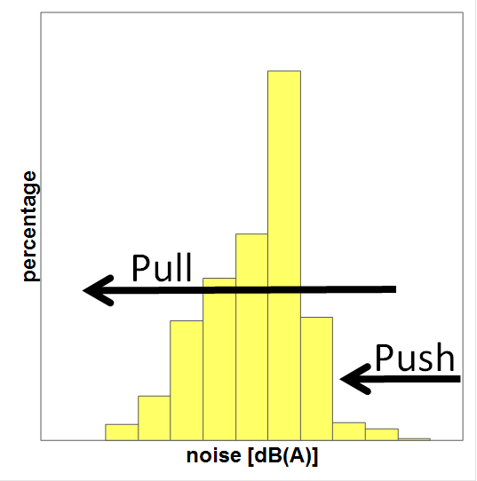

Slide 3
Noise Emission from Road Traffic
 | Emission Road Surfaces | Emission Tyres | Emission Powertrain
Limits (Push) | No | EU and UNECE | EU and UNECE
Labelling (Pull) | Demonstrated Consortium NLs | EU | Demonstrated NLs
Campaign (Pull) | No | Some countries, ETRTO | No

Slide 4
Road Surfaces
EUROCITIES Brochure (GRB 60-04 and 60-04-Add.1)
CEDR, 27 Member States (GRB 61-16)
  Overview noise, lifetime, costs (investments and maintenance) from 15 MS
NLs Consortium (GRB 65-20,21,22 and 65-22-Add.1)
  Labelling Road Surfaces

Slide 5
CEDR: Pavements: Noise (GRB 61-16)
initial noise reduction (in dB)
transition from much used pavements (DAC/SMA) to noise reducing pavements (PA/TL) reduces noise with 2 to 3 dB
average lifetime noise reduction is less than initial reduction
acoustic properties of pavements are covered in regulation and noise calculation model in CEDR MS
harmonization at EU level (END and CNOSSOS-EU)
W. Alberts
Traffic noise and motorway pavements
5
Notes:
Bern
16.02.2017
cocodrillotour
5

Slide 6
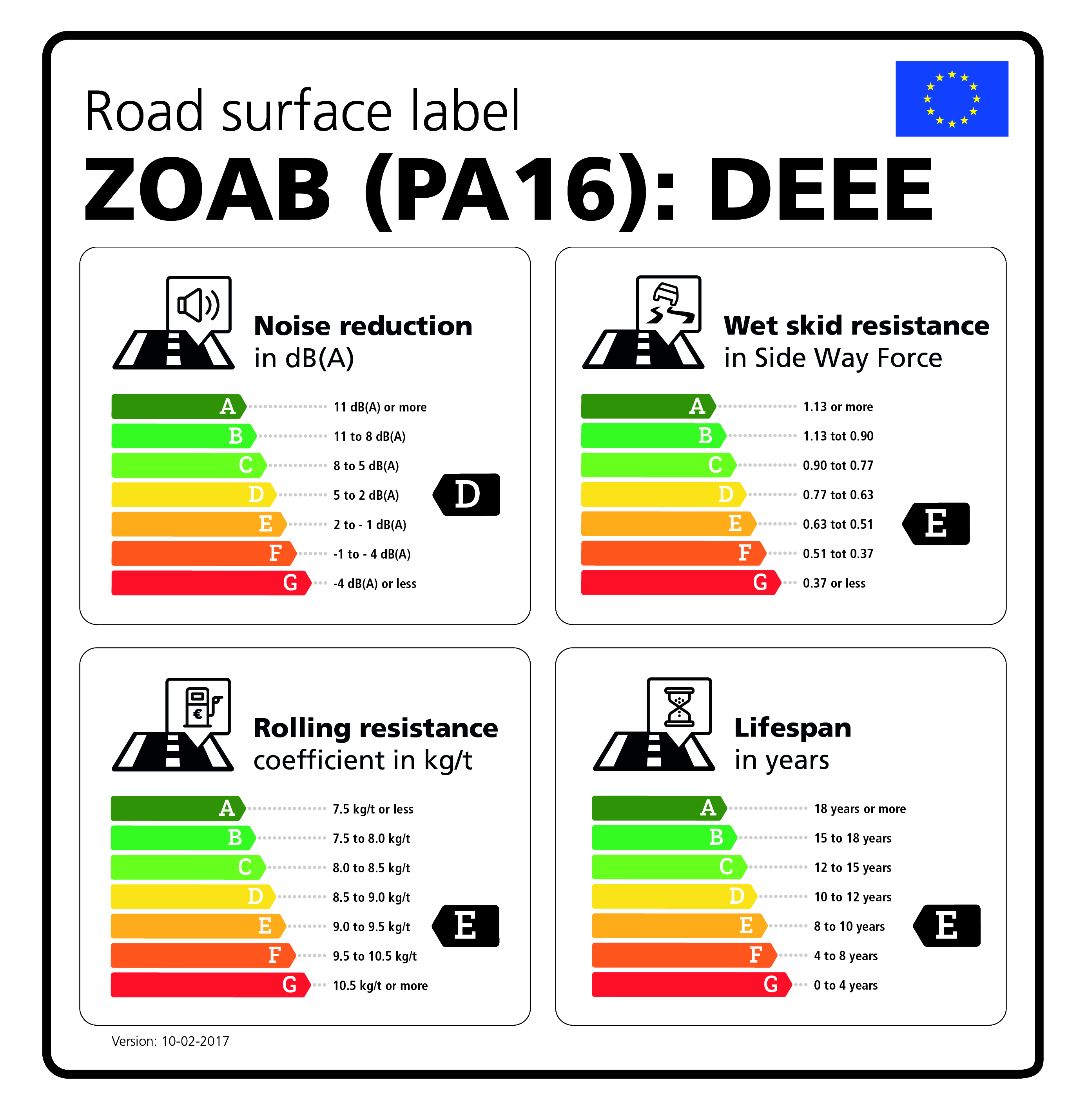
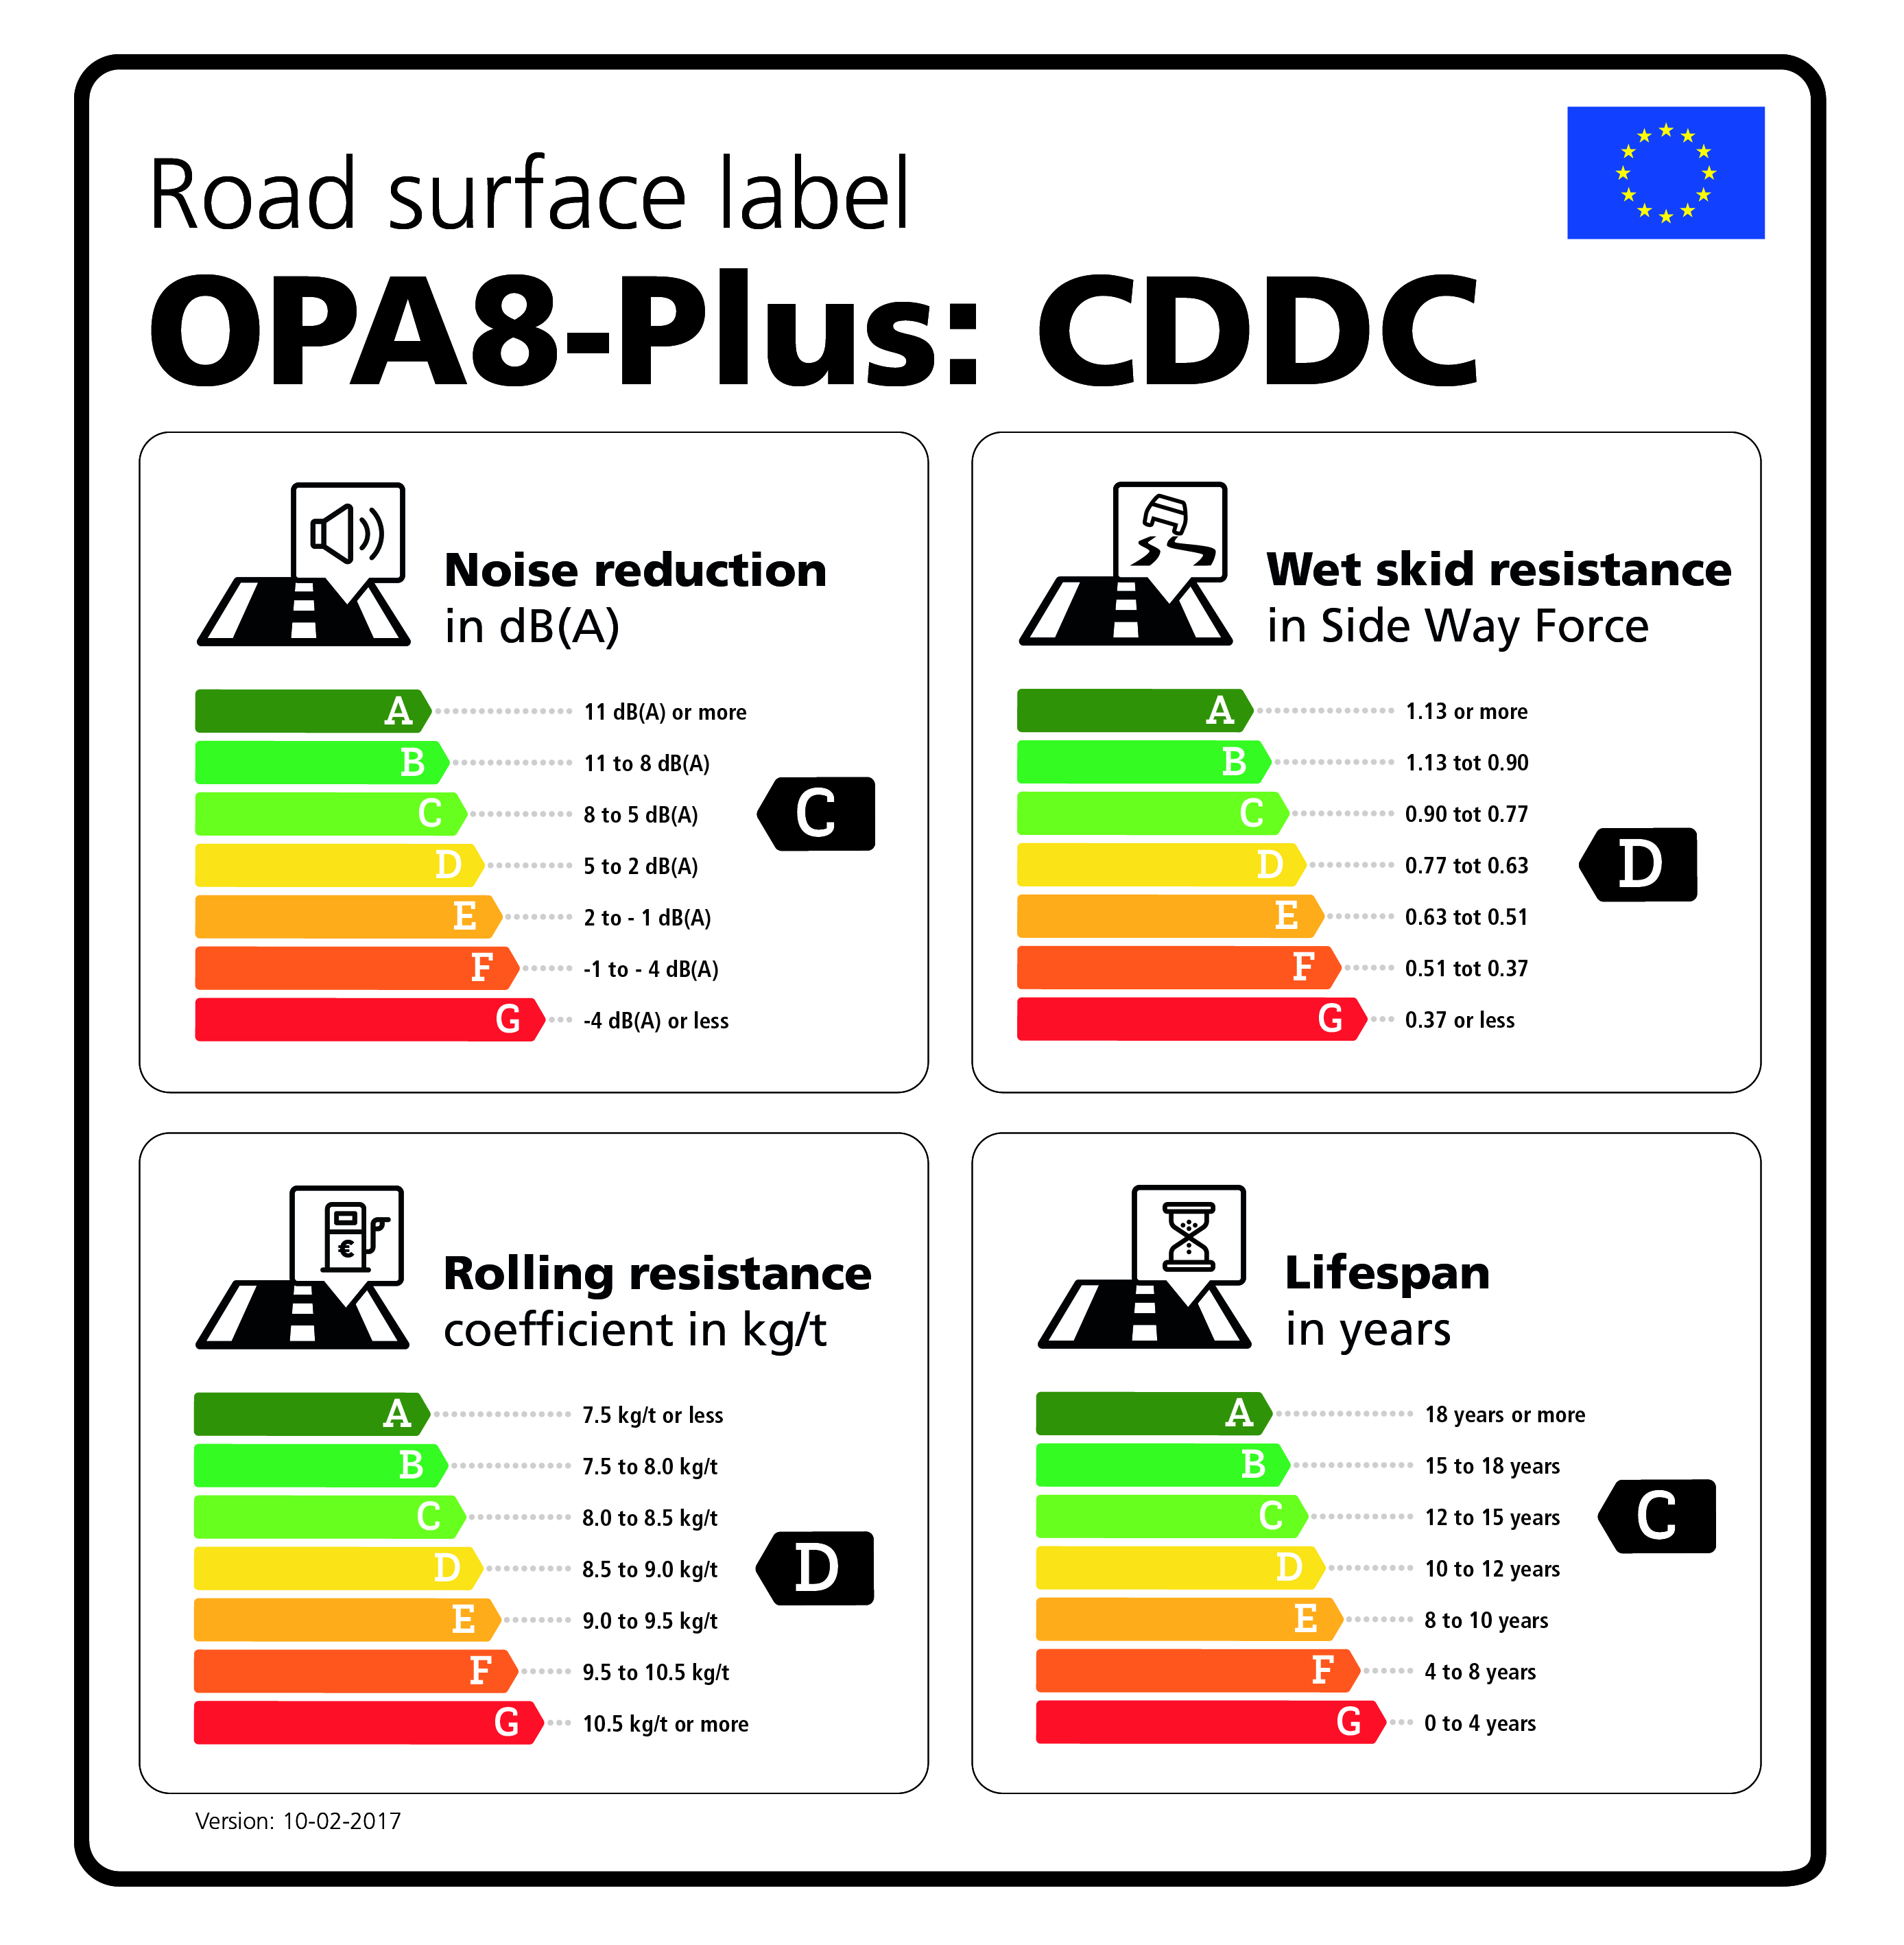
Road Surface Labels (GRB 65-20, 21, 22 and 22-Add.1)
Reference Best

Slide 7
Road Surface Labelling
Benefits: same as for tyres? Or more?
EU Regulation Vehicle Noise (Preamble nr 13: classification of road surface types)

Slide 8
Powertrain
Limits set in 2014
  Future reduction equals traffic growth
  Allowance for testing with worn tyres!
Labeling asked for in EU Regulation Vehicle Noise (article 7)
Possible Labelling system demonstrated by the NLs (GRB 61-01 and 61-01-Add.1)

Slide 9
A noise label for motor vehicles: towards quieter traffic (GRB 61-01-Add.1)
Points rating for private cars (and other vehicles)
Three elements (each 5 pnts max)
  Interior noise
  Powertrain noise
  Tyre noise

Slide 10
Noise label | Points total | Description of quality
A | 14-15 | Excellent
B | 12-13 | Good
C | 10-11 | Fair
D | 8-9 | Satisfactory
E | 6-7 | Moderate
F | 4-5 | Noisy
G | 0-3 | Extremely noisy

Slide 11
Gurka S | Interior (69 dB) | Powertrain (68 dB) | Tyre (66 dB)
Label D Satisfactory 8 pts | Insufficientª 2 pts | Insufficientª 2 pts | Goodª 4 pts
Remarks: In terms of noise emissions, this model is average for its type and class. | At 100 km/h, the interior noise level is 3 dB above the baseline^{b}. | The engine and exhaust system produces 4 dB above the baseline^{b}. | These tyres are quiet tyres, 4 dB lower than the baseline^{b}.
ª Score in each sub-category: 5 = Excellent; 4 = Good; 3 = Satisfactory; 2 = Insufficient; 1 = Bad ^{b} A difference of -3 dB represents a 50% reduction in the emission of acoustic energy.

Slide 12
Tyres
The Tyre Label !!!
It all started by looking at the numbers behind the colours and letters
NLs average label: D, C, B

Slide 13
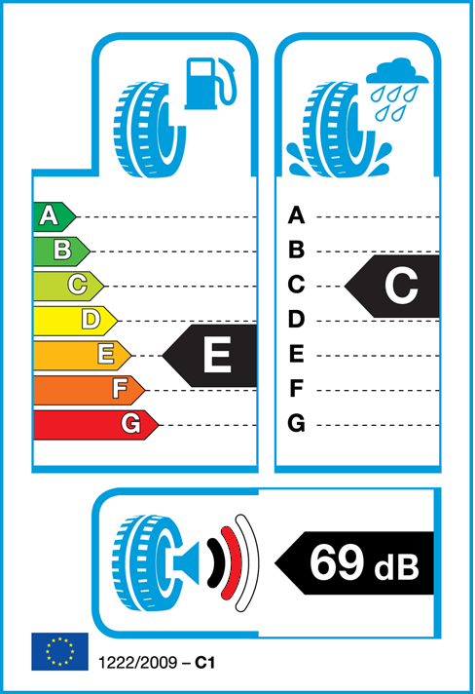
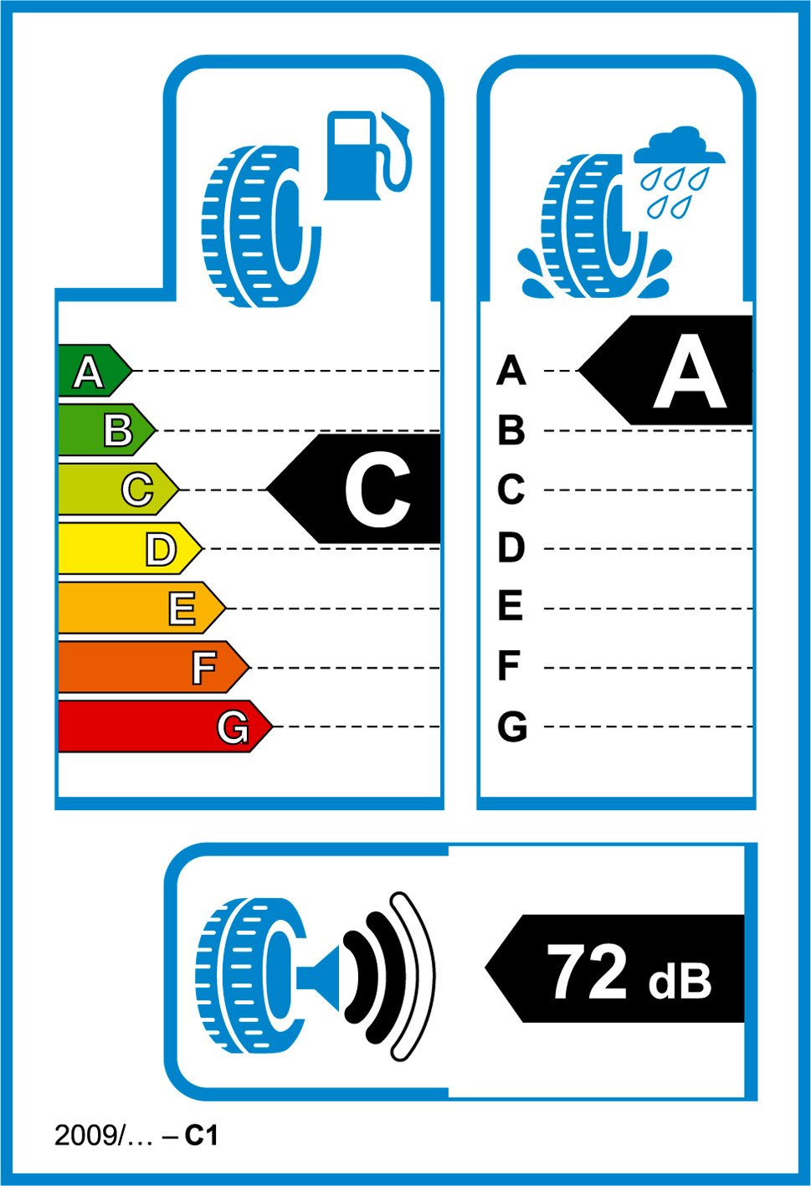
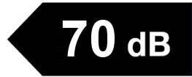
¹ Extra fuel costs per year (17000 km/yr)
² Extra braking distance wet road at 80 km/h (Braking distance A=27 m)
³ Noise
A: 2 times as quiet
B: average
C: 2 times as loud
1
2
0 €
0 m
+30 €
+3 m
+90 €
+6 m
-
-
+150 €
+10 m
+220 €
+14 m
+250 €
-
3
C
A
B
+4 dB

Slide 14
Potential Benefits of Triple A tyres
Netherlands (GRB 60-3) and EU (GRB 60-14-Rev.1)
EU (GRB 60-13)
City of Rotterdam (GRB 62-01)
Carfleets of Amsterdam, Rotterdam and Dutch National Road Authority (RWS) (GRB 62-02-Rev.1)

Slide 15
Benefits Triple A in EU
Potential benefits | Energy | Safety | Noise | TOTAL
Annual fuel savings [ billion l] | 17 | - | -
Annual CO₂ reduction [ MtCO₂] | 42 | - | -
Reduced number of fatalities | - | 2567 | -
Reduced number of slight/ serious injuries | - | 19631/ 12353 | -
Reduced number of annoyed people [millions] | - | - | 13
Reduced number of sleep disturbed people [ millions] | - | - | 6
Annual cost savings [ billion €] | 13 | 10 | 11 | 34

Slide 16
Tyres: a two track approach in the NLs
Pull
  A public awareness raising campaign
Push
  Strengthen the tyre limits (EU and UNECE)

Slide 17

Dutch Campaign ‘Choose the Best Tyre’

Slide 18
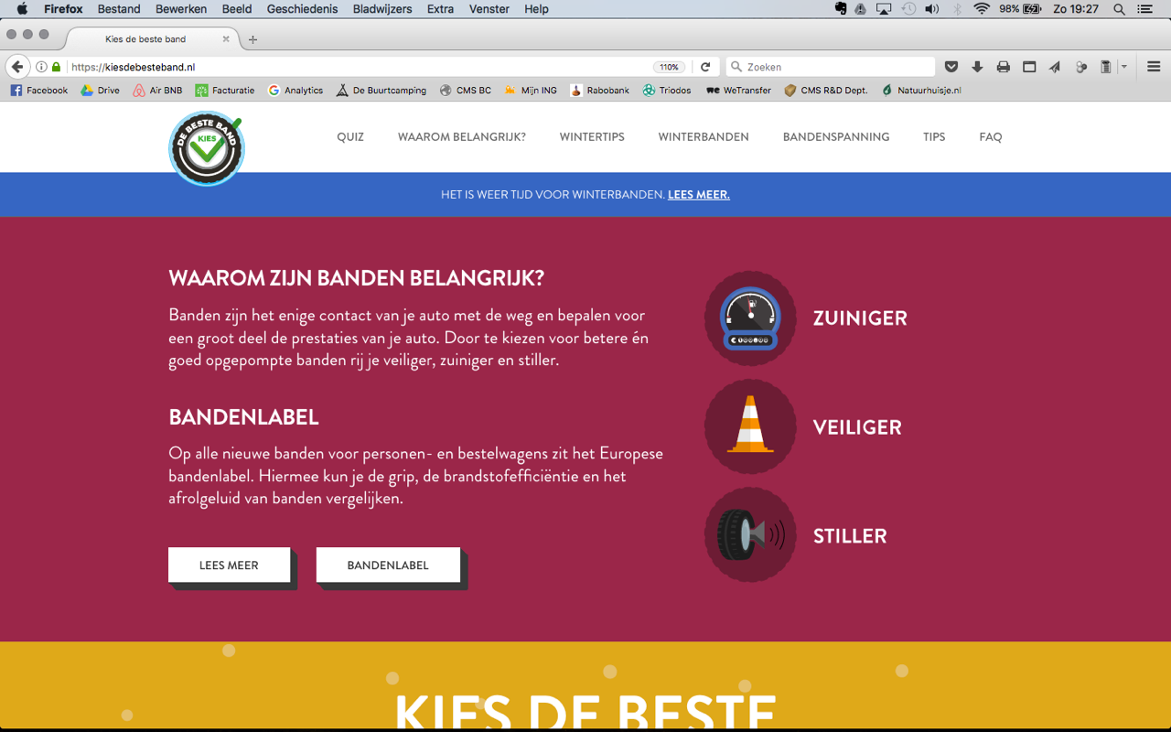
Website: www.debesteband.nl

Slide 19
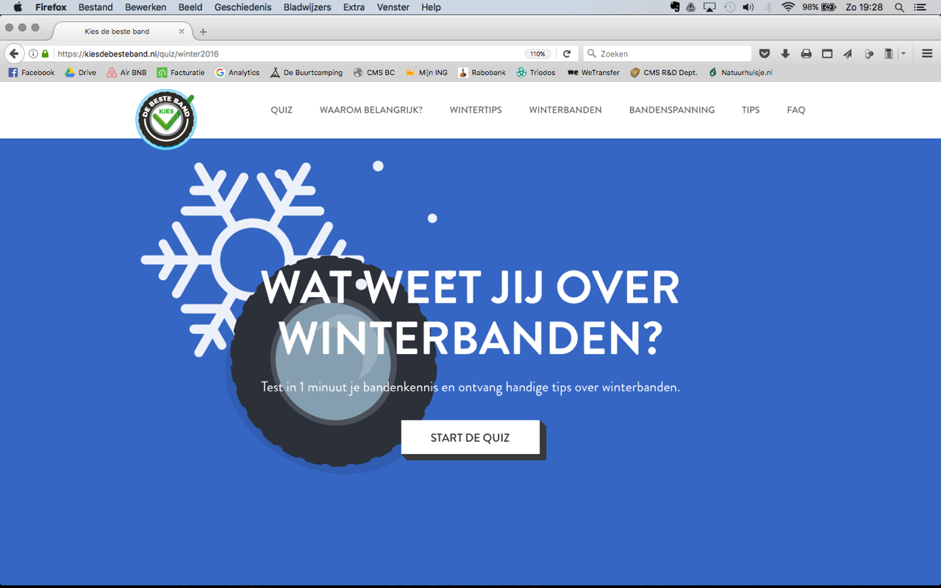

Slide 20
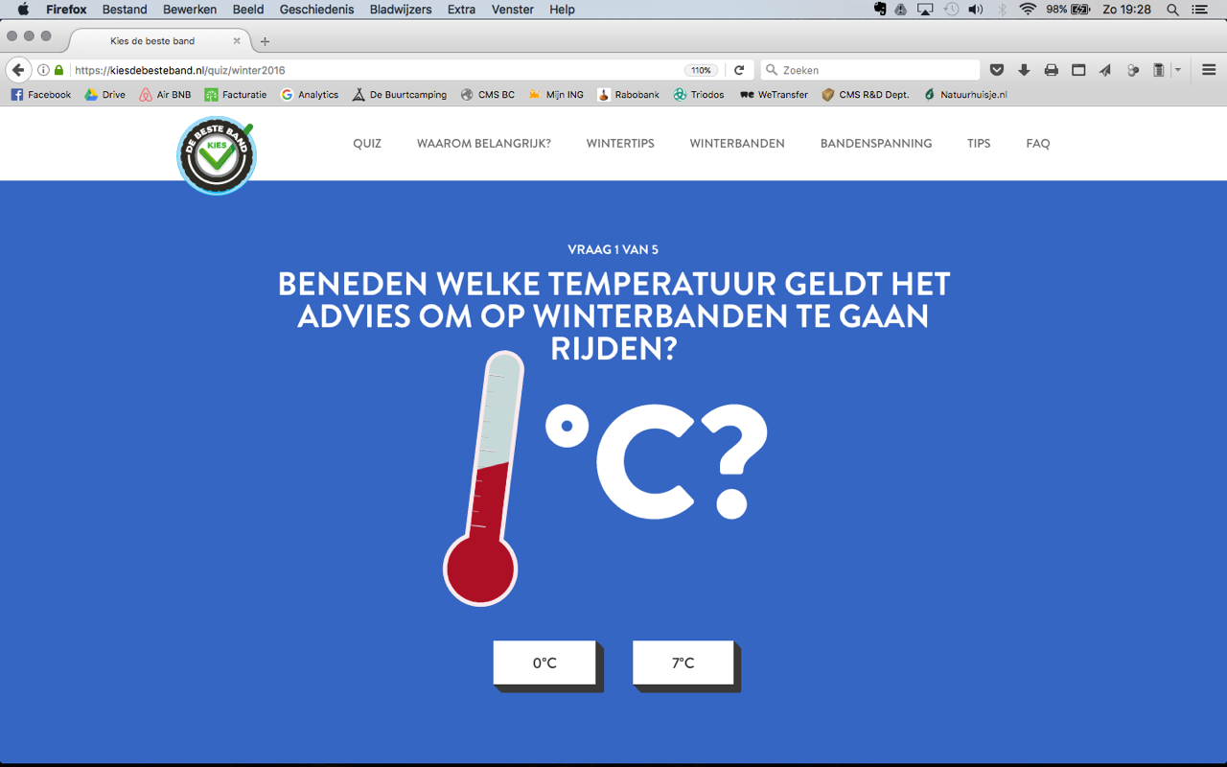

Slide 21
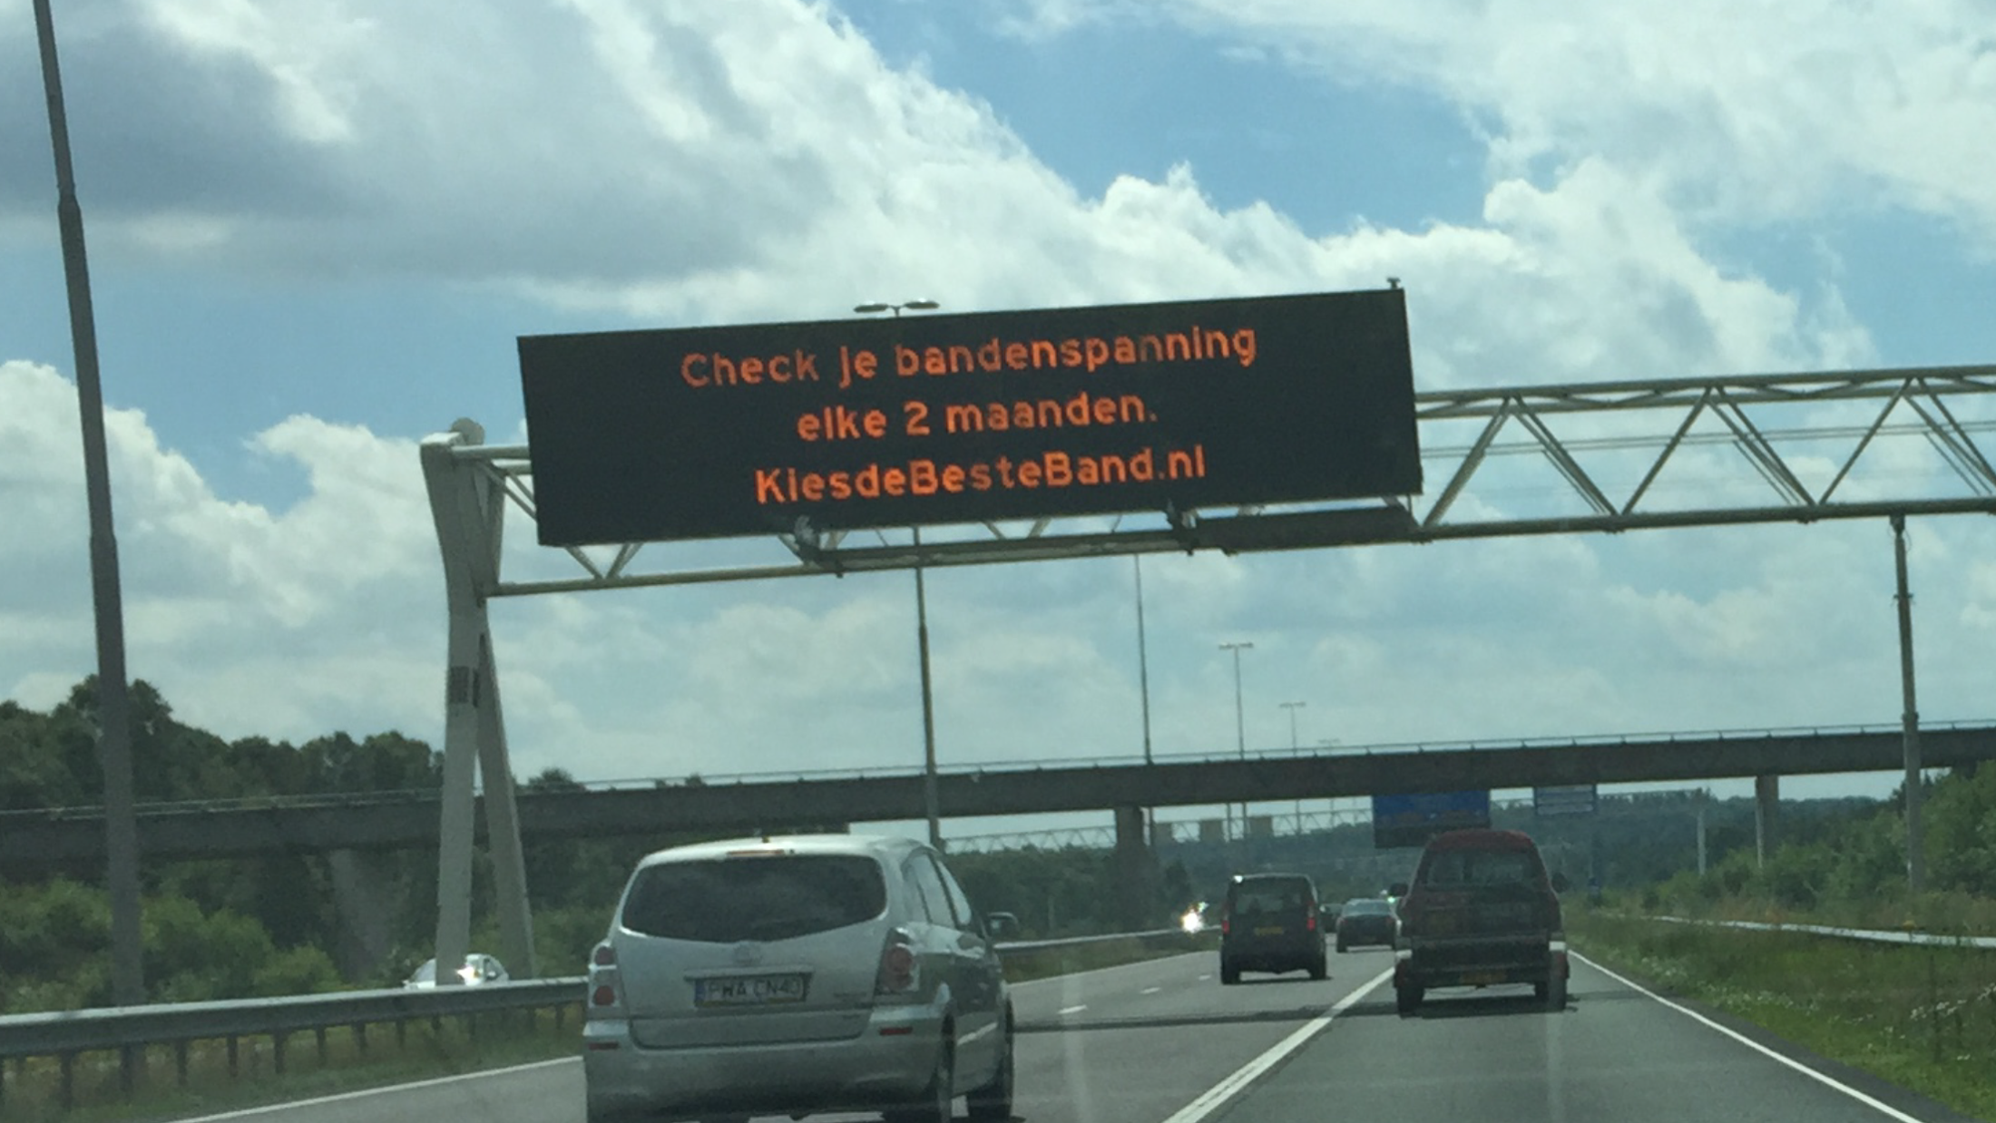

Slide 22
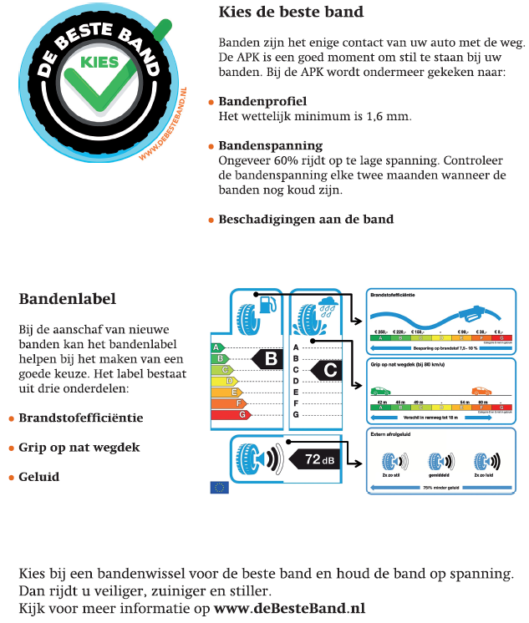
Backside Letter Periodic Technical Inspection (PTI)

Slide 23
Fleets on A for Energy and correct tyre pressure
Potential benefits | RWS | Amsterdam | Rotterdam
Number of vehicles | 1575 | 781 | 1097
Vehicle average [ km/yr ] | 26000 | 17200 | 17300
Annual fuel savings (correct pressure) [ thousands ltr] | 152 (26) | 147 (33) | 200 (45)
Annual CO₂ reduction [ ton CO₂] | 388 | 379 | 514
Annual cost savings [€] | 237000 | 224000 | 304000
Annual cost savings per vehicle [€] | 150 | 287 | 277

Slide 24

Declaration on Best Tyres
Netherlands
  25 Partners
  www.betere-banden-nu.nl
EUROCITIES (200)
  www.better-tyres-now.eu

Slide 25
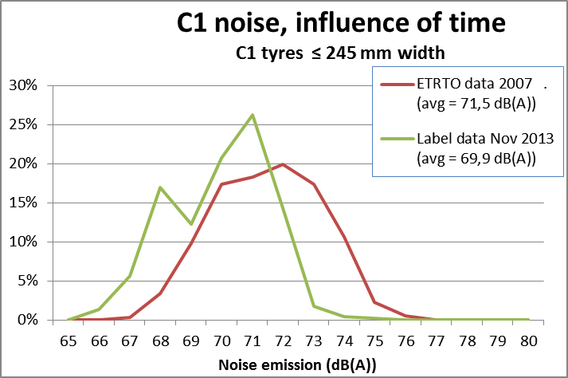
Tyres (limits, Push)
Strengthening on agenda GRB (GRB 59-11)

Slide 26
Tyres research
Shifts in tyre sound levels between 2007 and 2013 (GRB 60-8 and 60-8-Add.1)

Slide 27
Tyres research (2), Various
OEM Tyres?
Statistics of tyre noise label values in OEM tyres (GRB 62-9 and 62-9-Add1)
  Average OEM perform 1 dB better
GRB 61-3 and 61-3-Add.1
Better tyres have major benefits
Better tyres are widely available
Better tyres do not cost more

Slide 28
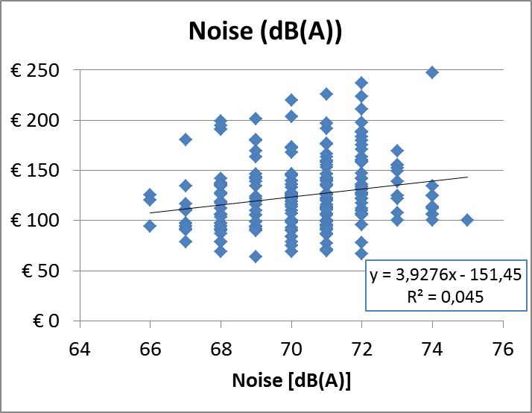

Slide 29
Proposals to strengthen tyre limits
First: only noise in January 2015 (GRB 61-3 and 61-8)
Last: all three tyre limits 64th session GRB, September 2016 (62-11-Rev.1 and 62-11-Rev.1/Add.1)
Label values: C, B, A

Slide 30
NLs average: DCB
Sales 2016 NLs 50% CBA or better
(GRB 62-11-Rev.1/Add.1)

Slide 31
Policy Indicator (GRB 62-14, 62-14-Add.1 and 62-11-Add.1)
E Road S. + E Tyres + E Powertrain = E Tr. Noise
E Tr Noise → # annoyed/sleepdisturbed people
E Road S. + E Tyres + E Powertrain = # a/s people
Noise emission and people!
2016 update Triple A in NLs (a.o. new tyre sales data and influence tyre pressure) (GRB 62-11-Rev.1/Add.1 , september 2016, GRB 64)

Slide 32
Potential Benefits EU
 | Triple A Tyres | Tyre Pressure | Limits Prop. (GRB 62-11-Rev.1)
Fuel savings (b. l) | 17 | 5 | Sep. ‘17
Reduced CO2 (Mton) | 42 | 12 | Sep. ’17
Reduced # casualties | F. 2567 Inj. 12353/19631 | - | Sep. ‘17
Reduced # Ser. Annoyed (mil.) | 8.2 | 1.5 | 8.2
Reduced Ser. Sleepdist. (mil.) | 3.4 | 0.6 | 3.4
Cost savings (b. €) | 34 | 6 | Sep ‘17

Slide 33
To conclude
TPMS counter productive?
Advice tyre pressure (cold/warm)?
Huge benefits for:
  Better tyres
  More strict tyre limits
  Correct tyre pressure
Action EU and UNECE !

Slide 34

Thank you for your attention

