Slide 1
UNECE’s Transport Statistics Activities
Alexander.Blackburn@unece.org
Presentation to SC.2
Geneva, 27-29 November 2017

Slide 2
Overview
WP.6 meeting and workshop
Capacity building workshops and the SDGs
Ongoing data collection and dissemination
Interactive E-Census traffic map
E-Rail Census
Pilot questionnaires on rail accidents and accidents at level crossings
Glossary revision

Slide 3
WP.6 in June 2017
WP.6 Meeting, June 2017
Workshop on rail statistics, presentations from Canada, UK, Netherlands, Russian Federation, ERA, UIC
Challenges of data collection due to market liberalization (NL 3 companies to 17 in 10 years), using innovative methods.
Data consistency across entities
Uses of the data e.g. as a leading economic indicator
Details at http://tiny.cc/UNECE-Rail-Stats

Slide 4
Capacity Building
Workshops focused on improving the data situation, sharing country best practices and UNECE’s role in Sustainable Development Goals 3, 9 and 11.
Ashgabat September 2016 (SPECA countries)
Podgorica October 2017 (Western Balkans and Moldova)
Astana October 2017 (SPECA)
Ljubljana November 2017 (Danube Region)
Details at https://www.unece.org/trans/transport-and-the-sustainable-development-goals.html

Slide 5
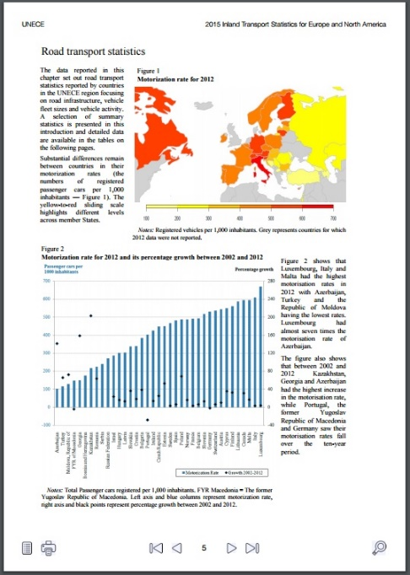
Two Longstanding Publications
Inland Transport Statistics
Latest version published in June
Road Accident Statistics
Latest version to be published in October
All available from https://www.unece.org/trans/resources/publications/transport-statistics.html

Slide 6
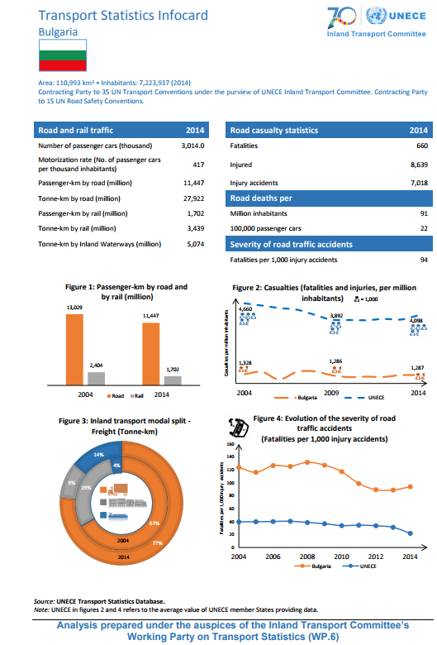
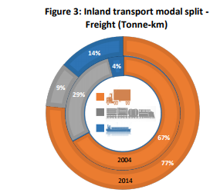
Infocards: Published with ITC

Slide 7
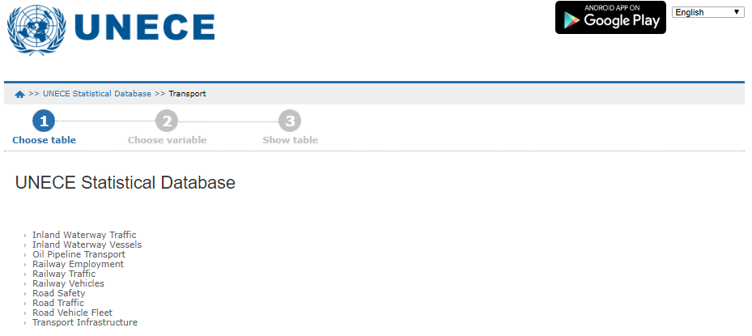
Improved Data Disseminated Online
Country data now updated ~3 times a year, last update in September 2017
Many more indicators added, and dissemination cubes simplified in August
Rail data include infrastructure, transport equipment, rail traffic (accidents soon)
Data here: http://w3.unece.org/PXWeb/en

Slide 8
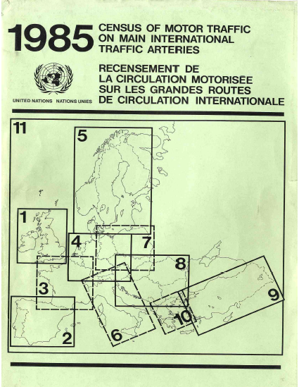
E- Censuses
Unique international traffic censuses, providing comparable data on traffic flows on main European routes
E-Road: For 2015, data received from 17 countries.
E-Rail: Deadline for responses was July 2017.

Slide 9
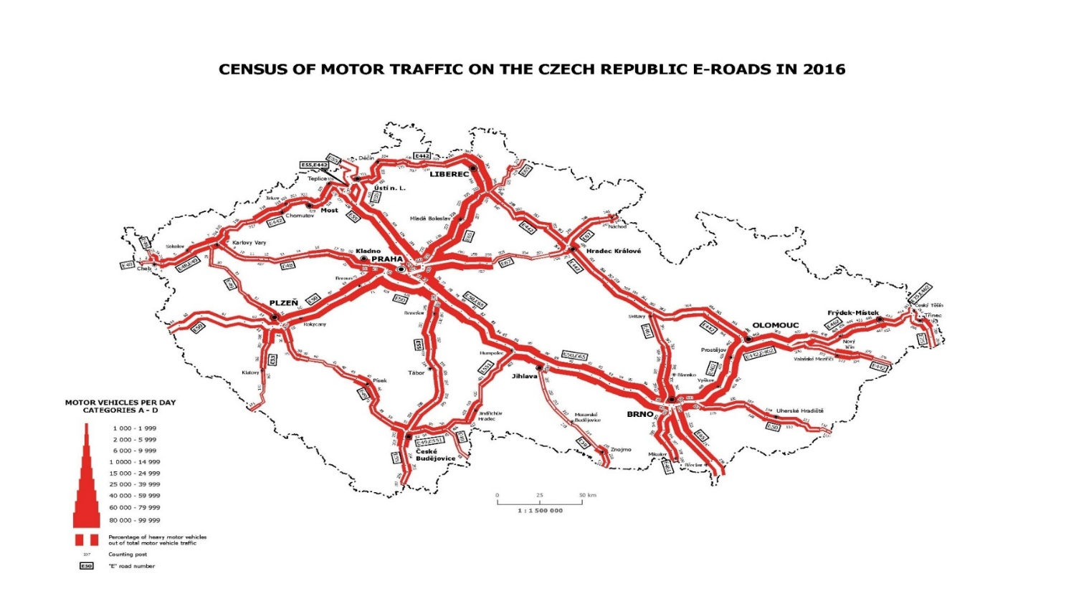
Road Traffic: E-Road Census
White thickness indicates HGV %. We can see at a glance where the crucial goods border crossings are, and how much of border crossings is trade

Slide 10
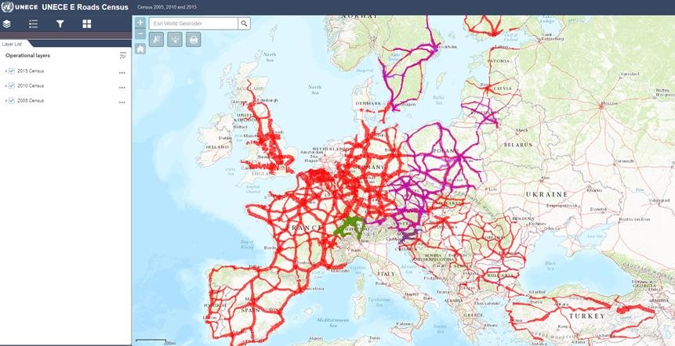
E-Road Census: Interactive European map
https://www.unece.org/trans/areas-of-work/transport-statistics/statistics-and-data-online/e-roads/traffic-census-map.html

Slide 11
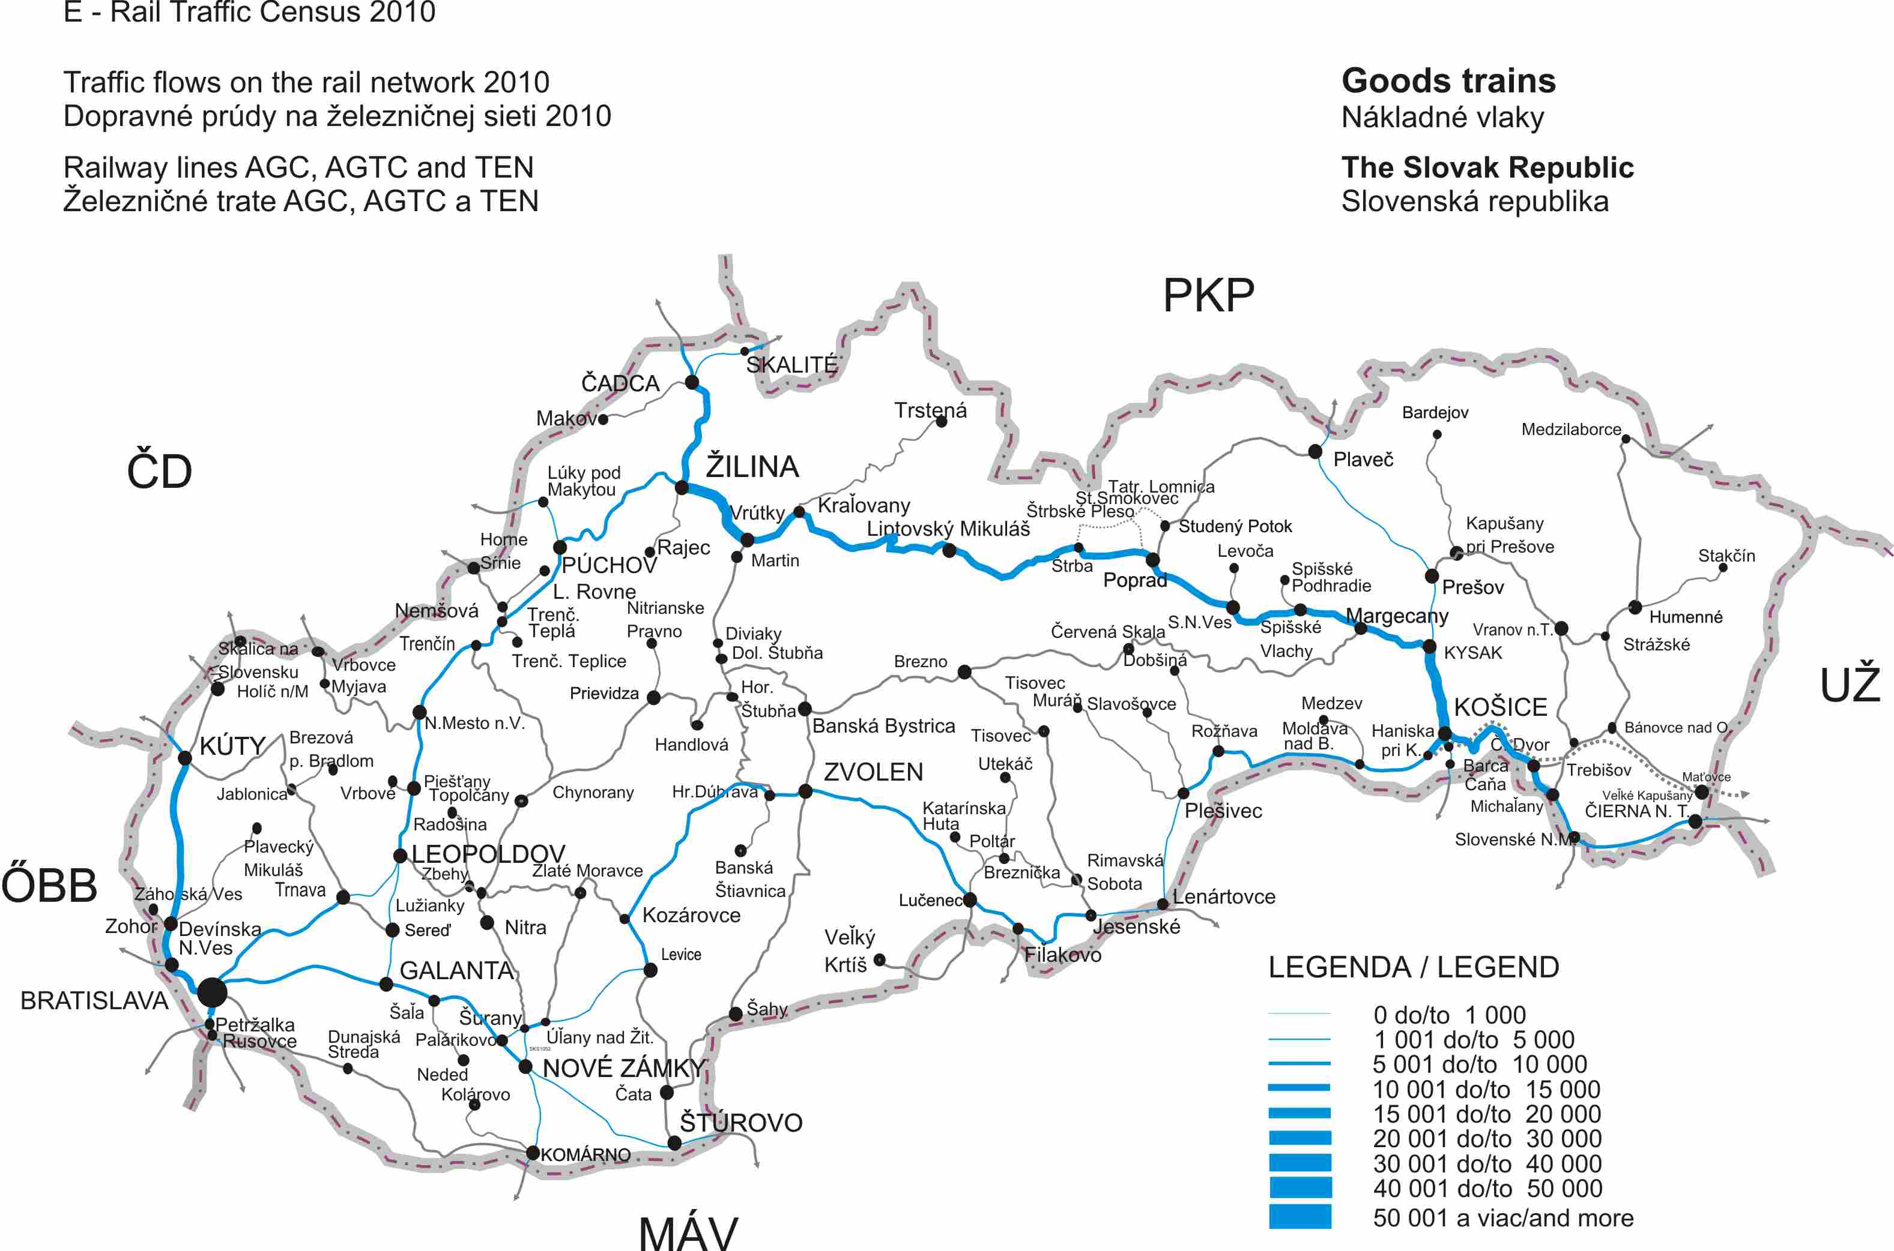
E-Rail Census

Slide 12
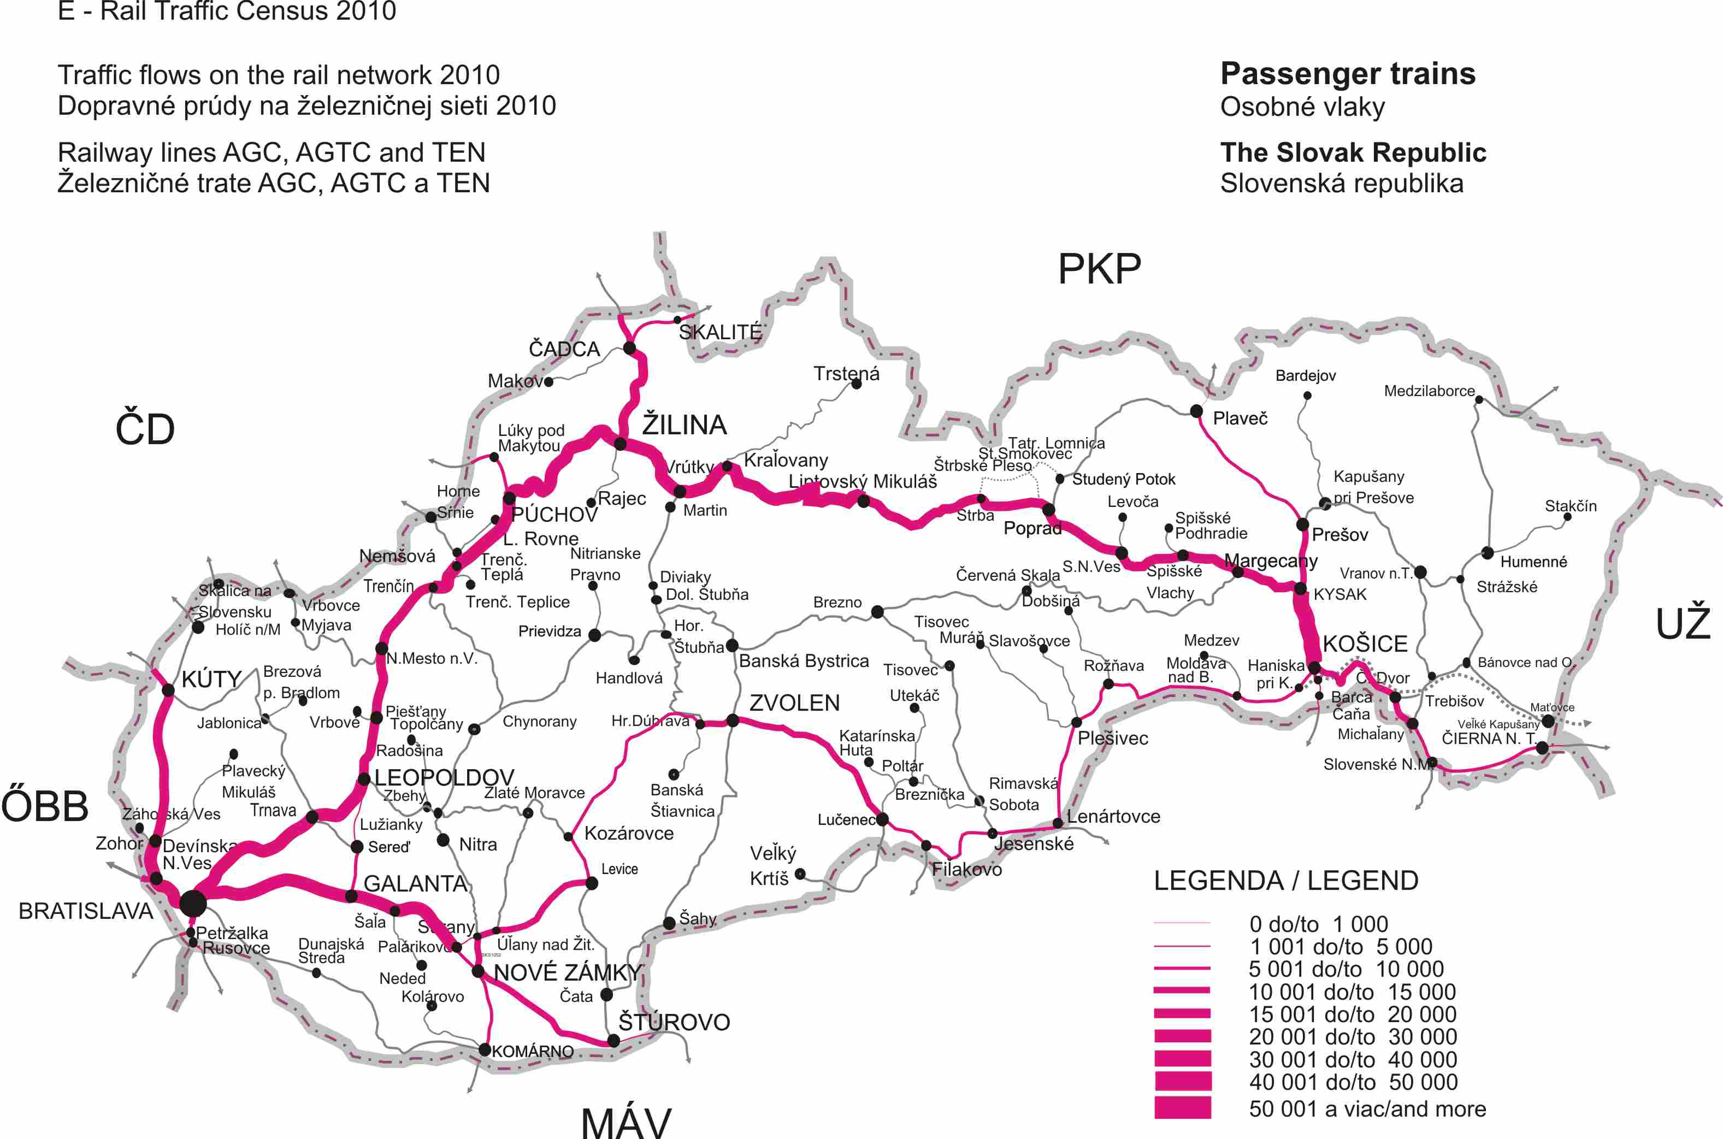
E-Rail Census

Slide 13
E-Rail Census Results Received
10 E-Rail censuses received so far:
Bosnia Herzegovina, Croatia, Denmark, Hungary, Latvia, Lithuania, Slovakia, FYR Macedonia, Slovenia, UK
More wanted!

Slide 14
Pilot Questionnaires
Rail accidents: questionnaire sent out in February to non-ERA countries. Data received for 8 countries (including Canada, USA, Russia, Serbia.)
Data reasonably complete, good breakdown (and simple questionnaire!): WP.6 decided to collect these data permanently. Data will be combined with European data and disseminated by end of 2017
Level crossings: questionnaire sent in July, deadline September. Typically less complete than the rail accidents. Results will be reported to UNECE Expert Group on Safety at Level Crossings (WP.1/GE.1).

Slide 15
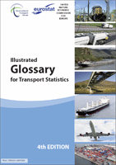
Glossary revision process
Glossary
Informal Group of Experts established under WP.6
Experts from 13 countries, covering most modes (not pipeline), and many intl. organisations (including ERA)
Statistics Canada coordinating the update of rail chapter
Collaboration starting with review of existing definitions and agreeing process, meetings to follow; a long process expected
Input from countries needed.
Notes:
15

Slide 16
Suggestions? Comments?
We are here to help!
stat.trans@unece.org
Alexander.Blackburn@unece.org

