Slide 1
NHTSA Experience with Non-Traditional Vehicles
Submitted by expert from the United States of America | Informal document GRSP-59-18 (59th GRSP, 9-13 May 2016, agenda item 22(g))
GRSP 59th Session
May 2016

Slide 2
Objective
Evidence of increasing numbers of Low Speed Vehicles (LSV's) and 3-Wheeled Motorcycles (Non-Traditional Vehicles) in use on American roadways
These vehicle classifications are still regulated by the FMVSS
NHTSA has conducted compliance tests and investigations to better understand these fleets
Will present some of the compliance issues we have observed

Slide 3
Vehicle Classifications in the FMVSS
CFR 571.3 vehicle classifications are:
Passenger Car
MPV (Multi-Purpose Passenger Vehicle)
Truck
Bus
Trailer
LSV –Low Speed Vehicle
• NEV- Neighborhood Electric Vehicles
Motorcycle
• 3-Wheeled Motorcycles

Slide 4
Non-Traditional Vehicles Do Not Include:
“Home Built” one of a kind vehicles.
Vehicles NOT certified to FMVSS by a Manufacturer.
Off-Road Vehicles.
Mini-Trucks.
Collectively – vehicles that the States permit on their roadways.

Slide 5
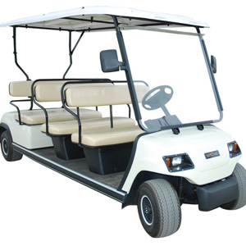
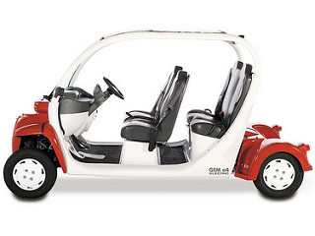
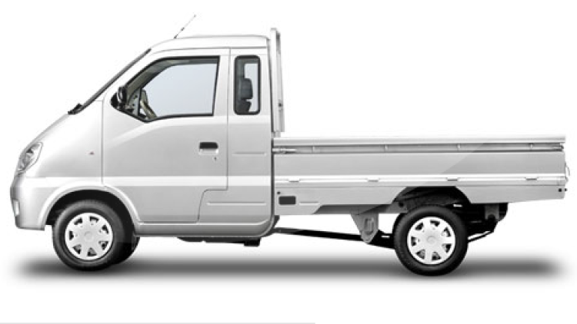
Low Speed Vehicle Examples

Slide 6
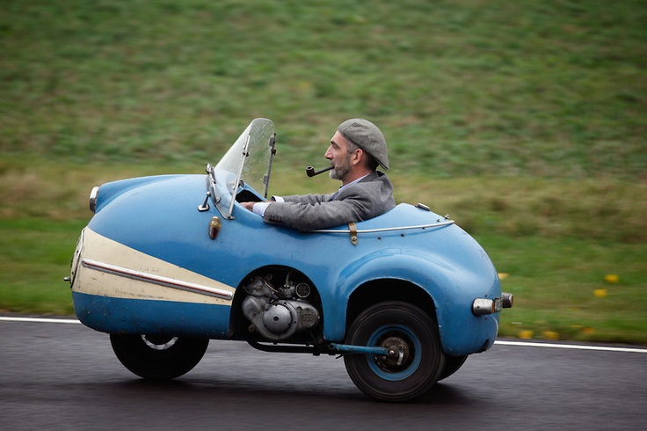
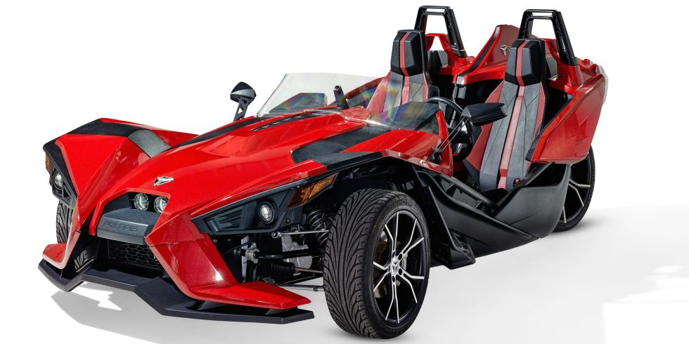
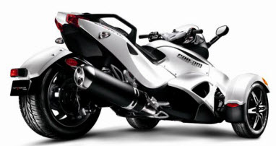
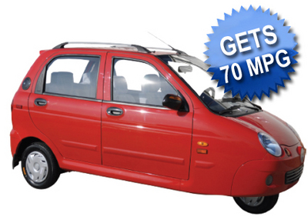
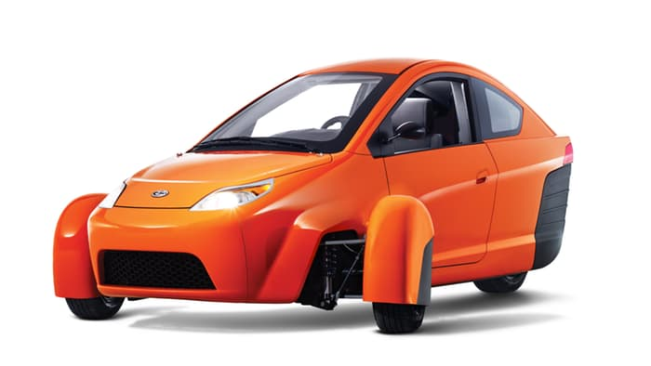
3-Wheeled Motorcycles

Slide 7
Low Speed Vehicle Background
LSV vehicle type was established in June 1998.
Initial rule responded to public interest in using golf carts and other similar vehicles for short trips, social and recreational purposes primarily within closed retirement or planned communities (Florida, California, Arizona).
Revised in August 2005 to include truck-based vehicles and in April 2006 to raise the GVWR to 1,361 kg (3,000 lb).
Designed for use in controlled low-speed environments.
States establish where LSVs can operate. In general, on roads with speed limits not exceeding 35 mph.
Most cost between $8,000 to 10,000.
Most are electric with a 50 to 65 km range.
We estimate there are roughly 50,000 LSVs traveling an average of 1,700 km/yr each in the U.S.

Slide 8
FMVSS No. 500 Requirements for LSVs
Max Speed must be between 20 and 25 mph
Required equipment (verified by visual inspection)
(1) Headlamps
(2) Front and rear turn signal lamps
(3) Tail lamps
(4) Stop Lamps
(5) Reflex reflectors –red on sides/red rear
(6) Driver side mirror and passenger side or interior mirror
(7) Parking Brake
(8) Windshield AS1/AS4 (FMVSS 205)
(9) VIN/Certification Label
(10) Type 1 or Type 2 Seat Belt (FMVSS 209) Primarily to mitigate ejection.
States can adopt own performance requirements for lighting equipment, mirrors, and parking brakes; not preempted by federal regulations.

Slide 9
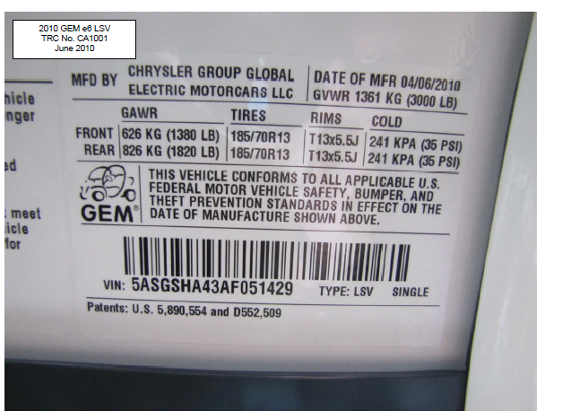
Part 567 Certification Label

Slide 10
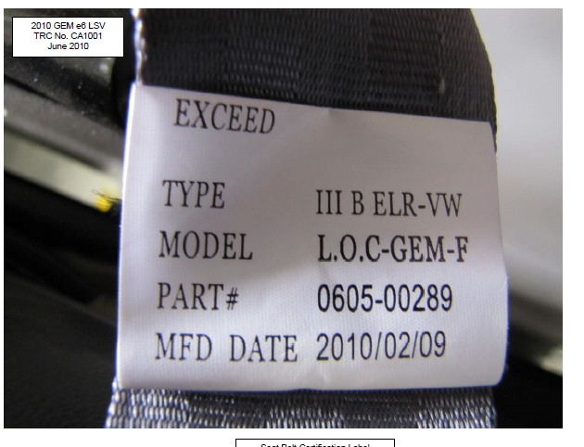
Properly Labeled Seat Belt

Slide 11
Results of NHTSA Compliance Tests
Manufacturer | Year | Model | Result
Zenn | 2008 | Hatchback | Pass
Columbia Parcar | 2009 | Summit SUV | Pass
Miles | 2009 | Truck | Pass
Wheego | 2010 | Sedan | Fail- Reflex Reflectors/illuminate when braking 10V-320 → 308 LSV’s
Club Car | 2010 | Carryall | Fail – FMVSS 209 seatbelt locking G level 10V-277 → 840 LSV’s
GEM | 2010 | E6 | Pass
Various | - | - | Fail – Windshield AS1/AS4

Slide 12
Wheego Reflex Reflector Failure
Not Reflective/Actuated upon brake application.

Slide 13
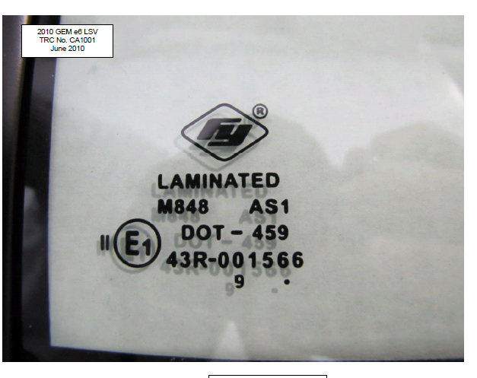
Incorrect Glazing
Should be

Slide 14
LSV Crash Data
Limited data concerning safety performance for LSVs due in part to small fleet size, low miles traveled, and reporting methods. Sample data includes:
FARS Data (2005 through 2008): One fatal crash but much of vehicle safety equipment had been removed.
State Data Systems Florida (2003-2007): 21 cases involving an LSV with 37 Occupants.
19 No Injuries
1 Possible Injury
10 Non-incapacitating Injuries
3 Incapacitating Injuries
4 Injuries, Severity Unknown
— Results for LSVs crash-tested by IIHS and Transport Canada indicate the vehicles would not meet passenger car crashworthiness requirements.

Slide 15
Issues NHTSA Is Experiencing With LSVs
In 2008, NHTSA denied petitions to create a new class of vehicles, medium speed vehicles (MSV), with a maximum speed of 35 mph because:
Higher speed changes vehicle classification – must meet all FMVSS.
Without full complement of safety features, occupants would run the risk of serious injury and death.
Encourages use outside intended controlled low-speed environments.
In 2007, Montana and Washington State passed laws permitting electrically powered MSV’s (MSEV’s) to be operated on roadways with speed limits of 45 and 35 mph, respectively.
In 2008, denied ETA petition to increase GVWR limit for electric-powered LSV’s to 4,000 lbs.

Slide 16
Issues NHTSA Is Experiencing With LSVs
LSVs that achieve > 25 mph through removal of speed limitations by software changes or manual adjustment of linkage, are inherently faster vehicles that have been limited to 25 mph or lower maximum speed.
These vehicles as originally manufactured must comply with applicable FMVSS that apply to motor vehicles other than legitimate LSVs.
These speed-restricted LSVs are actually PCs, trucks, or MPVs depending on their configuration, rather than LSVs, and must comply with the full range of FMVSS that apply to those types of vehicles, and not simply the limited requirements in FMVSS 500.

Slide 17
Excerpted From a LSV Owner's Manual
“MAXIMUM OPERATING SPEED
In compliance with Federal guidelines, your LSV has been manufactured and programmed so that the maximum driving speed is set for 25 mph (3200 RPM). Some local and state governments have passed legislation or have pending legislation that will allow owners to operate their LSVs at higher maximum speeds, usually 35 or 40 mph.
Should an owner in these jurisdictions choose to have a service technician reprogram their vehicle to comply with these local or state laws, the maximum motor RPM should be reset to:
3850 RPM for 30 mph,
4400 RPM for 35 mph, or
5100 RPM for 40 mph.
You should not attempt to make this change yourself.”

Slide 18
Motorcycles
“A Motor Vehicle with motive power having a seat or saddle for the use of the rider and designed to travel on not more than three wheels in contact with the ground.”
Motorcycles traditionally were 2 wheeled with possible side car or 3–wheeled with single wheel in front (trike).
Newer versions incorporate dual front wheel/single rear wheel with Electronic Stability Control
Motorcycles with enclosed compartments probably not envisioned when motorcycle rules first promulgated.
Under 20 mph – NHTSA does not regulate.

Slide 19
Motorcycles
3 Wheelers must comply with same FMVSS as 2-wheelers
FMVSS 123 “Controls and Displays” not applicable if steering wheel. Probably not envisioned when rule first promulgated.
In 122 “Motorcycle Brakes” main difference is additional requirement for a parking brake.

Slide 21
Results of NHTSA Compliance Tests
Manufacturer | Year | Model | FMVSS
China Qingqi Group, Inc. | 2009 | Xebra Electric | 122 | Fail – Master Cylinder Reservoir Indicator Light Stopping Distance 09V-177 →738 Motorcycles
Piaggio (Italy) | 2009 | MP3 | 122 | Pass
Panther Motors Inc. | 2009 | Scoot Coupe | 122 | Fail – Parking Brake utilizes hydraulic fluid for retention 09V-379 → 434 Motorcycles
Zhejiang Xingyue Vehicles Co. Ltd. | 2010 | Auto Moto | 123 | Fail – “Controls and Displays” Foot vs. left hand for rear brake control- Automatic Scooter 10V-405 → 305 Motorcycles

Slide 22
FMVSS Non-Compliances Observed
Master Cylinder Reservoir – Each brake circuit must have its own cover, seal, and cover retention device. (S5.1.2.1)
Reservoir Labeling – Incorrect wording and not permanently affixed. (S5.1.2.2)
Failure Indicator Light (split service systems) – Not provided to indicate low brake fluid or pressure. (S5.1.3.1)
Stopping Distance Requirements – Unable to meet various S5 requirements.
Parking Brake – Shall be equipped with a parking brake of a friction type with a solely mechanical means to retain engagement. (S5.1.4)

Slide 23
Single Master Cylinder Opening

Slide 24
Improper Wording and Not Permanently Affixed on Labels

Slide 25
FMVSS 122 Braking Effectiveness Test Failure Xebra Electric (max. speed 37 mph)

Slide 26
FMVSS 122 Parking Brake Non-Compliance Friction Type - Solely Mechanical Means
Parking brake latch

Slide 27
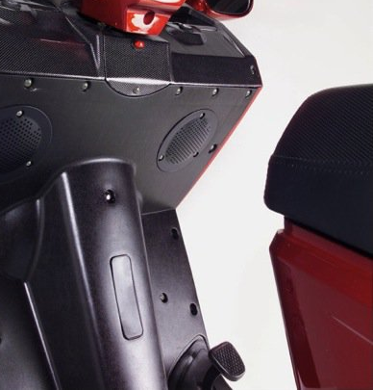
Additional 3-Wheeler Compliance Issues
FMVSS 123 “Controls and Displays” – Rear Brake Control for a Scooter with an Automatic Clutch.
Resulting recalls.
Primarily off-shore manufactured but importer has to take corrective action.
FMVSS 123 requires left hand brake

Slide 28
Summary
LSV manufacturers must insure that the vehicle complies with FMVSS 500 which includes various requirements for lighting, reflectors, mirrors, parking brake, FMVSS 205 windshield - AS1 or AS4, FMVSS 209 belts, and a Part 565 VIN.
Speed-Reprogrammed LSV’s are actually PCs, trucks, or MPVs depending on their configuration, rather than LSVs, and must comply with the full range of FMVSS.
--------------
Manufactures must recognize that 3-wheeled vehicles are motorcycles and as such, must comply with all applicable Motorcycle FMVSS and regulations.

Slide 29
Thank you.

