Slide 1
A Single European Railway Area :
Where are we with passenger transport?
Single European Rail Area
European Commission
Directorate General for Mobility and Transport

Slide 2
Policy priorities for rail : White Paper
Triple the lenght of existing high speed rail network by 2030; maintain a dense network in all Member States; by 2050, majority of medium-distance passenger transport → rail;
Core network : all core-network airports to be connected to rail network by 2050;
Deployment ERTMS
2

Slide 3
Where we are
Where we want to be
What still needs to be done
3

Slide 4

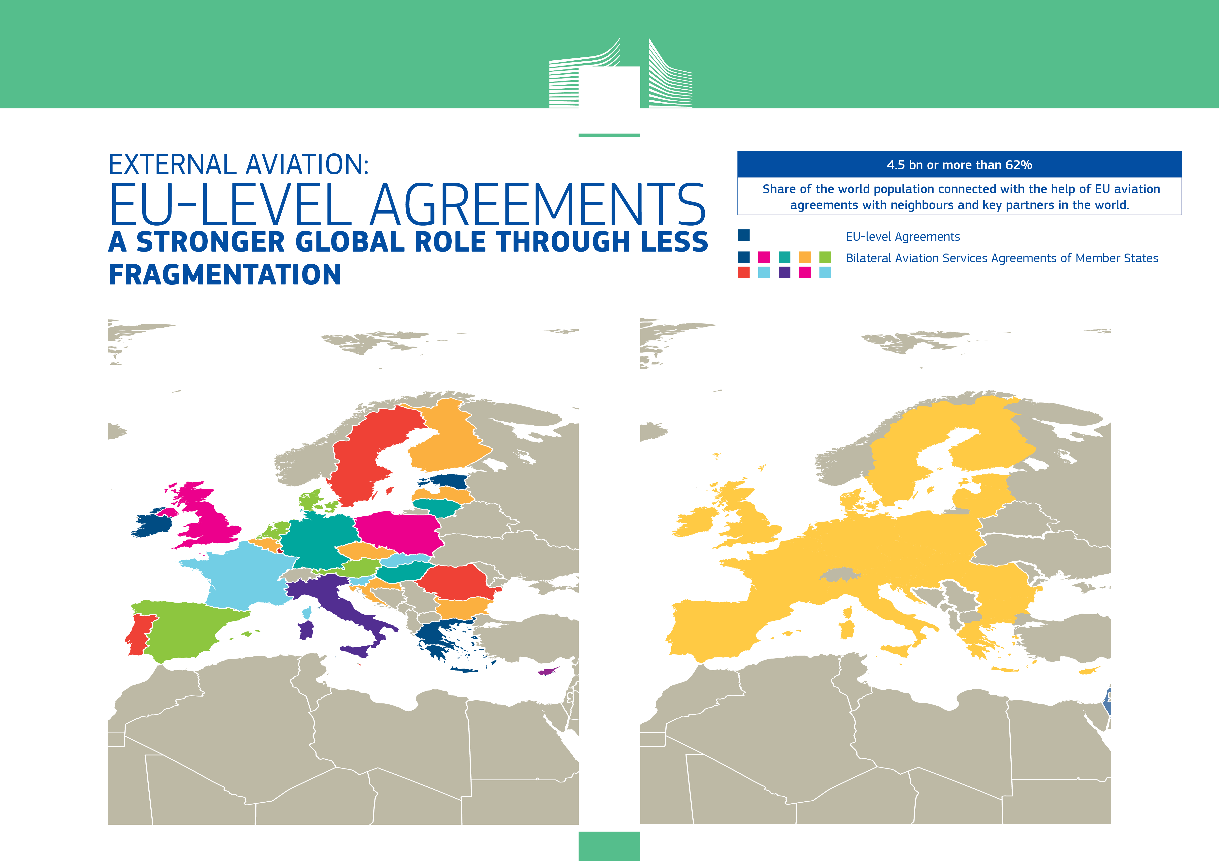
AN AVIATION STRATEGY FOR EUROPE
From this …. to this …
4

Slide 5
Where we want to be…
Competitive, attractive Railways with a higher modal share, through:
Single Europaen
Railway Area
Level playing field within rail
Open competition in rail services
Efficiency
Innovation
Interoperability/avoiding national rules
5

Slide 6
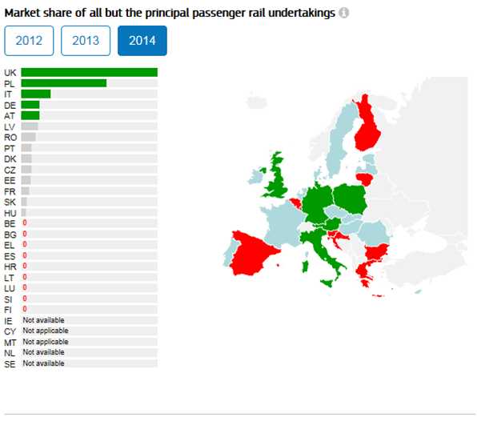
7

Slide 7
We have come a long way, from 1991 to 2016
8

Slide 8
Our current priorities and actions :
Complete the ongoing legislative work : 4th Railway Package
Improve implementation, enforcement
Propose new legislation : RFCR, TDD, access to services facilities, timetabeling, RU levy, cheap traction electricity, noise?
New challenges : security, digital, ticketing
9

Slide 9
4th Railway Package
Technical pillar, adopted June 2016, to be transposed by June 2019
Market pillar
  revision of Recast December 2018 (then 2020)
  Principle of competitive award for PSO from December 2019 (with transitional period 2023)
10

Slide 10
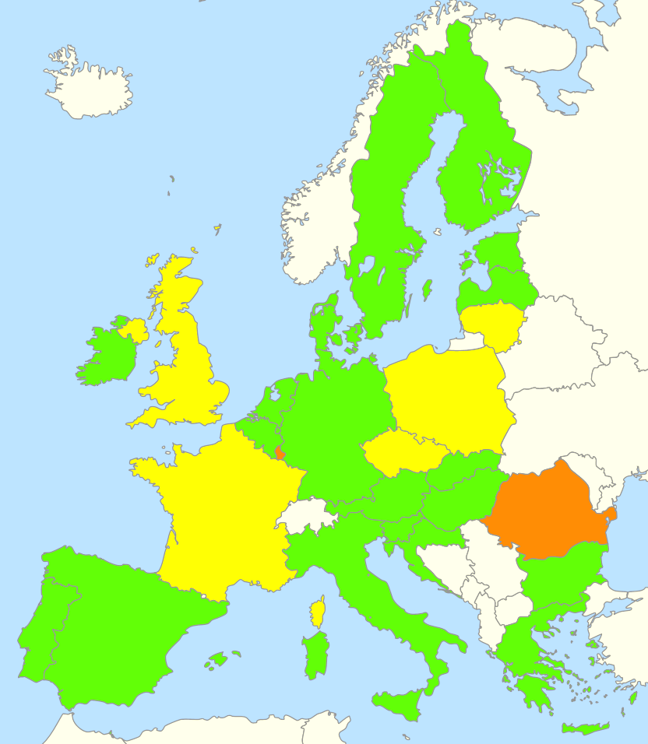
Transposition of Directive 2012/34/EU
State of play as of 10 November 2016
GREEN: transposition declared complete (EC assessment pending)
YELLOW: partial transposition measures notified to EC
RED: no transposition measures notified to EC so far
Implementation/
Enforcement
11

Slide 11
Key elements of the recast
Implementation
Enforcement
Financial sustainability
infra. development strategies
multi-annual contracts + incentives
Service facilities
access
transparency
Regulatory bodies
independence
powers
business plans
charging rules
cooperation
Affordable user charges
12

Slide 12
Implementing acts already adopted under the recast
Implementation/
Enforcement
Modalities for calculation of direct cost
Framework agreements
Licensing
Applicants
Principal purpose and economic equilibrium test
Noise differentiated track access charges
Rail Market Monitoring System
13

Slide 13
Recast brought
Implementation /Enforcement
Better monitoring tools covering
Infrastructure charging
Prices
Degree of market opening
Capacity allocation
Quality of rail services
licensing
Infrastructure investments
Public service contracts
employment
harmonisation
14

Slide 14
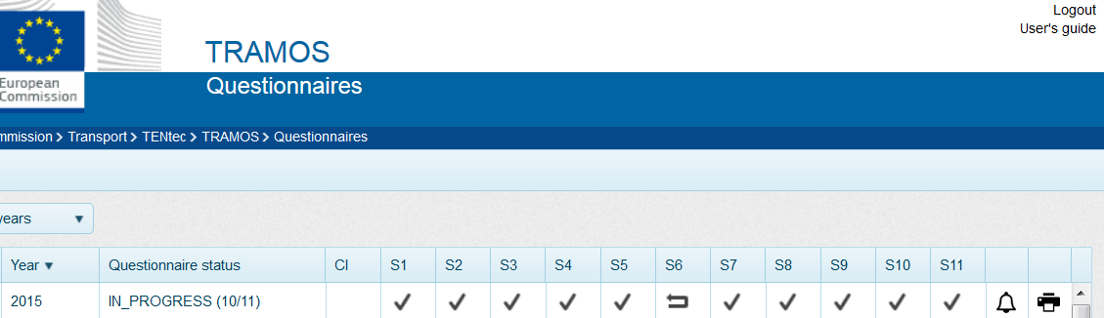
Market data
Implementation/
Enforcement
More reliable and accessible market data through
Transport Monitoring System – Rail (TRAMOS - Rail)
  Allowing Member States to submit their RMMS data online
  Performing real time data quality checks both for Member States and EC
  Further developments to allow stakeholders to access validated, historical, cross-country RMMS data
15

Slide 15
Access to service facilities
Proposed new legislation
Key component to enable competition in rail markets
Service facilities are essential for the operation of rail transport services - RUs do not only need out track but also access to service facilities to run a train
Under the Recast, Regulatory body supervises access to service facilities (on own initiative or upon complaint)
need to set out more detailed rules in an implementing act (e.g. transparency requirements, procedure for handling conflicting requests)
16

Slide 16
Timetabling
Proposed new legislation
Stable timetables and flexibility in handling requests
Timely consultation of operators on traffic restrictions
Non-discrimination of international service
17

Slide 17
Evaluation and possible revision of the Train driver Directive
Proposed new legislation
22

Slide 18
Rail security (1) :
New challenges
New threats
Variations MS to MS in terms of threat level
Uncoordinated national initiatives = new barrier to cross-border transfer
Response :mandatory = controversial; focus on Member States demonstrating that suitable arrangements are in place
EU sector action based on guidelines
23

Slide 19
Rail security (2)
Possible elements
Risk-based security management systems based on a concept of Safety management systems
Arrangements for identifying and mitigating the risks associated with third party staff;
Training staff to address security threats and incidents;
Define guidance for CCTV / monitoring equipment, blast protection and visibility of all areas on trains.
24

Slide 20
Ticketing - what is not in rail, but should be possible
New challenges
to buy through-tickets for intl journeys or multiple-operators
Buy domestic train tickets from abroad
Buy tickets more than 3 months before the trip
Access the most attractive fares from a retailer
Passenger do not know their rights in the event of missed connection if more than one ticket was needed for the journey
Rail industry lags behind aviation industry
25

Slide 21
Ticketing
New challenges
Rail industry has made significant progress on technical and administrative standards and interfaces
Passengers have the right on access to timetables
TAP-TSI deployment will facilitate
25

Slide 22
Regular dialogue :
Member States (SERAC, RISC, Corridors)
National Regulatory Bodies (ENRRB)
Infrastructure Managers (PRIME)
Railway Undertakings (RUD)
27

Slide 23
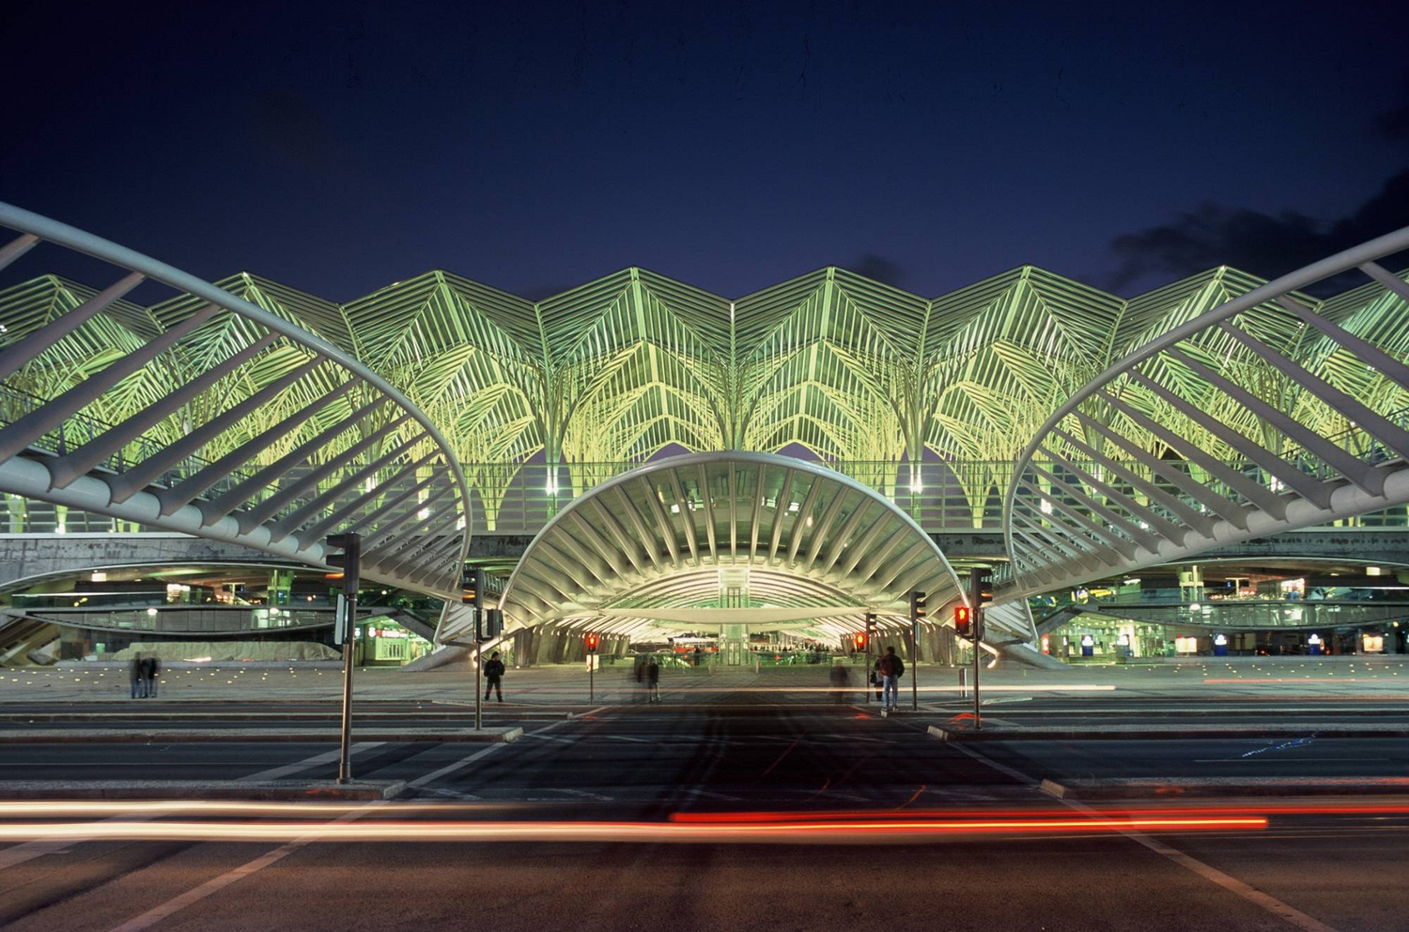
Thank you for your attention!
Thank you for your attention
28

