Slide 1
Submitted by the expert from Italy
Informal document GRRF-79-30
(79th GRRF, 16 – 20 February 2015,
agenda item 6)
Proposal
to introduce requirements for the approval
of replacement brake discs for L-category vehicles
in UN Regulation No. 90
79° GRRF
16 February 2015

Slide 2
Preamble
At the 78° session of GRRF held on 16 Sept 2014, ITALY had tabled a proposal
(doc ECE/TRANS/WP.29/GRRF/2014/23)
It was aimed at including in UN-R 90 a set of new requirements for the approval of replacement brake discs for L-category vehicles, taking into consideration the latest technologies available in the market.
GRRF agreed to ask ITALY to revise the proposal and submit at 79° GRRF session, taking into account all the comments received.
To this extent, ITALY has forwarded the following documents for today’s discussion:
Working document ECE/TRANS/WP.29/GRRF/2014/23/Rev.1
Informal document GRRF-79-11e
Informal document GRRF-79-13e

Slide 3
ECE/TRANS/WP.29/GRRF/2014/23/Rev.1
Comment raised during 78° GRRF:
Need to exclude L6 and L7 categories.
Revision:
We have included reference to L₁, L₂, L₃, L₄, L₅ throughout the document, excluding L₆ and L₇

Slide 4
ECE/TRANS/WP.29/GRRF/2014/23/Rev.1
Comment raised during 78° GRRF:
Need to modify the definition of both ″Original replacement brake discs for category L ″ (2.3.3.1.2) and
″Identical brake discs for category L ″ (2.3.3.2.2), for competitive reasons.
Revision:
The original definitions are restored, same as for M, N and O categories.

Slide 5
ECE/TRANS/WP.29/GRRF/2014/23/Rev.1
Comment raised during 78° GRRF:
Italy proposal (1): the DTV is modified from 0,015 to 0,020 mm in order to consider the standard of production adopted at international level
Not applicable to L, since no application with vent discs exist
Why
no values
for L ??
Both D10 and H11 tolerances are widely
adopted in OEM, depending from production process
Not applicable to L, since the disk is always mounted externally on the wheel rim, and not interposed between the wheel hub and the rim

Slide 6
ECE/TRANS/WP.29/GRRF/2014/23/Rev.1
Comment raised during 78° GRRF:
May the definition of a list of stainless steel materials pose problem of design restriction?
We confirm that the list can be regarded as exhaustive of the materials used in production
(Example: JIS SUS 420 is included in X20Cr13)
Italy proposal (2): HRC is changed from (32-38) to (30-40) in order to be adapted with the OEM standard and production process

Slide 7
ECE/TRANS/WP.29/GRRF/2014/23/Rev.1
Comment raised during 78° GRRF:
Need to define a better classification,
not based on commercial definition
A new classification is proposed, based on disc DIAMETER and THICKNESS
Notes:
No groups defined for peripherical discs (> 350)
Fixed, floating and composed discs have all a diameter < 3 50 mm
In current production , max of 330 mm is reached

Slide 8
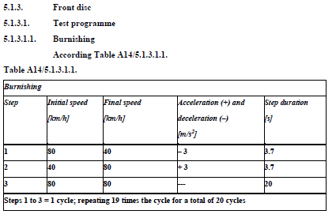
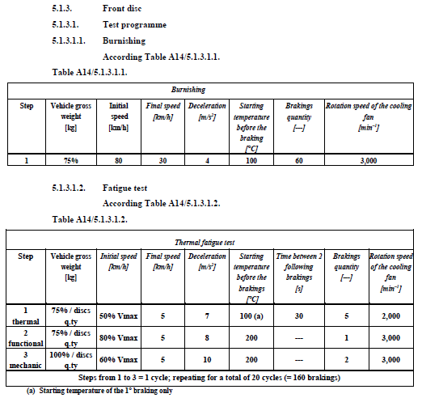
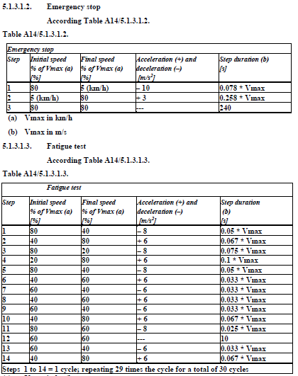
ECE/TRANS/WP.29/GRRF/2014/23/Rev.1
Italy proposal (3):
In Annex 14 (new), the thermal FATIGUE test has been modified for both front and rear discs.
FRONT DISC
TUV Directive
OEM procedure: longer test for a
better /pad/disc alignment
TUV Directive
Emergency stop has been included into fatigue test and improved.
TUV fatigue test is too severe (at first cycle, T was > 800 °C !!)

Slide 9

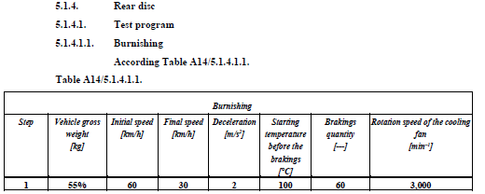
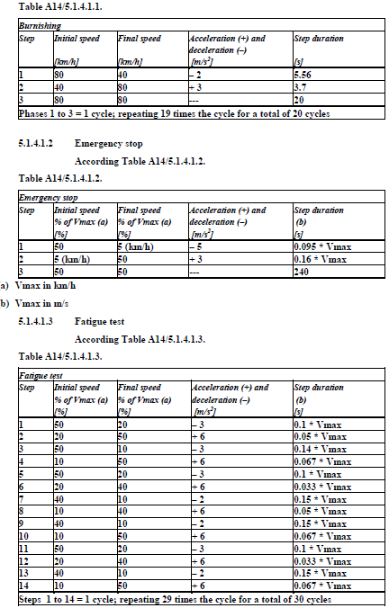
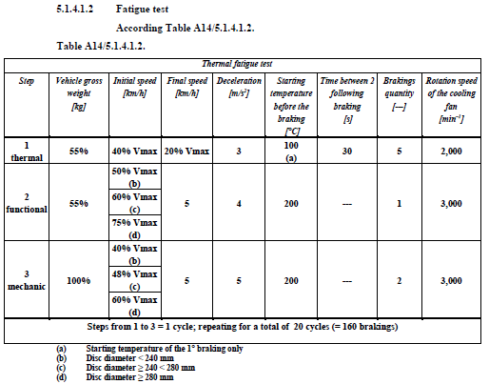
ECE/TRANS/WP.29/GRRF/2014/23/Rev.1
Italy proposal (3):
In Annex 14 (new), the thermal FATIGUE test has been modified for both front and rear discs.
REAR DISC

Slide 10
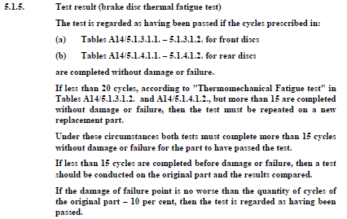
ECE/TRANS/WP.29/GRRF/2014/23/Rev.1
Italy proposal (3):
In Annex 14 (new), the thermal FATIGUE test has been modified for both front and rear discs.
Instead of 30
Instead of 20
The number of cycles have been slightly reduced, BUT the severity of brakins have been also increased.

Slide 11
GRRF-79-11e (informal doc)
In Annex 14, "Requirements for replacement brake discs for vehicles of categories L1, L2, L3, L4 and L5“
Paragraph 2.2.4. , correct to read:
"2.2.4. Apply the force F, specified in Table 2.1.2.5. A14/2.2.5., as shown in Fig.1“
Justification: editorial

Slide 12
GRRF-79-13e (informal doc)
Justification: The note has been introduced in order to allow the operator to carry out and conclude the test
in case of premature wear of the friction material of the pads.

Slide 13
GRRF-79-13e (informal doc)
Justification: the % of the “vehicle gross weight” has been reduced from 55% to 50% in conformity with
what is foreseen in par 5.1.4.1.3.

Slide 14
GRRF-79-13e (informal doc)
Justification: the proposed “Fade” test has the aim of stabilising the friction coefficient of pads.
The Fade test has the target of spilling the gas out from friction material, otherwise these gases
leak during the “Fatigue” test causing a reduction of the friction coefficient.
This could bring to the need of an increase of braking pressure up to excessive values, so that
a sudden consumption of the friction material may happen.
This phenomenon is typical for organic friction material, while pads with sintered friction material
are less subject to it.

Slide 15
GRRF-79-13e (informal doc)
Justification 1: the % of “vehicle gross weight” has been reduced
from 55% to 50% (for step 1 and 2) and from 100 to 90% (for step 3),
in order to optimize the mechanical stress on the brake disc,
so as to reach a Tmax of around 500 °C , instead of 660 °C
Justification 2: the threshold for the diameter
of the rear discs has been modified from 240mm
to 245mm in order to take into account a typology
of rear discs typically used on sport motorcycles
Justification 3: This note is added to allow the operator
to finalize the test in case of premature wear of the
friction material of the pads

Slide 16
GRRF-79-13e (informal doc)
Justification: a reference to UN-R78 is needed for braking system of vehicles of category L

Slide 17
GRRF-79-13e (informal doc)
[AMENDMENT 6 editorial]: for consistency with R.E.3, modify L1, L2, L3, L4, L5
with: L₁, L₂, L₃, L₄, L₅, throughout the document.
[AMENDMENT 7 editorial]: in Table A14/2.2.5, change the heading “spessore disco” with: “disk thickness”.
[AMENDMENT 8 editorial]: in paragraph 3.4.2.1, change “part C” with capital “Part C”.
Justification: all editorial

Slide 18
Thank you
for
the attention
!!!

Slide 19
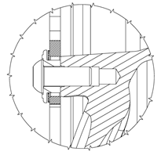
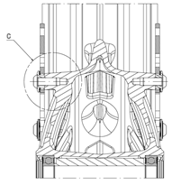
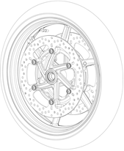

Back up slides – location bore

Slide 20

Back up slides – top hat parallelism

Slide 21
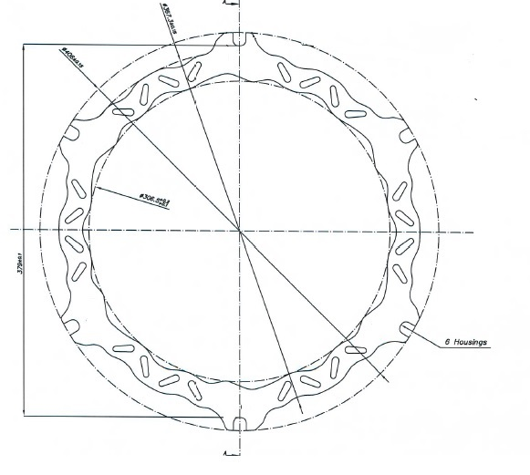
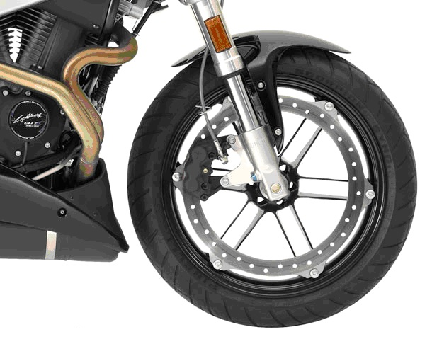
Back up slides – peripherical disc

Slide 22
Back up slides – TUV Fatigue test

Slide 23
Back up slides – New Fatigue test

