Slide 1
Submitted by the VIAQ Chair and Secretary
Informal document GRPE-72-21
72nd GRPE, 11-15 January 2016, agenda item 13
Progress Report of the
VIAQ (Vehicle Interior Air Quality)
Informal Working Group
15 January 2016
Report to the 72nd GRPE session

Slide 2
VIAQ Background
VIAQ Background ToR and mandate
WP.29 Mandate(ECE/TRANS/WP.29/1112)
AC.3 endorsed the proposed action plan to, in a first stage, collect information, review existing standards and develop recommendations.
End of mandate : November 2017
GRPE Adoption(ECE/TRANS/WP.29/GRPE/70)
GRPE adopted the proposals for terms of reference to the IWG on VIAQ as reproduced in Annex VI of this report.
Review of VIAQ Terms of Reference
The scope of the work is to develop a recommendation to harmonize test procedures of interior air emissions emitted/generated from interior materials
Notes:
2

Slide 3
VIAQ IWG Meetings
VIAQ IWG Meetings since last GRPE
2nd VIAQ IWG Meeting
Paris, France, 03-04 November 2015
3rd VIAQ IWG Meeting
Geneva, Switzerland, 13th January 2016
Notes:
3

Slide 4
VIAQ Progress Report
Topics/Issues
VIAQ Organization
Chair: Jongsoon Lim, Korea
Co-Chair : Yunshan GE, China
(Elected by the group at the 2nd meeting)
Secretary: Andreas Wehrmeier, OICA
Notes:
4

Slide 5
VIAQ Progress Report
Work Items – close issues
Test Measurement Modes
Background
Which test mode is the most suitable for the interior air emission.
Discussion
Korea prefers only using Ambient mode.
EC, China and OICA prefers using the three modes (Ambient, Parking, Driving) test procedure based on ISO 12219-1.
Group’s Conclusion
Adopting the Ambient, Parking and Driving mode based on the ISO-standards with discussions continuing on the detailed parameters. Each contracting party will have a choice of which test modes to adopt depending on their situation.
Test mode | Descriptions
Ambient mode | simulates cars parked in the garage overnight.(ambient temp)
Parking mode | simulates cars parked outside in the sunlight(high temp)
Driving mode | simulates air-conditioning conditions right after parking mode(Idling)
Notes:
5

Slide 6
VIAQ Progress Report
Work Items – close issues
Substances to be measured
Background
Many relevant substances(e.g. VOCs) with regard to Interior air quality
Target measurement substances are required before setting the test parameters.
Group’s Conclusion
According to the existing standards, - Substances to be measured: Formaldehyde, Acetaldehyde, Benzene, Toluene, Xylene, Ethylbenzene, Styrene, and Acrolein. These are the most relevant substances. An odor test will not be a part of the method.
Notes:
6

Slide 7
VIAQ Progress Report
Work Items – open issues
Test Procedure Parameters
Vehicle categories:
Passenger car, Category M1 or “Category 1-1 vehicle”, Category N1.
Definition of new vehicle : less than 50 km, 70 km, 80km
Age of vehicle at measurement:
28d ± 5 days after production date, Definition of production date
Sampling conditions: protection covers should stay in the vehicle and be taken off one day before the measurement.
Vehicle transportation conditions : to be determined
Vehicle storage conditions : to be determined
Notes:
7

Slide 8
VIAQ Progress Report
Work Items – open issues
Test Procedure Parameters
Preconditioning time (doors open): 30 min
Soak time: Stabilization is reached after approx 10 h. To facilitate the test procedure, it is recommended to have a 14h ± 2h soak time or 16 h.
Temperature for ambient mode: 25°C or 23°C.
Humidity for ambient mode: 50% ± 10% (relative humidity)
Measurement point for temperature and humidity: one at driver seat (nose position) and one outside vehicle (1m from vehicle)
Sampling point: Driver seat (nose position)
Analytics: Aldehydes according to ISO 16000-3 and VOCs according to ISO 16000-6
Notes:
8

Slide 9
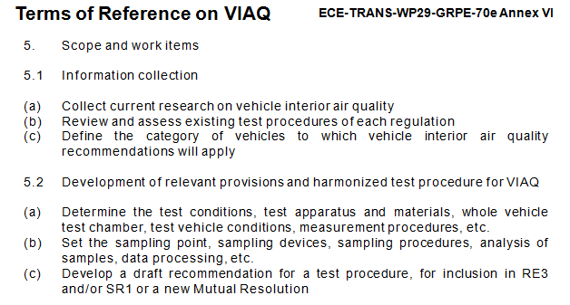
VIAQ Progress Report
Work Items – Need to check for work scope
Vehicle family concept(worst case within the model family)
Conformity of Production
Notes:
9

Slide 10
Roadmap, Timeline
Roadmap
2015 2016 2017
1 2 3 4 5 6 7 8 9 10 11 12 1 2 3 4 5 6 7 8 9 10 11 12 1 2 3 4 5 6 7 8 9 10 11 12
WP.29
GRPE
VIAQ
171
172
173
70
71
72
73
74
75
Informal
document
formal
document
Kick-off
1
2
3
4
5
6
7
8
9
Collect information and review existing test procedures
Decide on test mode suitable for the interior air emission
Draft a new recommendation/Resolution
Develop provisions and harmonized test procedures.
January 2017 : Present a final draft report as an informal document to GRPE
November 2017 : Possible adoption of Recommendation(R.E.3, SR1 or mutual resolution)
Notes:
10

Slide 11
Next VIAQ IWG Meeting
Next VIAQ IWG Meeting
4th VIAQ IWG Meeting
Beijing, China, March 2016(TBD)
5th VIAQ IWG Meeting
Geneva, Switzerland, June, during 73rd GRPE
Half a day requested
Notes:
11

