Slide 1
Report to 167th WP.29 session from the 19th IWVTA Informal Group meeting
Transmitted by the Co-Chairs of IWVTA Informal Group
Informal document WP.29-167-09 (167th WP.29, 10 - 13 November 2015, agenda item 4.3)

Slide 2
Contents
Report from Sub-group « 1958 Agreement »
1. Transitional provisions of UN Regulations
2. The outcome of discussion on Ukrainian comments
II. Report from Sub-group « UN R0 »
3. UN Regulations applicable to IWVTA
4. UN R0 pretesting
5. Q&A document on UN R0 and IWVTA
III. IWVTA IG
6. Request to extend the mandate of IWVTA IG
7. Working schedule

Slide 3
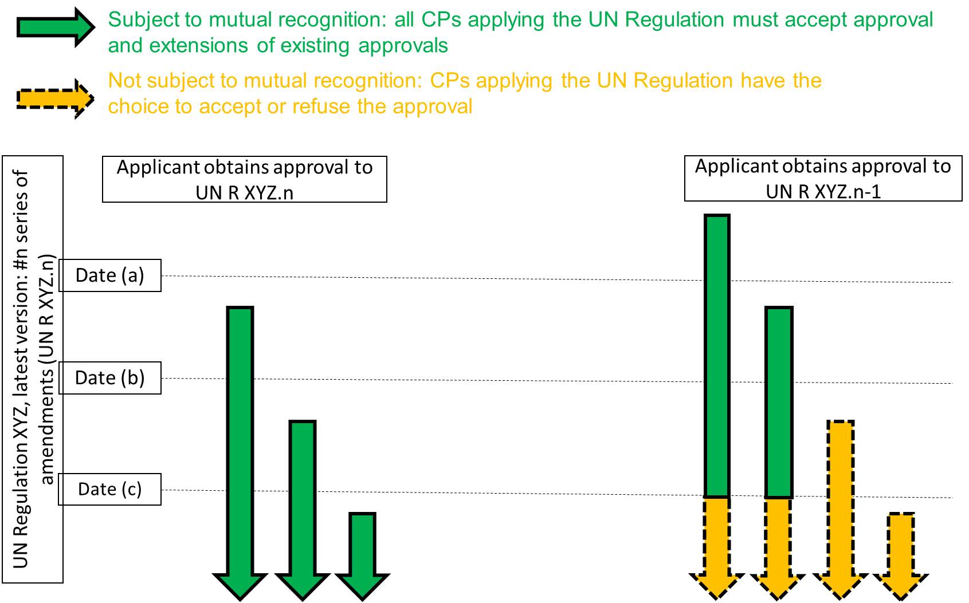
1. Transitional provisions of UN Regulations

Slide 4
2. The outcome of discussion on Ukrainian comments
Editorial comments as shown below to amend the draft revision 3 of the 1958 Agreement submitted by Ukraine will be reflected in the very final proposal.
Schedule 1, paragraph 1.2: update the number of ISO standard
Schedule 2, Part two: correct the reference to Technical Services in the title
Schedule 2, Part two, paragraph 2.1: update the number of ISO/IEC standard
Schedule 2, Part three, paragraph 4.1 (b): more precise description of the personnel in charge (in charge of testing → in charge of testing and /or inspections)
Schedule 4, paragraph 1: add paragraph 2.8 which should be respected when issuing type approval number
Schedule 4, example of type approval numbers: “/” is missing

Slide 5
3. UN Regulations applicable to IWVTA (R51 added )
Number | Topic | UN-Regulation
1 | Retro reflecting devices | 3
2 | Illumination of rear registration plates | 4
3 | Direction indicators | 6
4 | Front and rear position lamps, stop-lamps & end-outline marker lamps | 7
5 | Electromagnetic compatibility | 10
6 | Door latches & retention components | 11
7 | Steering impact | 12
8 | Safety Belts | 16
9 | Seats, their anchorages, & head restraints | 17
10 | Front fog lamps | 19
11 | Interior fittings | 21
12 | Reversing & manoeuvring lamps | 23
13 | External projections | 26
14 | Audible warning signals | 28
15 | Tyres | 30
16 | Filament lamps | 37
17 | Rear fog lamps | 38
18 | The Speedometer equipment | 39
19 | Safety glazing | 43
20 | Built-in Restraining device for children | 44
Number | Topic | UN-Regulation
21 | Headlamp cleaners | 45
22 | Sound emissions | 51
23 | Tyres for commercial vehicles | 54
24 | Rear underrun protective devices | 58
25 | Parking lamps | 77
26 | Steering equipment | 79
27 | Measurement of engine power | 85
28 | Side marker lamps | 91
29 | Frontal collision | 94
30 | Lateral collision | 95
31 | Headlamps with gas-charge light sources | 98
32 | Gas-charge light sources | 99
33 | Electric power train | 100
34 | Headlamps with filament lamps and/or LED modules | 112
35 | Tyre wet grip/Noise/RR | 117
36 | Cornering lamps | 119
37 | Hand controls and tell tales | 121
38 | Adaptive front-lighting systems | 123
39 | Forward field of vision | 125
40 | Pedestrian safety performance | 127
41 | LED light sources | 128

Slide 6
3. UN Regulations applicable to IWVTA ; B List
UN Reg. | Topic | Expected agreement date by GR | Expected agreement date by WP.29 | Note
13H | Braking | February, 2016 | June, 2016 | Split provisions for ESC/BA
14 | Safety belts Anchorages | unknown | unknown | Wait for proposal by Australia
34 | Prevention of fire risks | May, 2014 | November, 2014 | To be included in Annex 4 of UN R0 in November, 2017
46 | Indirect vision devices | May, 2015 | November, 2015 | To be included in Annex 4 of UN R0 when adopted
48 | Installation of lighting and light-signalling devices | unknown | unknown | Study on DRL by Japan was reported to GRE
64 | Temporary tyres | February, 2016 | June, 2016 | Split provisions for TPMS
116 | Anti-theft and alarm systems | unknown | unknown | Task force was established for clarifying the scope and amending the Regulation
New | Tyre installation | February, 2016 | June, 2016 | IG was created for drafting the Regulation
WLTP | CO2 emissions | unknown | unknown | Discussion is on going.
WLTP | Exhaust emissions | unknown | unknown | Discussion is on going.

Slide 7
4. UN R0 pre-testing program
Participants
The pre-test will be run independently and in parallel by pairs consisting of a TAA, technical services and a manufacturer. The following pairs have volunteered to participate in the program.
 | TAA | Tech. Service | Manufacturer
Germany | KBA | tbd | Daimler, VW
The Netherlands | RDW | RDW | Kia, Hyundai,
UK | VCA | VCA | Toyota
Japan | MLIT | NTSEL | Nissan, Honda, Mazda, Toyota

Slide 8
4. UN R0 pre-testing program
(2) Test Program
The vehicle manufacturer selects a vehicle type that really exists and consists of several variants.
On system and parts level real UN type approvals are used whenever feasible.
Step 1; New type approval
- The manufacturer applies for original U-IWVTA and/or L-IWVTA
- The entire approval process is performed between TAA/ technical service and the manufacturer
- TAA grants U-IWVTA and/or L-IWVTA with revision 00 which is unfortunately invalid.
Step 2; extension of type approval
Different patterns of extension are performed
also involving status changes of the type between universal and limited

Slide 9
4. UN R0 pre-testing program
(3) Schedule

Slide 10
5. Q&A document on UN R0 and IWVTA
(1) Purpose
Promote understanding of not only Contracting Parties but also potential Contracting Parties to the 1958 Agreement on UN Regulation No.0 and IWVTA.
The text of the questions and answers is not legally binding.
(2) Q&A document
Questions are classified into 1) UN R0 and IWVTA and their application and 2) Rights and obligations of Contracting Parties applying UN R0.
Sub-group members tried to avoid legal terms and make it easy and simple as much as possible.
(3) Request to WP.29 members
Please give any feedback on Q&A document WP.29-167-10 to Technical Secretary, IWVTA IG (ryuzo_oshita@mail.toyota.co.jp).

Slide 11
6. Request to extend the mandate of IWVTA IG
A request to WP.29 to extend the mandate of IWVTA Informal Group by 15 months; i.e., until June, 2017 to complete the task. Refer to document WP.29-167-11.
TIMELINE
December, 2015 to June, 2016: Pre-testing of UN Regulation No. 0
November, 2016: Submission of final proposal for the text of UN Regulation No. 0
November, 2016: Submission of proposal to set up a permanent informal group administering IWVTA
November, 2016: Submission of proposal for updated “General Guidelines for UN regulatory procedures and transitional provisions in UN Regulations” (ECE/TRANS/WP.29/1044/rev.2).

Slide 12
7. Working schedule

Slide 13
7. Working schedule

