Slide 1
LED HEADLAMPS DESIGN RESTRICTIVE REQUIREMENT Regulation ECE R48
Transmitted by the representative of France
Informal document WP.29-166-23
(166th WP.29, 23 - 26 June 2015,
agenda item 4.2.3)
Document ECE/TRANS/WP.29/GRE/2015/21.

Slide 2
Context of the current regulation.
Installation regulation: R48
A practical study done on different types of vehicles (halogen, xenon, led headlamps) shows that the light source has no influence on the dazzle of the oncoming drivers. Such study was presented during 71st session of GRE.
The existing requirement of ECE R48 is based on product and not on lighting performance which would encourage the development of LED light sources new technology.

Slide 3
Proposal
Document GRE/2015/21 presented by France at 72nd and 73rd session of GRE without final conclusion.
Modify ECE R48 series 04, 05 & 06 so that prescriptions for auto-levelling devices are the same for LED headlamps as for headlamps of other types (halogen and xenon).
Benefits of such modification will be important in terms of CO2 savings.
Such proposal does not interfere with other subjects under examination at GRE.

Slide 4
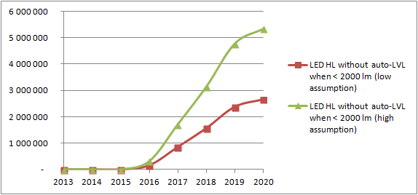
Marketing study.
Removing the auto-levelling requirement for LED headlamps whose luminous flux of the source is less than 2,000 Lm has a significant impact on the equipment rate of the vehicles.
➔ in 2020, between 2.6 and 5.2M vehicles more with LED due to the proposed modification.
Impact of the proposal on the LED equipped vehicles: (Europe + Turkey)

Slide 5
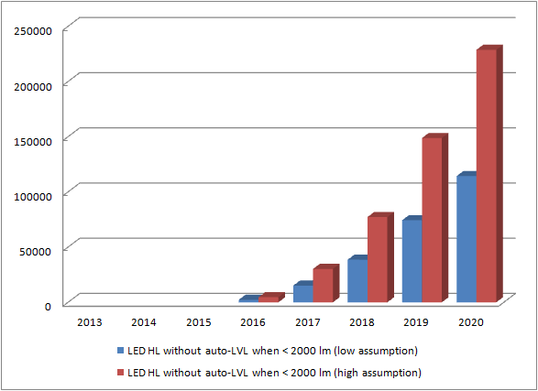
CO₂ emissions impact
Hypothesis:
LED headlamps save 1g CO₂ /km.
Average mileage : 15000km/year.
CO2 savings in tons
Between 110,000 and 220,000 tons CO2 saved per year in 2020 in Europe.

Slide 6
Conclusions.
No influence of the light source type on the dazzle of other road users.
Proposal: Same requirement upon the auto levelling for LED as for other light source types in the current R48.
Consequences:
More LED headlamps fitted on new vehicles.
➔ reduction of CO2 emissions.

