Slide 1
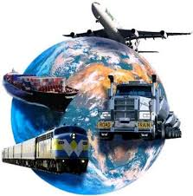
TERMINOLOGY on COMBINED, MULTIMODAL and INTERMODAL TRANSPORT
Kayıhan Ö. TURAN
UTIKAD
November 30 – December 1, 2015

Slide 2
UTIKAD
Over 400 Member companies
Direct employment reaching to 50.000
Total turnover of the members is more than 5 billion TL
Voice of Industry in Turkey with the governmental bodies & NGOs
Voice of Industry at international bodies
9 Educational Books & 2 Special Reports
Founding Member of ECOLPAF
Working Groups of 7 Sectoral Divisions
FIATA Diploma in Freight Forwarding
Hosted 4 International Organizations
1999
2002
2011
2014
International Organizations By UTIKAD
Balkan Congress
FIATA 2002
World
Congress
10. Southeast European
Freight Forwarders
& Logistics Operators
Congress
FIATA 2014
World
Congress

Slide 3
Different Terminologies for the Freight
Transportation Systems with Multiple Modes
I. Multimodal Transportation (broadest term and covers all of the other notions)
II. Intermodal Transportation (a specific type of multimodal transportation)
III. Combined Transportation ( recently used one )
IV. Co-Modal Transportation (focusing on the overall sustainability and resource utilization)
V. Synchromodal Transportation (synchronized combination of different transport modes and focusing on real-time flexibility)

Slide 4
Different Terminologies for the Freight
Transportation Systems with Multiple Modes
THANKS FOR YOUR SUPPORT TO JOIN SMALL QUESTIONNAIRE.
HERE ARE THE RESULTS ☺
TOTAL ATTANDANCE : 18
TOTAL ATTANDANCE : 17 + 1 is not named any of options
HOW DO YOU NAME BELOW DESCRIPTION
Carriage of goods in one and the same loading unit or road vehicle, which uses two or more modes of transport respectively without handling the goods themselves while changing modes
MULTI MODAL 2 | COMBINED 5 | INTERMODAL 11
HOW DO YOU NAME BELOW DESCRIPTION
The carriage of goods by using two or more modes of transport respectively by physical handling of the goods themselves while changing transport modes.
MULTI MODAL 12 | COMBINED 1(=intermodal) | INTERMODAL 5

Slide 5
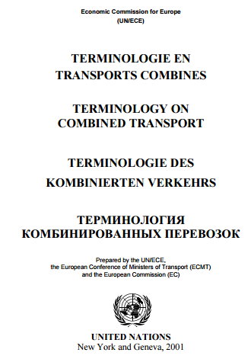
UNECE TERMINOLOGY ON COMBINED TRANSPORT

Slide 6
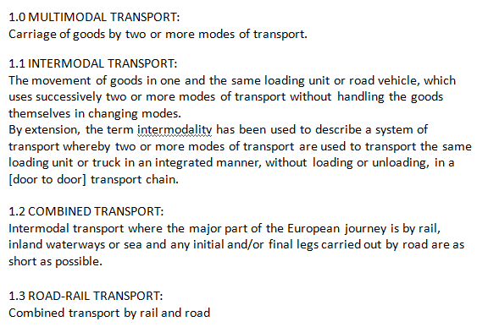
UNECE TERMINOLOGY ON COMBINED TRANSPORT

Slide 7
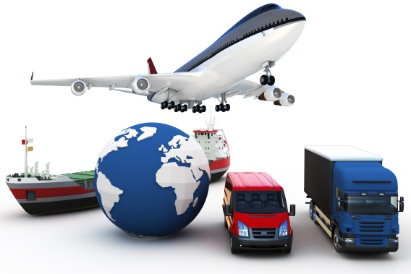
1.0 MULTIMODAL TRANSPORT
Current Definition:
1.0 MULTIMODAL TRANSPORT:
Carriage of goods by two or more modes of transport.
Our Proposal:
1.0 COMBINED TRANSPORT
Carriage of goods by two or more modes of transport respectively. There are two types of combined transport modals.

Slide 8
1.1 INTERMODAL TRANSPORT
Current Definition:
1.1 INTERMODAL TRANSPORT
The movement of goods in one and the same loading unit or road vehicle, which uses successively two or more modes of transport without handling the goods themselves in changing modes.
By extension, the term intermodality has been used to describe a system of transport whereby two or more modes of transport are used to transport the same loading unit or truck in an integrated manner, without loading or unloading, in a [door to door] transport chain.
Our Proposal:
1.1 INTERMODAL TRANSPORT
Carriage of goods in one and the same loading unit or road vehicle, which uses two or more modes of transport respectively without handling the goods themselves while changing modes.
In an intermodal transport, the main transport is executed by rail, inland waterways or sea. Pre carriage and/or final delivery is carried out by road as short as possible.

Slide 9
1.2 COMBINED TRANSPORT
Current Definition:
1.2 COMBINED TRANSPORT
Intermodal transport where the major part of the European journey is by rail, inland waterways or sea and any initial and/or final legs carried out by road are as short as possible.
Our Proposal:
1.2 MULTIMODAL TRANSPORT :
The carriage of goods by using two or more modes of transport respectively by physical handling of the goods themselves while changing transport modes.

Slide 10
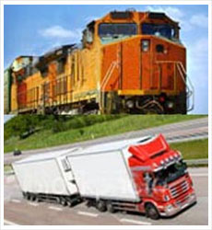
1.3 ROAD-RAIL TRANSPORT
Current Definition:
1.3 ROAD-RAIL TRANSPORT:
Combined transport by rail and road
Our Proposal:
Removal of the term
1.3 ROAD-RAIL TRANSPORT:
Combined transport by rail and road

Slide 11
UNECE TERMINOLOGY ON COMBINED TRANSPORT

Slide 12
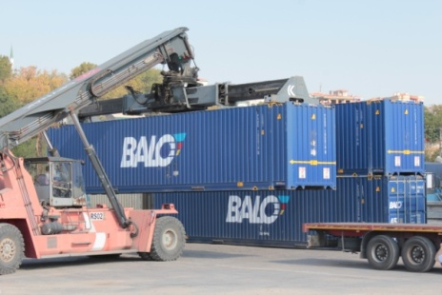
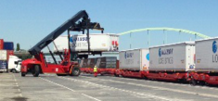
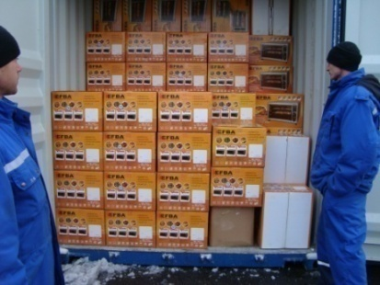
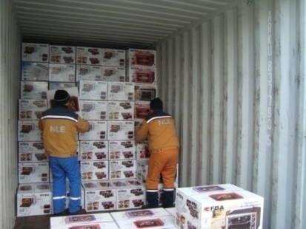
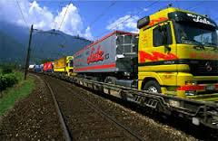
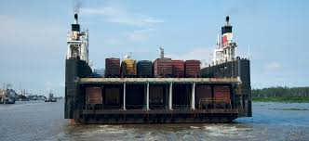
UNECE TERMINOLOGY ON COMBINED TRANSPORT
BECAUSE MAIN DISTINGUISHING ITEM
PHYSICAL HANDLING OF THE GOODS OR WITHOUT HANDLING THE GOODS
BY CHANGING MODES
OR

Slide 13
UTIKAD / Amendment proposals to the AGTC Agreement
(33) TURKEY
AGTC Annex I
Add the following railway lines:
C-E 70/1 (Svilengrad-) Kapikule-Tekirdag
AGTC Annex II
Terminals of importance for international combined transport
Add the following terminals:
Çezkezkoy
Tekirdag
Kosekoy(İzmit)
Kayseri
Hasanbey(Eskisehir)
D. Ferry links/ports forming part of the international combined transport network
Tekirdag – Derince ( Turkey – Turkey )

Slide 14
UTIKAD / Amendment proposals to the AGTC Agreement
Chapter I
GENERAL
Article 1
DEFINITIONS
For the purposes of this Agreement:
a) The term "combined transport" shall mean the transport of goods in one and the same transport unit using more than one mode of transport;
“Carriage of goods by two or more modes of transport respectively. There are two types of combined transport modals.”

Slide 15
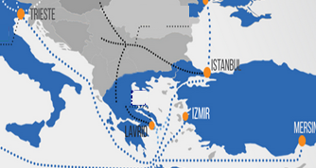
UTIKAD / Amendment proposals to the AGTC Agreement
Chapter I
GENERAL
Article 1
DEFINITIONS
For the purposes of this Agreement:
b) The term "network of important international combined transport lines" shall refer to all railway lines considered to be important for international combined transport if:
We propose that this should not be related only
to direct railways lines as in Turkey we have an
important connection between trieste and
Pendik ports by RoRo vessels.
Trieste has a railway connection but
Pendik has not ( for the time being )
but so many CTU ( cntrs and trailers )
are handled at Pendik port as a part of
İntermodal transport

Slide 16
Thank You
Kayıhan Ö. Turan
UTIKAD

