Slide 1


Government of Israel
Ministry of Transport and Road Safety
Rail Safety Department
“The Rail Safety Case in Israel”
Workshop on “Rail Safety: Trends and Challenges”.
November 24th 2015
Akiva Rom, MSc. Head of Rail Safety Department

Slide 2

Agenda
The rail network in Israel
New projects
Safety regulation development
Challenges and Goals

Slide 3
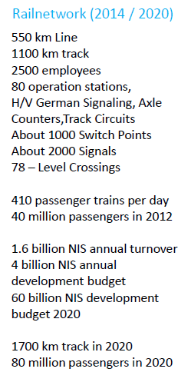
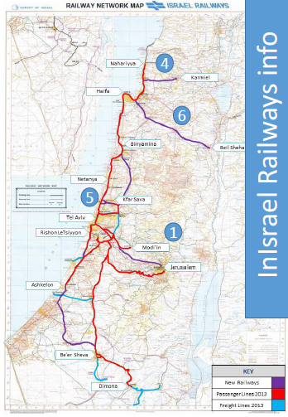
The Rail Network In Israel

Slide 4
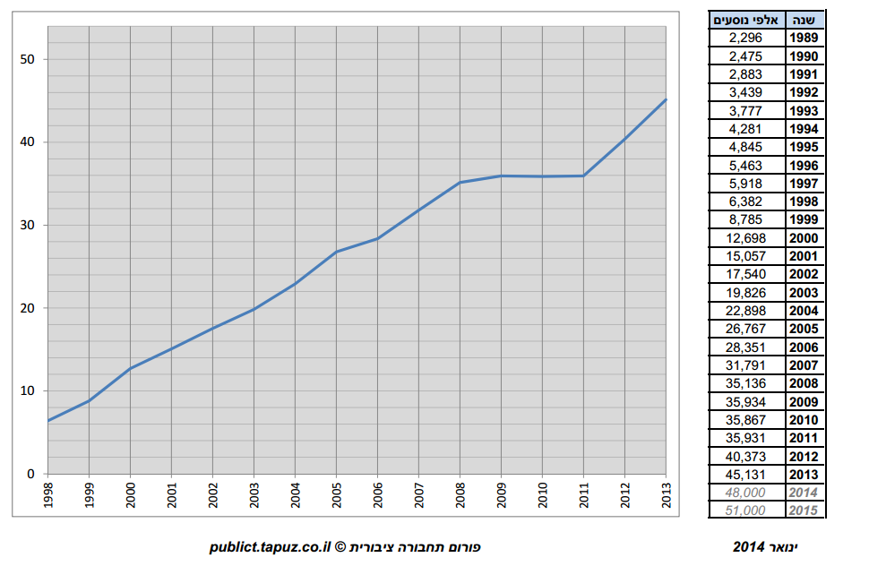
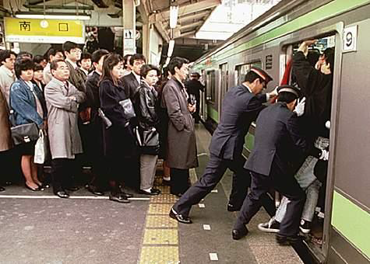
Number of Passengers 1989-2015
Million of passengers
Year

Slide 5
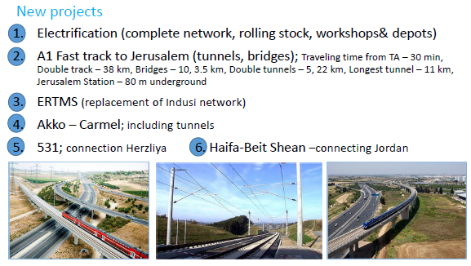

Slide 6
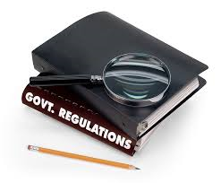
The safety regulation development - Short History
Till 2008 -No rail regulation in Israel.
Following changes in the legal structure of Israel railways, and after two train accidents with fatalities in 2005 and 2006, The Government of Israel established the Rail Regulation Department within MOT.
Since 2008 the rail safety regulation developed based on the methodology in Europe.
6

Slide 7

Main steps
Permits
Supervision
Regulation Instructions
Organizational Structure
Recruiting professional staff
development of procedures and methods
Updating the primary legislation
Comparison study by European company “Ardanoy”
2008
2009
2010
2011
2012
2013
2014
2015
7

Slide 8
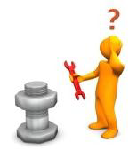
The Bricks
Rail law
Amendment to the law *
Other legislation
*Passed first reading
Establishing the Safety Regulation framework based on the European Methodology.
Cooperation with ISR
Directives
Management commitment
TSI
Adaptation of ISR procedures
EN/UIC
applicative documents

Slide 9
New version (Israeli railway law)
תשל"ב-1972
Applicable lows
Amendment
Electricity Law
National infrastructures plan
Regulations Ruling
Frame agreement
National railway
Regulation
structure
Manager technical guidelines
Manager safety guidelines
Fright
Signaling
Energy
Infrastr.
Rail/Road
Pass. Stations
Rolling Stock
Operation Plans and service levels
ISR
ISR
ISR
ISR
ISR
ISR
ISR
Purchase construc.
Main.
Main.
Purchasing
Tech. .Spec
Tech. .Spec
Tech. .Spec
I
Tech. .Spec
Tech. .Spec
Tech. .Spec
Tech. .Spec
EN , UIC IS
EN , UIC IS
EN , UIC IS
EN , UIC IS
EN , UIC IS
EN , UIC IS
EN , UIC IS
Draft
To be developed
Approved

Slide 10
Monitoring
performance
SMS
RAMS
(EN50126)
NRv
Bench marking
Manager Safety
Guidelines
(based on 2004/49/EC)
CSM
National Safety Guidelines
(based on 2004/49/EC)
Safety
targets
Supervision
Risk Matrix
Fn Curve
Accidents Inv.
Training Workshops
10

Slide 11
CENELEC Life Cycle

Slide 12
Main Challenges
To finalize the regulation structure in light of the new projects (Electrification, ERTMS, Tunnels).
To implement the regulation requirements parallel to the massive development plan.
To implement the regulation requirements (new methodology for existing rail operator).
ECM
Placing RS
into the Market
SMS
Safety Certificate
POT Permits to Operate
12

Slide 13
Thank you for your attention

Slide 14

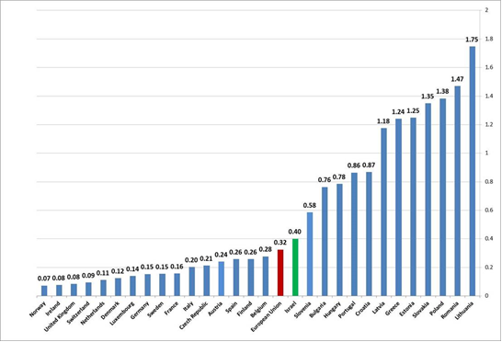
Railway fatalities per million train-kilometres in 2006–2013 for the EU-28 including ISRAEL
Based on ERAIL DATABASE 27.4.15
14
Notes:
For the analysis and presentation of the events as shown in this graph , data was collected from number of sources:
data for all EU Member States for the years 2006 -2013 as reported by the EU
summary of data from the events of safety investigation reports in Israel Railways safety events for the years 2005-2011 (as collected and recorded by the company Aida), and for the years 2013,2014 as collected and recorded by the department.
It appears that safety levels vary greatly among Member States (MS). One third of MS have a significantly higher risk than other MSs
For the first time we got a broad picture for the levels of risk for Railway fatalities and serious injuries and comparison between countries based on an extensive database of about 10 years.

Slide 15
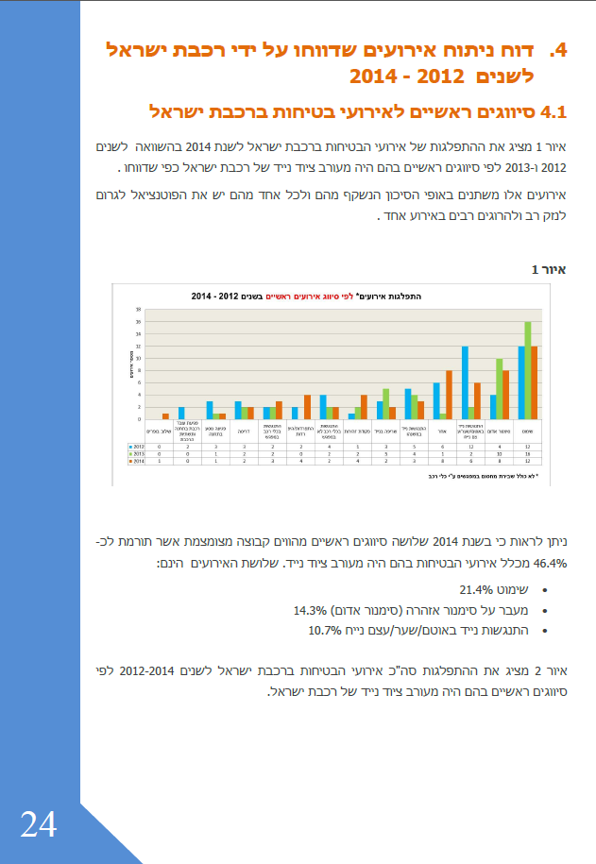
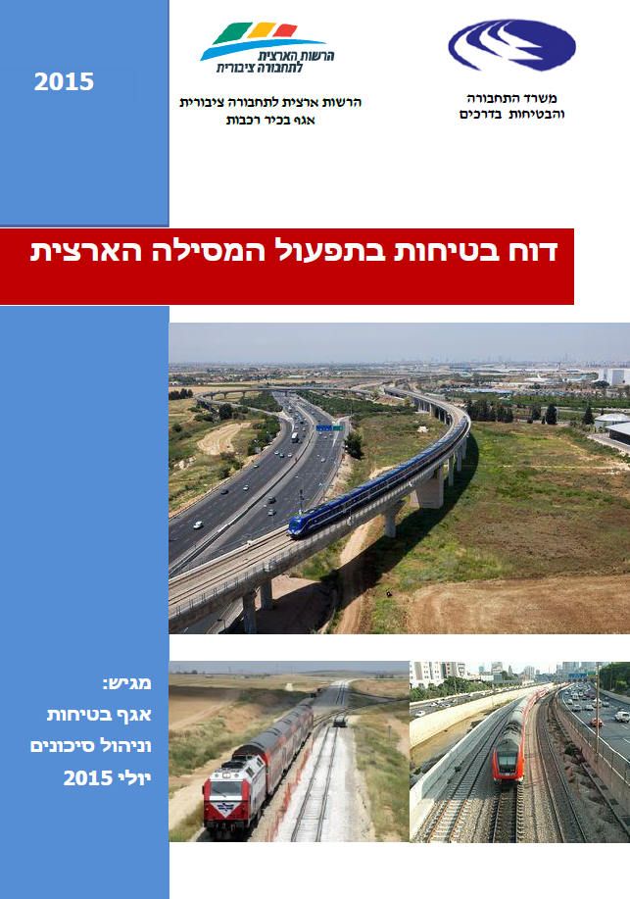
Annual Safety report

Slide 16
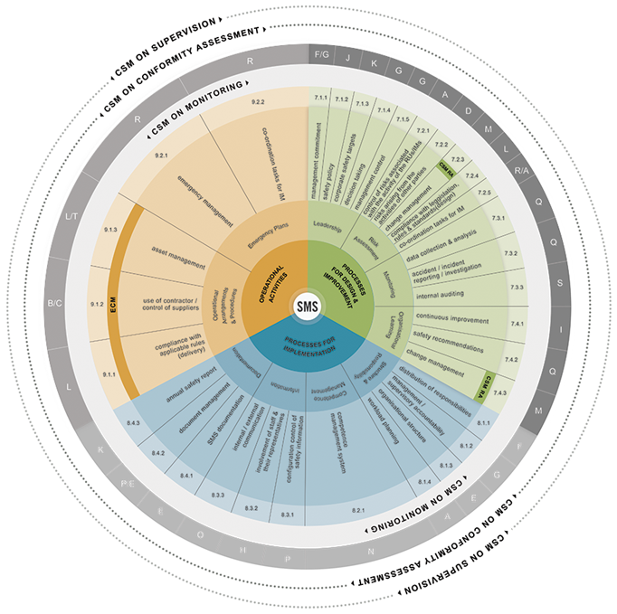
from the ERA website:
http://www.era.europa.eu/tools/sms/Pages/SMS.aspx

Slide 17
Ministry of transport and road safety
Administration of shipping and ports
The civil aviation authority
Public transport authority
Traffic administration
Road Sector
Senior rail department
Engineering rail department
Rail safety department
Operational program and service level department

Slide 18
