Slide 1
lnformation of Korea Cases on Vehicle Indoor Air Quality (VIAQ)
KATRI, The Republic of KOREA
(Ministry of Land, Infrastructure and Transport)
Transmitted by the expert from the Republic of Korea
Informal document No. GRPE-68-11
68th GRPE, 7-10 January 2014
Agenda item 15

Slide 2
Contents
1. Background
2. Case Study in Korea
3. The effects of VIAQ Regulation
4. Conclusion
Notes:
2

Slide 3


Background
Increasing concerns about Vehicle Indoor Air Quality(VIAQ)
Various chemical materials to harmful to human body are emitted from
vehicle interior materials
Researching & Managing vehicle indoor air quality by many countries
Netherlands, France, Sweden, Germany, Japan, USA, China, Korea
ISO Standard(12219-1:2012), China(GB/T 27630-2011), Korea(Notification No.
2007-539)
Need to unified regulation on vehicle indoor air quality(VAIQ)
to protect driver’s health and safe driving

Slide 4

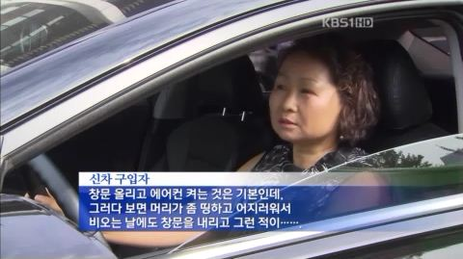
Case Study in Korea
    Sick House Syndrome & Sick Car Syndrome : became a social issue
    New car driver feel a headache, eye irritation, sneeze and so on
    The main cause is the chemical materials that emitted from vehicle interiors
<Media :KBS news “Hazardous substances in new car interiors”>
Interview : I feel slight headache and dizzy…

Slide 5


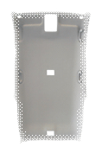
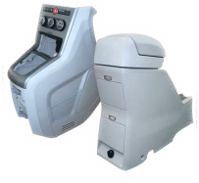
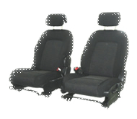
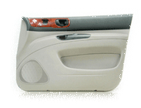
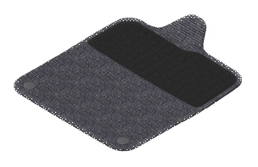



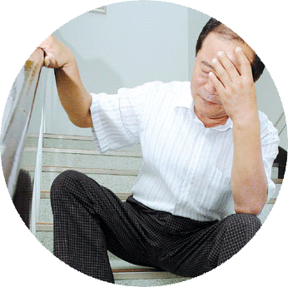





Case Study in Korea
    Surveyed 800 people who purchased a new car
    Feeling the physical symptoms under driving : 51.5%,
    Headache 31.5%, Eyes irritation 31%, Sneeze 15.8%, Fatigue11.1%...
Vehicle interior materials
SEAT
DOOR TRIM
CARPET
IP
HEADLINING
BACK SHELF
PANEL
CONSOLE
Formaldehyde
Toluene
VOCs
Amines
phthalate
PAHs
Headache
Dizzy
Sneeze
Dyspnoea
Sleepiness
Allergy
Smell

Slide 6

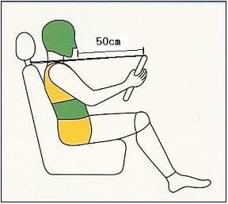
Case Study in Korea
    Specification and method for the determination of VIAQ
Test measurement method
Time
Temp stabilize
Min. 12hr
Ventilation
30min
Close door
Sealing
2hr
sampling
15min
Cabin
Temp
25℃
25℃
25℃
25℃
    Temperature : 25 ℃(The average temperature in summer in Korea)
    The hottest month, the average temperature in August 30 years(1971-2000) : 24.9 ℃
    Door close time : 2hour(Recommended by the long running time)
    2006 New car driver survey results : about 2.2 hour
    In summer parking, the 94.6% of driver is driving after the ventilation : Not considered High temperature mode and driving mode
    Using a air conditioning fan or window slightly open (10 ~ 15 cm) when driving open while driving, Within 2-3 minutes more than 90% of the initial concentration decrease

Slide 7
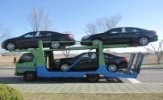
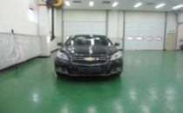
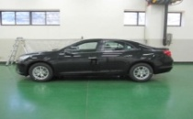
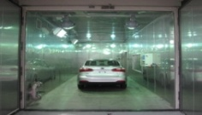
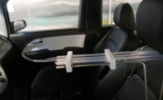
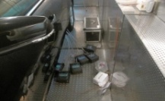
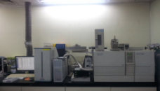
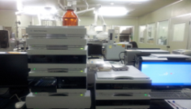
Case Study in Korea
    Verification test whether automobile manufactures comply with guideline
14days
28days
Car Preparation
2 hours
Room Temperature Stabilizing
Sampling
Temp. Stabilizing
Sampling
Sample
Analysis
  7
GC/MS
HPLC
Content Analysis

Slide 8
The Effects of VIAQ Regulation
    Verification Test results of VIAQ by year
YEAR | ITEM | Formaldehyde | Toluene | Ethylbenzene | Styrene | benzene | Xylene
2006 (36 model) Before VIAQ regulation | averg | 98 | 518 | 222 | 64 | 111 | 828
 | Min | 22 | 51 | 49 | 12 | 7 | 112
 | Max | 955 | 2384 | 632 | 185 | 385 | 2164
2011 (9 model) AFter VIAQ regulation | averg | 35 | 1046 | 102 | 14 | - | -
 | Min | 8 | 108 | 20 | 7 | - | -
 | Max | 56 | 2846 | 470 | 25 | - | -
2012 (8 model) AFter VIAQ regulation | averg | 20 | 328 | 66 | 33 | 7 | 199
 | Min | 4 | 85 | 18 | 4 | 5 | 45
 | Max | 49 | 753 | 131 | 136 | 13 | 379
2013 (4 model) AFter VIAQ regulation | averg | 24 | 206 | 28 | 5 | 1 | 80
 | Min | 5 | 65 | 8 | 3 | 1 | 21
 | Max | 38 | 430 | 51 | 7 | 3 | 140

Slide 9
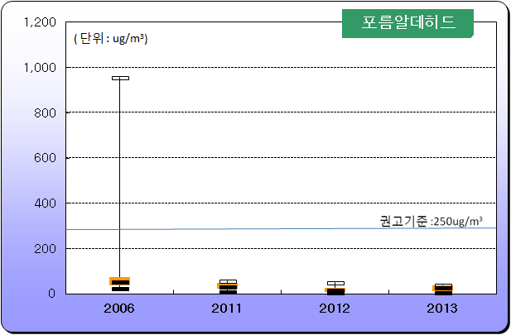
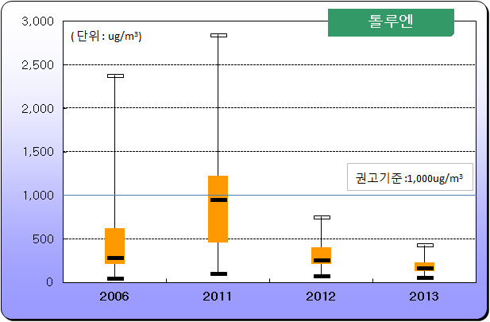
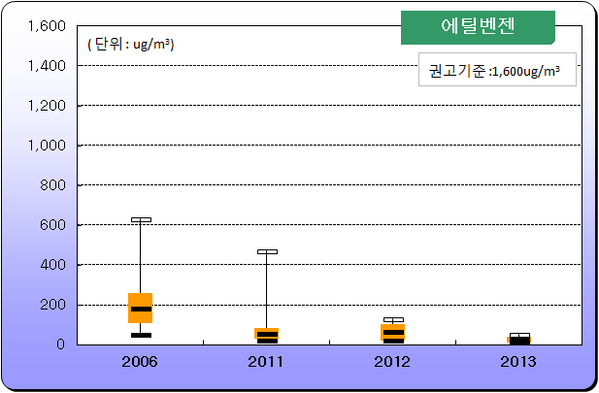
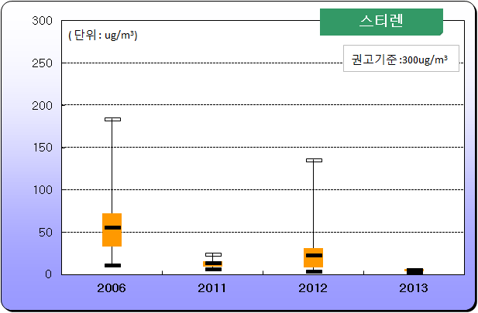
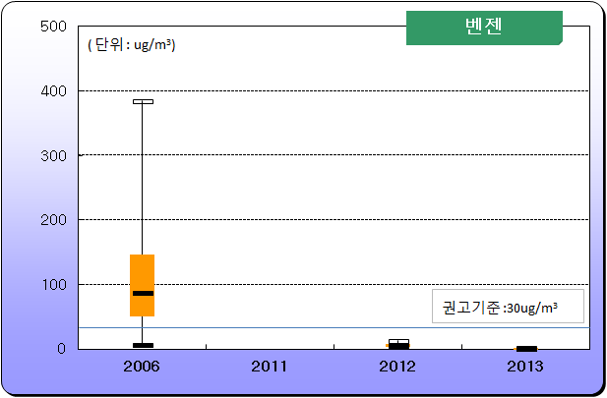
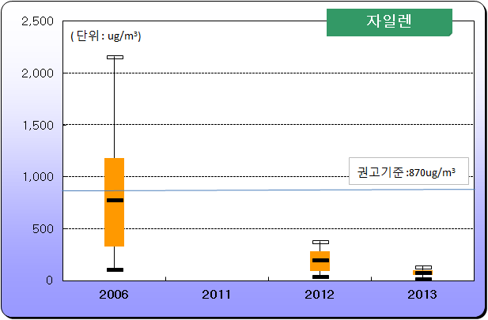
The Effects of VIAQ Regulation
    This graph shows a comparison to 2006(Not Apply) and 2011~2013(VIAQ)
After the VIAQ regulation , Vehicle indoor air quality levels improved
VIAQ management regulation that this effect is confirmed
<Formaldehyde>
<Toluene>
< Ethylbenzene>
<Styrene>
<benzene>
< Xylene>

Slide 10
Conclusion
To protect driver and passenger’s health and safe driving, Korea was conducted VIAQ regulation since 2011
After the VIAQ regulation, Vehicle indoor air quality levels improved that this effect is confirmed
Need to unified regulation on vehicle indoor air quality(VAIQ) to protect driver’s health and safe driving
Notes:
To protect driver and passenger’s health and safe driving against harmful substances for human body.
We need for discussion on a unified standard for vehicle indoor air quality

Slide 11

Thank you very much ! !
Notes:
11

