Slide 1

Shifts in tyre sound levels between 2007 and 2013
Informal document GRB-60-12
(60th GRB, 1-3 September 2014,
agenda item 9)
Transmitted by the expert from the Netherlands
‒‒
Erik de Graaff
(presented by Gijsjan van Blokland)
Client: Netherlands Ministry of Infrastructure and Environment

Slide 2
Objective of the study
Investigate shifts in sound level distribution in tyre population on sale before and after revision of tyre regulation in 2009
Investigate correction values for specific tyre types
Interpret present distribution in terms of ambitious future threshold values

Slide 3
Work plan
Comparison was made between the distribution of sound levels in the tyre type population in 2007 and 2013
Both C1, C2 and C3 tyres were taken into account
The 2007 population is based on data from ETRTO (C1) and FEHRL/TÜV/NL data for C2 and C3
The 2013 population is based on the tyre type data base of VACO combined with the label values attached to these tyre types
A selection of most common types was made on base of manufacturer selection and size selection
In total 760 C1, 172 C2 and 372 C3 types were included in the study

Slide 4
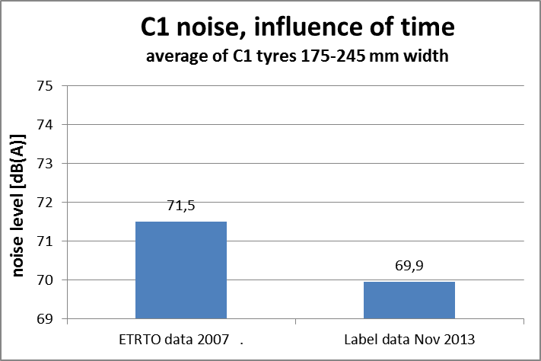
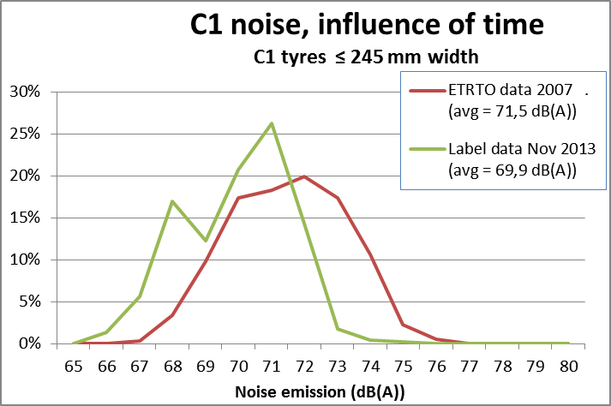
C1 tyres: 2007 vs. 2013

Slide 5
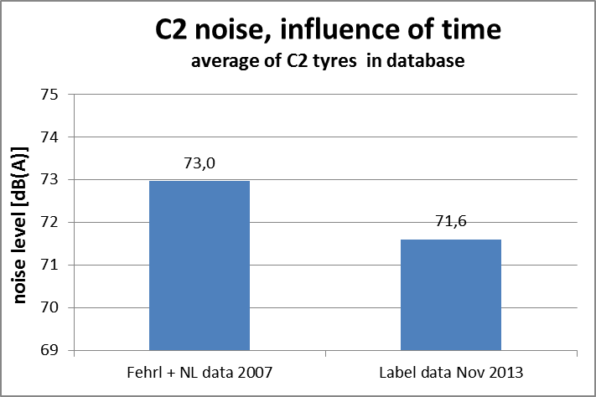
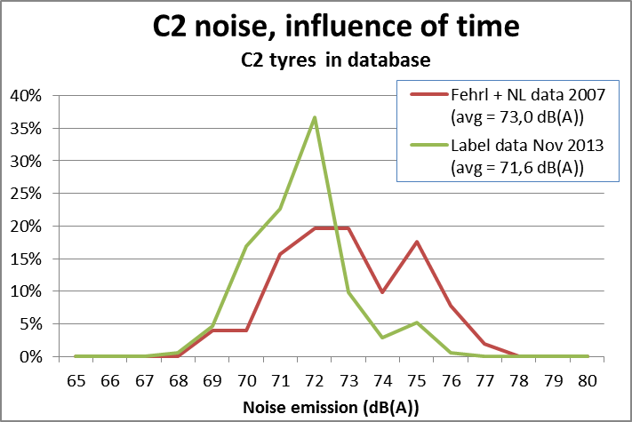
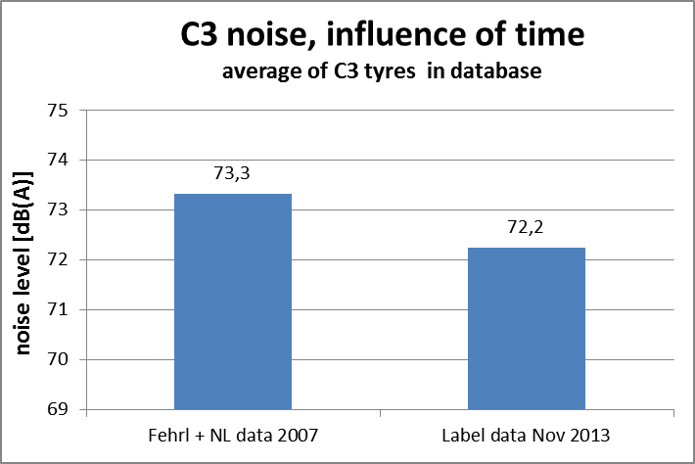
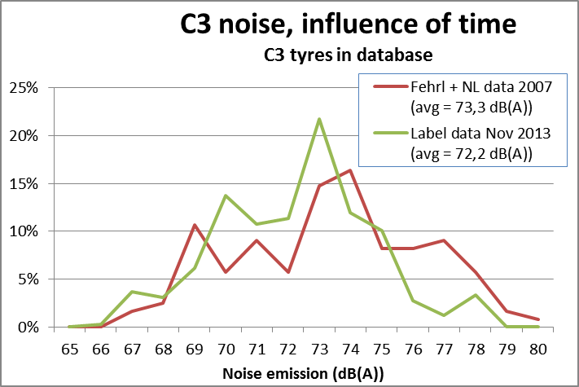
C2 and C3 tyres: 2007 vs. 2013

Slide 6
Observed shifts between 2007 and 2013
Shift in average level:
  C1 : - 1,6 dB
  C2 : - 1,4 dB
  C3 : - 1,1 dB
Shift in shape of distribution:
  C1 : moving of total distribution towards lower sound levels
  C2 and C3 : narrowing of distribution

Slide 7
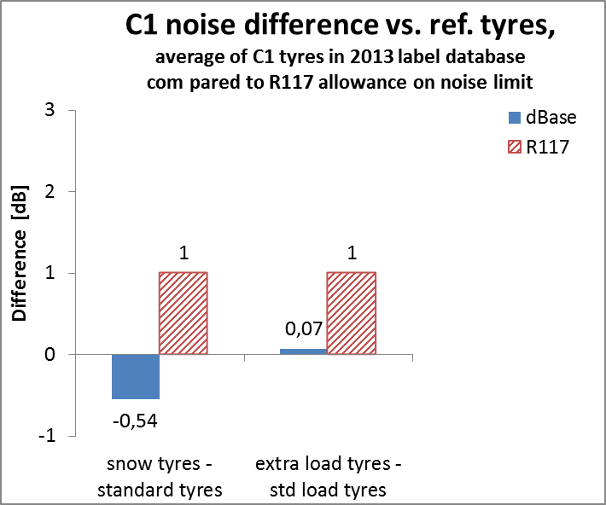
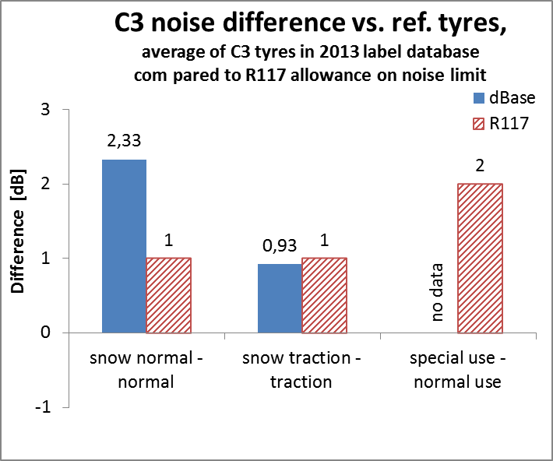
Observed effects due to special types
C1: The applied correction values were not corroborated by the data
C3: correction value for snow-normal underestimates difference found in data
C3: correction value for snow traction in line with observed effect

Slide 8
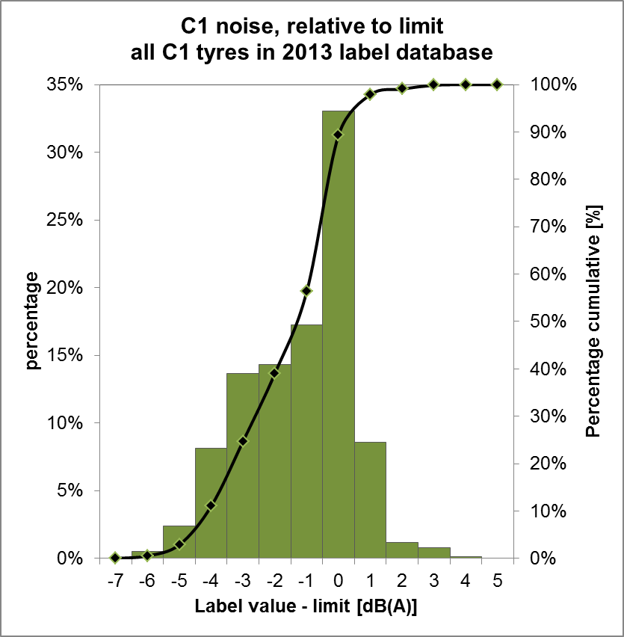
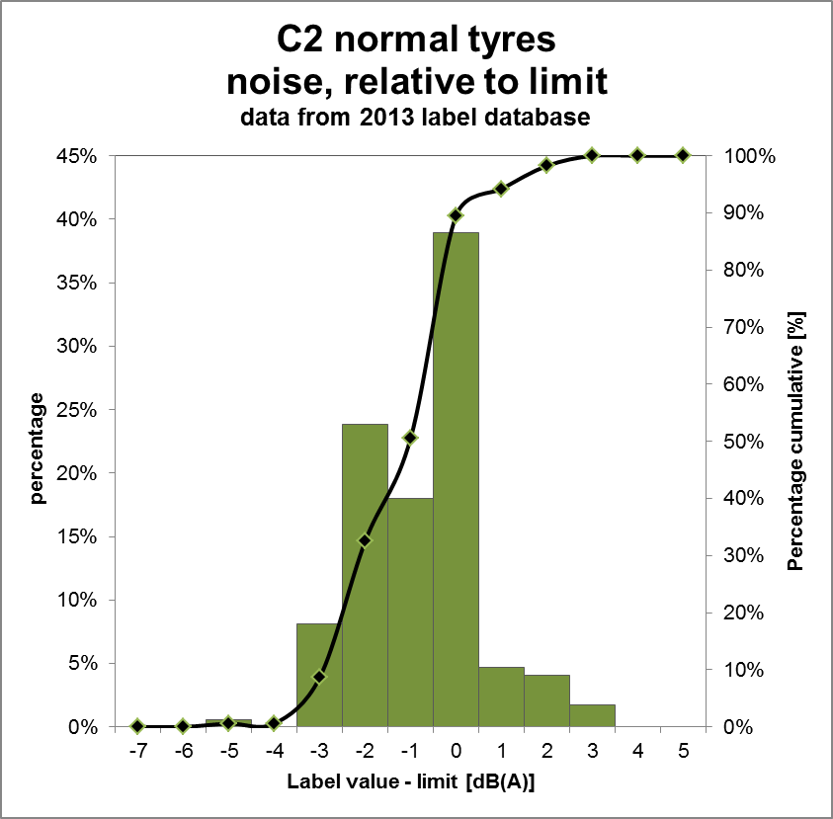
Evaluation margin with limit value:
C1 and C2

Slide 9
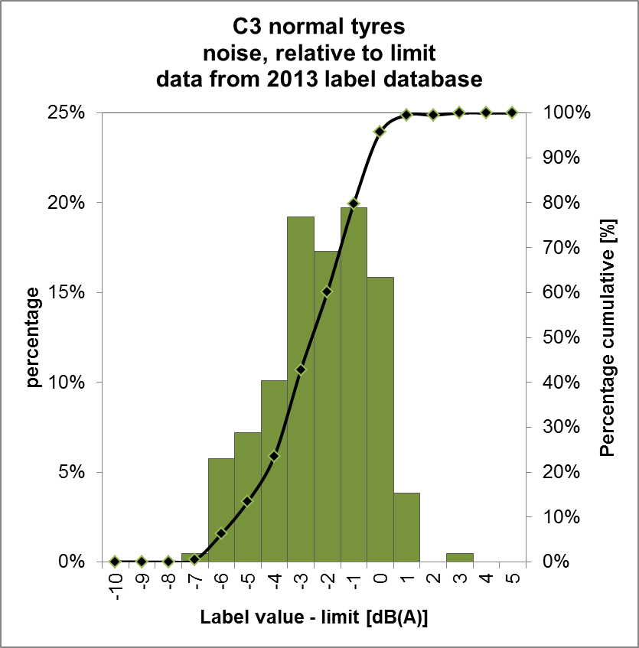
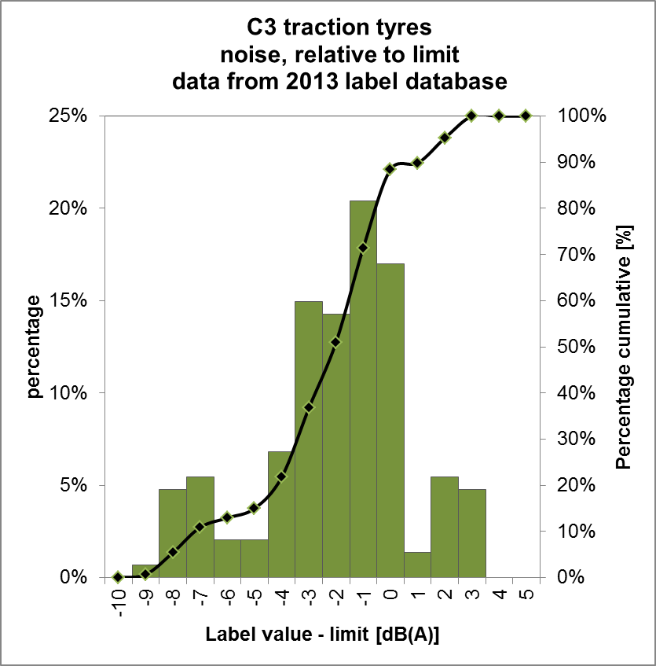
Evaluation margin with limit value:
C3 normal and traction

Slide 10
Values of 50, 80 and 99 percentile in margin distribution

Slide 11
Limits based on “best” 50% and “best” 20%

Slide 12
conclusions
A general reduction in tyre sound levels between 2007 and 2013 is observed
Trends in the found distribution reflects effects of 2009 revision
Regulatory correction values deviate from effects found in data sets
Margin relative to present limit value:
  50 percentile ≈ -1,5 dB
  80 percentile ≈ -3 dB
  99 percentile ≈ -7 dB

