Slide 1
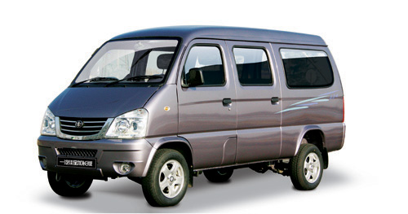
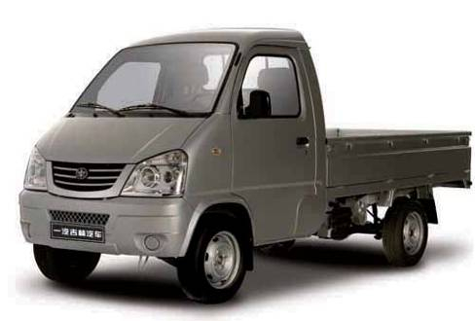

Informal document GRB-60-10-Rev.1
(60th GRB, 1-3 September 2014,
agenda item 4(a))
China Proposal for
Micro-Van and Micro-Truck
  Micro-van and Micro-truck ：
  GVM ≤ 2.5 ton
  R-point height ≥800mm from the ground
  Mid-engine and with Rear axle drive
China’s proposal is already included in the document “GRB-59-04” Paragraph 6.2.2.1.6. highlighted in red.
Limit value
74dB(A)
1
Notes:
1

Slide 2
Contents
Introduction of Micro-Van and Micro-Truck (Page 3)
Definition of Micro-Van and Micro-Truck (Page 4)
Market share of Micro-Van and Micro-Truck (Page 5-6)
Limitation of Micro-Van and Micro-Truck (Page 7-9)
Micro-Van and Micro-Truck have louder noise (Page 10)
Exposed noise sources lead to louder noise (Page 11-12)
Difficulty of adding noise shield for Micro-Van and Micro-Truck (Page 13-14)
Sound limit value problems of Micro-Van and Micro-Truck (Page 15)
Conclusion (Page 16)
Reference (Page 17)
Sidelights (Page 18)
2

Slide 3


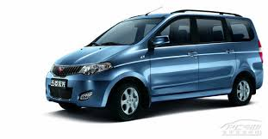

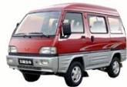



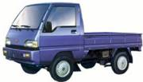
What are Micro-Van and Micro-Truck?
  GVM ≤ 2.5 ton
  R-point height ≥800mm from the ground
  Mid-engine and with Rear axle drive
M1 vehicle
SEDAN
(front engine)
SUV
(front engine)
MPV
(front engine)
Heavy M1
(GVM＞2.5t)
Micro-Van
(MR)
  GVM ≤ 2.5 ton
  R-point height ≥800mm
  Mid-engine and
  with Rear axle drive
N1 vehicle
Van
(FF)
Pick up
(FR)
Light truck
(GVM＞2.5t)
Micro-Truck
(MR)
3

Slide 4
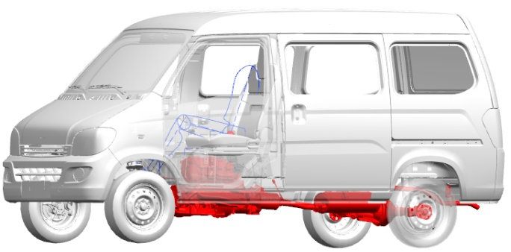
How to define Micro-Van and Micro-Truck?
  Height of R-point≥800mm
  GVM ≤ 2.5 ton
  Rear axle drive
  Mid-engine: Center of gravity of engine is between the front and rear axles, and the longitudinal distance from center of front axle to center of gravity of engine≥300mm.
4

Slide 5

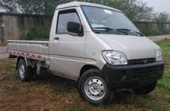

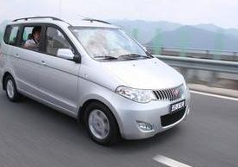
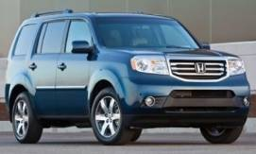
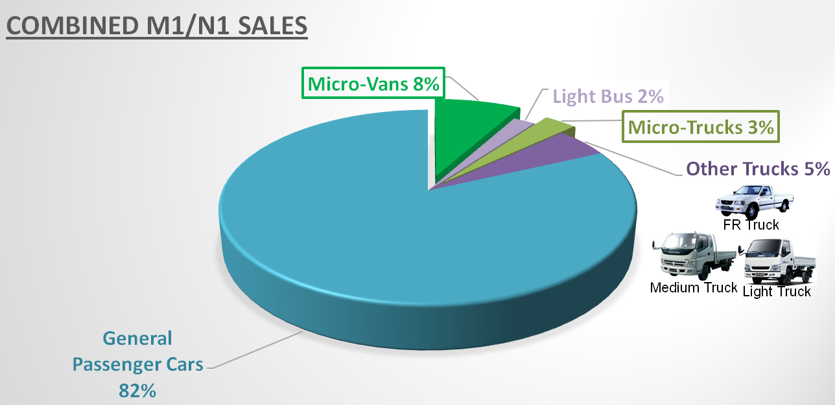
Market share of Micro-Van and Mirco-Truck in China(2013)
Sedan
MPV
SUV
  Total sales of vehicles: 22 million, M1 and N1: 20 million, Micro-Van and Mirco-Truck: 2.2 million
5
Notes:
5

Slide 6
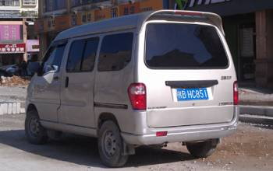

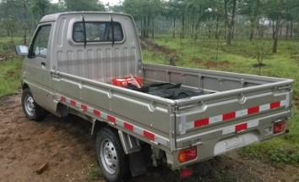
Micro-Van and Micro-Truck usage in China
By locations (%)
By usage (%)
6
Notes:
6

Slide 7




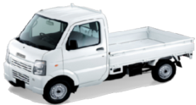

Micro-Van Micro-Truck and other vehicles Parameters Comparison
Model | SGMW Micro-Van | SGMW Micro-Truck | Renault Kangoo | PSA Partner | Japan Kei-truck | Piaggio Porter
Picture
Dimension and Weight
Exterior dimension OL/OW/OH(mm) | 3810/1510/1820 | 4250/1510/1760 | 4010/1672/1860 | 4137/1960/1800 | 3395/1475/1735 | 3390/1395/1730
Cabin dimension OL/OW/OH(mm) | N/A | 2500/1430/340 | N/A | N/A | 1700/1240/235 | 1760/1270/-
Wheelbase(mm) | 2500 | 3050 | 2600 | 2693 | 1900 | 1810
Treads(F/R)(mm) | 1290/1290 | 1280/1290 | 1400/1415 | 1420/1440 | N/A | 1205/1220
Kerb mass(kg) | 955 | 920 | 1230 | ---- | 790 | 850-1100
Gross vehicle mass (kg) | 1575 | 1720 | 1875 | 2054 | 1140 | 1500-2200
R Point(mm) | 895 | 845 | 691 | 711-724 | - | 780-800
Powertrain
Displacement(ml) | 995 | 1051 | 1598 | 1560 | 658 | 1300, 1202
Max Power(kw/rpm) | 47.5/5600 | 38.5/5200 | 70/5000 | 66/4000 | 37 | 52/5300, 47/3500
Max Torque(N.m/rpm) | 90/4000 | 83/3000~3500 | 130/3750 | 225/1750 | 63 | 105/4300, 140/1800
Transmission | 5MT | 5MT | 5MT | 5MT | 5MT | 5MT
Engine position | Middle | Middle | Front | Front | Front / Middle | Front
Drive axle | Rear | Rear | Front | Front | Rear | Rear
Tyre size | 165 / 70 R13 | 165 / 70 R13 | 175 / 65 R14 | 185 / 65 R15 | - | 155/80 R13, 165/65 R 14
Performance
Max Speed(km/h) | 120 | 105 | 164 | 154 | 104 | 130
Payload(kg) | ---- | 800 | ---- | ---- | 350 | 550-700
7
Notes:
7

Slide 8

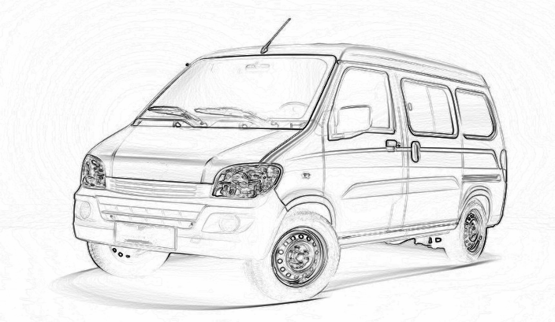
Chinese micro-vehicles are not designed or planned for sales in Europe, Japan or US.
The requirements of ECE, FMVSS and EPA regulations (R13H, R127, R94, FMVSS 208, EPA Tier II, etc.) are too difficult for Micro-Van and Micro-Truck.
Without Steering booster
R116
Engine Theft Protection
R 127
Pedestrian Protection
443/2009/EU (M1)
510/2011/EU (N1)
CO2 emission
R48
Day-time running lamp
ECE R94
Frontal impact
ECE R13H
Braking system
ABS
ESC
BA
661/2009/EC
TPMS
8
Notes:
在正面撞车时保护司机和乘客安全的标准（Ｒ９４），在侧面撞车时
保护司机和乘客安全的标准（Ｒ９５），
8

Slide 9

Global market of Micro-Van and Micro-Truck (2013)
China 94.9 %
Africa 2.4%
Southeast Asia 0.6%
South America 2.1%
＊ Over 2,180,000 Micro-Vans and Micro-Trucks were sold in 2013 globally, within this nearly 95% were sold in China, and others were sold into other Third World in Africa, South America and South East Asia. Europe, Japan and US are not our target markets.
＊ Although Micro-vehicles are very inexpensive and with poor performance, also will not be accepted by the customers in Europe, Japan, or US, it’s really an important type of vehicle for developing areas and developing countries.
9
Notes:
1、数量为2013年中国微车（微客和微货）出口该区域市场的总量
9

Slide 10
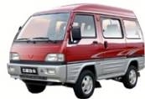

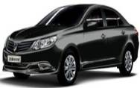
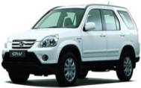
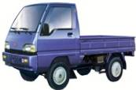

Micro-Van and Micro-Truck are typically 2 to 3 dB(A)
higher than front engine type.
Micro-Van & Micro-Truck need the 74 dB(A) limit value for phase 1 like heavy M1.
2 - 3 dB
Separation
10
Notes:
10

Slide 11
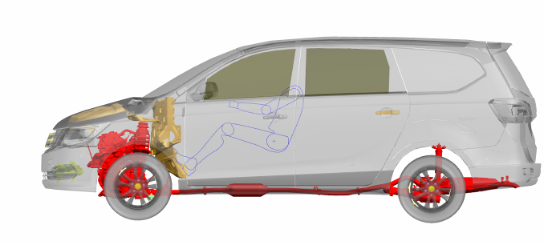
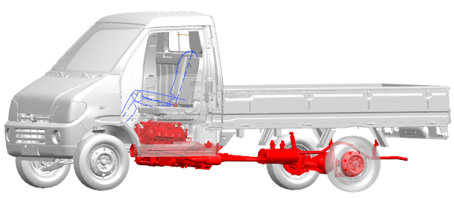
Micro-Van and Micro-Truck noise sources are much more exposed than front engine type
  Front Engine type GVM≤2.5t
  R﹤ 800mm
Different type
Same type
  R≥ 800mm
  R≥ 800mm
  GVM ≤ 2.5 ton
  R-point ≥800mm from the ground
  Mid-engine and with rear axle drive
11

Slide 12

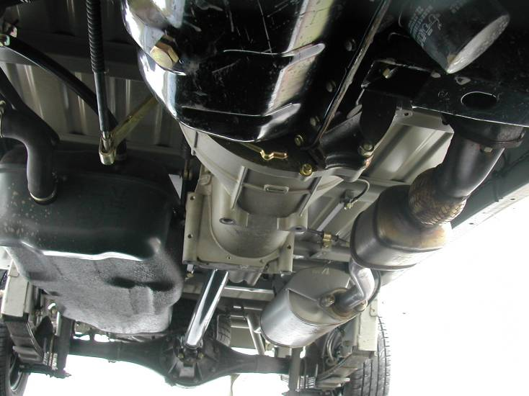
Micro-Van and Micro-Truck noise sources are much more exposed than front engine type
Floor
Engine
Gear box
The majority of noise sources in Micro-Van and Micro-Truck are directly exposed, resulting in inherently louder noise.
Shaft
Exhausted pipe
Final Drive and drive axle
Muffler
12

Slide 13
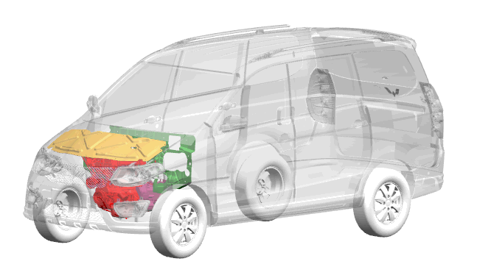

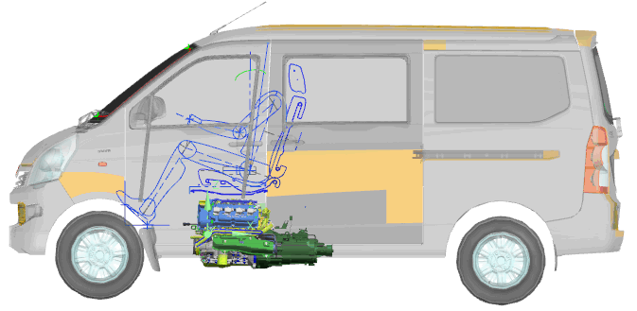

Difficulty of adding noise shield for Micro-Van and Micro-Truck
＊ There is no engine-compartment for Micro-Van and Micro-Truck, and it’s impossible to cover the whole powertrain system for the purpose of reducing noise, as what front engine type does.
Front engine type
Micro-Van and Micro -Truck
＊ Adding Noise shield will greatly reduce ground clearance, key characteristic for Micro-Van and Micro-Truck used in mountain, farm, and rural areas.
The ground clearance is about 140-155mm, adding noise shield will reduce ground clearance by 10mm, resulting in poor passing capacity.
The ground clearance and passing capacity are very important for Micro-vehicles used in mountain, farm, and rural areas.
13
Notes:
13

Slide 14
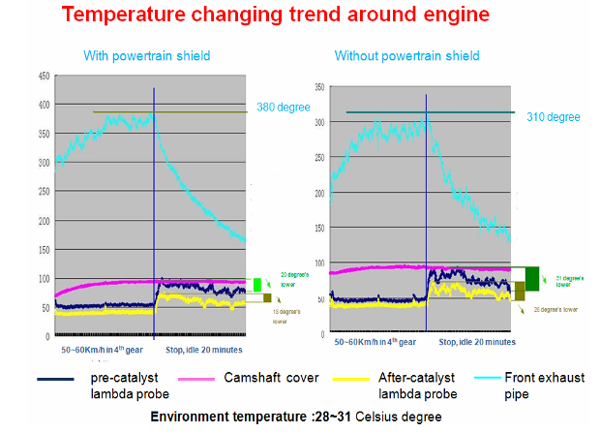
Difficulty of adding noise shield for Micro-Van and Micro-Truck
＊ The thermal performance of Micro-Van and Micro-Truck is not as good as front type for the reason of structure and powertrain differences, and adding noise shield will greatly reduce thermal performance.
14

Slide 15
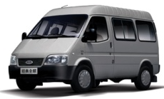
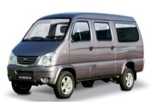
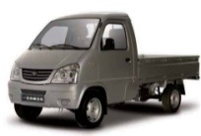

Limit value table for special M1 / N1 category
Sub-category | Figure | Country of Origin | China suggestion (GRB-55-05, GRB-56-07, GRB 57-05, GRB-58-09, GRB-59-04) | Limit value now (GRB/2014/5) | Ok?
Heavy M1 |  | Global | Support GRB | 74 | Ok
Micro-Van Micro-truck |  | China | 74 | 72 | NG
Kei-truck |  | Japan | Support GRB | 74 | Ok
“GRB-59-04”
6.2.2.1.6. For vehicle types of category M1 and N1 having a maximum technically permissible laden mass of less than or equal to 2.5 tons, a R-point height greater than 800mm from the ground and a mid engine with the longitudinal distance from center of front axle to center of gravity of engine≥300mm and with rear axle drive, the limits of the vehicle types of category N1 having a maximum technically permissible laden mass above 2.5 tons apply.
15

Slide 16
Conclusion
The structure and powertrain system of Micro-Vans and Micro-Trucks are quite different from the front-engine type vehicles, which will lead to a 2-3dB(A) higher test results according to ECE R51 / 03.
The Micro-Van and Micro-Truck need a 74dB(A) limit values for phase 1st with a cut-off nearly 15-20%.
China suggests modify “GRB 59-04 6.2.2.1.6. For vehicle types of category M1 and N1 having a maximum technically permissible laden mass of less than or equal to 2.5 tons, a R-point height greater than 800mm from the ground and a mid engine with the longitudinal distance from center of front axle to center of gravity of engine≥300mm and with rear axle drive, the limits of the vehicle types of category N1 having a maximum technically permissible laden mass above 2.5 tons apply.”

Slide 17
Reference
GRB-55-05 - (China) Discussion for limit values to Regulation No. 51
GRB-56-07 - (China) Proposal of new sound limit values to the draft 03 series of amendments to UN Regulation No. 51
GRB-56-22 - (China) Summary of the opinions of the expert from China for the noise test method of UN Regulation No. 51
GRB-57-05 - (China) Common solutions for Sub-categories of M1 and N1 Categories
GRB-57-07 - (China) Sub-categories suggestion from China
GRB-58-08 - (China) Comments on Japanese limit value suggestion of commercial vehicles
GRB-58-10 - (China) Set of sub-categories of M1 \ N1
GRB-59-04-Rev.1 - (GRB Expert Group on Regulation No. 51) Proposal for the 03 series of amendments to Regulation No. 51 (Noise of M and N categories of vehicles)
17

Slide 18




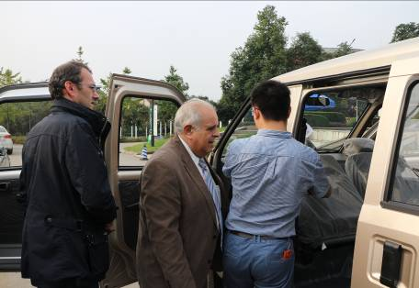
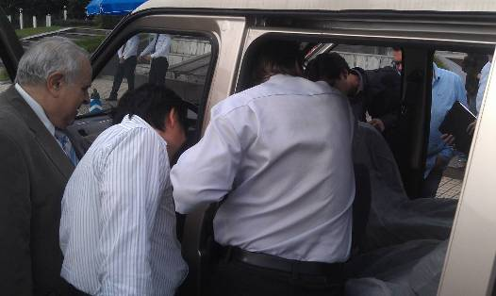
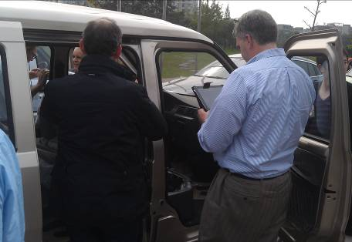

Experience of driving this new vehicle type
＊Experience of driving Micro-Van and Micro-Truck .
＊Check the mid-engine under driver seat and the different chassis.
18

Slide 19
Thank you for your attention
19

